Slide 1
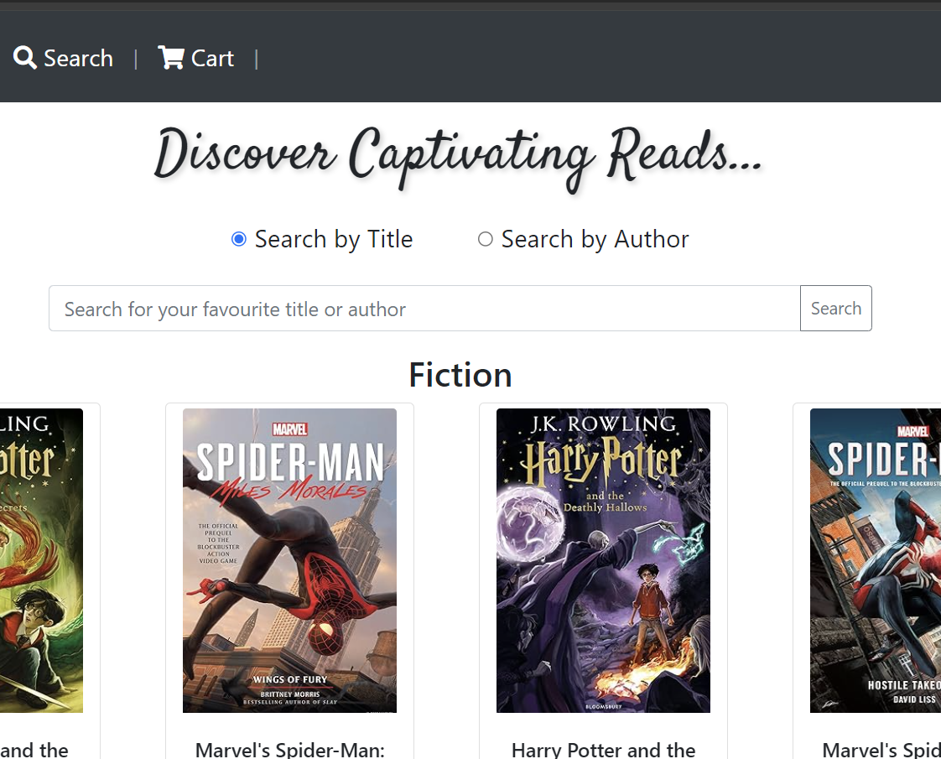
Bookshop automation System
TEAM MAD
Aashray Tandon
Deetosh Kumar Kuila
Mayash Nayak

Slide 2
Problem Description
Problem Overview:
Book shops often struggle with order processing, manual inventory management, sales tracking, and customer service, leading to inefficiencies and customer dissatisfaction.
User Requirements:
Develop a Bookshop Automation System (BAS) to address these challenges based on user requirements:
Query book.
Display book details and availability.
Maintain inventory.
Generate sales receipts and update stock.
Provide sales statistics and inventory management.
Objective:
Develop a comprehensive software solution to automate book shop operations, enhancing customer experience and optimizing business processes.

Slide 3
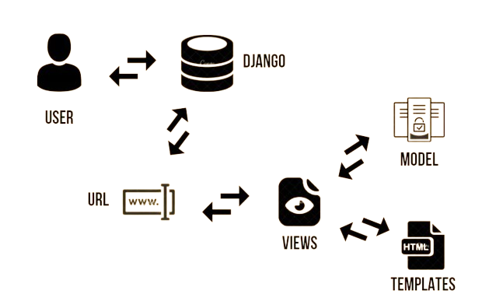
Technical Details
Backend Technology:
Django Framework: Django simplifies web development by providing a Model-View-Template (MVT) framework, which streamlines data handling (Model), request processing (View), and HTML generation (Template) for web applications.
Frontend Technologies:
HTML and CSS: Employed for creating an intuitive and user-friendly interface, ensuring seamless navigation and interaction.

Slide 4
Use Cases
Customer Use Case:
Customer queries book availability.
Adds desired books to cart.
Sends wish-list to email.
Collects books and proceeds to pay.
Receives sales receipt via email.
Requests for books not available.
Also requests for bulk orders.
Manager Use Case:
Monitors book requests.
Generates reports for sales and business analysis.
Finds books below threshold and send the order request to vendors.
Employee Use Case:
Updates inventory upon new supply arrival.
Adds new books to the inventory.
Handles book returns.
Contact the customer after procurement of required books.

Slide 5
Challenges Faced
Design Considerations:
Ensuring a user-friendly interface with limited expertise in frontend technologies.
Implementation Issues:
Debugging and resolving errors in Django codebase with constrained timelines.
Balancing feature implementation with thorough testing and bug fixing within project deadlines.
Solutions:
Collaborative problem-solving among team members to overcome technical challenges and share expertise.
Prioritizing essential features and iterative development to meet project milestones effectively.

Slide 6
