Slide 1
EmbodiedMAE for Sorghum
A multi-modal masked autoencoder over RGB, depth, point cloud and procedural growth parameters
Sorghum_15K · 15,000 plants · 20 September 2026
98.4%
0.3439 → 0.2781
≈3%
skill vs the average-plant floor, held-out test split
cross-modal generation after distillation
run-to-run noise floor, measured

Slide 2
01
The problem
why a multi-modal MAE
Phenotyping needs 3D structure. Breeders want leaf count, leaf angle, height and biomass. Those live in geometry, but geometry is expensive to capture and cheap to photograph.
One encoder, four views of the same plant. RGB, depth, a point cloud and the procedural parameters the plant was grown from are four descriptions of one object. A masked autoencoder over all four has to reconcile them in a single latent.
The novelty we defend. The procedural growth parameters are not just a prediction target — they are a co-trained token stream, an input modality like the others. To our knowledge that is unoccupied ground for plants.
Three questions this work has to answer
1 Does each modality actually pay for itself, or is the fourth stream dead weight? → E2
2 Given one modality, can the model generate the others — and does distillation improve that? → distillation
3 Does performance come from more data, or more capacity? → E3 / E4

Slide 3
02
The data
Sorghum_15K
15,000 procedurally generated plants, each rendered from 10 camera views — 150,000 samples, 774 GB on disk.
Four aligned modalities per view: an RGB render, a depth map, a camera-frame point cloud, and the generator parameters (stem, and up to 24 leaves × 7 fields each).
Split 70/15/15 BY PLANT, not by view. An earlier 10k split was made per camera view, so every validation sample was a training plant from a new angle. It scored 0.0003 and meant nothing. Splitting by plant is the difference between 0.0003 and an honest 0.05.
The ten views are an elevation ladder, not ten random cameras: sin(elev) = −0.9 + 0.2 × view index exactly, azimuth randomised. That makes camera angle a free controlled variable.
Split, by plant
split | plants | view-samples
train | 10,500 | 105,000
val | 2,250 | 22,500
test | 2,250 | 22,500
Only four files per sample are ever read
rgb.png, depth.png, *_nc_cam.ply, *_spline.yml — about 1.8 MB of the 5 MB per sample. The source .obj and the world-frame .ply are duplicated into all ten view folders and never opened in training, which is 64% of the bytes on disk.

Slide 4
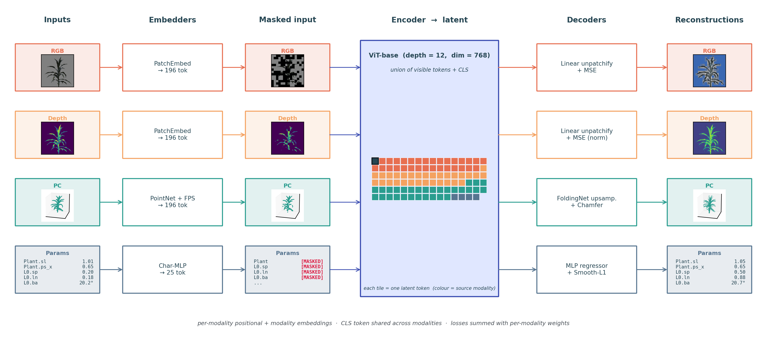
03
Method — one encoder, four token streams
ViT-base, depth 12, dim 768
Each modality gets its own embedder and its own decoder head; the encoder sees the union of visible tokens plus a shared CLS. RGB and depth patchify to 196 tokens, the point cloud is grouped into 196 FPS centres with kNN neighbourhoods, and the parameters become 25 tokens (1 plant + 24 leaves).

Slide 5
04
Method — masking and the training protocol
what is held fixed
Masking is allocated, not uniform. 80% of tokens are masked overall, but the split across the four modalities is drawn from a Dirichlet once per batch, with a floor of 25% masking per modality. The per-modality count is identical batch-wide, which avoids batch elements with zero visible tokens corrupting the encoder norms.
One view per plant per epoch. Views act as augmentation rather than as extra data, so an epoch is 10,500 items and not 105,000. The draw is a pure function of (seed, epoch, plant), so it is identical on every rank and reproducible from the seed alone.
Ablations are sized in optimizer steps
An epoch under view sampling is one view per plant, so its size IS the plant count. Equal epochs would hand the 10k-plant arm ten times the gradient updates of the 1k-plant arm, and the scaling curve would be measuring data and compute together.
Every ablation arm runs 197,400 optimizer steps at global batch 32.
So the E3 configs carry very different epoch counts — 6,169 / 2,100 / 631 — on purpose. Normalising them would unfix the one thing the experiment controls.
Global batch is per-GPU batch × GPU count, so each launcher sets its own per-GPU value: 16×2 on the 2-GPU nodes, 8×4 on the 4-GPU nodes.

Slide 6
05
Method — how a reconstruction is scored
and what it is scored against
Both Chamfer directions, reported separately
Two baselines bracket the number
They fail differently, and the symmetric sum hides it.
pred → gt is accuracy: it rises when the model puts points where no plant is.
gt → pred is completeness: it rises when the model misses parts of the plant.
A cloud that collapses to a dense blob scores well on accuracy and badly on completeness.
what is compared | mean chamfer
our prediction vs its own plant | 0.000791
our prediction vs a DIFFERENT plant | 0.039932
another plant's GT used as the prediction | 0.049264
On the test split our model is 0.000293 accuracy against 0.000498 completeness —
it misses real geometry roughly twice as often as it invents geometry. That is the same failure the red points in the next figures show, arrived at independently.
Why the floor is not zero.
Clouds are centred and unit-sphere normalised, so every sorghum already overlaps every other one. A model that learned nothing plant-specific lands at 0.049 — the average-sorghum floor — not at zero.
skill = 1 − model ÷ floor = 98.4%

Slide 7
06
Generating a point cloud from one image
held-out TEST split · 2,250 plants
RGB → point cloud, and depth → point cloud
Three things to take from this
Distillation pays on test, not just val.
0.000998 → 0.000840, a 15.8% improvement on plants the model has never seen.
Masking the source helps.
Hiding half the RGB tokens on the cross-modal training path buys a further 5.8%, replicated across two seeds.
Depth is the better single sensor.
0.000620 against 0.000791 from RGB — 22% better, which matters if a depth camera is an option in the field.
model | source | mean chamfer | skill
warm start, no distillation | RGB | 0.000998 | 98.0%
+ cross-modal distillation | RGB | 0.000840 | 98.3%
+ 50% source masking, seed 1 | RGB | 0.000791 | 98.4%
+ 50% source masking, seed 2 | RGB | 0.000792 | 98.4%
distilled generalist | depth | 0.000620 | 98.7%
Every row is 2,250 unseen plants, and the two seeds agree to the fourth decimal — source masking reproduces rather than being one lucky run.

Slide 8
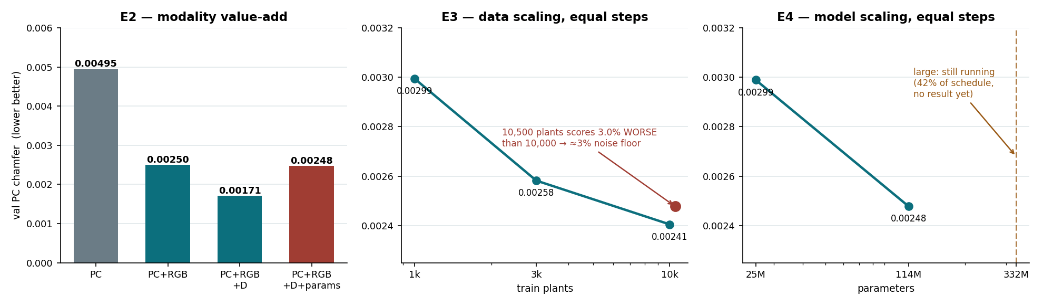
07
Results at equal compute
every arm = 197,400 steps
RGB buys −49.4% and depth a further 16 points — but adding the parametric stream gives back everything depth gained.
10,000 and 10,500 plants differ by 5% in data, yet the larger arm scores 3.0% worse: those two runs are effectively a duplicate, so ≈3% is this pipeline's noise floor. That makes 3k→10k (−6.9%) only ~2.3× noise, while 25M→114M parameters buys −17.1%. At this budget, capacity pays better than data.

Slide 9
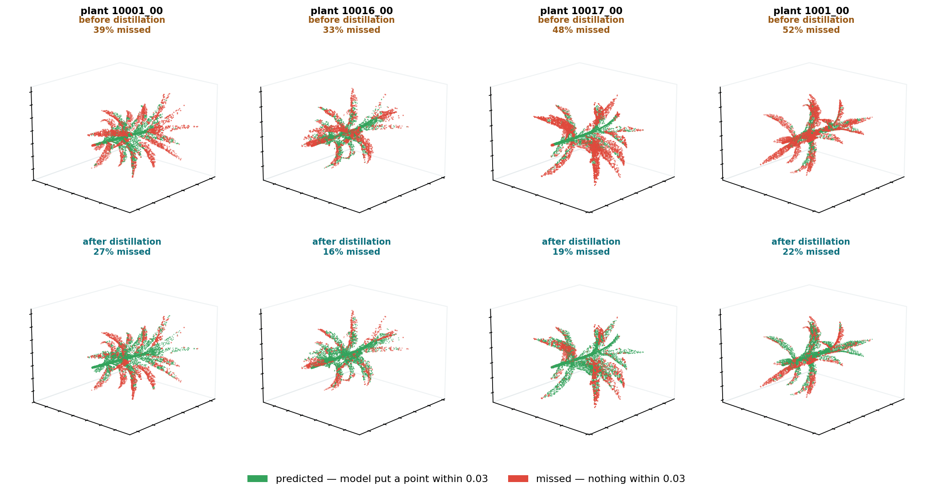
08
What the model cannot predict
ground truth, coloured by coverage
Green
a prediction lands within 0.03 of this ground-truth point.
Red
nothing does — geometry the reconstruction never reached.
Distillation closes the interior of the plant first. Thin leaf tips stay red longest in both models — they are the hardest geometry in the dataset.
Threshold 0.03, not the 0.01 training default: at 0.01 about 80% of every cloud is red in both models, which is true but shows nothing. Chamfer reports a SQUARED distance, so 0.0028 is an RMS error near 0.053.

Slide 10
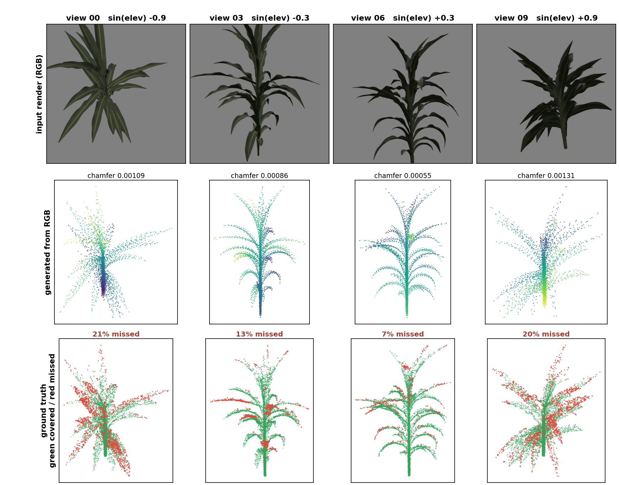
09
Ten cameras, one plant
generated from RGB alone
The view index is an exact elevation ladder
−0.9 + 0.2·index, from the camera matrix. All ten views share one point cloud and one parameter vector, so the answer never moves.
Chamfer traces a U
best side-on, worst looking steeply up or down — in both models.
Distillation improves 9 of 10 views, mean −28.5%
…but best/worst spread widens 2.35× → 2.49×. It lowers the curve without flattening it, so it is not the lever for view robustness.
Clouds are in the camera's own frame — same pose as the photograph.

Slide 11
10
Parameter head, and next steps
142 leaf tokens · 8 plants
Skill per leaf field (1 = perfect, ≤ 0 = no better than the mean)
Two decisions needed
1 · Build the downstream linear probe
Plan decision 6.4 requires it, it does not exist, and it is the only thing that can tell us whether the E2 parameter result is a token-budget artefact or real. Three of four targets are already in features.csv; biomass needs a definition and “leaf angle” is ambiguous between roll and branching.
2 · Choose the E8 baseline set
Ranked the largest reject risk; nothing in the repo addresses it. Each candidate is a training run that must fit before the 24 Oct freeze, so the decision is more time-critical than the runs.
Status: E2 complete (4/4) · E3 2 of 3 · E4 1 of 2. e3_1k and e4_large were preempted at 94% and 42% and are resuming from checkpoint.
leaf field | from PC | from RGB
starting_point | +0.95 | +0.90
branching_angle | +0.93 | +0.85
length | +0.67 | +0.66
roll_angle | +0.50 | +0.33
waviness_frequency | -0.02 | -0.01
waviness_period_start_0 | -0.01 | -0.04
waviness_period_start_1 | -0.01 | +0.02
Four of seven fields carry the whole result. The three waviness fields emit the dataset average and nothing more, from either source — so ~40% of the leaf vector dilutes a real result with a constant.
PC beats RGB on every field with skill, and on 7 of 8 plants.

