Slide 1
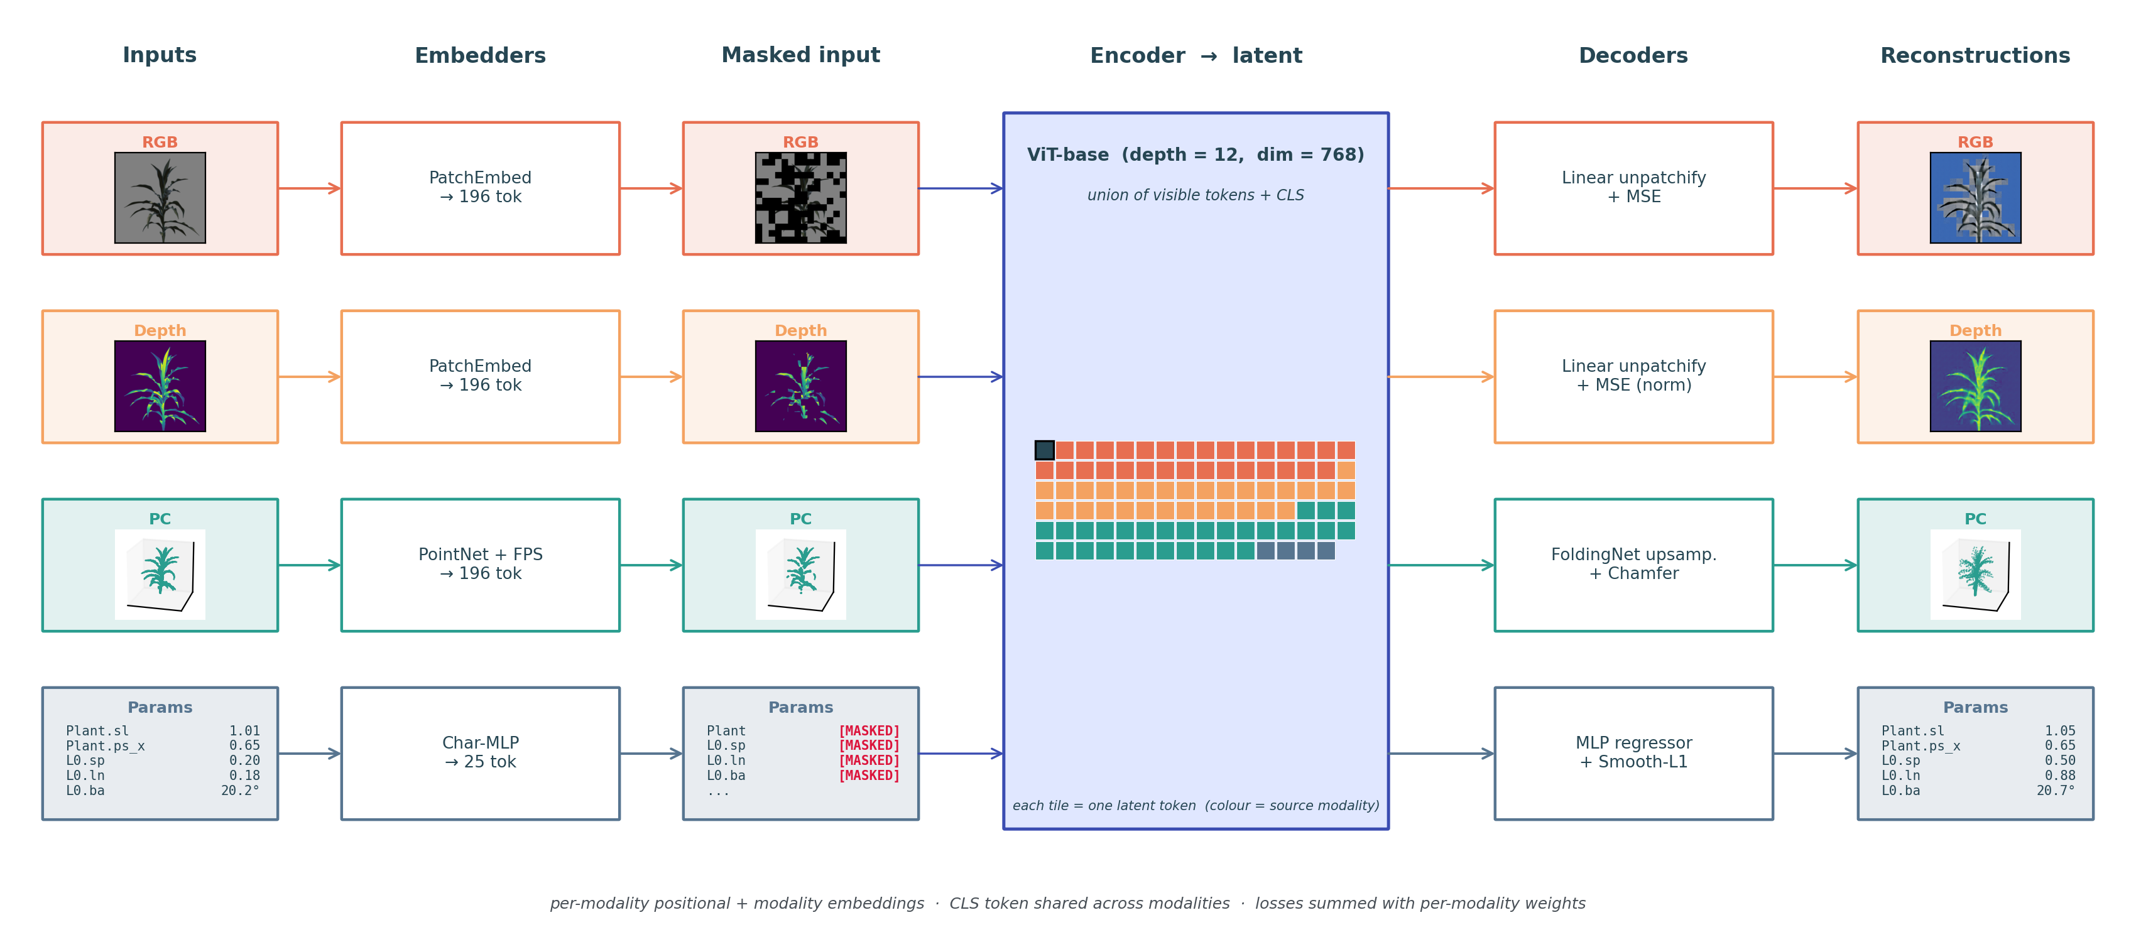
EmbodiedMAE-4M — Multi-modal MAE for synthetic sorghum · run v3 (completed)
(i) Problem
Plant phenotyping needs representations that capture geometry, appearance, and growth parameters jointly — but real-world labels for all of these together are scarce.
Pre-train one encoder by masked reconstruction over synthetic sorghum, where every sample carries all four modalities aligned, so the encoder learns physically meaningful plant structure that downstream phenotyping tasks can reuse.
(ii) Modalities
• RGB — 224×224 rendered image → 196 patch tokens
• Depth — 224×224 depth map → 196 patch tokens (target min-max normalised)
• Point Cloud — 8 196 pts, unit-sphere normalised → 196 FPS+kNN tokens
• Procedural params — 1 plant + up to 24 leaf tokens (stem length, leaf split / length / bend angle, …) normalised to [0, 1] from the generator YAML
(iii) Architecture — high level

Slide 2
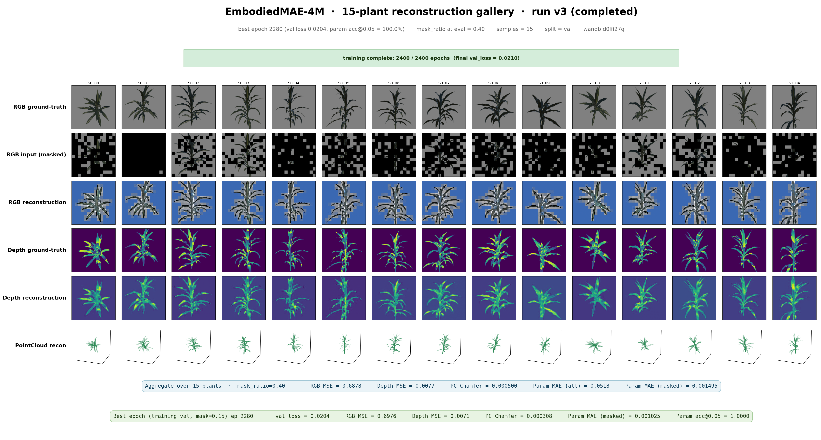
Reconstructions across 15 validation plants — best epoch 2280
Notes:
EmbodiedMAE-4M at the best checkpoint (epoch 2280 of the completed 2400-epoch schedule). Training finished cleanly on 2026-05-28.
At eval the Dirichlet allocation was driven with mask_ratio=0.40; per-modality fractions are sampled per batch.
Aggregate over 15 validation plants:
• RGB MSE : 0.6878
• Depth MSE: 0.0077
• PC Chamfer: 0.000500
• Param MAE (all) : 0.0518
• Param MAE (masked): 0.001495
Best held-out validation during training:
• val_loss : 0.0204
• RGB MSE : 0.6976
• Depth MSE : 0.0071
• PC Chamfer : 0.000308
• Param MAE (masked): 0.001025
• Param acc@0.05 : 100.0%

Slide 3
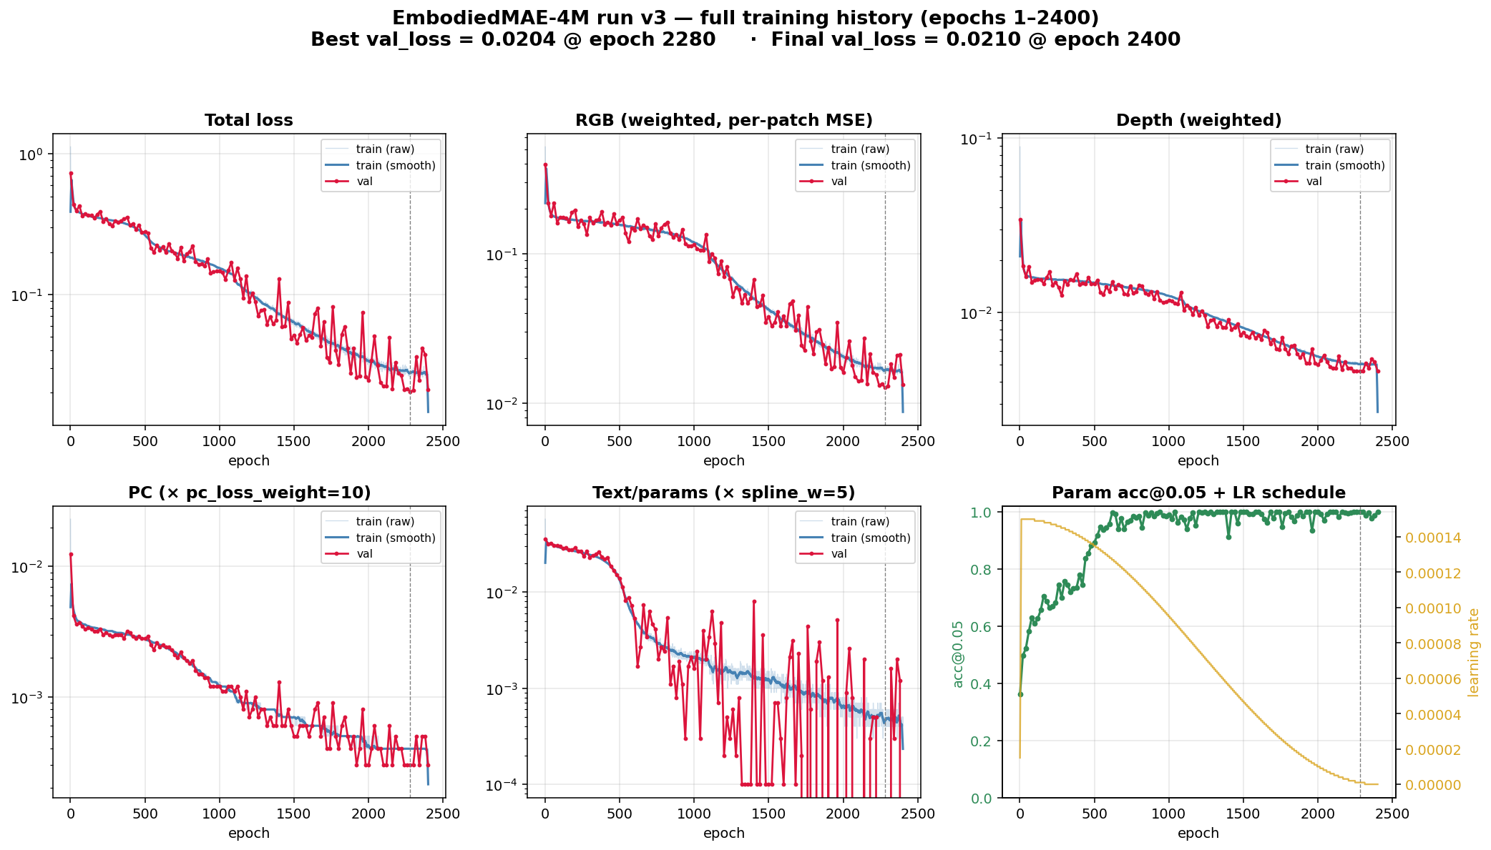
Training metrics — run v3 (epochs 1 – 2400, completed)
Best @ epoch 2280 · Final @ epoch 2400
Metric
Best Final
val_loss (weighted total)
0.0204 0.0210
val_rgb (× per-patch MSE)
0.0127 0.0133
val_depth (× per-patch MSE)
0.0046 0.0046
val_pc (× pc_loss_weight=10)
0.0003 0.0003
val_text (× spline_w=5)
0.0000 0.0000
—
—
RGB MSE (unweighted)
0.6976 0.6977
Depth MSE (on minmax target)
0.0071 0.0070
PC Chamfer (bidirectional)
0.000308 0.000299
Param MSE
0.0168 0.0165
Param MAE (all leaves)
0.0568 0.0546
Param MAE (masked tokens)
0.001025 0.001052
Param acc @ |err| < 0.05
100.0 % 100.0 %
—
—
Run state
COMPLETED ✓
Total epochs
2400
Notes:
Run v3 (wandb d0lfi27q) completed all 2400 epochs on 2026-05-28 23:01. Best val loss 0.0204 was recorded at epoch 2280, with param acc@0.05 reaching 100% — i.e. the model effectively memorised the procedural parametrisation from the other three modalities at the training mask_ratio of 0.15. PC chamfer dropped to 0.000308; depth and RGB also continued to improve through the cosine annealing tail.
Note: this 2400-epoch trajectory is the H200×4 resumed run (10727040). A concurrent single-A100 duplicate (10727184) was racing on the same output directory and has been cancelled.

