Slide 1
A Debugging Tool for
JavaScript Reactive Libraries
Chrome Reactive Inspector
RxJS & Bacon.js
Master Thesis
Waqas Abbas
Distributed Software Systems (DSS)
supervised by
Prof. Dr. Guido Salvaneschi
M.Sc. Pascal Weisenburger
Reactive Programming Technology

Slide 2
Agenda
Introduction
Motivation
Proposed Solution
Implementation
Evaluation
Demo
Summary

Slide 3
Introduction
JavaScript Reactive Libraries (RxJS & Bacon.js)
Helps you do Reactive Programming in JavaScript
To develop asynchronous and event-based applications
Programming paradigm to work with asynchronous data streams
Stream can be UI Events , Http Request etc ..
Mixture of Observer pattern, Iterator pattern and Functional programming.
Observables , Operators, Schedulers

Slide 4
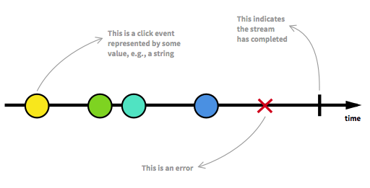
Introduction
Stream/Observable
Stream is a sequence of ongoing events ordered in time
Emits a value, error and complete signal

Slide 5

Introduction
Arrays Vs Streams
Array
[{x : 10 , y : 20 } , {x : 15 , y : 25 } , {x : 25 , y : 35 }]
Stream
[{x : 1 , y : 20 } , {x : 2 , y : 25 } , ........... , {x : 5 , y : 35 }]
Both are Collections (Group of values)
If every thing can be represent as Array then every thing can be Stream
Variable , User input , Properties , Caches , Data Structures etc ..
Scroll of webpage is also a stream of new information

Slide 6
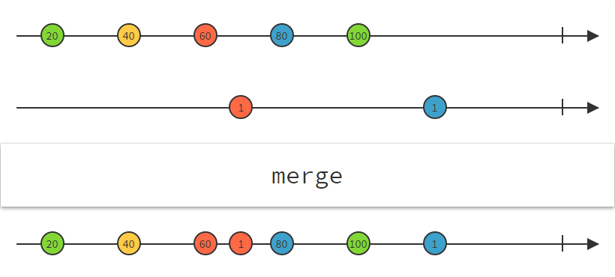
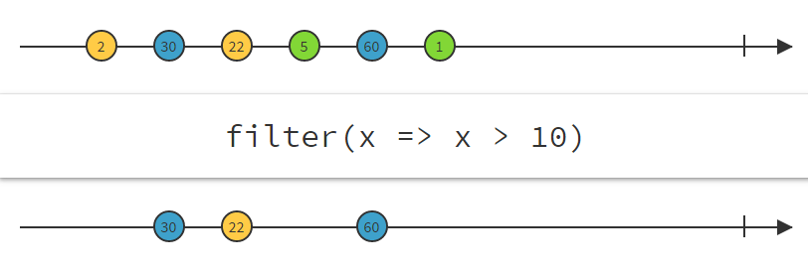
Introduction
Functional Magic
We already know Arrays are cheap
Map , merge , each , find etc ..
So same we can do with Streams

Slide 7
Introduction
Overcoming Asynchrony
Callbacks
Callback Hell (nested callbacks)
Hidden Logic (error handling)
Promises
You can not cancel promise (Guaranteed Future)
Promise are meant for single value (only ajax)
Observable
has everything that promise does + extras
multiple values
Cancellable
Subscribe and unsubscribe

Slide 8
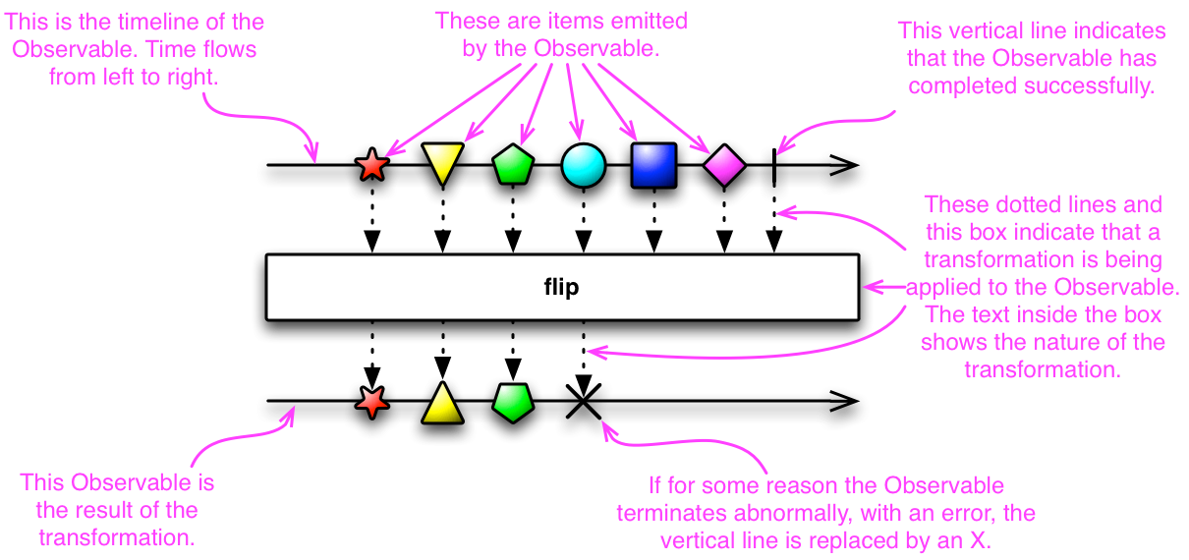
Introduction
Reactive pattern
Observer implement subset of following methods to connect to observable
onNext * (onCompleted | onError)

Slide 9
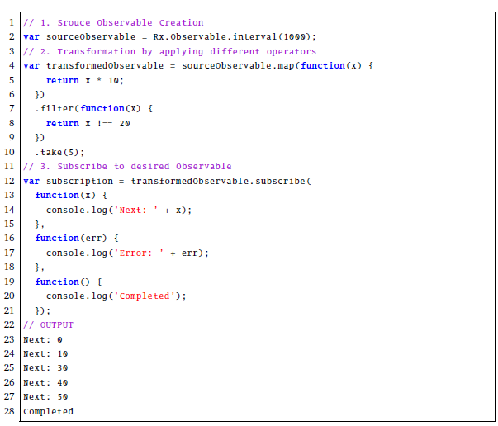
Introduction
RxJS Code Structure

Slide 10
Motivation
Problem
Very abstract code
Hard to comprehend
Hard to debug
Traditional Debuggers does not help
Current Approaches
Hand drawings of marble diagrams
Hand drawings of dependency graphs
Using the .do() operator

Slide 11
Proposed Solution
Chrome DevTools Extension
Implement RP Debugging technique
Model reactive applications into dependency graphs
Node represent Observable/Stream
Edge represent Dependency among reactive variables
Save history of dependency graph during the execution of a program.
Reactive Breakpoints
Ability to download Dependency graph

Slide 12
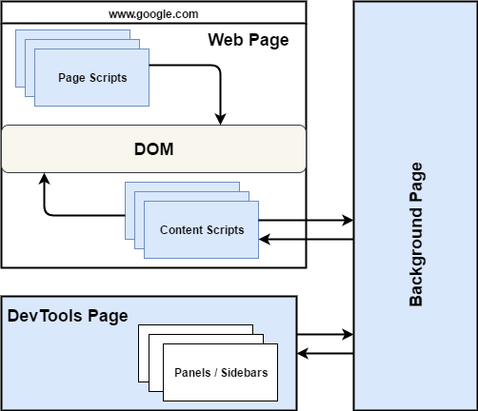
Chrome DevTools Extension

Slide 13
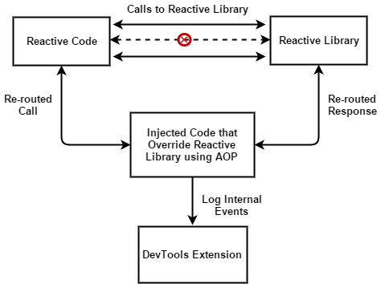
Event Sniffing - 1
We use this for RxJS to overrid lift method

Slide 14
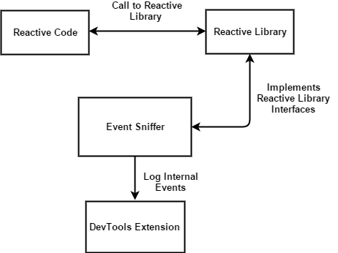
Event Sniffing - 2
We used spy method of Bacon.js library

Slide 15
How Jalangi Works
Before Instrumentation
x = y + 1
// After Instrumentation
x = Write( 'x' , Binary ( '+' , Read( 'y' , y ) , Literal(1) , x )

Slide 16
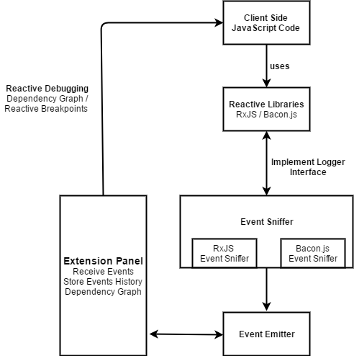
System Design

Slide 17
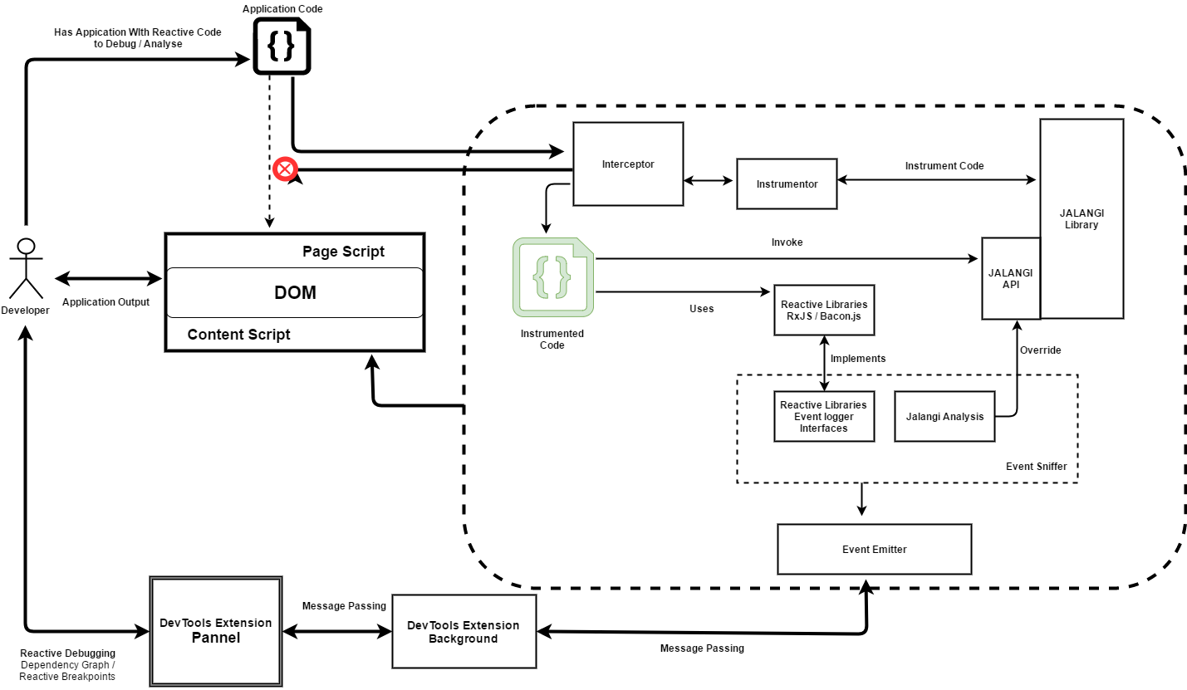
CRI – Implementation 1

Slide 18
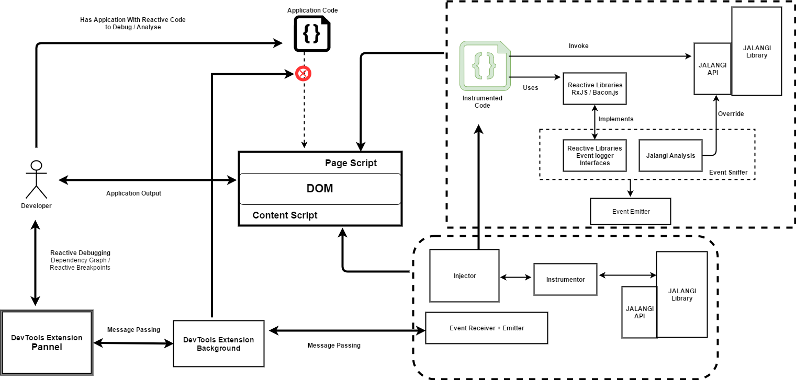
CRI – Implementation 2

Slide 19
Evaluation
22 sample applications from internet
Lines of code
Number of streams
Number of Operators (unique and total)
Evaluation Criteria
Target application run as before ?
Did CRI deliver dependency graph ?
Propagation of change visible ?
Traversing dependency graph help to understand target application ?
Reactive breakpoints ?
Number of nodes (green + total)
Steps recorded

Slide 20
Demo

Slide 21
Summary
Conclusion
CRI help to understand the abstract code
CRI help to find bugs
Future Work
Implement for other browsers (Firefox)
Enhance scoping feature
Performance analysis at nodes level
Export of debugging sessions
Able to deactivate subscription to decrease overhead
Live editing

Slide 22
Questions

Slide 23
Thank you

