Slide 1
A Debugger for Reactive Javascript Libraries
Chrome Reactive Inspector
Master Thesis
Pradeep Baradur
Distributed Software Systems (DSS)
supervised by
Prof. Dr. Guido Salvaneschi
M.Sc. Pascal Weisenburger
Reactive Programming Technology

Slide 2
Agenda
Introduction to Rx libraries
Why CRI?
CRI Architecture
Implementation details
Evaluation
Conclusion

Slide 3
Introduction
Reactive Javascript Libraries (RxJS & Bacon.JS)
Implements the Reactive Programming concepts in Javascript
Libraries for composing asynchronous and event-based programs
Best ideas from Observer pattern, Iterator pattern and Functional programming
Provides a set of operators to operate on data streams(response from WebSockets, DOM events)

Slide 4
Why use these libraries?
Callbacks
Promises
Async/Await

Slide 5
Concepts
RxJS :
Observable
Observer
Subscription
Subject
Operator
Bacon.Js :
Property
EventStream

Slide 6
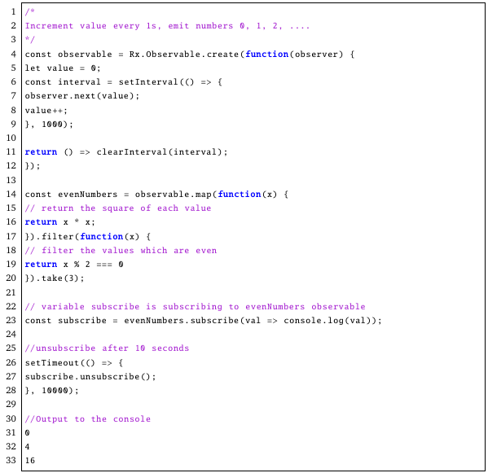
RxJS Code example

Slide 7
Why CRI?
Problem
Very abstract code
Hard to debug
Traditional Debuggers does not help
Current Approaches
Hand drawings of marble diagrams
Hand drawings of dependency graphs
Using the .do() operator
Existing tools
RxVision, RxFiddle

Slide 8
Motivation
An extensive support for all the operators in RxJS
Support for Subjects
Improving user experience
Improve performance of CRI
Adding features such as displaying dependents and dependencies of a given node

Slide 9
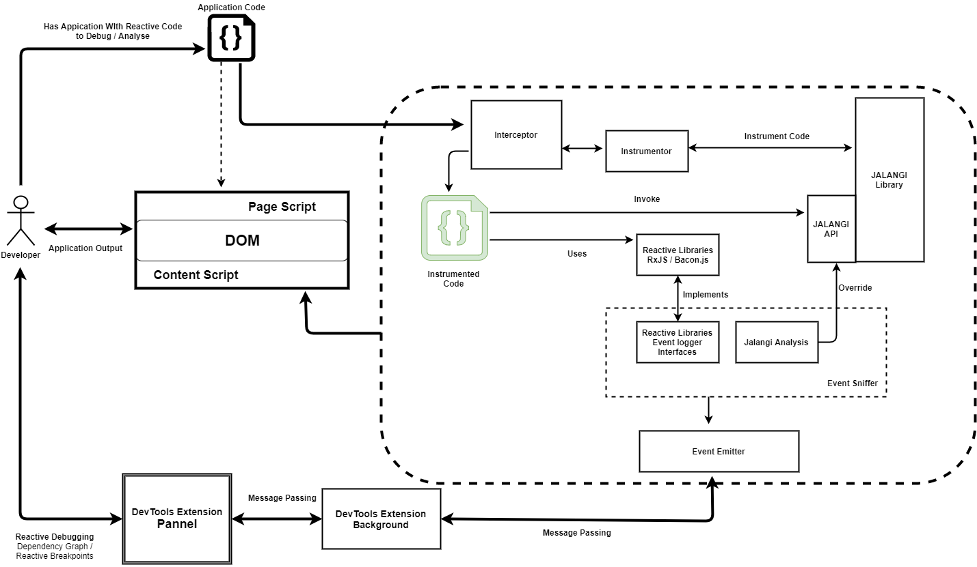
Previous architecture

Slide 10
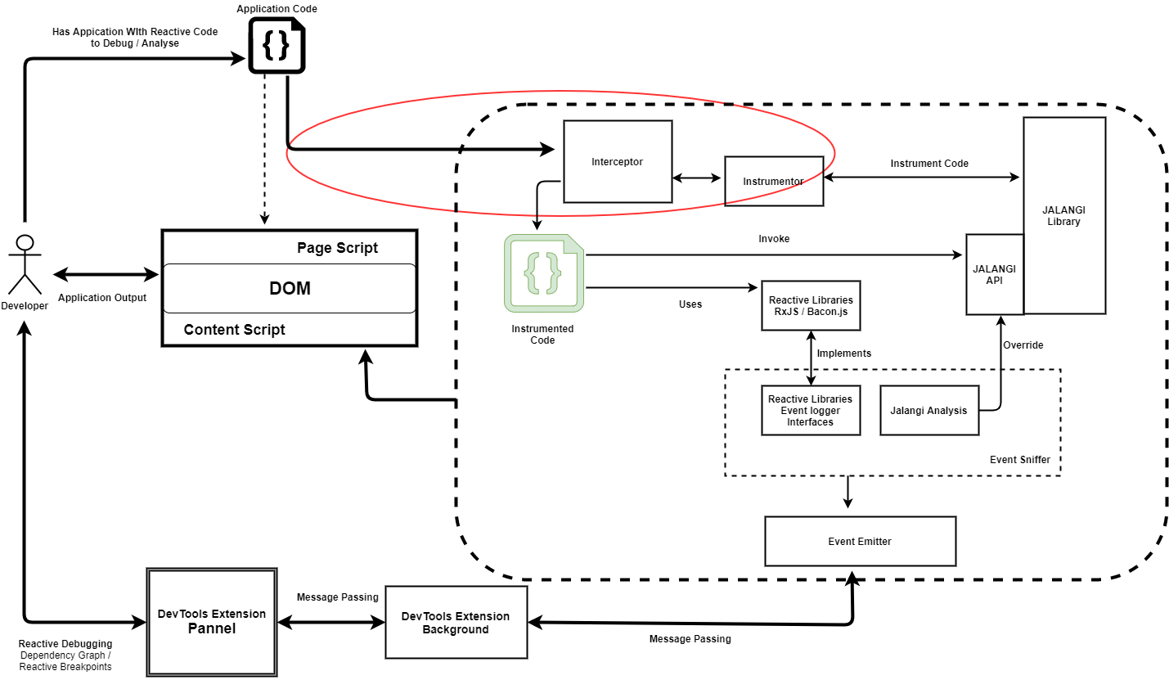
Previous architecture – contd.

Slide 11
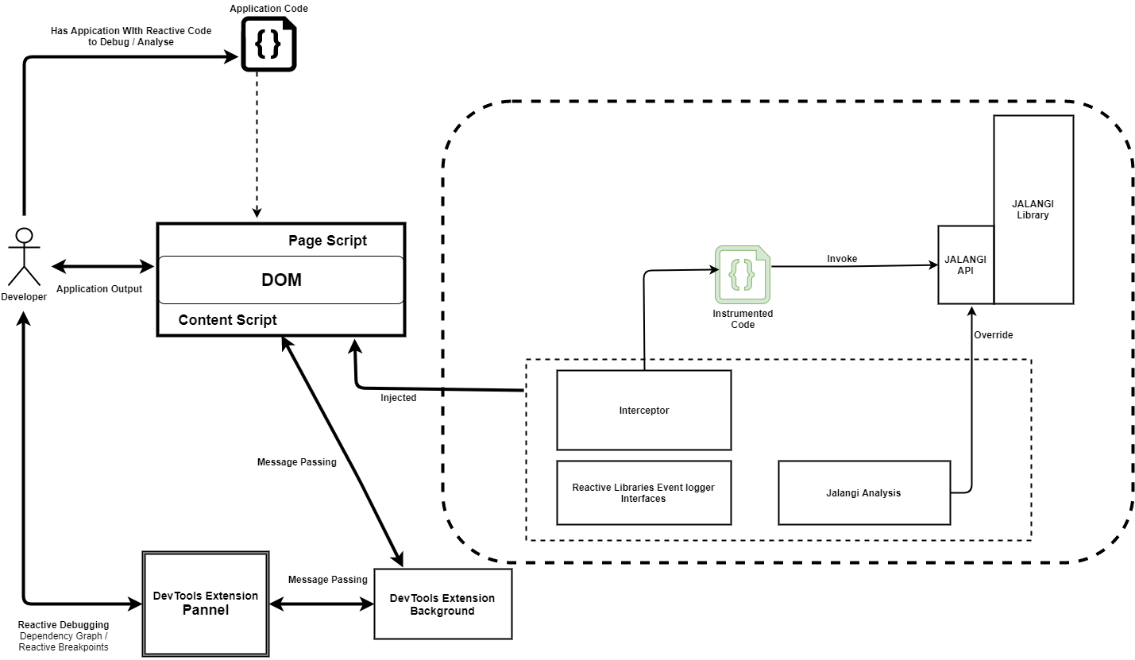
Proposed Architecture

Slide 12

Demo – previous vs current architecture

Slide 13
Catching events
RxJS:
lift architecture
Previous methodology
Subscribe to each observables again
Current methodology
Re-write functions – subscribe and next
BaconJS:
Bacon.spy method

Slide 14
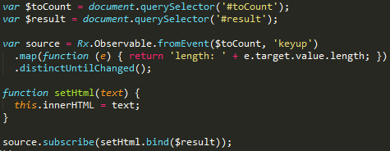
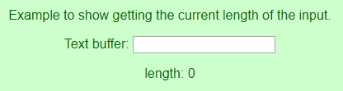
Letter count example

Slide 15
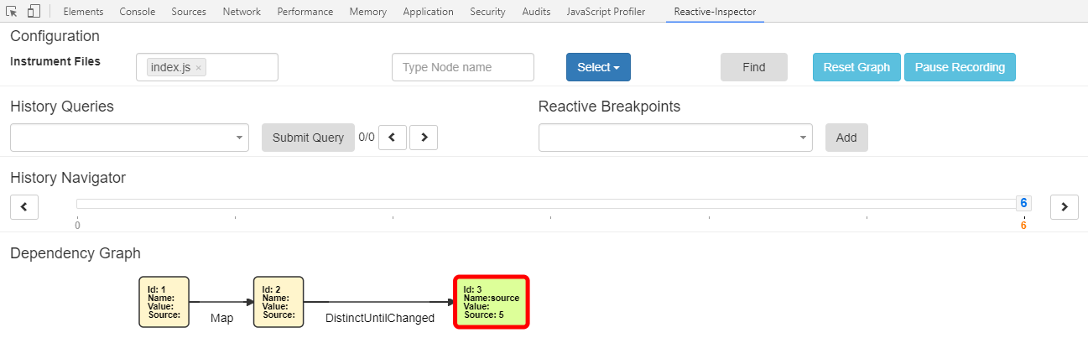
Dependency graph

Slide 16
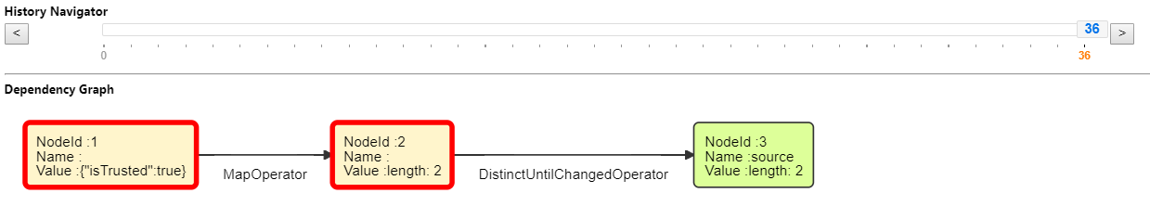
Previous version

Slide 17
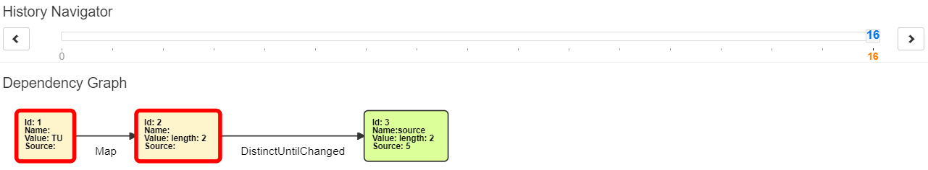
Current version

Slide 18
Evaluation
Demo

Slide 19
Evaluation – Profiling Time
Profiling Runtime calls
Self Time
- Time spent for doing the work directly in that function.
Total Time
- Time spent in the current function + the amount of time spent in functions it called.

Slide 20
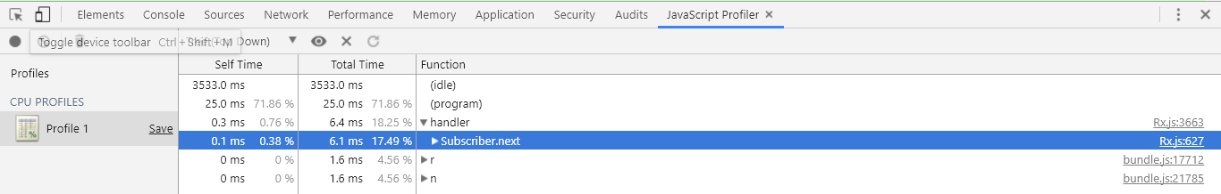
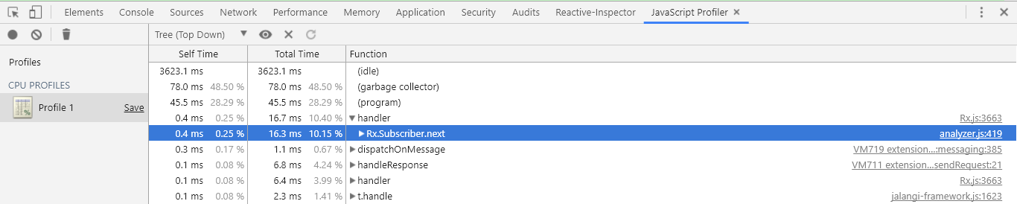
Profiling Runtime calls
Without CRI
With CRI

Slide 21
Profiling Runtime calls – contd.
Application name | LOC | No. of operators | Self-time With CRI (in ms) | Self-time Without CRI (in ms) | Overhead time (in ms)
Simple Databinding | 25 | 2 | 0.3 | 0.2 | 0.1
Animated Image | 26 | 4 | 0.3 | 0.3 | 0
Backpressue | 39 | 2 | 0.6 | 0.3 | 0.3
Mouse3 | 49 | 11 | 0.9 | 0.7 | 0.2
Stopwatch | 64 | 24 | 0.3 | 0 | 0.3
CombineLatest | 70 | 22 | 0.6 | 0.3 | 0.3
Animation Test | 78 | 3 | 0.5 | 0.5 | 0
Crop | 150 | 5 | 0.7 | 0.3 | 0.4

Slide 22
Summary
Conclusion
Helps user to understand the abstract code and debug
An extensive support to all the operators in RxJS
Support for Subjects
Improvement in CRI performance
Improve User experience
Search node, find dependents and dependencies of a node
Future Work
Performance analysis at nodes level
“edit-and-debug” feature

Slide 23
Questions

Slide 24
Thank you

Slide 26
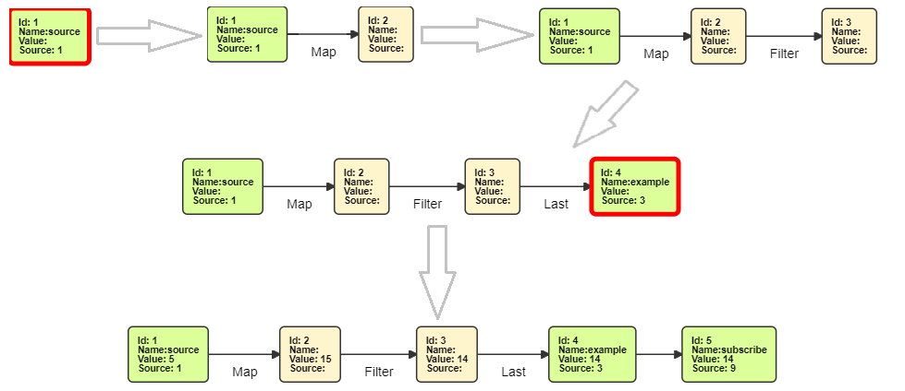
Reference slide – Evolution of dependency graph

Slide 27
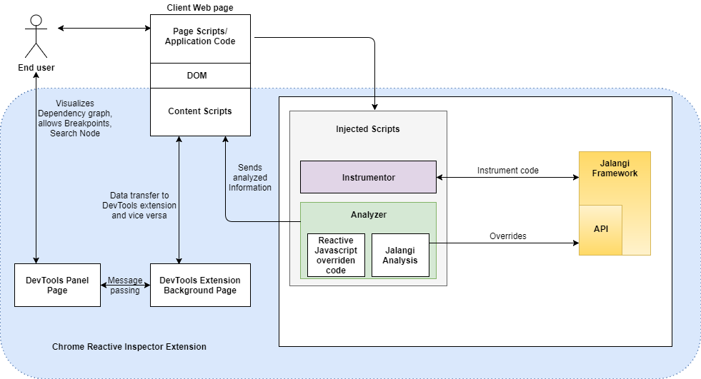
Reference slide – Current Architecture

