Slide 1
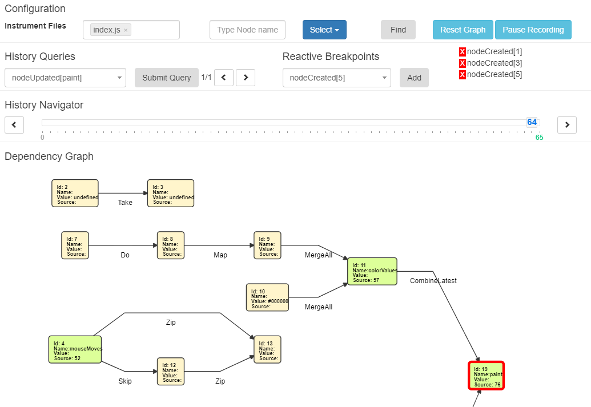
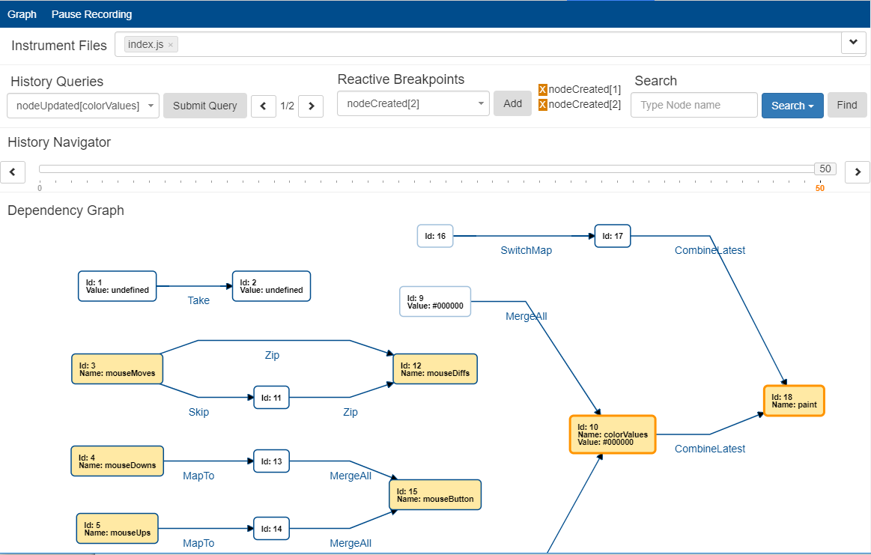
Advancing the Chrome Reactive Inspector

Slide 2


Reactive Programming
multiple values over time
observables
event streams
Implementations in all major programming languages
ReactiveX
source: http://reactivex.io/
Bacon.js
source: https://baconjs.github.io/

Slide 3
Traditional Debugging
breakpoints
step by step execution
event logging
stack trace inspection
printf-debugging

Slide 4
Debuggin Reactive Code
do-debugging
abstraction of dependencies
limited number of tools
Reactive Inspector for Scala
Chrome Reactive Inspector
RxFiddle

Slide 5
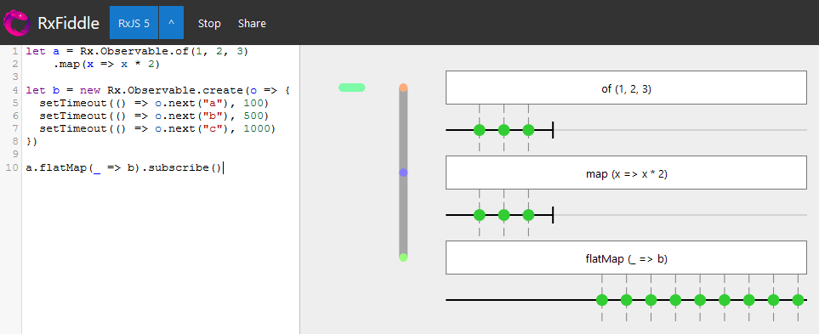
Debuggin Reactive Code - RxFiddle
Screenshot of the RxFiddle Demo
Source: https://rxfiddle.net/

Slide 6
Advancing the Chrome Reactive Inspector
The Chrome Reactive Inspector

Slide 7
The previous User Interface

Slide 8
The new User Interface

Slide 9
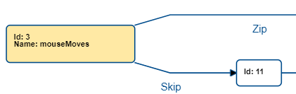
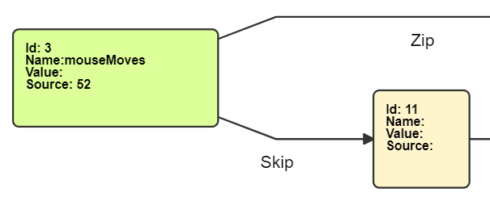
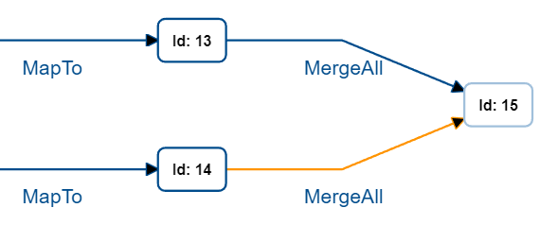
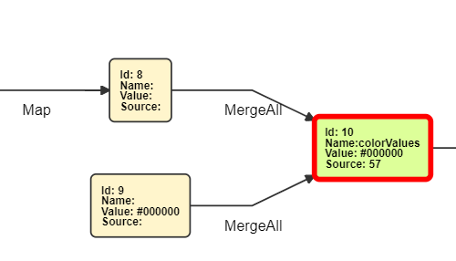
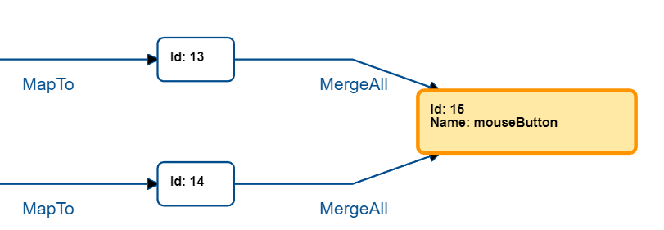
Advancing the User Interface Reducing the cognitive load

Slide 10
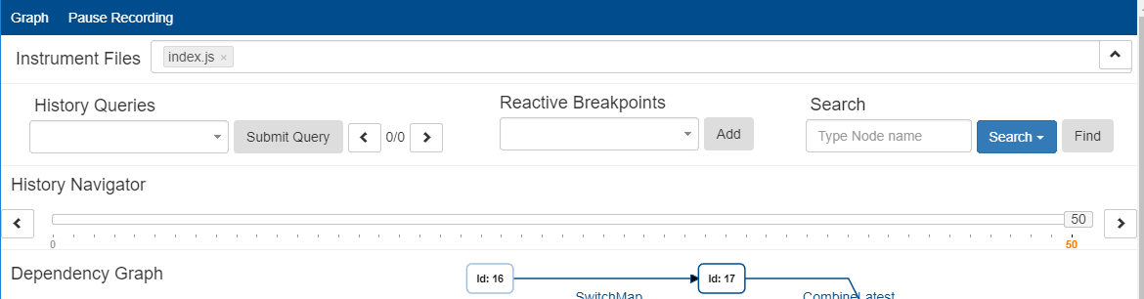
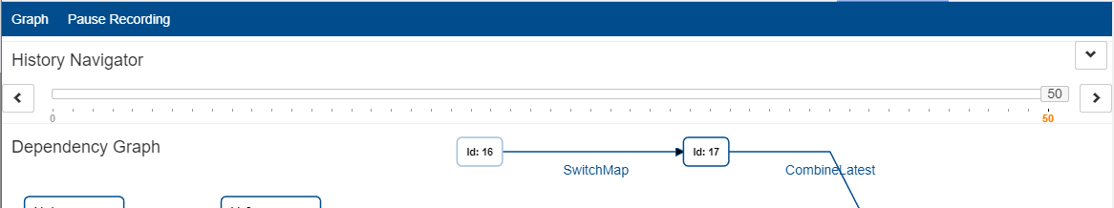
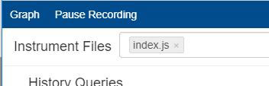
Advancing the User Interface Reducing the cognitive load

Slide 11
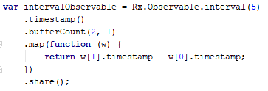
Connecting abstract graph with JavaScript code
provide additional context
merge both views
Method Chaining:

Slide 12
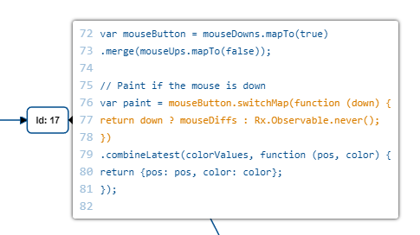
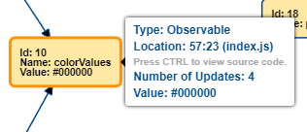
Connecting abstract graph with JavaScript code
difficulty: instrumented JavaScript code
covers almost all nodes

Slide 13
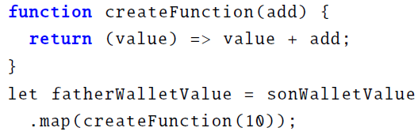
Connecting abstract graph with JavaScript code
Source Code Tooltips
  Pro
    compliments dependency graph
    easily accessible
    highlight code
    existing workflow
  Con
    only snippets
    no search feature
    limited when using references to functions
Function reference example:

Slide 14
Rapidly updated Observables
timers, mouse movement, network traffic
generate thousands of steps
limited by recording performance
may render CRI useless

Slide 15
Rapidly updated Observables improving performance
UI update throttling
(software) Paging
Delta Encoding
improved similar to Video Compression
I
P
P
P
P
P
P
P
P
I
P
P
P
P

Slide 16

Excessively created Observables
describes a group of observables
created as part of a loop
created multiple times temporarily
all originating from the same code
require detection and representation in the graph

Slide 17
Evaluation
changes to the UI
Source Code Tooltips cover 75% of all nodes
CPU Performance
  Version 2: 154s
  Version 3: 5.5s
Memory
  Version 2: 54mb - depending on steps
  Version 3: 15mb - constant

Slide 18
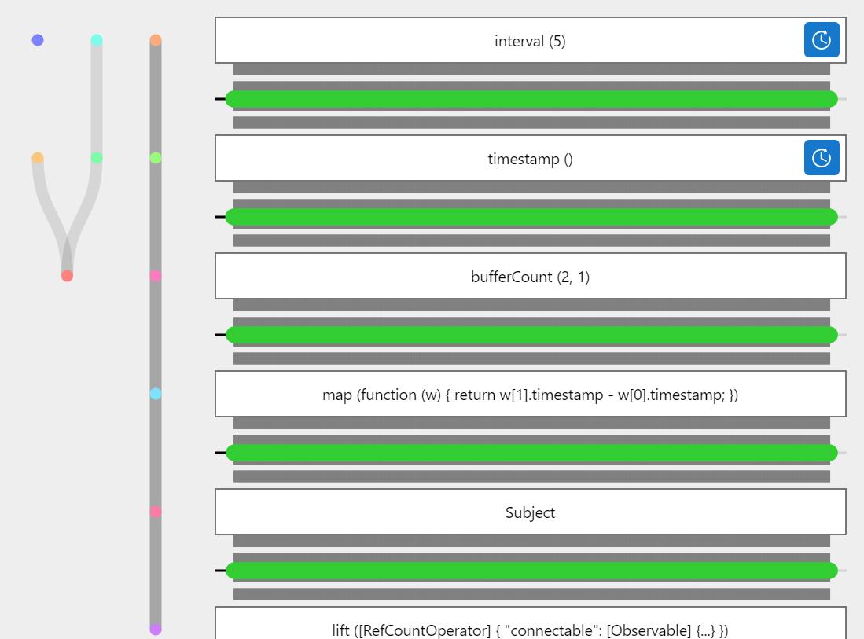
Evaluation
Comparison to RxFiddle
Screenshot of RxFiddle with the test application

Slide 19
Evaluation
Test Applications
verify robustness
state of the project
9 specifications tested for each applicaiton
388 of 420 checks were successful
notable findings:
  Ambiguity
  JavaScript in HTML attributes
  breakdown of recording for a specific pattern

Slide 20

Future
module loaders
ES6 and TypeScript support
extend node exclusion
excessively created observables
Source: http://requirejs.org/logo.png

Slide 21
Summary – Q and A
Reducing the cognitive load on the user
Connecting the abstract graph with JavaScript code
Rapidly updated observables
Excessively created Observables
Evaluation
Advancing the Chrome Reactive Inspector

Slide 22
Advancing the Chrome Reactive Inspector
Thank you

Slide 23
Advancing the Chrome Reactive Inspector
Backup Slides:

Slide 24
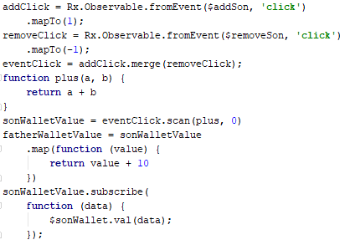
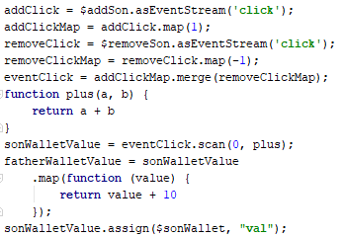
Reactive Programming
very similar source code
Rx.js
Bacon.js

Slide 25
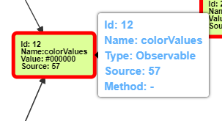
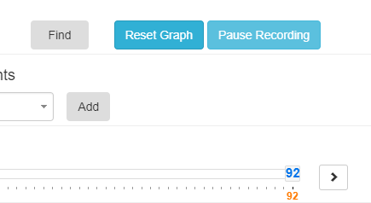
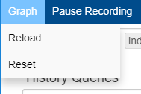
Advancing the User Interface Reducing the cognitive load

