Slide 1
Talent Management Analysis
Allison Roderick

Slide 2
Frito-Lay & DDSAnalytics: Partnership in Data Science
Who You Are
Who We Are
Frito-Lay has over 10,000 employees across multiple departments and at multiple levels.
The company is looking to utilize data science to understand and reduce voluntary employee attrition.
For over a decade and for dozens of customers, DDSAnalytics has specialized in using data science to provide talent management solutions.

Slide 3
What We Offer
Identify top factors contributing to Attrition
Identify top factors that predict Monthly Income
Provide predicted values on subset of employees
Provide insight to help mitigate voluntary employee Attrition

Slide 4
Attrition

Slide 5
What Variables are highly associated with Attrition?
Variable | P-Value
MonthlyIncome | 0.0%
JobLevel | 0.0%
TotalWorkingYears | 0.0%
YearsInCurrentRole | 0.0%
JobInvolvement | 0.0%
YearsWithCurrManager | 0.0%
StockOptionLevel | 0.0%
Age | 0.0%
YearsAtCompany | 0.0%
JobSatisfaction | 0.1%
DistanceFromHome | 1.6%
WorkLifeBalance | 1.9%
Variable (ctd) | P-Value
WorkLifeBalance | 1.9%
EnvironmentSatisfaction | 3.4%
TrainingTimesLastYear | 5.9%
NumCompaniesWorked | 9.8%
Education | 14.2%
MonthlyRate | 19.8%
RelationshipSatisfaction | 26.4%
HourlyRate | 27.4%
DailyRate | 31.9%
EmployeeNumber | 49.8%
PerformanceRating | 66.1%
PercentSalaryHike | 66.9%
Welch’s Two Sample T Tests on each of the numeric variables
P-value explains the likelihood of observing at least as extreme of difference in the mean of the variable when the employee attrited vs when they did not attrite
For preliminary consideration in predictive model, we include all variables with p-value < 10%

Slide 6
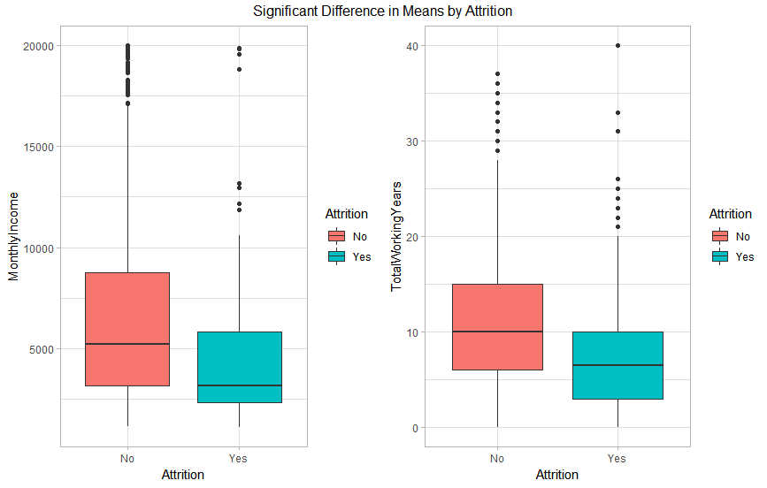

Slide 7
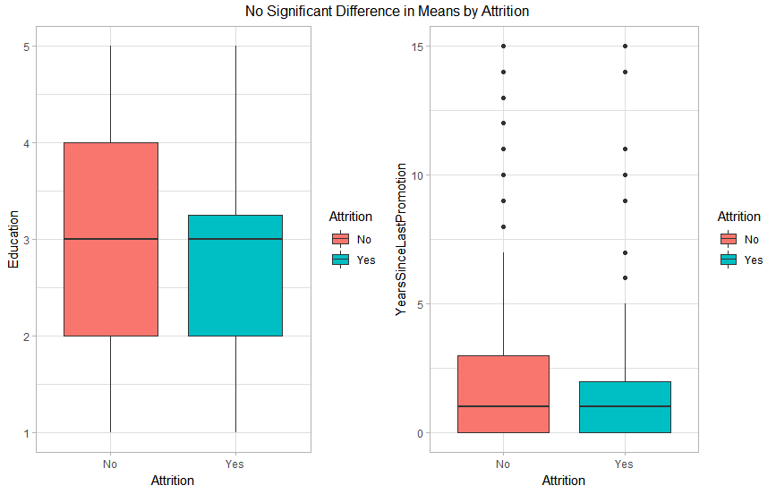

Slide 8
What Variables are highly associated with Attrition?
Variable | P-Value
Over18 | 0.0%
OverTime | 0.0%
JobRole | 0.0%
MaritalStatus | 0.0%
Role | 0.0%
Department | 0.9%
BusinessTravel | 5.0%
EducationField | 26.8%
Gender | 51.5%
Chi-Squared Test for Independence on each of the categorical variables
For preliminary consideration in predictive model, we include all variables with p-value < 10%

Slide 9
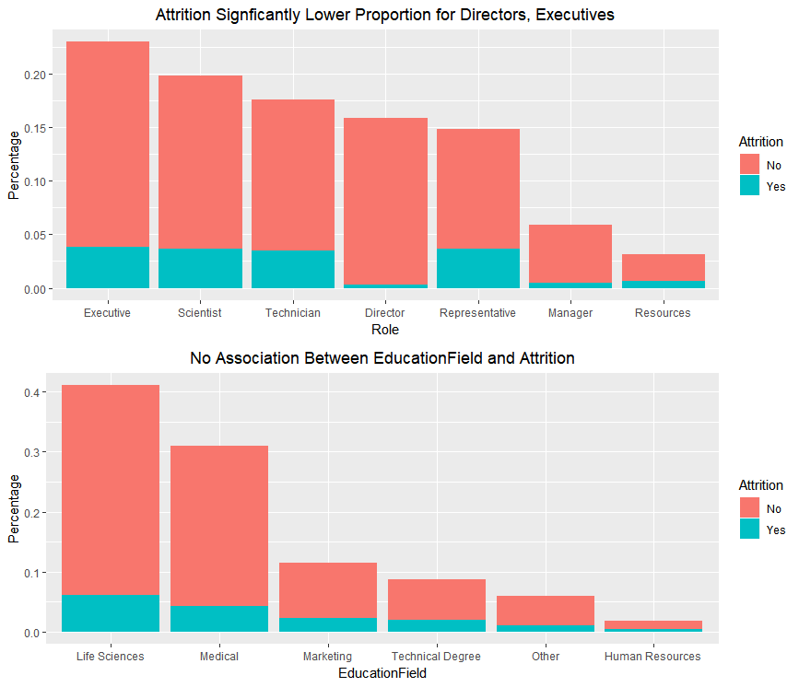

Slide 10
The Model – Naïve Bayes
Pros: simple, good for binary classification
Cons: assumption that all variables are independent may not be ideal
Variables included: Monthly Income, Job Level, Total Working Years, Years in Current Role, Job Involvement, Years with Curr Manager, Job Satisfaction, Stock Option Level, Age, Distance From Home, Work Life Balance, Environment Satisfaction, Over Time, Role (last word of Job Role), Number Companies Worked, Years at Company, Training Times Last Year, Marital Status, Department, Business Travel
Process:
Removed unique combinations of low-volume categorical data (e.g. one HR Manager who is Non-Travel)
Subset data into 50/50 train/test split
Train the model
Assess metrics such as accuracy, specificity, and sensitivity

Slide 11
Model Performance
Accuracy: 85.7%
Sensitivity (true positive* rate): 88.8%
Specificity (true negative rate): 66.1%
We experience a lower Specificity due to the fact that, in the training dataset, there was an overall attrition rate of approximately 16%
* Positive is “No” Attrition
Prediction | Actual
 | Attrition | No | Yes
 | No | 310 | 19
 | Yes | 39 | 37

Slide 12
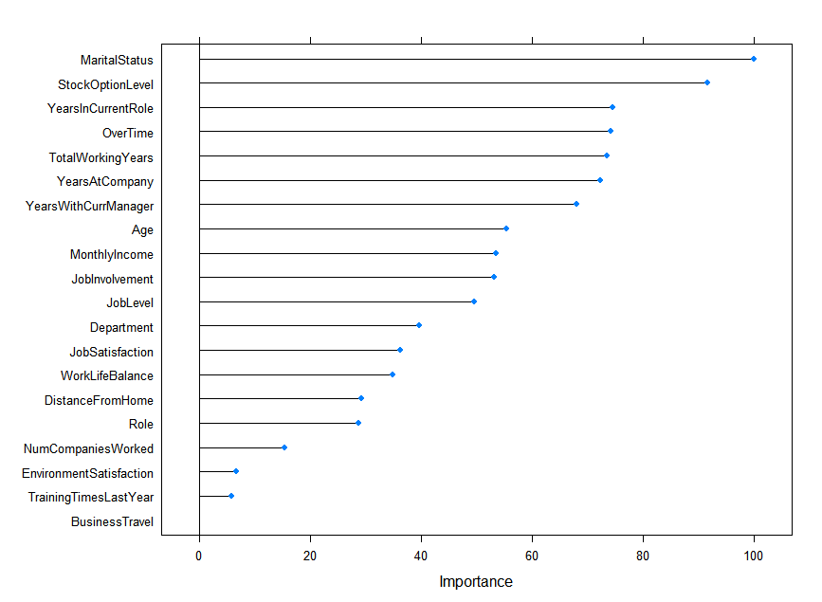
#1
#2
#3

Slide 13
Monthly Income

Slide 14
What Variables are associated with monthly income?
Variable | R² | P-Value
JobLevel | 90.6% | 0.0%
TotalWorkingYears | 60.6% | 0.0%
YearsAtCompany | 24.1% | 0.0%
YearsInCurrentRole | 13.1% | 0.0%
YearsSinceLastPromotion | 10.0% | 0.0%
YearsWithCurrManager | 10.8% | 0.0%
Age | 23.5% | 0.0%
NumCompaniesWorked | 2.4% | 0.0%
Education | 1.6% | 0.0%
MonthlyRate | 0.4% | 5.7%
PercentSalaryHike | 0.3% | 11.2%
JobSatisfaction | 0.3% | 11.7%
Variable (ctd) | R² | P-Value
PerformanceRating | 0.2% | 20.4%
TrainingTimesLastYear | 0.2% | 25.0%
EmployeeNumber | 0.1% | 31.4%
WorkLifeBalance | 0.0% | 54.0%
StockOptionLevel | 0.0% | 57.8%
EnvironmentSatisfaction | 0.0% | 61.9%
DistanceFromHome | 0.0% | 84.4%
RelationshipSatisfaction | 0.0% | 90.9%
HourlyRate | 0.0% | 94.4%
JobInvolvement | 0.0% | 98.9%
DailyRate | 0.0% | 99.8%
PerformanceRating | 0.2% | 20.4%
Examine linear models for each numeric variable with MonthlyIncome as the response
MonthlyIncome is right-skewed, but we feel comfortable that we have a large enough overall sample size to draw conclusions from
For preliminary consideration in predictive model, we include all variables with p-value < 10%

Slide 15
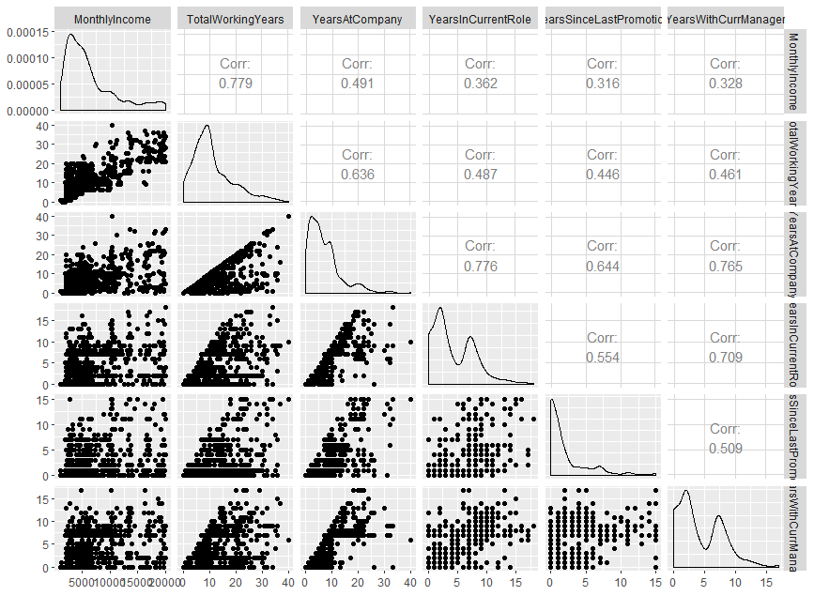

Slide 16
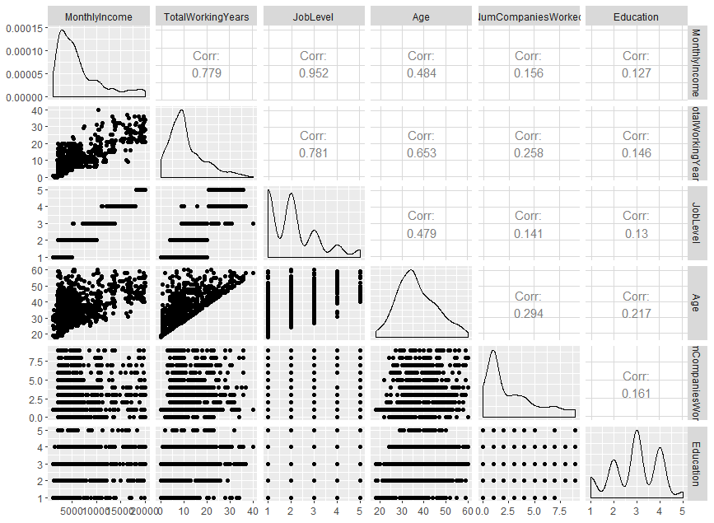

Slide 17
What Variables are associated with monthly income?
Variable | P-Value
Role | 0.0%
Department | 0.0%
EducationField | 0.8%
MaritalStatus | 0.9%
Gender | 4.6%
BusinessTravel | 32.6%
OverTime | 61.6%
Perform Kruskal-Wallis Tests on each categorical variable to determine if the distributions of Monthly Income are the same by category
Since Monthly Income is right-skewed and some of the individual categories have small sample sizes (e.g. Human Resources Department), we use Kruskal-Wallis
For preliminary consideration in predictive model, we include all variables with p-value < 10%

Slide 18
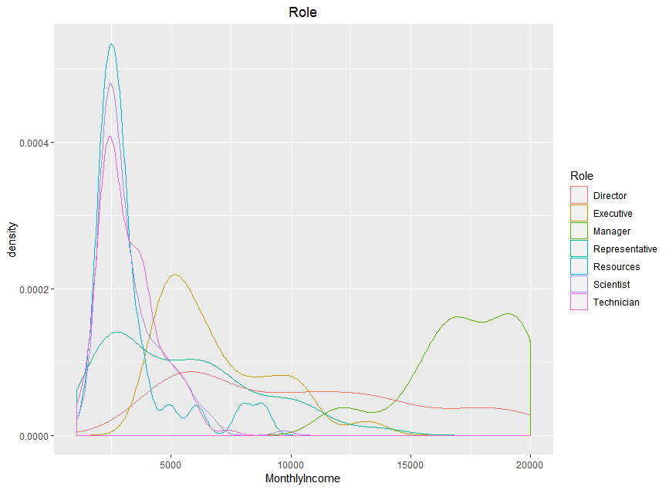

Slide 19
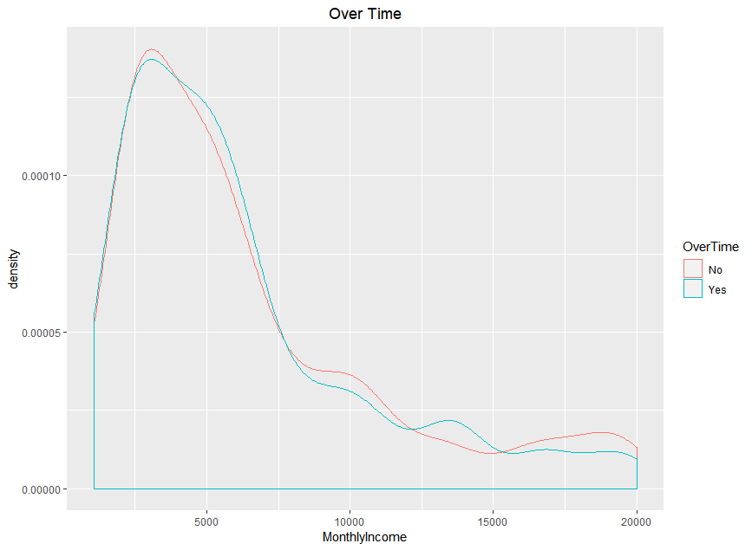

Slide 20
The Model – Multiple Linear Regression
Variables included for consideration: Job Level, Number Companies Worked, Education, Role, Department, Education Field, Marital Status, Gender
Used stepwise selection to narrow down variables
Variables in final model, which are the top 4 predictive factors of Monthly Income
Job Level
Role
Number of Companies Worked
Gender
The model with these predictors explains 92% of the variation in Monthly Income
RMSE is $1,268

Slide 21
Conclusion

Slide 22
Attrition
Income
Assess voluntary Attrition for factors you can control
Stock Option Level
Over Time
Monthly Income
Focus on mitigating these factors at the Role and Department level
Monitor potential attritions through the predicted dataset we provided
Assess accuracy of these predictions at a later date and recalibrate model
Question the importance of variables such as Marital Status
Anticipate employee income demands, utilizing our predictive model
Examine income differences by Gender
Research market salaries by role to ensure competitiveness

