Slide 1
Accuracy:
Apache Griffin DSL: one Measurement for id and name matching
source.id = target.id and source.name = target.name
Accuracy Use Case: 检查两个数据集的精确度
Terms:
target: 来源数据集合 single source of true
source: 待检查数据集合 datasets to be measured
accuracy: 精确度 : total_source – miss/total_source
有时source -> target 是多对1关系,
griffin 以source 为分母
DSL => Real Work:
Miss items: 保存到 miss_items
SELECT source.* FROM source LEFT JOIN target ON coalesce(source.id, '') = coalesce(target.id, '') and coalesce(source.name, '') = coalesce(target.name, '') WHERE (NOT (source.id IS NULL AND source.name IS NULL)) AND (target.id IS NULL AND target.name IS NULL
2. save total items to total_count:
select count(*) from source
3. Calculate accuracy: miss_items/total_source save to accuracy table

Slide 2
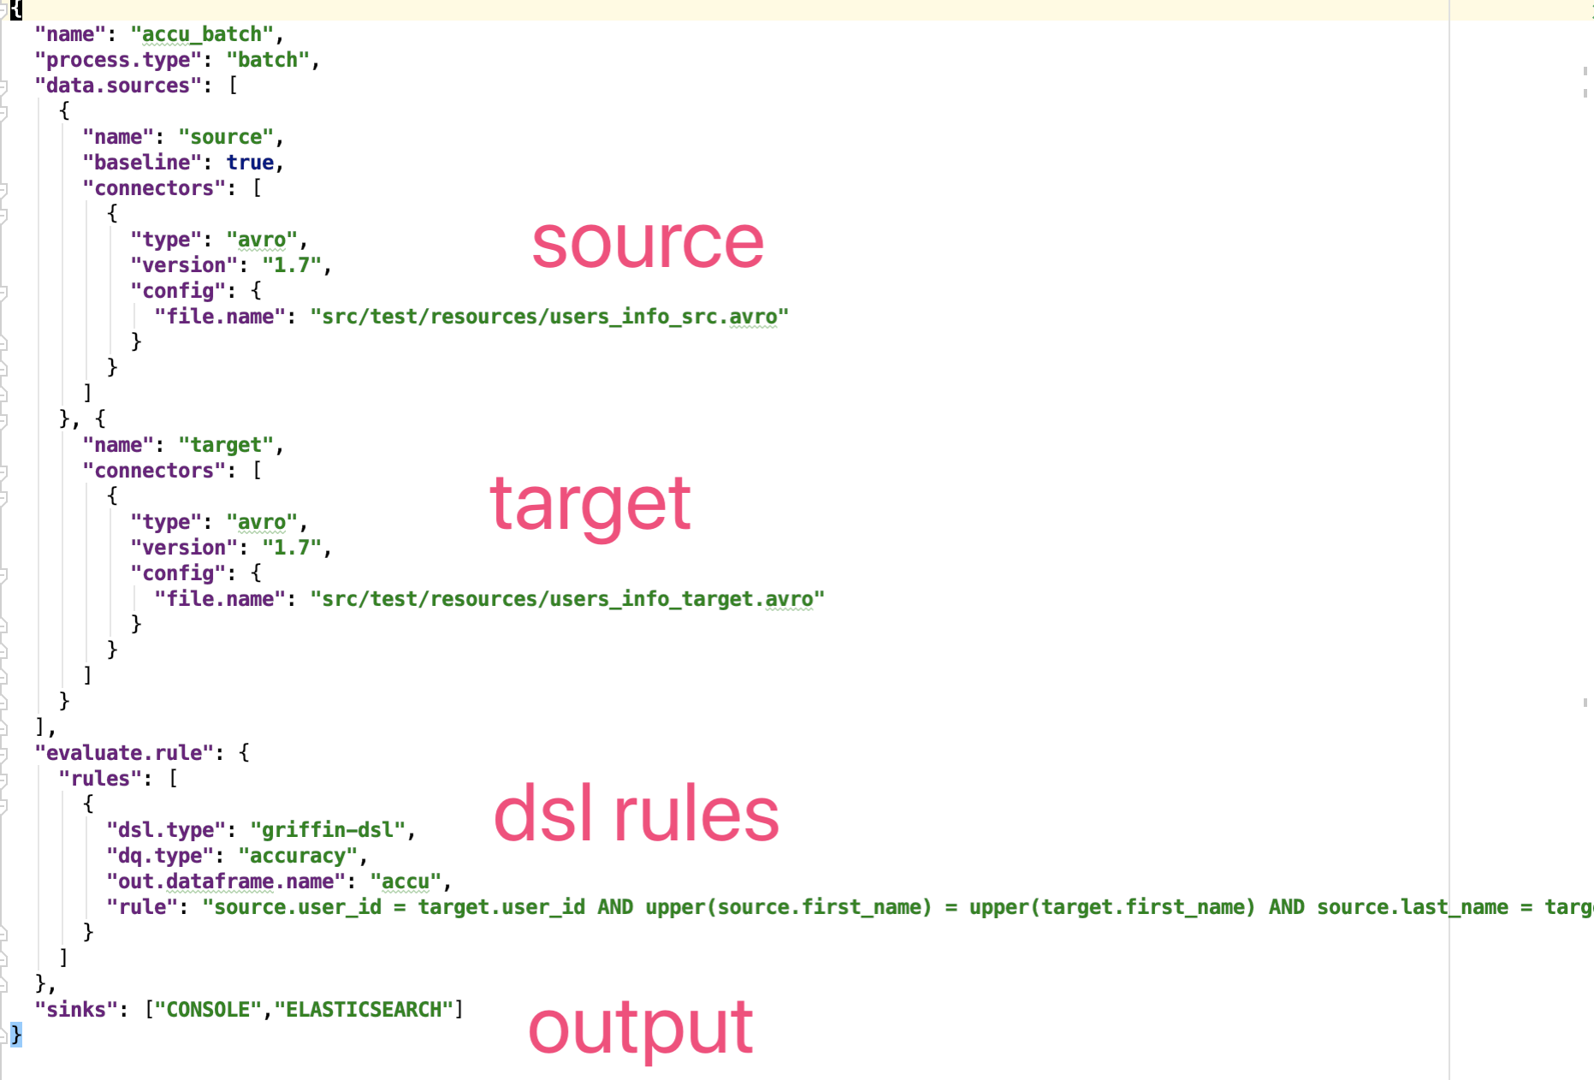
Accuracy: Griffin Configuration

Slide 3
Profiling:
Apache Griffin DSL: one Measurement for id and name matching
source.id = target.id and source.name = target.name
Accuracy Use Case: 检查两个数据集的精确度
Terms:
target: 来源数据集合 single source of true
source: 待检查数据集合 datasets to be measured
accuracy: 精确度 : total_source – miss/total_source
有时source -> target 是多对1关系,
griffin 以source 为分母
DSL => Real Work:
Miss items: 保存到 miss_items
SELECT source.* FROM source LEFT JOIN target ON coalesce(source.id, '') = coalesce(target.id, '') and coalesce(source.name, '') = coalesce(target.name, '') WHERE (NOT (source.id IS NULL AND source.name IS NULL)) AND (target.id IS NULL AND target.name IS NULL
2. save total items to total_count:
select count(*) from source
3. Calculate accuracy: miss_items/total_source save to accuracy table

