Slide 1


G.H. RAISONI COLLEGE OF ENGINEERING
AND MANAGEMENT, WAGHOLI, PUNE
Department of CSE (AIML)
An Intelligent Aircraft Maintenance Prediction System Using Machine Learning and Real-Time Simulated Data
Group No.:
20
    Guide:
    Prof. Soma Joshi
Name of Projectees
Soham Chaudhari(N42) Yug Shah(N60)
V Divakar(N50) Manjusha Mandhane(M49)

Slide 2
Contents
Introduction
Problem Statement
Objectives
Literature Survey
Existing System Architecture
System architecture/Block Diagram
Methodology and Tool Used
Implementation & Results
Work Plan & Project Completion

Slide 3
Introduction
Aircraft maintenance is one of the most critical aspects of aviation safety, where unexpected component failures can lead to increased operational costs, flight delays, and safety risks. Traditional maintenance methods are either scheduled at fixed intervals or performed after a fault occurs, which may result in unnecessary maintenance or unexpected failures. This project developed an AI-based Aircraft Predictive Maintenance and Decision Support System that predicts the Remaining Useful Life (RUL), State of Health (SOH), and fault or abnormal conditions of five aircraft subsystems. Each prediction is converted into a maintenance recommendation and priority level and shown on a monitoring dashboard driven by simulated real-time data, supporting proactive maintenance decisions.

Slide 4
Problem Statement
Current aircraft predictive maintenance systems mainly focus on predicting component failures or Remaining Useful Life (RUL) but provide limited support for maintenance planning and decision-making. This can lead to inefficient maintenance scheduling, increased operational costs, and unexpected downtime. Therefore, an intelligent decision support system is needed to assist engineers with maintenance prioritization, recommendations, and real-time monitoring.

Slide 5
Objectives
To develop a machine learning-based predictive maintenance system for five major aircraft subsystems.
To use subsystem-specific sensor data to predict RUL, SOH, and abnormal/fault conditions.
To integrate Engine, Battery, Hydraulic, Fuel, and Landing Gear into a unified system with FastAPI and a React dashboard.
To convert model predictions into maintenance recommendations and priority levels using simulated real-time data.

Slide 6
Literature Survey
Sr. No. | Paper Title and Year | Details of Publication | Findings
1 | Maintainability Improvement in Ageing Aircraft: A Critical Review of Evolving Strategies (2025) | Systems Engineering, Wiley (ISSN 1520-6858) | A review of aircraft predictive-maintenance research found that most studies focus on aircraft engines because data for other aircraft systems is limited. It highlights the need for AI, IoT, and digital twins to improve maintenance automation and efficiency.
2 | Interpretable Ensemble Remaining Useful Life Prediction Enables Dynamic Maintenance Scheduling for Aircraft Engines (2025) | Scientific Reports, Nature | An ensemble model using LightGBM, CatBoost, and Gradient Boosting accurately predicts Remaining Useful Life (RUL). It outperforms several recent methods while using SHAP to provide explainable maintenance decisions.

Slide 7
Literature Survey
Sr. No. | Paper Title and Year | Details of Publication | Findings
3 | Digitalization in Aircraft Maintenance Processes (2023) | Aviation (Vilnius Tech), Vol. 27, Issue 2 | A survey of MRO professionals found that the aviation industry is not fully ready for digital transformation. The main barriers are high costs, limited training, and technology reliability, while younger engineers show greater trust in automation than older engineers.
4 | Predictive Maintenance Analytics and Implementation for Aircraft: Challenges and Opportunities (2023) | Systems Engineering, Wiley (ISSN 1520-6858) | A review of aircraft predictive maintenance found that most research focuses on aircraft engines due to limited public data for other systems. It recommends greater use of AI, IoT, and digital twins to improve maintenance efficiency.

Slide 8
Existing System Architecture
Most existing predictive maintenance approaches focus on individual aircraft components or a single subsystem, limiting their ability to provide a broader aircraft maintenance view.
Many systems mainly provide fault detection or RUL prediction but do not translate these predictions into clear maintenance recommendations and priority levels.
Existing approaches often depend on offline historical datasets, with limited support for simulated real-time monitoring and continuous prediction.
Different aircraft subsystems may require different datasets, features, and ML models, making it difficult to integrate them into one unified framework.
Many research models are evaluated on specific laboratory, simulated, or benchmark datasets, making direct generalization to real aircraft fleet conditions difficult.

Slide 9
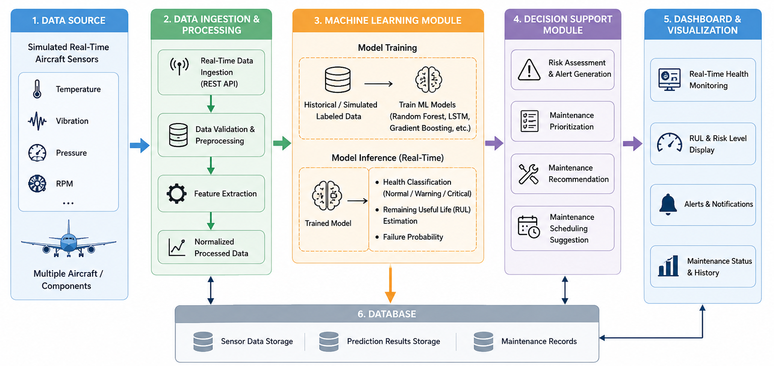
System architecture/Block Diagram

Slide 10
Methodology and Tool Used
Data Collection – Collect and organize data for Engine, Battery, Hydraulic, Fuel, and Landing Gear systems.
Data Preprocessing – Validate, clean, transform, and prepare the subsystem data for modelling.
Feature Engineering – Extract relevant sensor-based features to capture degradation and abnormal conditions.
Model Training & Evaluation – Train and compare suitable ML models for RUL, SOH, and condition prediction.
Prediction & Maintenance Decision – Generate predictions and convert them into maintenance recommendations and priority levels.
System Integration – Integrate the trained models with FastAPI and React for simulated real-time monitoring.

Slide 11
Methodology and Tool Used
Tools & Technologies Used
Programming Language: Python
Machine Learning: Scikit-learn
Data Processing: Pandas, NumPy
Data Analysis & Visualization: Matplotlib
Backend: FastAPI
Frontend: React.js, Vite
UI & Visualization: Tailwind CSS, Recharts, Lucide React
Real-Time Data: REST APIs and Simulated Sensor Data
Development Tools: VS Code, Jupyter Notebook, Git/GitHub

Slide 12
Implementation & Results
Engine (Random Forest): RUL MAE of 13.80 cycles on 100 unseen FD001 test engines.
Battery (Linear Regression / Random Forest): SOH MAE of 2.62 percentage points; RUL MAE of 9.36 cycles on unseen cells.
Hydraulic (Logistic Regression / Extra Trees / Random Forest): 83.99% to 96.1% accuracy across the four component conditions.
Landing Gear (Random Forest, digital-twin data): 95.07% fault accuracy; RUL MAE of 1.37 percentage points.
Fuel (Extra Trees): detects 93.13% of abnormal readings as a screening signal.
All outputs mapped to a Maintenance Recommendation and Priority on the dashboard.

Slide 13
Work – Plan
Months Activities | August’26 | Sept’26 | Oct’26 | Status
Literature Reviews | √ |  |  | Completed
Requirement Analysis | √ |  |  | Completed
Designing | √ |  |  | Completed
Experimental Analysis | √ | √ | √ | Completed
Module wise Implementation |  | √ | √ | Completed
Testing and Debugging |  | √ | √ | Completed
Preparation of Project Report |  |  | √ | Completed

Slide 14
Project Completion Status
Overall Project Completion: 100%
Scope & Dataset Preparation – Completed for 5 aircraft subsystems.
Data Preprocessing – Completed for all selected datasets.
Feature Engineering – Completed for relevant sensor and operational parameters.
ML Model Development – Final models trained and saved for all 5 subsystems.
Model Evaluation – Performance evaluation and comparison completed.
Backend Integration – FastAPI APIs completed for all 5 subsystems.
Frontend Integration – React dashboard with monitoring and data upload.
Testing & Validation – 232 tests passed; reproducibility verified.
Final Phase – Explainability, report, research paper and presentation completed.

Slide 15
Thank you !

