Slide 1
Location Weather API and
Product Recommendations
Allston Fojas, Denver Engineering Intern
August 2020
Notes:
Hi everyone, I’m Allston, and I’m an Engineering Intern with the Denver team.
→ For my internship, I worked on 2 projects: creating a location weather API and curating product recommendations.

Slide 2
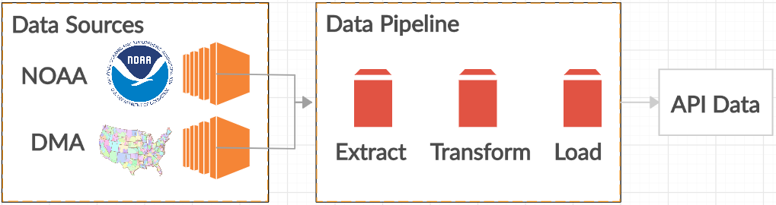

Agenda
Introduction
Objectives
Data Background
Structure of NOAA Station Data
Structure of DMA Data
Project Details
Location Weather API
Product Recommendations
Live Demo
Conclusion
Future Work
Notes:
So I’ll first introduce my projects with the overall objectives.
Then, I’ll talk about the data background, specifically the structure of my data sources.
Next, I’ll discuss my project details.
Then, I’ll do a live demo of my projects.
Finally, I’ll conclude with talking about future work.
NOAA = National Oceanic and Atmospheric Administration

Slide 3
Objectives
Location (DMA) Weather API
Create a data pipeline that ingests data from the NOAA Stations and Designated Market Area (DMA) data sources to match each station and its weather data to the closest DMA
Create an API that takes a DMA as an input and returns its weather data as an output
Product Recommendations
Download Amazon product data
Build machine learning model to learn on the DMA, weather, and product data to recommend products based off a user’s DMA/location and weather

Slide 4
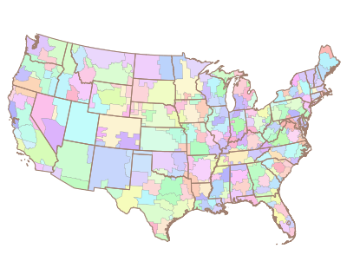
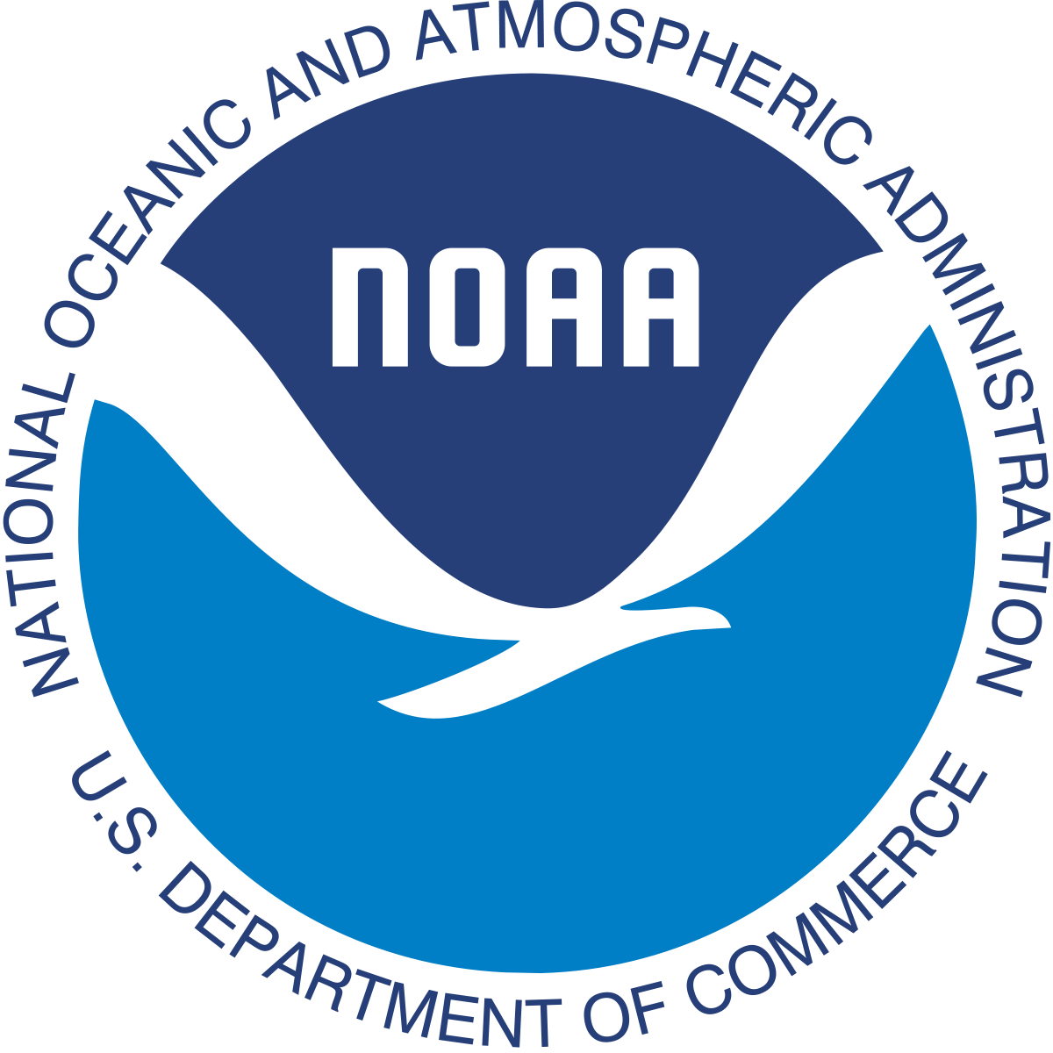
Objectives
Location Weather API
Created a data pipeline that ingests data from:
NOAA Stations (weather), and
Designated Market Area (DMA/location)
Matched each station and its weather data to the closest DMA
Created an API that takes a DMA as an input and returns its weather data as an output
Notes:
So the first objective is to create the location weather API.
The first step was to create a data pipeline that ingests data from the NOAA Stations (or weather) and Designated Market Area (or DMA/location) data sources.
For context, the NOAA, or National Oceanic and Atmospheric Administration, is an American scientific agency within the US Department of Commerce that focuses on the conditions of the oceans, major waterways, and the atmosphere.
→ This agency is where I gathered the weather data.
The other data source I used was DMA regions, which are the geographic areas in the US in which local television viewing is measured by Nielsen.
→ So working with both data sources, I matched each station and its weather data to the closest DMA.
→ After some data cleaning and transformation, I created an API that takes a DMA as an input and returns its weather data as the output.
Extra Talking Points:
→ There are 210 DMA regions, covering the entire continental US, Hawaii, and parts of Alaska.

Slide 5
Objectives
Product Recommendations
Downloaded Amazon product data
Built recommender system to learn on the:
DMA,
weather, and
product data
Recommended products based off a user’s location and weather data
Notes:
The second objective is to curate product recommendations based off the user’s location and weather.
The first step was to web scrape and download product data from Amazon.
Then, I built a recommender system to learn on:
the DMA and weather data from the API, and
the product data that I web scraped.
Once the system learns that data, I used the system to create a list of recommended products based off a user’s location and weather data.
Extra Talking Points:
Specifically, I created a list of Amazon product URLs suited for the rain and snow that can be recommended to users.
I chose products for the rain and snow since the weather data I gathered only had data on the amount of rain and snow.
Then, I web scraped each URL to get relevant information from each product, such as the product title, URL, price, and reviews.

Slide 6
Data Background
Notes:
Now, I’ll talk about the data background.

Slide 7
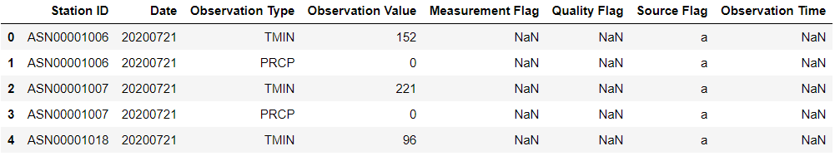
NOAA Station Weather Data
Station ID – station identification code
Date – YYYYMMDD
Observation Type – one of 5 core element types (precipitation, snowfall, snow depth, max temperature, min temperature)
Observation Value – measurement of the corresponding observation
Notes:
I used 2 data sources from NOAA. One data source was the weather data, which has the observation type and observation value columns.
The observation type column contains one of 5 core element types, which are precipitation, snowfall, snow depth, max temperature, and min temperature.
So each row contains one observation type and value for a specific station.
For example, in the data shown, the first 2 rows show 2 different observation types and values for the same station.
Extra Talking Points:
The observation value column has the measurement of the corresponding observation.

Slide 8
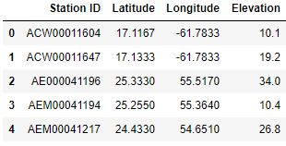
NOAA Station Location Data
Station ID – station identification code
Latitude – latitude
Longitude - longitude
Elevation - elevation
Notes:
The second data source was the location data, which has the latitude, longitude, and elevation for each station.

Slide 9
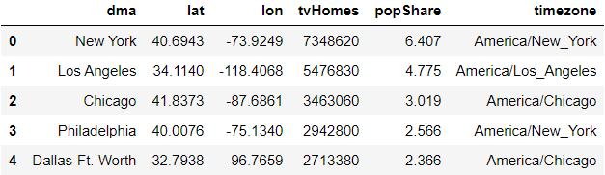
DMA Data
dma – Name of the DMA
lat – Latitude
lon - Longitude
tvHomes – number of TVs in homes in a particular DMA
popShare – number of people, in millions, in the DMA
timezone – DMA timezone
Notes:
I also used the DMA data source, which includes the latitude and longitude for each DMA.

Slide 10
Location Weather API
Notes:
Now, I’ll talk about my first project working on the location weather API.

Slide 11
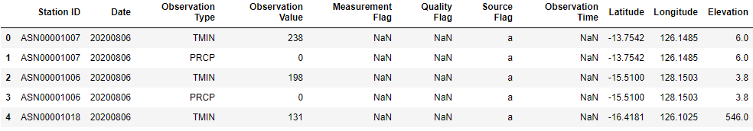
NOAA Station Merged Data
Matched on Station ID to merge station weather and location data
Notes:
After I read in both NOAA data sources, I matched them on Station ID to merge station weather and location data.

Slide 12
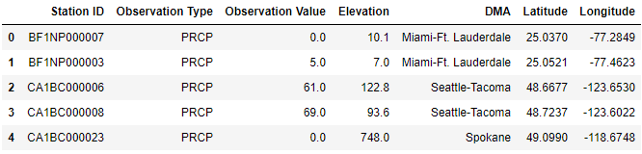
NOAA Station Weather and Location Data
Filtered NOAA stations to get just US locations and found the closest DMA for each station
Calculated Haversine Distance to find the closest DMA for each station
Notes:
Then, I filtered the NOAA stations to get just the US locations and found the closest DMA for each station.
I had to get just the US locations since DMA regions are only within the US.
Next, I calculated the Haversine Distance to find the closest DMA for each station.
Extra Talking Points:
One thing to note is that my filtering process considers locations only in the lower 48 states, not Alaska and Hawaii.
However, there are only a few DMA regions located in Alaska and Hawaii, so we are still working with a majority of relevant data.
Afterwards, I converted the NOAA & DMA data from a Python Dictionary to a DataFrame.

Slide 13
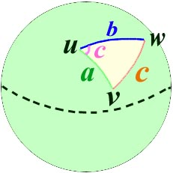
Haversine Distance
Determines the great-circle distance (shortest distance) between two points on a sphere given their latitudes and longitudes
Better than measuring Euclidean Distance (straight-line distance) since I was working with distances at a large scale
Notes:
So for some context, Haversine Distance determines the great-circle, or shortest, distance between two points on a sphere given their latitudes and longitudes.
It’s better than measuring Euclidean, or straight-line, distance since I was working with distances at a large scale.
Extra Talking Points:
The basic idea being at very small scales, the surface of a sphere looks very much like a plane. At very large scales, it distances along the surface are more curved and therefore the difference between the incorrect Pythagorean Theorem and the correct Haversine Formula is greater.
From https://math.stackexchange.com/questions/2978144/difference-between-haversine-and-euclidean-distance

Slide 14
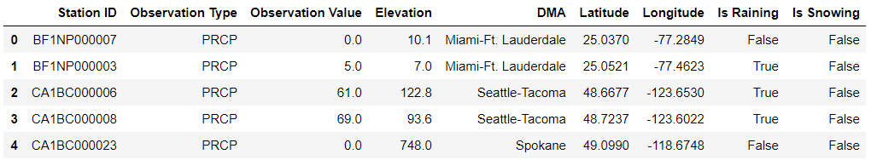
NOAA Station Rain and Snow Data
Made columns to determine if it’s raining and if it’s snowing
Determined based off a user defined threshold value
Notes:
After I got a DMA for each station, I made columns to determine if it’s raining and if it’s snowing based off a user defined threshold value and labeled each row as True or False.

Slide 15
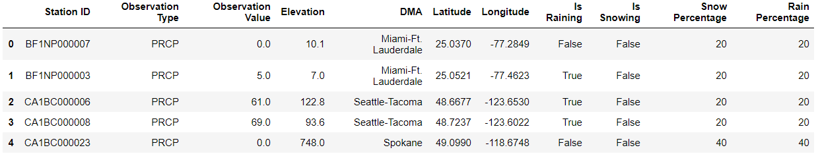
NOAA Station Rain and Snow Percentage Data
Added the Rain Percentage and Snow Percentage columns
Determined percentages based off DMA elevation values
Made higher elevations have greater snow and rain percentages than lower elevations to account for natural phenomenon
Notes:
Then, I added columns to measure the percentage that a location rains and snows based off DMA elevation values.
So, I calculated 5 ranges of elevations and set percentages in 5 increments of 20 for each row in the data set.
After some research, I found that higher elevations have greater snow and rain percentages than lower elevations.
So, I accounted for this natural phenomenon when assigning percentages.

Slide 16

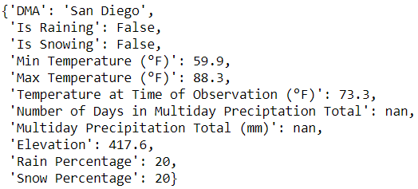
Location Weather API Data
Accessed the Location Weather API to get the data of whether it is rainy/snowy for a DMA
Notes:
Finally, I combined all these steps into one API that facilitates the process of getting the data of whether it is rainy or snowy for a DMA.
In the example shown, I entered San Diego as the DMA into the API and got its corresponding weather data.
Extra Talking Points:
I did some data formatting to make the temperatures be in Fahrenheit instead of Celsius, which is how the raw data was measured in, and rounded to just 1 decimal place for readability.
An interesting note is that the precipitation totals are nan values, which indicate that there has not been any rain recorded in San Diego.
This makes sense since we’re in the summer season, and it rarely rains in San Diego, as I know firsthand.

Slide 17
Product Recommendations
Notes:
Once I got the API working, I worked on taking that data and curating product recommendations, which was my second project.

Slide 18
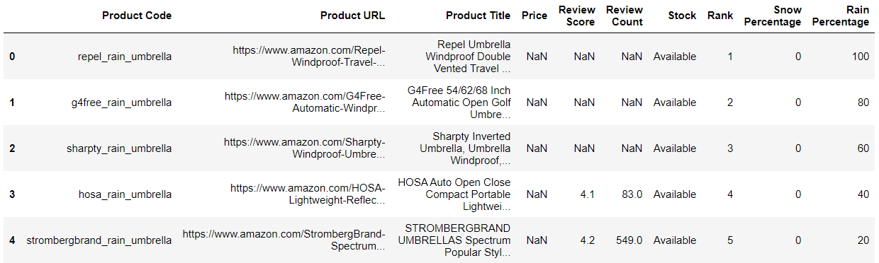
Amazon Products Data
Web scraped Amazon for products used in rainy or snowy weather
Products used as product recommendations based off a user’s location and corresponding weather data
Notes:
The first step was I web scraped Amazon for products used in rainy or snowy weather.
I chose Amazon because it was the website with the most intuitive format to get HTML tags for relevant product information, such as the product title, URL, price, and reviews.
To match these products with the user’s weather data, I added columns for rain and snow percentages.
Since we’re at the end of summer and transitioning into fall, I only focused on working with products suited for the rain, but I created the capability of including products suited for the snow.
Extra Talking Points:
→ As I mentioned earlier, the products that are used as product recommendations are based off a user’s location and corresponding weather data.
I got several different product categories that are tailored for the rain, such as an umbrella and rain jacket, and snow, such as a snow jacket and gloves.
For each category, I got 5 products for variety.
The example shown here shows product information for 5 umbrellas.
I made the percentages in 5 increments of 20, similarly to that of the DMA data, and assigned them based on a rank of 1-5 that I defined by numbering each product category sequentially.

Slide 19
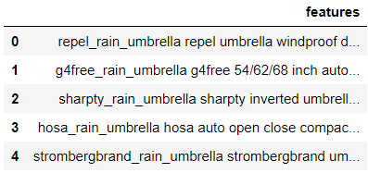
Feature Engineering
Removed all the NA values
Combined all the fields into a large string and put into new column
Removed the stop words (I, on, in, the, an, etc.) to make the recommender system more accurate
Notes:
Once I web scraped the product data, I performed feature engineering to ultimately work with these features in a recommender system.
The first step I took was I removed all the NA, or nan, values in numerical columns and replaced it with 0 as a placeholder value.
Then, I combined all the fields into a large string and put it into a new column called features, which is shown here.
Next, I removed the stop words, or articles, to make the recommender system more accurate.
Extra Talking Points:
I did so since my recommender system works with text data from the products.
So, having the text data for each product in one string made it easy to work with.

Slide 20
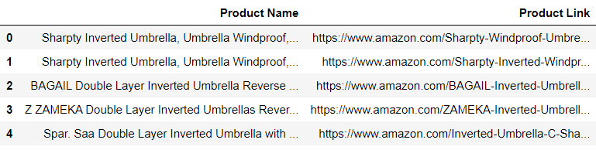
Feature Engineering
Computed count matrix (number of occurrences of each word in each feature)
Computed cosine similarity between each item to find how similar they are to each other
Created a list of recommended products and sort based on descending cosine similarity value
Notes:
I continued performing feature engineering by computing the count matrix, which is the number of occurrences of each word in each feature.
Then, I computed the cosine similarity between each item to find how similar they are to each other.
I’ll go into more depth on cosine similarity on the next slide.
Next, I created a list of recommended products.
Specifically, I used the rain percentage to match products with a user’s weather data.
Then, I sorted these products based on descending cosine similarity value.

Slide 21
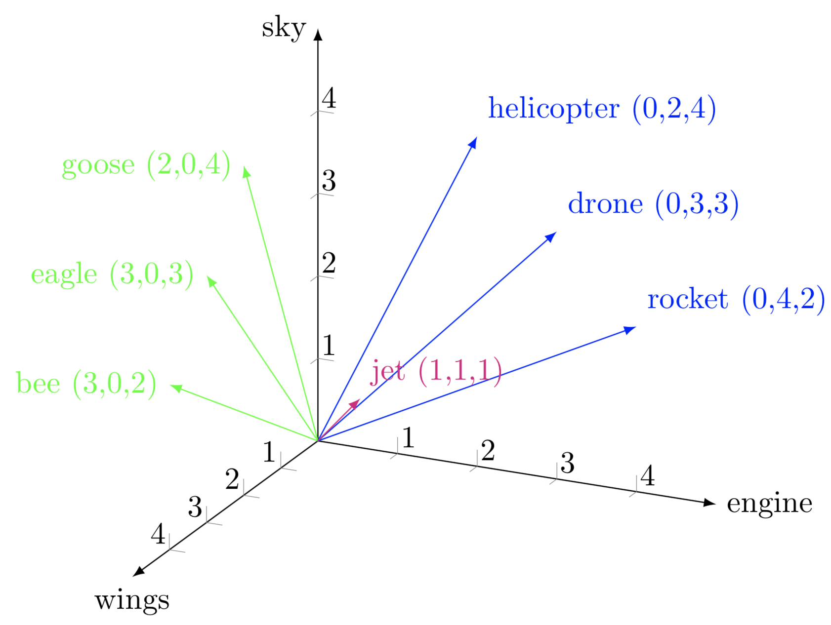

Cosine Similarity
A metric used to measure how similar the documents (products) are, irrespective of their size
Mathematically, it measures the cosine of the angle between two vectors projected in a multi-dimensional space
Notes:
So for context, cosine similarity is a metric used to measure how similar product information is, irrespective of the size.
From the example shown, we see a graph with 3 axes: engine, wings, and sky.
This example compares jet with 6 other terms based off the 3 axes.
Given the term jet, we see that helicopter, drone, and rocket have the 3 greatest cosine similarity values and would therefore be recommended in this case.
Extra Talking Points:
So, we see that jet is closely associated with helicopter, drone, and rocket since all these items have an engine and fly in the sky.
Similarly, we see that goose, eagle, and bee are closely associated with each other since these items have wings and fly in the sky.
Knowing this, a more technical definition of cosine similarity is that it measures the cosine of the angle between two vectors projected in a multi-dimensional space.
So, from the example, given the term jet, we see that helicopter, drone, and rocket have the 3 greatest cosine similarity values and would therefore be recommended in this case.

Slide 22
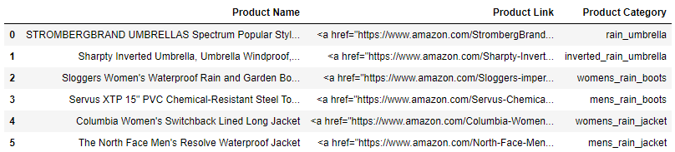
Amazon Product Recommendations Data
Made product links as hyperlinks to show hyperlinks on webpage
Notes:
Once I got a list of recommended products, I made the product links show up as hyperlinks to show them on a webpage that I made.

Slide 23
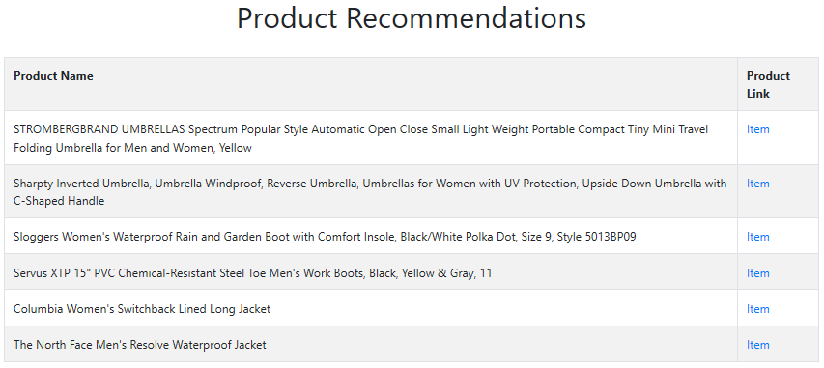
Amazon Product Recommendations
Made a webpage to automatically update the product recommendations after each run-through of getting product recommendations
Notes:
So the webpage gets automatically updated with the latest product recommendations.
Extra Talking Points:
→ It updates after each run-through of getting product recommendations.

Slide 24
Live Demo
Notes:
So now, I’m going to do a live demo.

Slide 25
Product Recommendations Webpage
Made a webpage to automatically update the product recommendations after each run-through of the product recommendations API
index
Notes:
First, I’ll demo the webpage to show the latest product recommendations.
[Show demo]
This is the webpage where it shows the product names and links.
You can click on the links to go to the specific item on Amazon.

Slide 26
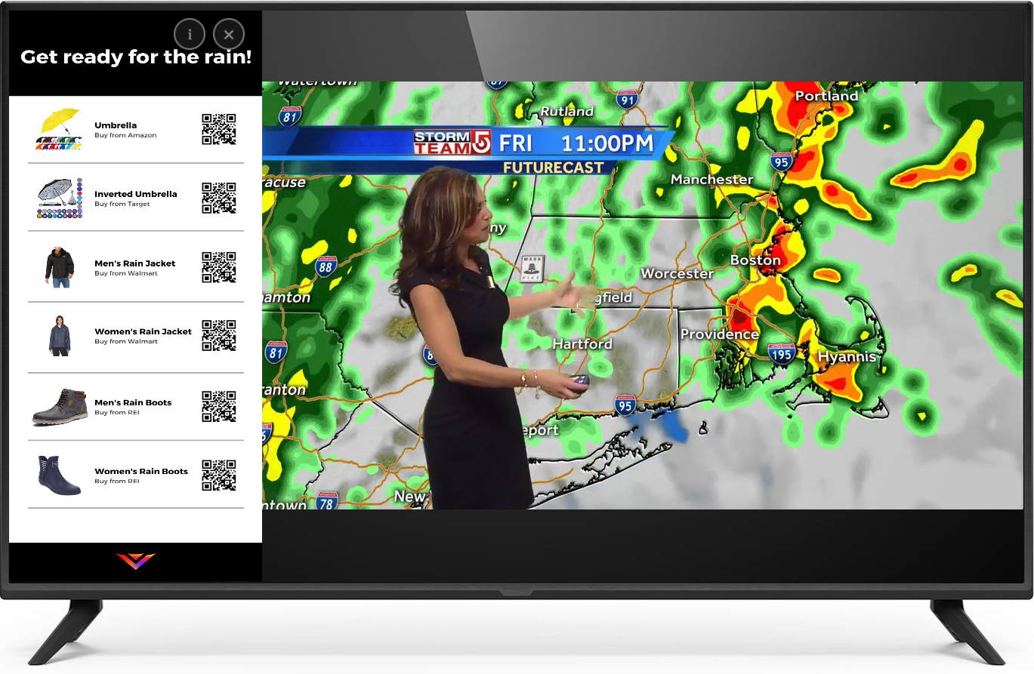
Product Recommendations TV Ad
Made a proof-of-concept TV ad showing recommended products based off what the user is currently watching
Notes:
My next demo is showing the business use case of these product recommendations by showing products suited for the rain as the user is watching their local weather forecast.
→ [Show demo]
Extra Talking Points:
Here, we see a list of recommended products on the left sidebar as the user watches their local weather forecast. This powerful integration of curated products based off the user’s weather provides a meaningful experience since the products are related to what the user is currently watching. The user simply has to scan the QR code next to a particular item to get its product link for the respective store, whether it’s Amazon, Target, Walmart, REI, or another store.

Slide 27
Conclusion
Notes:
Now, I’ll conclude with talking about potential future work.

Slide 28
Key Challenges
Raw Data / Data Cleaning
Raw weather data is limited to just measuring amount of rain and snow
Data Transformation
Rain and snow percentage data is defined by me
Percentage data is biased and arbitrary
API Creation
Only takes in data locally
Product Recommendations
Only recommends Amazon products
Web scraping process is manual
Notes:
So the first challenge I faced was with data cleaning.
The raw weather data is limited to just measuring the amount of rain and snow.
The second challenge I faced was doing data transformation.
→ As I mentioned, the rain and snow percentage data is defined by me.
Because I defined the percentages, that data is biased and arbitrary since I assigned percentages based off a location’s elevation.
The third challenge was with API creation, specifically that the API currently takes in data locally.
The fourth challenge was working on product recommendations.
Currently, the recommender system only works with Amazon products.
Also, the current web scraping process is manual.

Slide 29
Future Work
Add more weather data
Get more weather data to account for whether the data is sunny
Add more ranges to rain and snow percentages (ex: 5 → 10 ranges)
Improve Location Weather API
Have an option for the API to take in location and weather data remotely
Improve recommender system
Automate web scraping process
Include products from other websites (Walmart, Target, REI, etc.)
Notes:
The first goal is to add more weather data.
→ Currently, the raw weather data is limited to just measuring the amount of rain and snow.
So, I would get more weather data to account for whether the location is sunny, for example.
In addition, I would add more ranges to rain and snow percentages. For example, from 5 to 10 ranges.
The second goal is to improve the API by including an option for the API to take in location and weather data remotely.
The third goal is to improve the recommender system by automating the web scraping process and including products from other websites.

Slide 30
Thank you!

