Slide 1
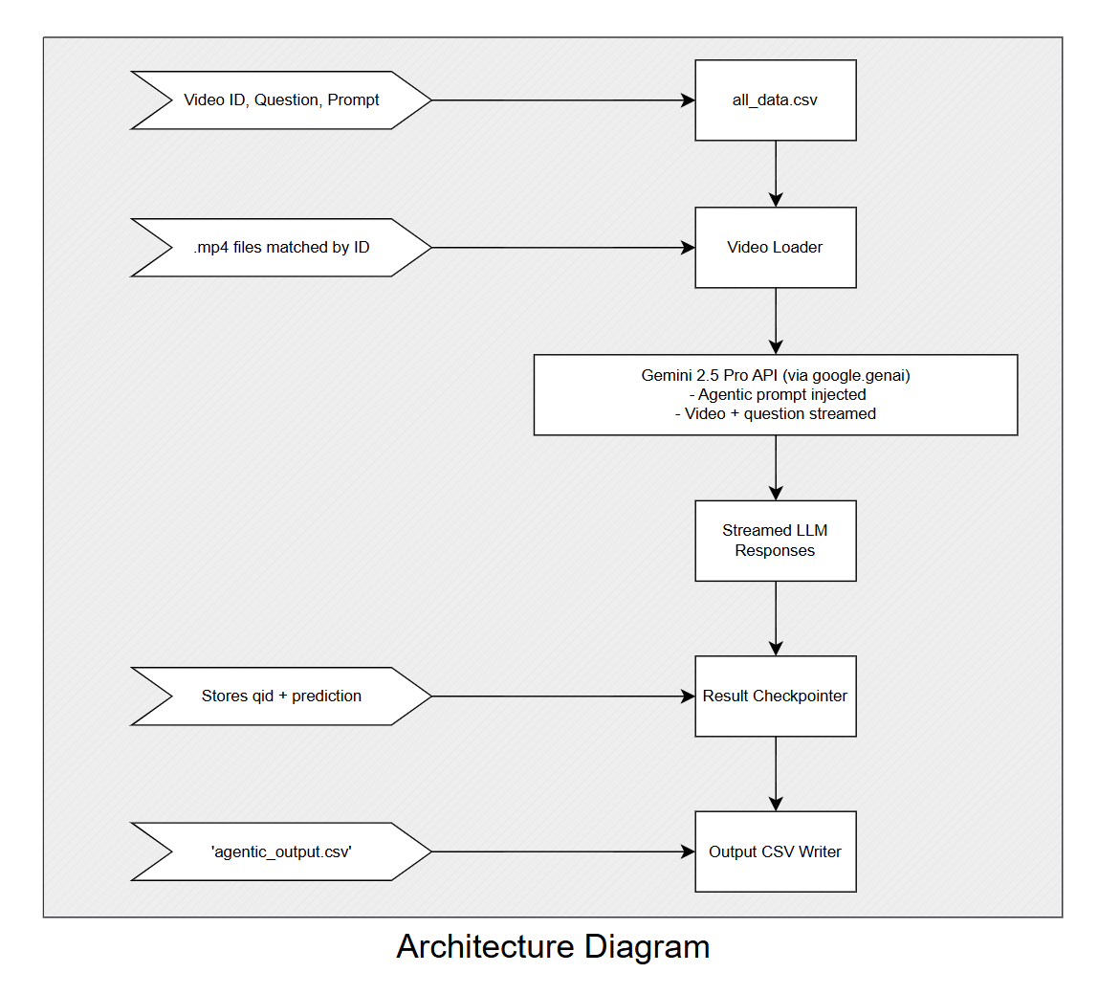
Key Design Features
Agentic Prompting: Custom system prompt breaks reasoning into Observation, Decomposition, Verification, and Final Answer — boosting factual accuracy and interpretability.
Checkpoint System: Already processed QIDs are skipped, ensuring resumability even with intermittent API limits or crashes.
Rate Limit Handling: Detects ‘429’ errors and pauses processing if Gemini quota is exceeded.

