Slide 1
Musical Tapestry:
Re-composing Natural Sounds
Ananya Misra, Perry R. Cook, Ge Wang
Princeton University
Notes:
Motivation, goals, challenges, technical aspects, limitations, contributions, famous last words
Keep reviewer comments in mind, especially re: novelty and existing tools (see given list)
Demo(s)
Analysis, transformation, synthesis (sine, trans, residue, parametric)
Don’t crash

Slide 2
?

Slide 3
Musique concrete
?

Slide 4
Musique concrete
?
Soundscape composition

Slide 5
Musique concrete
?
Soundscape composition
Acousmatic
music

Slide 6
Musique concrete
?
Soundscape composition
Acousmatic
music
Sound design

Slide 7
Musique concrete
?
Soundscape composition
Acousmatic
music
Sound design
Manipulating recorded sounds

Slide 8
Goal
A single framework for transforming recorded sounds on multiple levels
Results lie anywhere on found to unrecognizable continuum
Found
Unrecognizable

Slide 9
Goal
A single framework for transforming recorded sounds on multiple levels
Results lie anywhere on found to unrecognizable continuum
Found
Unrecognizable

Slide 10
Introducing TAPESTREA
Techniques And Paradigms for Expressive Synthesis, Transformation and Rendering of Environmental Audio

Slide 11
Introducing TAPESTREA
An integrated workspace for:
Interactively extracting reusable sound templates
Transforming them independently
Putting them together in different ways
Thus re-composing the sounds

Slide 12
TAPESTREA system

Slide 13
Sinusoidal modeling
TAPESTREA system

Slide 14
Stochastic background modeling
Sinusoidal modeling
TAPESTREA system

Slide 15
Stochastic background modeling
Sinusoidal modeling
TAPESTREA system
Transient detection

Slide 16
Stochastic background modeling
Sinusoidal modeling
TAPESTREA system
Transient detection
New class of
user interface

Slide 17
Stochastic background modeling
Sinusoidal modeling
TAPESTREA system
Transient detection
And more
New class of
user interface

Slide 18
Related Work

Slide 19
Related Work
Spectral modeling synthesis (Serra 1990)

Slide 20
Related Work
Spectral modeling synthesis (Serra 1990)
Auditory scene analysis (Bregman 1990)

Slide 21
Related Work
Spectral modeling synthesis (Serra 1990)
Auditory scene analysis (Bregman 1990)
Granular synthesis (Truax 1990, Roads 2002)

Slide 22
Related Work
Spectral modeling synthesis (Serra 1990)
Auditory scene analysis (Bregman 1990)
Granular synthesis (Truax 1990, Roads 2002)
Transient analysis (Verma & Meng 1998)

Slide 23
Related Work
Spectral modeling synthesis (Serra 1990)
Auditory scene analysis (Bregman 1990)
Granular synthesis (Truax 1990, Roads 2002)
Transient analysis (Verma & Meng 1998)
Wavelet tree learning (Dubnov 2002)

Slide 24
Related Work
Spectral modeling synthesis (Serra 1990)
Auditory scene analysis (Bregman 1990)
Granular synthesis (Truax 1990, Roads 2002)
Transient analysis (Verma & Meng 1998)
Wavelet tree learning (Dubnov 2002)
Miscellaneous sound editors

Slide 25
Related Work
Spectral modeling synthesis (Serra 1990)
Auditory scene analysis (Bregman 1990)
Granular synthesis (Truax 1990, Roads 2002)
Transient analysis (Verma & Meng 1998)
Wavelet tree learning (Dubnov 2002)
Miscellaneous sound editors
Audicle (Wang et al 2004)

Slide 26



Fundamental sound templates
Deterministic
(sinusoidal)
Transient
Stochastic
background

Slide 27
Additional synthesis constructs
Loops
Timelines
Mixed bags
ChucK scripts
Quantizations

Slide 28
Transformations
Frequency warping and time stretching
(massive for deterministic templates)
Density, periodicity, randomness of repetitions
Control over other synthesis parameters

Slide 29
Demo

Slide 30
Some contributions
“Give me this part of that sound”
Specialized modeling techniques for different types of templates => more freedom of transformation
Set of interfaces allowing parametric control over each phase
Ability to weave components of different sounds together into a musical tapestry

Slide 31
Future Work
Enhance user interface
Use templates for sound classification, searching, music information retrieval…
Integrate machine learning on multiple levels

Slide 32
Thanks
Matt Hoffman
Philip Davidson
Seth Cluett
Spencer Salazar
Princeton Graphics Group

Slide 33
TAPESTREA
http://taps.cs.princeton.edu/
video available
Notes:
??????????????????????????????????????!!!!!!!!!!!!!!!!!!!!!!!!!!?????!!!!!!!!!!!!!!!!!?????????????????????????????????????????????????????????????????????????????????????????????????????????????????????!!!!!!!!!!!!!!!!!!!!!!!!!!!!!!!!!!!!!!!!!!!!!!!!!!!!!!!!!!!!!!!!!!!!!!!!!!!!!!!!!!!!!!!!!!!!!!!!!!!!!!!!!!!!!!!!!!
Save me
Who am I?
I don’t know which copy of the presentation I am.

Slide 35
Two Steps
Separate components
Save as templates
Apply transformations
Synthesize templates
Synthesize scenes
Input sound scenes
Analysis
Templates
Synthesis
Output sound scene

Slide 36
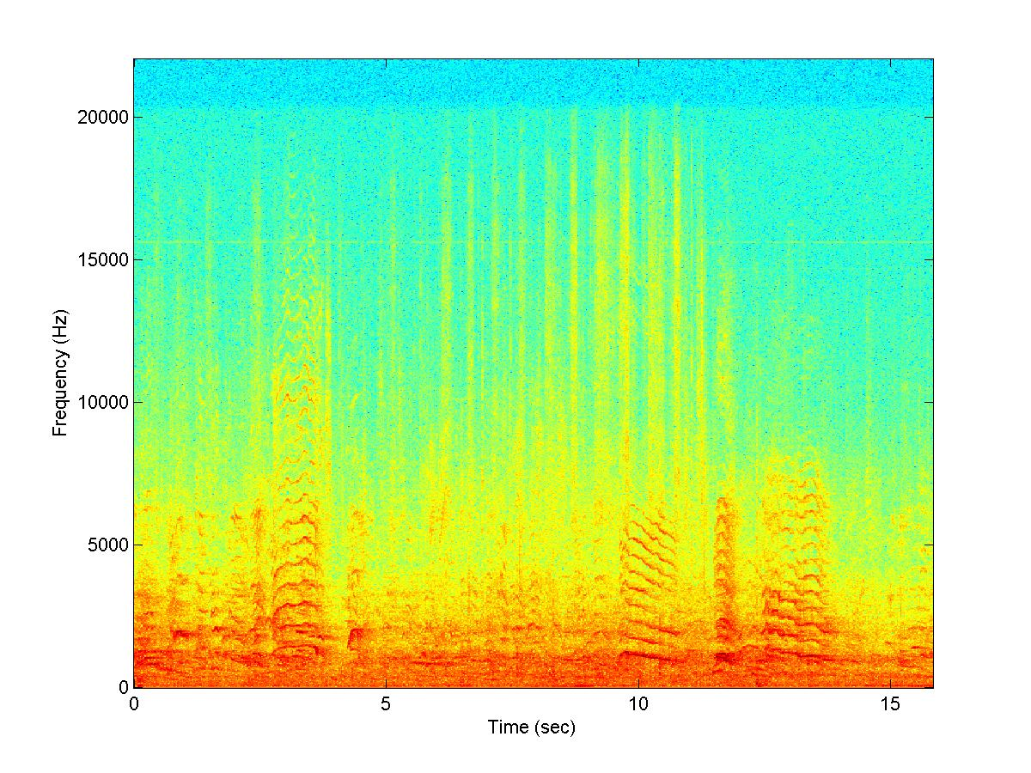
Analysis: Deterministic
Goal: Extract highly sinusoidal components within user-selected regions

Slide 37
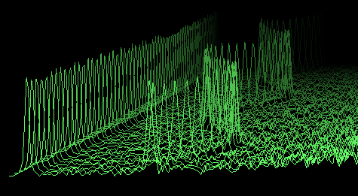
Overview of method
Obtain spectrum for each frame
Locate peaks in spectrum
WATERFALL PLOT
Match peaks across frames to get tracks
Identify some tracks as events
M
a
g
n
I
t
u
d
e
Frequency

Slide 38
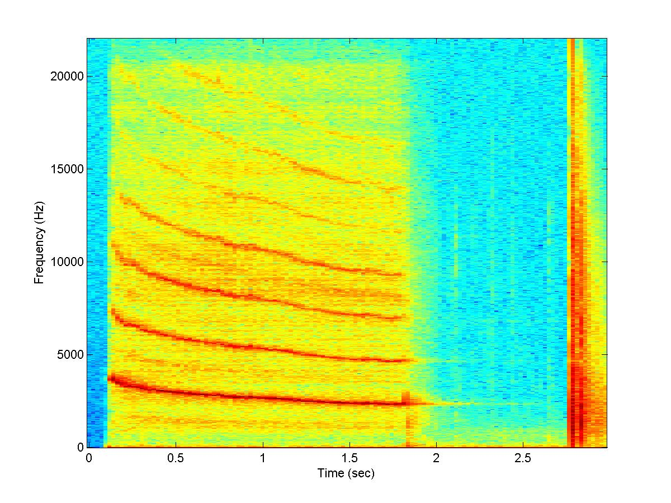
Analysis -- Transient
Goal: Extract brief non-deterministic events

Slide 39
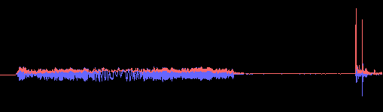
Transient Detection
Envelope-based
  Non-linear one-pole envelope follower filter
  Transient when envelope changes rapidly
A
m
p
l
I
t
u
d
e
Time

Slide 40
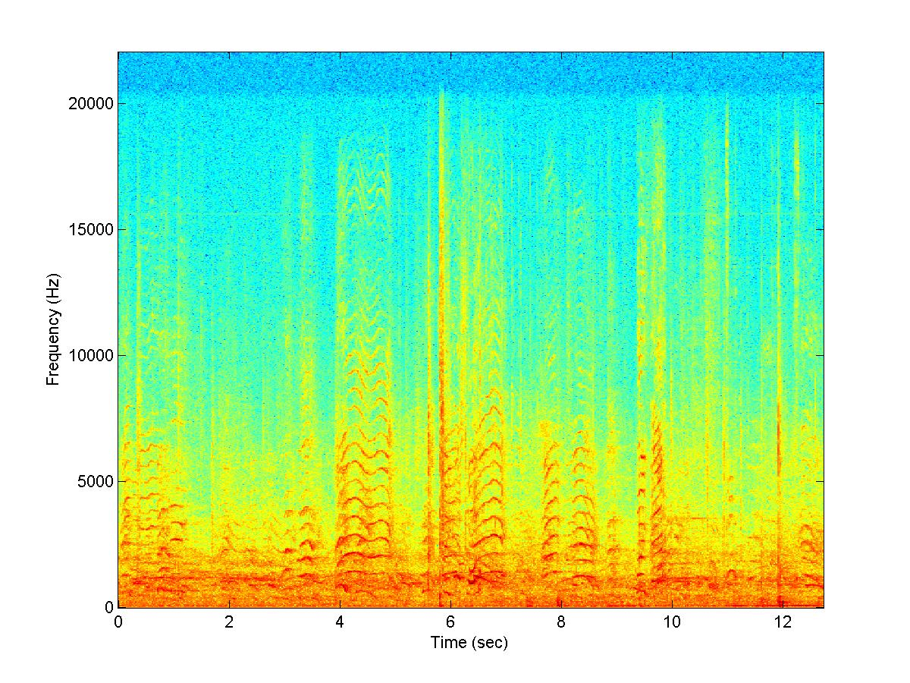
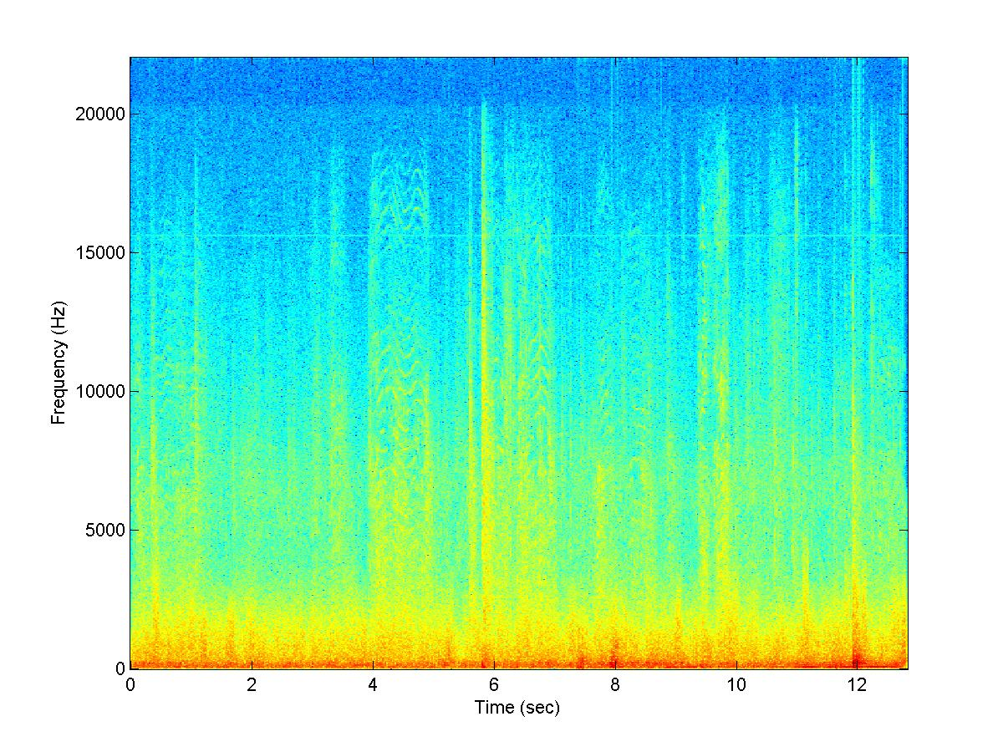
Analysis -- Stochastic
Goal: Separate stochastic background

Slide 41
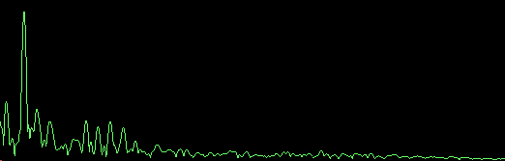
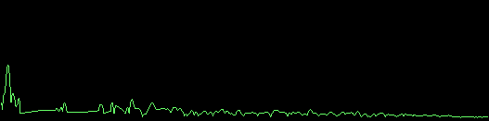
Removing Sinusoidal Events
Frequency-domain
Zero out peaks
Randomize phase
M
a
g
n
I
t
u
d
e
Frequency

Slide 42
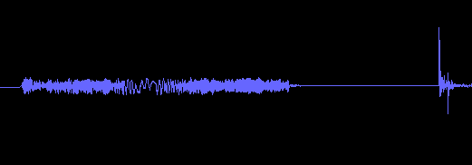

Removing Transient Events
Find nearest free clips
Wavelet tree learning
Replace event
A
m
p
l
I
t
u
d
e
Time

Slide 43
Synthesis
Deterministic: Sinusoidal resynthesis
  Large scale transformations
Transient: Play back sound samples
  Phase vocoder transformations

Slide 44
Synthesis -- Background
Wavelet tree learning (Dubnov)
  Decompose into wavelet coefficients
  Learn new coefficients
  Synthesize new sound
Modifications:
  Restrict learning to fewer levels
  Continuously re-learn and synthesize
  Control parameters during synthesis

Slide 45

Synthesis -- ChucK Scripts
ChucK: audio programming language (Wang & Cook, 2003)
  Time-centric
  Concurrent
  On-the-fly
Gives API for real-time control of TAPESTREA
Freely available, open-source, cross-platform

Slide 46
Watch out!
Live
Demo

Slide 47
Limitations
Hard to separate some foreground sounds
  Events overlapping in time and frequency
Hard to unite some components
  Events with deterministic and transient parts

Slide 48
Future Work
User interface
Learning
Classification

Slide 49
Acknowledgements
Matt Hoffman
Benedict Brown
Keith Morley
Phil Shilane
Szymon Rusinkiewicz
Adam Finkelstein
Tom Funkhouser
and the rest of the Princeton Graphics Group

Slide 50
TAPESTREA
http://taps.cs.princeton.edu/
Notes:
??????????????????????????????????????!!!!!!!!!!!!!!!!!!!!!!!!!!?????!!!!!!!!!!!!!!!!!?????????????????????????????????????????????????????????????????????????????????????????????????????????????????????!!!!!!!!!!!!!!!!!!!!!!!!!!!!!!!!!!!!!!!!!!!!!!!!!!!!!!!!!!!!!!!!!!!!!!!!!!!!!!!!!!!!!!!!!!!!!!!!!!!!!!!!!!!!!!!!!!
Save me
Who am I?
I don’t know which copy of the presentation I am.

Slide 51
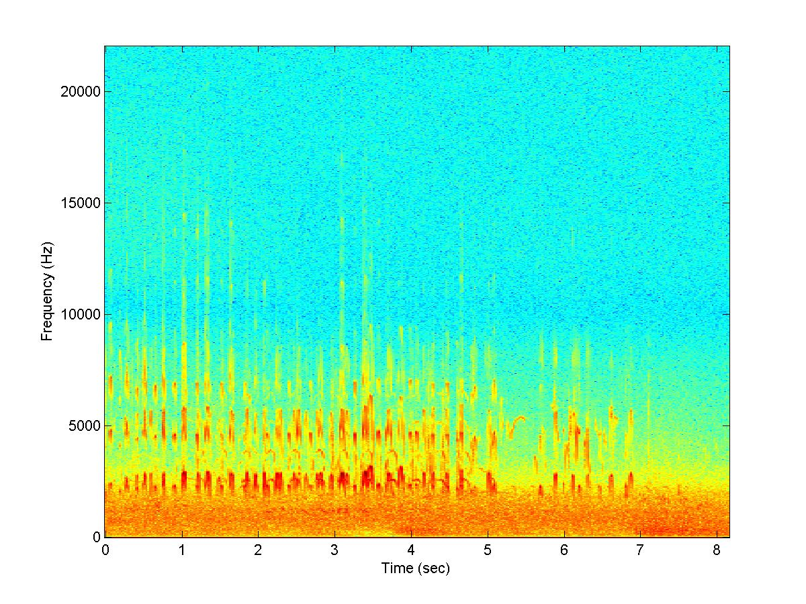

Sound Scene
In general :
Background
Foreground
Environment
Notes:
From sketch: “A sound scene is a combination of background and foreground sounds that together evoke the sense of being in a specific environment.”
This one, favorite example, birds on beach (maybe play a clip)

Slide 52
Why?
Many pre-recorded sounds : use them!
Where?
Entertainment
Virtual / Augmented Reality
Art Projects
Multimedia
Notes:
Advantage of using pre-recorded sounds –
they may have interesting components, if you hear something you like you can just extract it instead of searching for it in a sound effects library

Slide 53
Challenges
Pre-recorded sounds are “tainted”:
Desired + undesired parts
In same time interval
Hard to mix / transform
Limited control
Notes:
Challenges when using pre-recorded sounds

Slide 54
Synthesis -- Transient
Transient events are brief
Save entire sound clip
Play back sound clip
Transformations:
  Gain, pan
  Time-stretch, frequency-warp possible

Slide 55
Related Work: ideas
Transient analysis (Verma and Meng,1998)
  Analyzing signals for brief energy bursts
Auditory scene analysis (Bregman, 1990)
  Separating sound into perceptual components
  Our work: not automated

Slide 56
TAPESTREA
New sound design paradigm and framework
Analysis, transformation, synthesis
Users can:
  Interactively select and extract sound templates
  Transform them independently
  Controllably recombine them
Freely available, open-source, cross-platform
Notes:
Real-time

Slide 57
Contributions
Extract templates from points of interest
Transform components independently
Continuously synthesize background using wavelet tree learning
Fill holes left by transients using wavelet tree
Control placement of events over background, varying key parameters

Slide 58

Synthesis – Other Structures
Loop
  Parametric control over repeating events
Timeline
  Control over absolute timing of template synthesis

Slide 59
Related Work

Slide 60
Related Work
Spectral modeling synthesis (Serra, 1990)

Slide 61
Related Work
Spectral modeling synthesis (Serra, 1990)
Sound texture synthesis
  Linear predictive coding (Athineos & Ellis, 2003)
  Wavelet tree learning (Dubnov, 2002)

Slide 62
Related Work
Spectral modeling synthesis (Serra, 1990)
Sound texture synthesis
  Linear predictive coding (Athineos & Ellis, 2003)
  Wavelet tree learning (Dubnov, 2002)
Model-based synthesis (Cook, 2002)

Slide 63
Related Work
Spectral modeling synthesis (Serra, 1990)
Sound texture synthesis
  Linear predictive coding (Athineos & Ellis, 2003)
  Wavelet tree learning (Dubnov, 2002)
Model-based synthesis (Cook, 2002)
Transient analysis (Verma & Meng, 1998)

Slide 64
Related Work: existing tools
Sound editors
  Home or commercial production
  MIDI, plug-ins, audio effects
But none for this task
Notes:
Current tools for commercial or home audio production include a range of sound editors. Free or inexpensive commercially available
software such as Audacity and GoldWave perform simple audio production tasks. Midline audio editing systems, including
Peak, Logic, and Cubase, are geared towards music production and often offer real-time MIDI sequencing capability. At the high
end are digital audio production hardware/software systems such as Pro Tools, geared towards commercial sound production. Most
of these products support Virtual Studio Technology (VST) plugins that perform synthesis algorithms and apply effects such as reverb.
However, none of them provides one real-time, extensible, integrated analysis-transformation-synthesis workspace similar to TAPESTREA.

