Slide 1
TAPESTREA:
Sound Scene Modeling by Example
Ananya Misra, Perry R. Cook, Ge Wang
Princeton University
Notes:
Motivation, goals, challenges, technical aspects, limitations, contributions, famous last words
Keep reviewer comments in mind, especially re: novelty and existing tools (see given list)
Demo(s)
Analysis, transformation, synthesis (sine, trans, residue, parametric)
Don’t crash

Slide 2
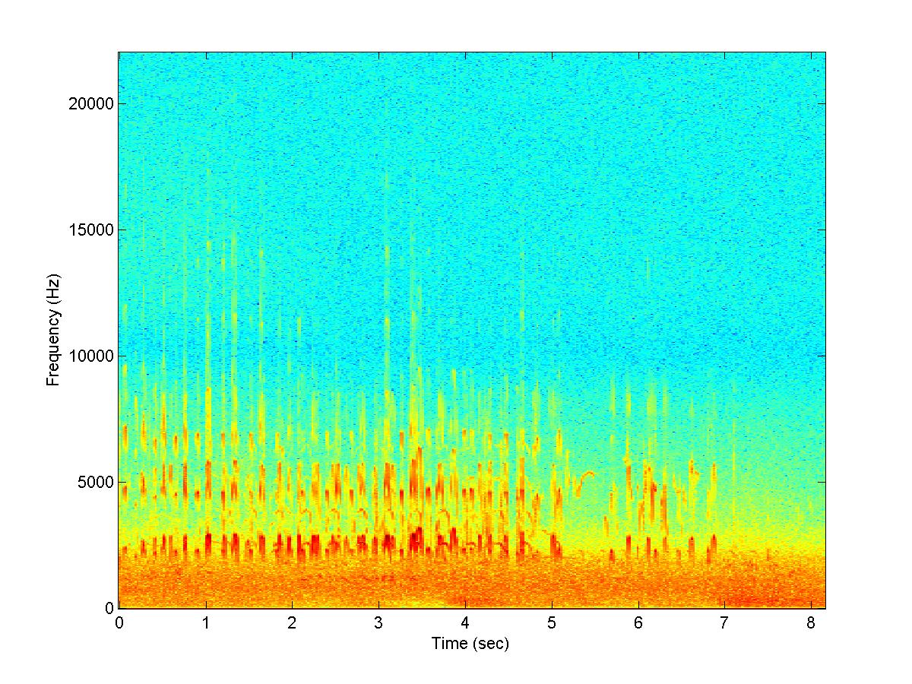

Sound Scene
In general :
Background
Foreground
Environment
Notes:
From sketch: “A sound scene is a combination of background and foreground sounds that together evoke the sense of being in a specific environment.”
This one, favorite example, birds on beach (maybe play a clip)

Slide 3
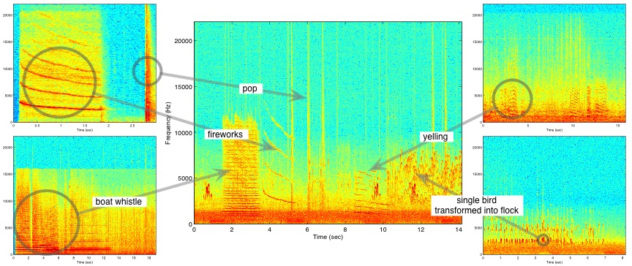
Modeling by Example
Notes:
Building a sound scene by stealing (extracting, reusing) components from existing scenes
Explain figure
Could play resulting scene, but it was made mostly for visual effect

Slide 4
Why?
Many pre-recorded sounds : use them!
Where?
Entertainment
Virtual / Augmented Reality
Art Projects
Multimedia
Notes:
Advantage of using pre-recorded sounds –
they may have interesting components, if you hear something you like you can just extract it instead of searching for it in a sound effects library

Slide 5
Challenges
Pre-recorded sounds are “tainted”:
Desired + undesired parts
In same time interval
Hard to mix / transform
Limited control
Notes:
Challenges when using pre-recorded sounds

Slide 6
TAPESTREA
New sound design paradigm and framework
Analysis, transformation, synthesis
Users can:
  Interactively select and extract sound templates
  Transform them independently
  Controllably recombine them
Freely available, open-source, cross-platform
Notes:
Real-time

Slide 7
Related Work: techniques used
Spectral modeling synthesis (Serra, 1990)
  Sinusoids + noise separation
  For instruments and speech
Wavelet tree learning (Dubnov, 2002)
  Wavelet tree analysis, learning and re-synthesis
  For sound texture synthesis

Slide 8
Related Work: ideas
Transient analysis (Verma and Meng, 1998)
  Analyzing signals for brief energy bursts
Auditory scene analysis (Bregman, 1990)
  Separating sound into perceptual components
  Our work: not automated

Slide 9
Related Work: existing tools
Sound editors
  Home or commercial production
  MIDI, plug-ins, audio effects
But none for this task
Notes:
Current tools for commercial or home audio production include a range of sound editors. Free or inexpensive commercially available
software such as Audacity and GoldWave perform simple audio production tasks. Midline audio editing systems, including
Peak, Logic, and Cubase, are geared towards music production and often offer real-time MIDI sequencing capability. At the high
end are digital audio production hardware/software systems such as Pro Tools, geared towards commercial sound production. Most
of these products support Virtual Studio Technology (VST) plugins that perform synthesis algorithms and apply effects such as reverb.
However, none of them provides one real-time, extensible, integrated analysis-transformation-synthesis workspace similar to TAPESTREA.

Slide 10
Movie
Fasten
your
seat
belts.

Slide 11
Recap
Modeling sound scenes by example
Separate scene into:
  Deterministic
  Stochastic
  Transient
Use templates to build new sound scenes

Slide 12



Two Steps
Separate components
Save as templates
Apply transformations
Synthesize templates
Synthesize scenes
Input sound scenes
Analysis
Templates
Synthesis
Output sound scene

Slide 13
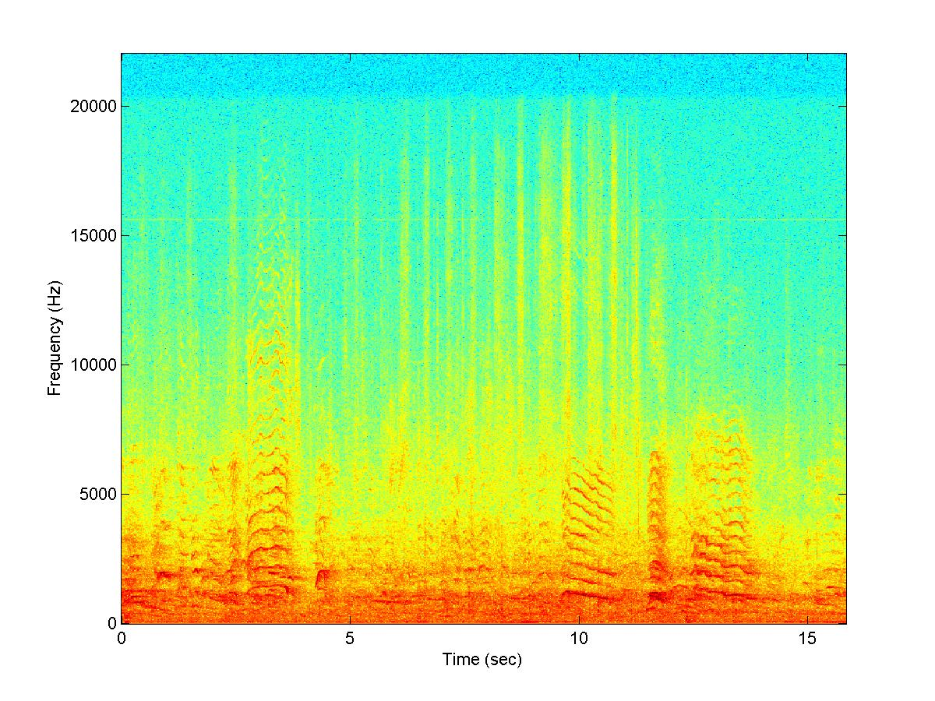
Analysis: Deterministic
Goal: Extract highly sinusoidal components within user-selected regions

Slide 14
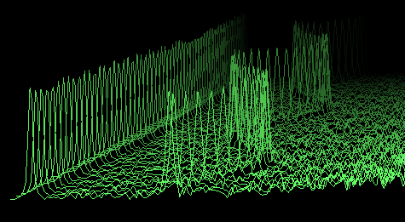
Overview of method
Obtain spectrum for each frame
Locate peaks in spectrum
WATERFALL PLOT
Match peaks across frames to get tracks
Identify some tracks as events
M
a
g
n
I
t
u
d
e
Frequency

Slide 15
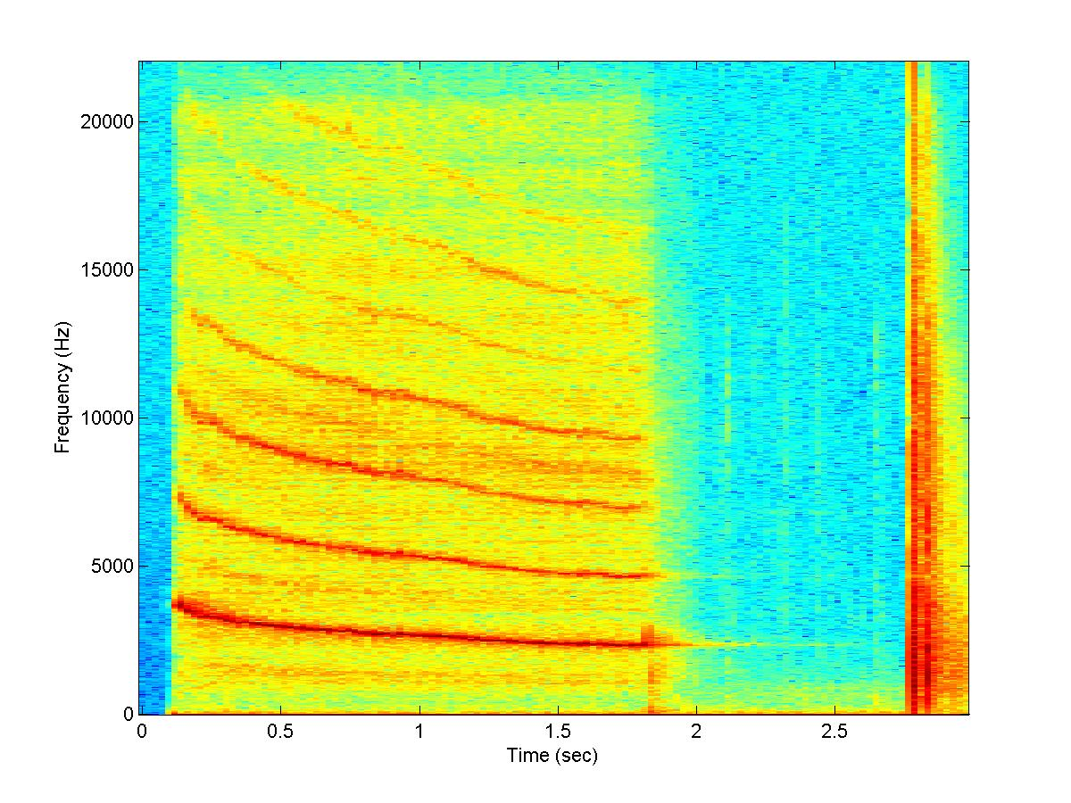
Analysis -- Transient
Goal: Extract brief non-deterministic events

Slide 16
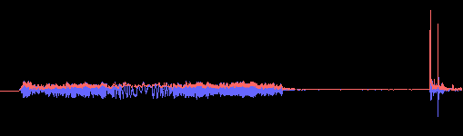
Transient Detection
Envelope-based
  Non-linear one-pole envelope follower filter
  Transient when envelope changes rapidly
A
m
p
l
I
t
u
d
e
Time

Slide 17
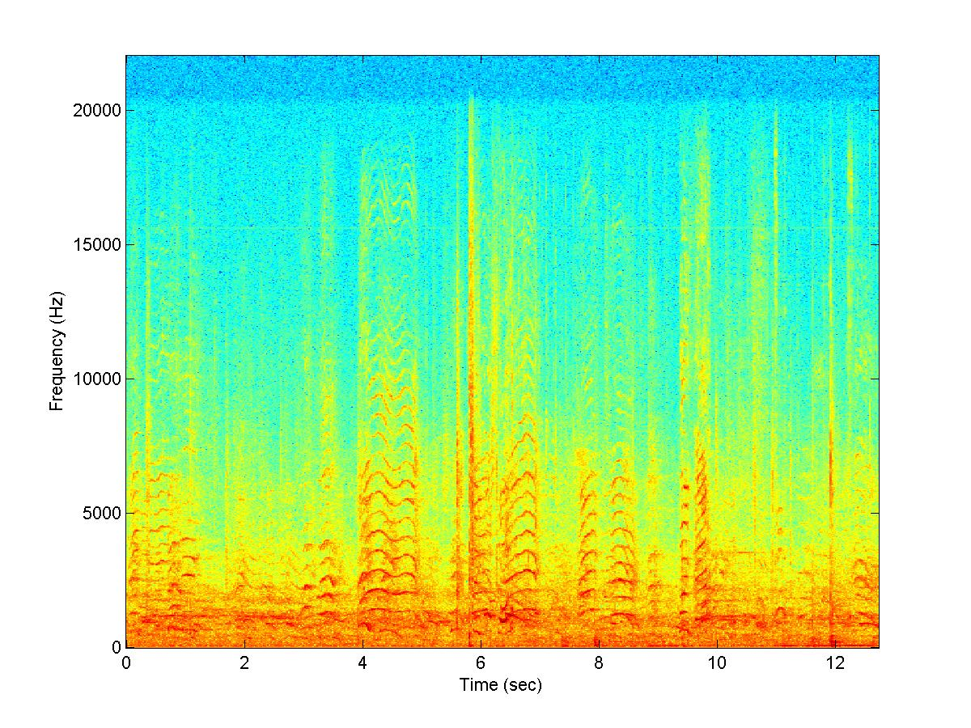
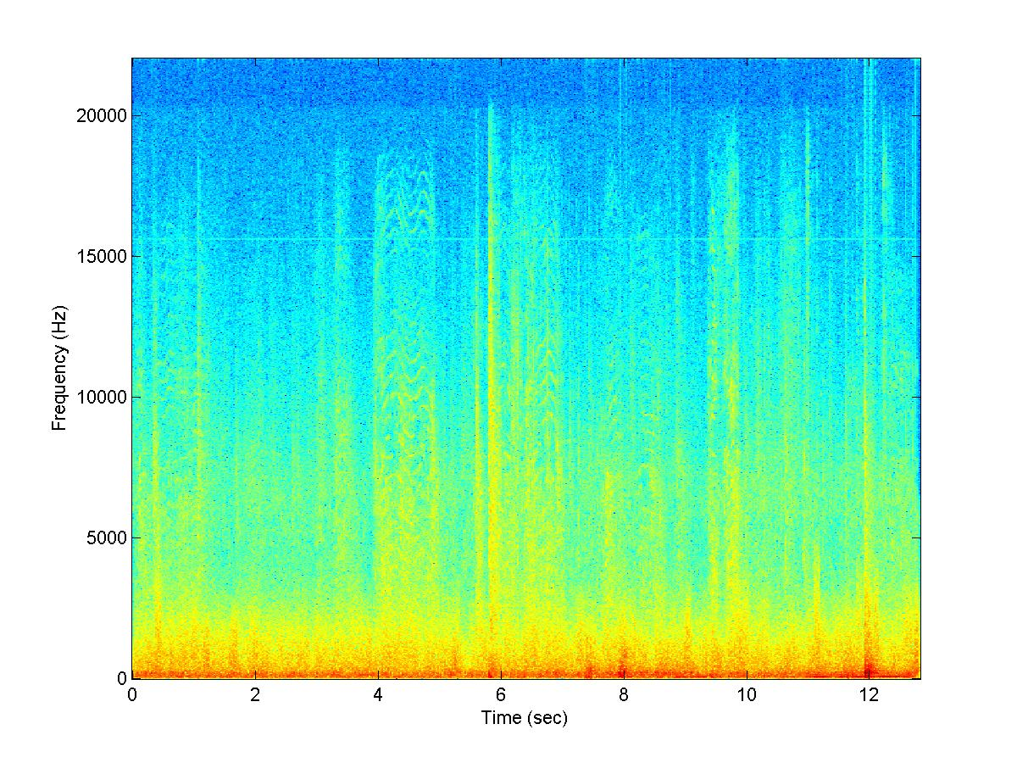
Analysis -- Stochastic
Goal: Separate stochastic background

Slide 18
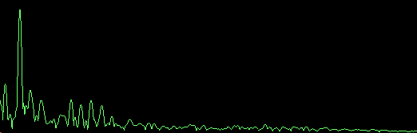
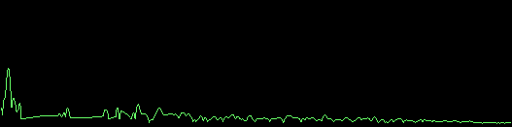
Removing Sinusoidal Events
Frequency-domain
Zero out peaks
Randomize phase
M
a
g
n
I
t
u
d
e
Frequency

Slide 19
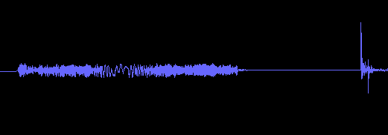

Removing Transient Events
Find nearest free clips
Wavelet tree learning
Replace event
A
m
p
l
I
t
u
d
e
Time

Slide 20
Synthesis -- Deterministic
Sinusoidal resynthesis
Transformations:
  Frequency-warp
  Time-stretch
  Pan, gain

Slide 21
Synthesis -- Transient
Transient events are brief
Save entire sound clip
Play back sound clip
Transformations:
  Gain, pan
  Time-stretch, frequency-warp possible

Slide 22
Synthesis -- Background
Wavelet tree learning (Dubnov)
  Decompose into wavelet coefficients
  Learn new coefficients
  Synthesize new sound
Modifications:
  Restrict learning to fewer levels
  Continuously re-learn and synthesize
  Control parameters during synthesis

Slide 23

Synthesis --
Loops & Timelines
Loop
  Parametric control over repeating events
Timeline
  Control over absolute timing of template synthesis

Slide 24

Synthesis -- ChucK Scripts
ChucK: audio programming language
  Time-centric
  Concurrent
  On-the-fly
Provides API for real-time control of TAPESTREA
Also freely available, open-source, cross-platform

Slide 25
Demo!
Live
Demo

Slide 26
Contributions
Extract templates from points of interest
Transform components independently
Continuously synthesize background using wavelet tree learning
Fill holes left by transients using wavelet tree
Control placement of events over background, varying key parameters

Slide 27
Limitations
Hard to separate some foreground sounds
  Events overlapping in time and frequency
Hard to unite some components
  Events with deterministic and transient parts

Slide 28
Future Work
User interface
Learning
Classification

Slide 29
Acknowledgements
Matt Hoffman
Benedict Brown
Keith Morley
Phil Shilane
Szymon Rusinkiewicz
Adam Finkelstein
Tom Funkhouser
and the rest of the Princeton Graphics Group

Slide 30
TAPESTREA
http://taps.cs.princeton.edu/
Notes:
??????????????????????????????????????!!!!!!!!!!!!!!!!!!!!!!!!!!?????!!!!!!!!!!!!!!!!!?????????????????????????????????????????????????????????????????????????????????????????????????????????????????????!!!!!!!!!!!!!!!!!!!!!!!!!!!!!!!!!!!!!!!!!!!!!!!!!!!!!!!!!!!!!!!!!!!!!!!!!!!!!!!!!!!!!!!!!!!!!!!!!!!!!!!!!!!!!!!!!!
Save me
Who am I?
I don’t know which copy of the presentation I am.

Slide 31
Strengths
Deals with “impure” recordings
Real-time, extensible, parametric
Analysis + transformation + synthesis workspace
New approach, system, interface

