Slide 1
Drone flight controller
Aleksi Olkkonen
I-TT-5N2

Slide 2
Project scope
Implement a flight controller on Arduino systems
  Communication between joystick and flight controller
  Sensor data to calculate drone orientation
  Control motor speed based on joystick input and calculated orientation
  Build a circuit board to connect sensors, PWM module and power distribution to Adafruit Feather 32u4
  Find out if LoRa is suitable technology for commanding a drone

Slide 3
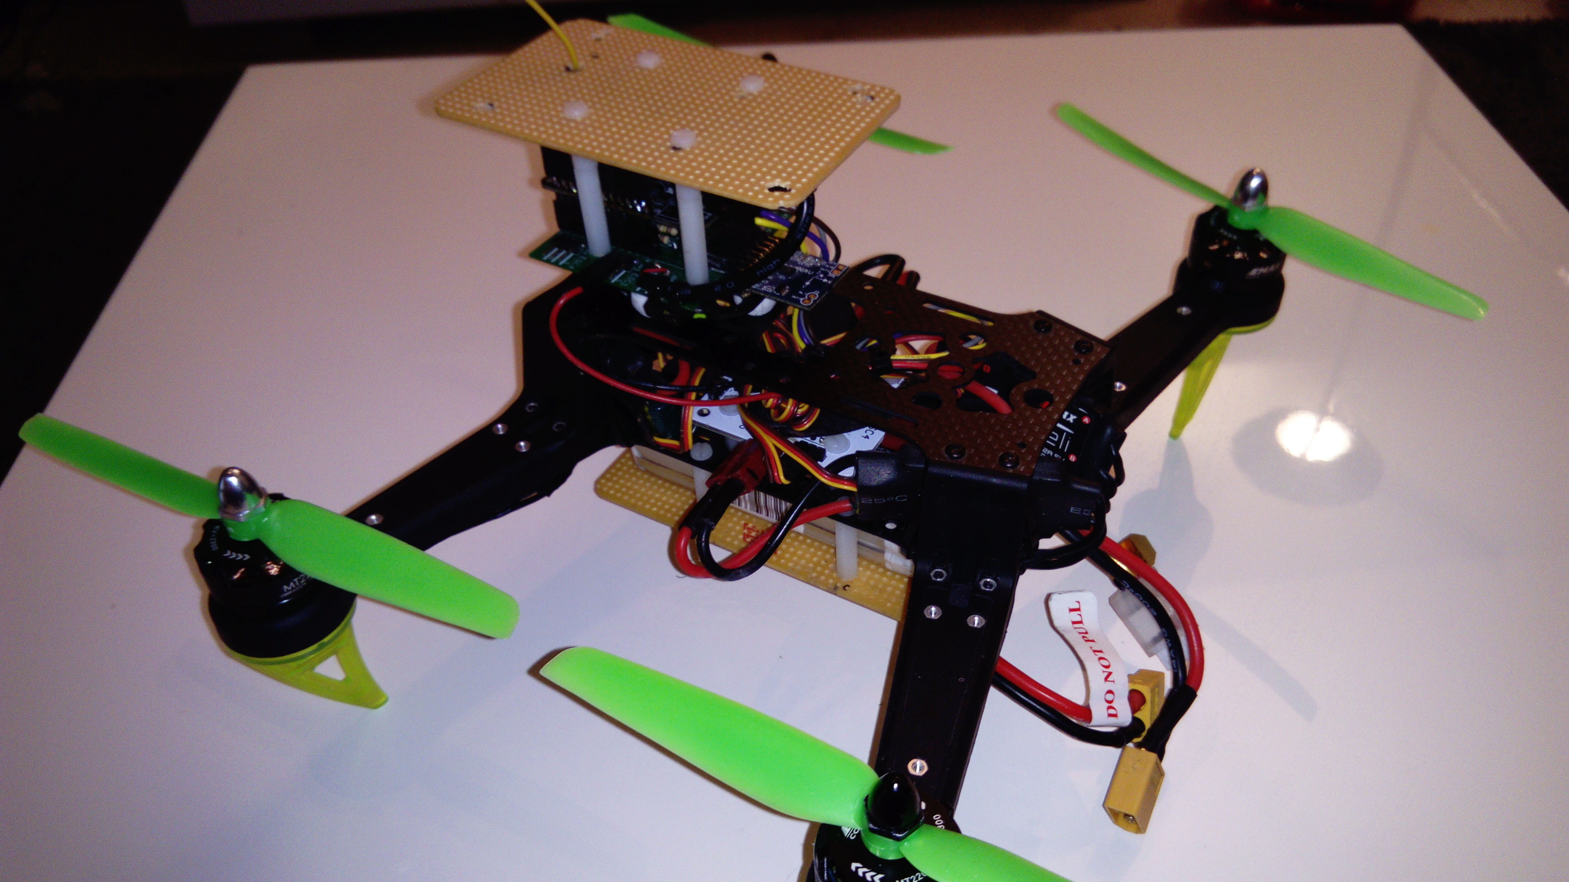

Slide 4
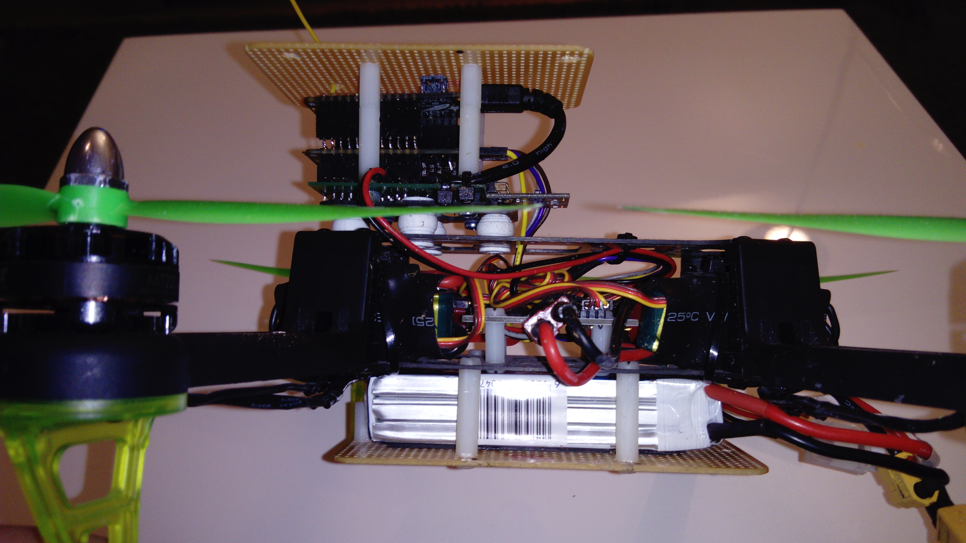

Slide 5
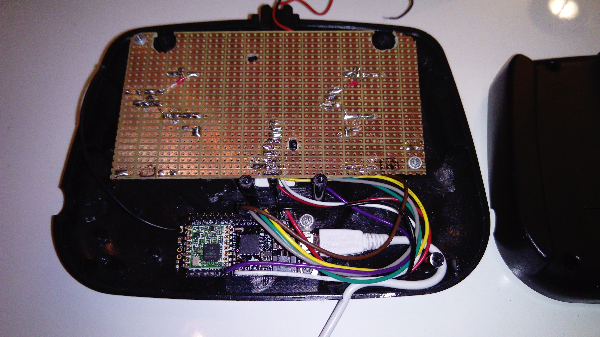

Slide 6
Hardware
Motors | 2x CCW and 2x CW EMAX MT2204
Electronic speed controllers | 4x Emax 20A ESC with BEC
Propellers | 4x 6"4 propellers
Battery | Gens ace 2200 mAh 3 cell, 11.1v, 25C LiPo battery
Charger | GTPower B3 2-3s LiPO charger
Microcontrollers | 2x Adafruit feather 32u4 with integrated LoRa module 1x Adafruit 8-Channel PWM module
Gyroscope/Accelerometer/ Magnetometer | PmodNAV 9-axis IMU
Frame | Spedix S250Q FPV racing drone frame kit
Circuit board | Custom made circuit board for microcontroller, sensors and PWM module
Controller | A modified RC car controller case
Controller joystick | 2x PS2 joystick, 3-axis potentiometers

Slide 7
Flight controller
Controls motor speed according to user input and sensor measurements
Can implement different flight modes
  Manual and assisted
  GPS navigation
  Controlling altitude
  Safe landing

Slide 8
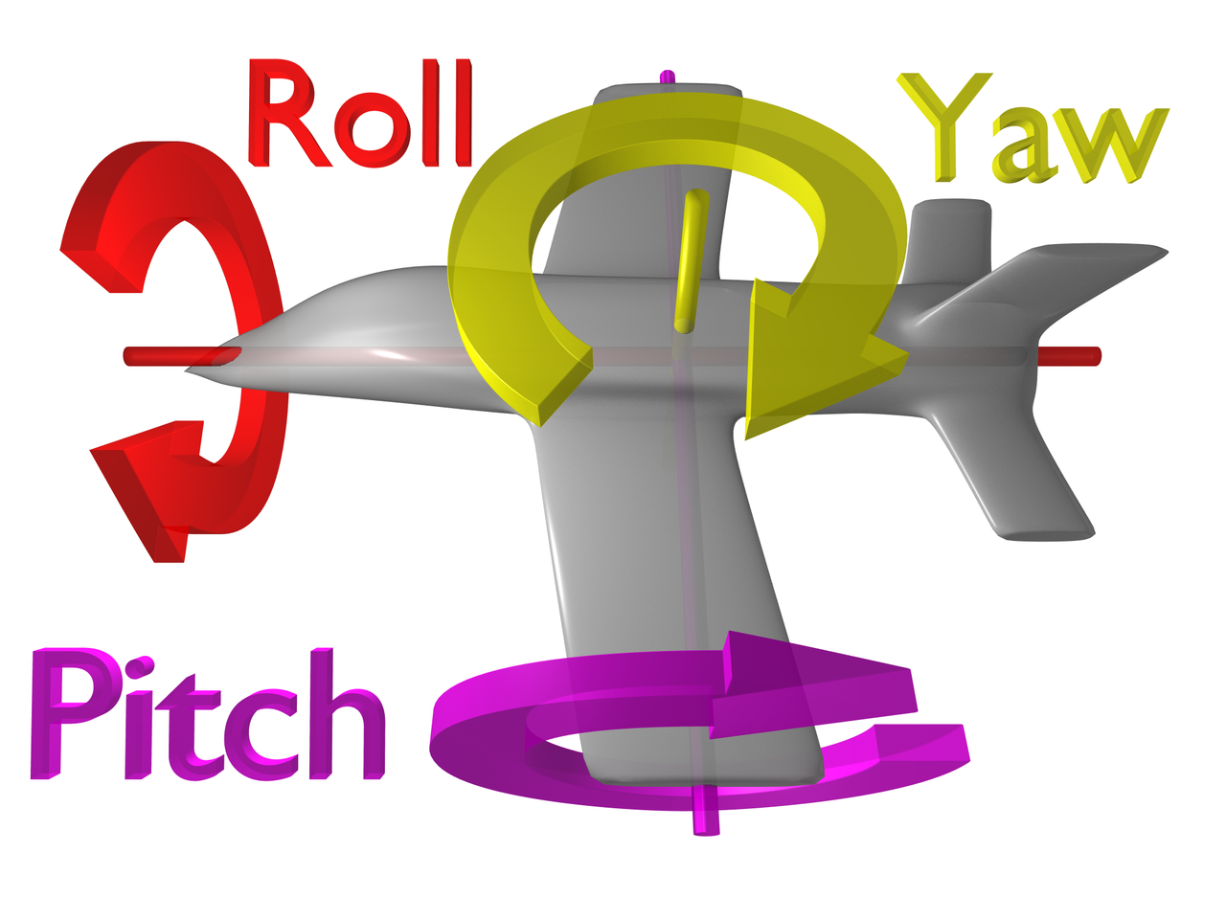
Flight modes
Self-level mode
  User controls orientation of the drone
  Drone levels by default to 0 pitch, roll and yaw
Acro mode
  User controls angular
  velocity of the drone
https://en.wikipedia.org/wiki/Aircraft_principal_axes

Slide 9
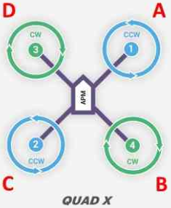
Drone maneuvers
Throttle: All motors spin at equal speed
Pitch: motors A and D spin different speed than motors C and B
Roll: motors A and B spin different speed than motors D and C
Yaw: CW and CCW motors
spin at different speed
http://ardupilot.org/copter/docs/connect-escs-and-motors.html

Slide 10
Flight controller loop
Executes following tasks:
  Reads input received from joystick and sets drone target orientation
  Reads accelerometer, gyroscope and magnetometer measurements
  Estimates drone orientation using complementary filter
  PID controller calculates control pitch, roll and yaw
  Calculates motor speed and writes it to ESC using PWM

Slide 11
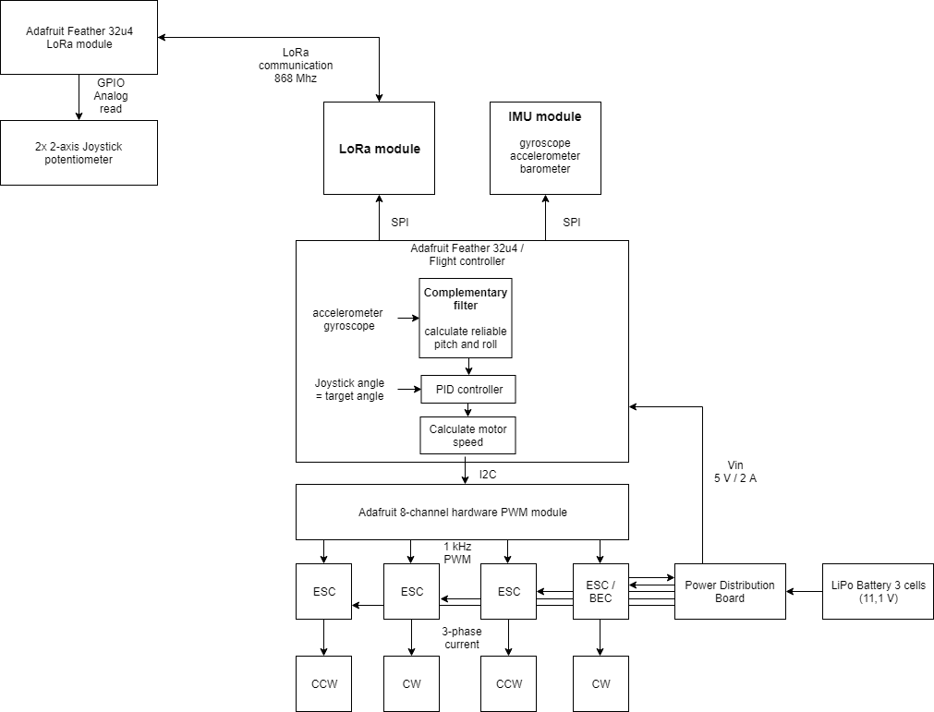

Slide 12
Sensors
Accelerometer provides linear acceleration on 3 axes in g (g = 9.81 m/s2)
  Due to earth's gravitation accelerometer measures 1 g when it is not moving
  If sensors orientation is neutral, 1 g is measured on Z-axis. Once it rotates acceleration can be measured on other axes also
  Accelerometer is easily affected by noise, such as drone's motors causing the frame shake

Slide 13
Sensors
Gyroscope provides angular velocity on 3 axes in degrees per second
  By integrating angular velocity, offset from the original orientation can be calculated
  Gyroscope is not prone to noise but the calculated orientation will start to drift because integration leads to minor inaccuracies

Slide 14
Complementary filter
It is used to calculate a quite accurate estimation of the drone's orientation
Faster and simpler than Kalman filter
Eliminates noise in accelerometer and drift in gyroscope
ACCL_RATIO = 0.02
angle = (1 - ACCL_RATIO) * (angle + dps + dt) + ACCL_RATIO * accel

Slide 15
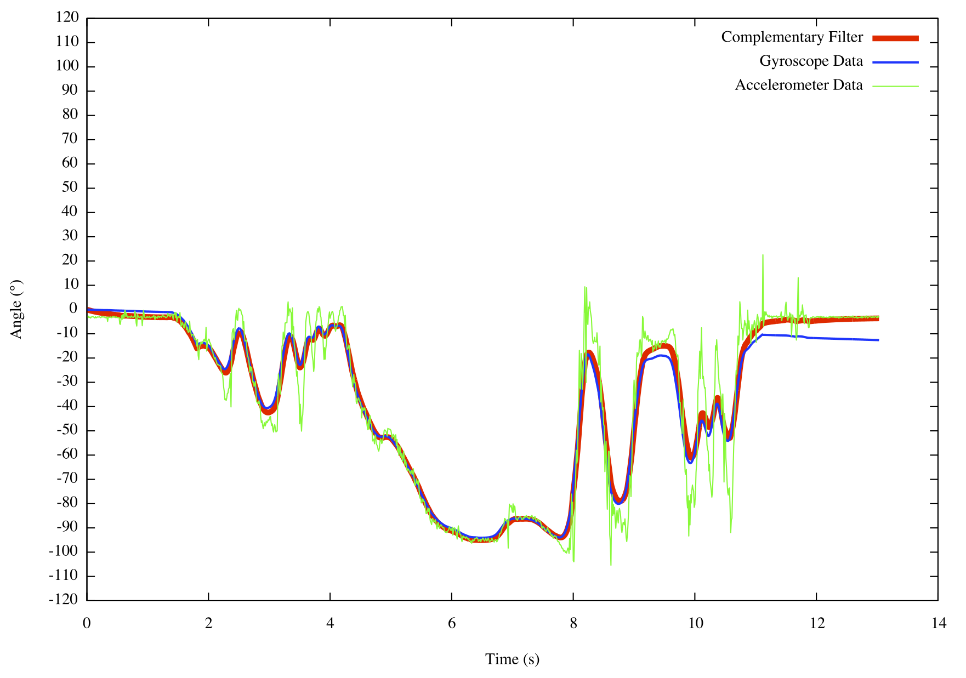
Complementary filter
http://www.pieter-jan.com/node/11

Slide 16
PID controller
Takes user's target orientation and complementary filters output as input
Uses porpotional, integral and derivative terms to calculate control orientation
Stabilizes the drone

Slide 17
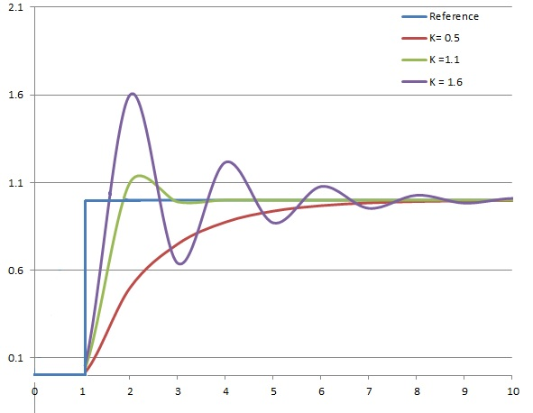

PID controller
Porpotional term controls error margin
Integral term controls cumulative error
Derivative term estimates trend of error margin and dampens it
https://upload.wikimedia.org/wikipedia/commons/thumb/a/a3/PID_varyingP.jpg/320px-PID_varyingP.jpg

Slide 18
Motor speed calculation
Takes PID controller's output as input, that is the control orientation
Motor speed = throttle + mdir*pitch + mdir*yaw + mdir*roll
http://ardupilot.org/copter/docs/connect-escs-and-motors.html

Slide 19
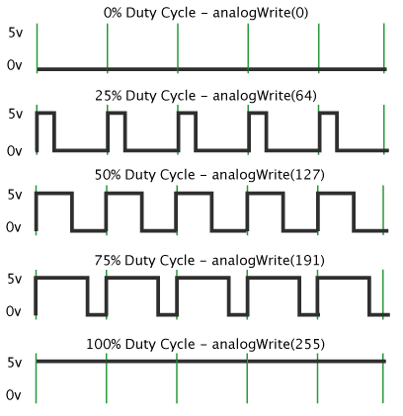
PWM
Adafruit 8 channel servo PWM module
ESCs can be controlled with
  50...500 Hz (T = 20...2 ms), 1-2 ms control signal
  >1 kHz PWM signal, 0-100% duty cycle
https://www.arduino.cc/en/Tutorial/PWM

Slide 20
Joystick
DIY joystick built in an old RC car controller case
PS2 3-axis potentiometers
Sends a LoRa packet containing joystick state (throttle, yaw, pitch, roll, press buttons 1 and 2)
Flight inactive: user can configure PID terms as well as joystick and gyroscope sensitivity
Flight activated by setting throttle to 0 and inactivated by pressing right joystick

Slide 21
Communication
LoRa provides packet validation for the frame
Payload sent by joystick needs to be validated by flight controller: XOR and CRC
Invalid packets are ignored but affect performance

Slide 22
LoRa
Long range, low power radio communication
Data transmission is packet based, traditional drone controllers use analog signals & multiple channels
Provides network architecture, but this project uses only raw protocol
10 packets per second is feasible for a drone that has assisted flight mode
Allows controlling multiple drones that are self sustaining: use GPS to navigate to destination

Slide 23
Drone flying and Finnish law
Not age restricted
Constant line of sight
Flying in first person view requires a spotter
Max 150 m altitude
Not close to airport
Evade manned flying vehicles
Do not fly on private property without permission

Slide 24
Current state of the project
Improvements
  Faster flight controller loop (~1 kHz)
    Use Adafruit's own PWM generators
  Yaw calculation based on magnetometer measurements
  PID controller tuning
https://drive.google.com/open?id=1FBo6AJJuPCN5kl9Vw5QY1CYxNjSyFrZ2

Slide 25
Thank you!

