Slide 1

SIDDARTHA INSTITUTE OF SCIENCE AND TECHNOLOGY (AUTONOMOUS)
Department of Computer Science and Engineering
(ARTIFICIAL INTELLIGENCE AND DATA SCIENCE
UPI FRAUD DETECTION USING MACHINE LEARNING
Presented by
MAJJIGA GOWTHAM 224E1A4718
T V CHANDANA 224E1A4787
A VISHNU VARDHAN 224E1A4788
K HARI PRASAD 224E1A4720
O LIKHITH KUMAR 224E1A4739
Under the guidance of
Ms. A. Surekha, M. Tech.
Assistant Professor, Dept. of CSE

Slide 2
ABSTRACT
UPI (Unified Payment Interface) has rapidly grown as a digital payment system, but this expansion has led to rising financial fraud. Traditional rule-based detection methods fail to adapt to evolving attack strategies.
This work introduces a machine learning–based framework for real-time UPI fraud detection. The system analyzes transaction attributes such as amount, sender/receiver VPA, and device ID to identify suspicious activity. A Streamlit-powered interface enables two modes: single transaction verification and batch analysis through CSV uploads.
The framework generates dashboards highlighting fraudulent transaction counts, potential monetary loss, and high-risk users or devices. By leveraging classification models and predictive analytics, the approach improves accuracy and scalability compared to conventional methods.
The proposed solution enhances financial security by providing a reliable, interactive tool for detecting and mitigating UPI fraud in real time.

Slide 3
INTRODUCTION
Begins with the design of a secure architecture that integrates machine learning models for UPI fraud detection. The framework employs classification algorithms to derive fraud indicators from transaction features such as amount, sender/receiver VPA, and device ID.
A Stream lit interface supports single transaction checks and batch CSV uploads, enabling scalable analysis. Dashboards summarize fraudulent counts, potential monetary loss, and risky users or devices.
Anomaly detection ensures transaction legitimacy without exposing sensitive data, while integrity protections maintain reliability of stored results. Comparative evaluation with rule-based systems demonstrates improved adaptability, accuracy, and efficiency.
The proposed framework strengthens financial security by providing a practical, real-time solution for detecting and mitigating UPI fraud.

Slide 4
DOMAIN SPECIFICATION
UPI Fraud Detection Using Machine Learning focuses on securing digital payment transactions by identifying and preventing fraudulent activities in real time.
It leverages machine learning algorithms to analyze transaction patterns and detect anomalies that traditional rule-based systems fail to capture.
The system ensures financial security by continuously learning from new fraud techniques and adapting to evolving threats.
It provides both single-transaction analysis and bulk transaction verification through CSV uploads, with results displayed on an interactive Streamlit dashboard.
By integrating predictive modeling and real-time classification, the project enhances trust and reliability in the UPI ecosystem.
Involves:
Transaction classification using supervised machine learning models
Feature extraction (amount, sender/receiver VPA, device ID, transaction frequency)
Real-time anomaly detection and predictive modeling
Interactive dashboards for fraud reporting and visualization
Bulk transaction analysis with CSV file uploads
Metrics for fraud impact (money lost, risky users/devices)

Slide 5
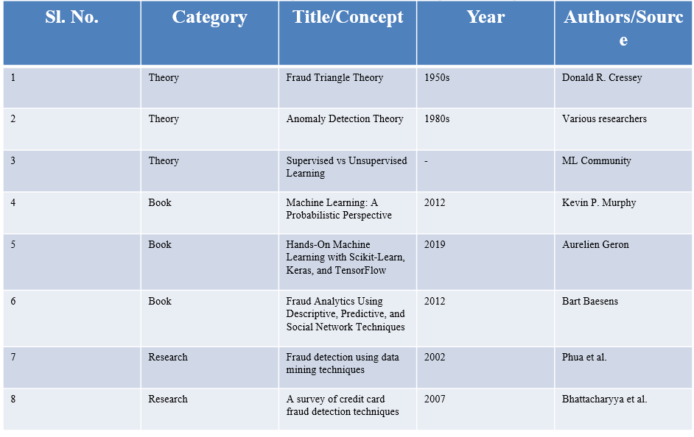
LITERATURE SURVEY

Slide 6
PROBLEM STATEMENT
UPI growth has created complex fraud patterns that traditional and manual systems cannot detect.
A real-time ML system is needed to automatically identify abnormal transactions and prevent financial loss.

Slide 7
EXISTING SYSTEM
Current payment systems (IMPS/NEFT/basic UPI) use static, rule-based security to verify transactions.
They expose sensitive details (Account No., IFSC) and rely only on simple authentication like MPIN/OTP.
These systems cannot analyze transaction behavior in real time, making them weak against new fraud patterns.

Slide 8
DIS ADVANTAGES OF EXISTING SYSTEM
Sensitive banking data (Account No., IFSC) is exposed during transactions, increasing data theft risk.
Finds Fraud After Money is Lost
Cannot Understand User Behavior

Slide 9
PROPOSED SYSTEM
Our system replaces static rule-based checks with a Machine Learning-driven fraud detection framework.
It uses Decision Tree and \XG Boost classifiers for high accuracy, and is integrated into a Streamlit web app for real-time fraud detection and analysis.

Slide 10
ADVANTAGES OF PROPOSED SYSTEM
No Need to Share Account Details.
Pre trained model no need to train again and again.
Role based approach.
Detect amount before lost
Based On the role we can Access the details.
Who is receiver? Is device new?
Is amount abnormal? Is time suspicious?

Slide 11
SYSTEM REQUIREMENTS
HARDWARE REQUIREMENTS:
Processor: Intel Core i3 or higher
Speed: 2.4 GHz or higher
RAM: 4 GB (Minimum) / 8 GB (Recommended for ML training)
Hard Disk: 500 GB

Slide 12
SYSTEM REQUIREMENTS
SOFTWARE REQUIREMENTS
Operating System: Windows 10 / 11
Programming Language: Python 3.8 or higher
Web Framework: Stream lit.
Development IDE: VS Code / Jupyter Notebook
Key Libraries: Scikit-Learn, Pandas, NumPy, Plot-ly.

Slide 13
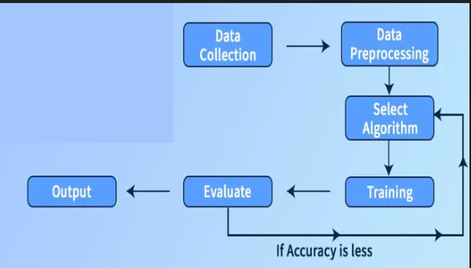
BLOCK DIAGRAM

Slide 14
MODULES
DATA COLLECTION
DATA PREPROCESSING & CLEANING
MODEL TRAINING
EVALUATE RESULTS

Slide 15
MODULES
DATA COLLECTION
Collect raw UPI transaction records from the dataset.
Includes fields like: VPA, amount, time, device ID, location, and frequency.
This data is used to train and test the fraud detection model.

Slide 16
MODULES
DATA PREPROCESSING & CLEANING
Remove missing values, incorrect entries, and duplicate transactions.
Convert raw text data into proper format for ML (normalization & encoding).
Ensures the dataset is clean and reliable for modeling.

Slide 17
MODULES
MODEL TRAINING
Train ML models like Decision Tree and XGBoost using the processed dataset.
The model learns normal vs abnormal transaction patterns.

Slide 18
MODULES
EVALUATE RESULTS
Check model performance using accuracy, precision, recall, and F1-score.
If accuracy is low, tune parameters and retrain for better results.
Choose the best performing algorithm for final deployment.

Slide 19
ALGORITHMS
Decision Tree — simple and interpretable; decision-rule based classification of transactions.
Very easy to understand and interpret — you can literally follow the path of decisions for any transaction.
Works with both numerical and categorical data; no need for complicated data scaling or normalization.
Fast to train the model

Slide 20
ALGORITHMS
XG Boost — advanced boosted-tree ensemble; powerful and accurate for detecting complex fraud patterns.
Highly accurate and powerful — good at capturing complex patterns, non-linear relationships, and subtle signs of fraud.
Handles mixed data (numerical, categorical), missing values, and works well even with many features / large datasets.

Slide 21
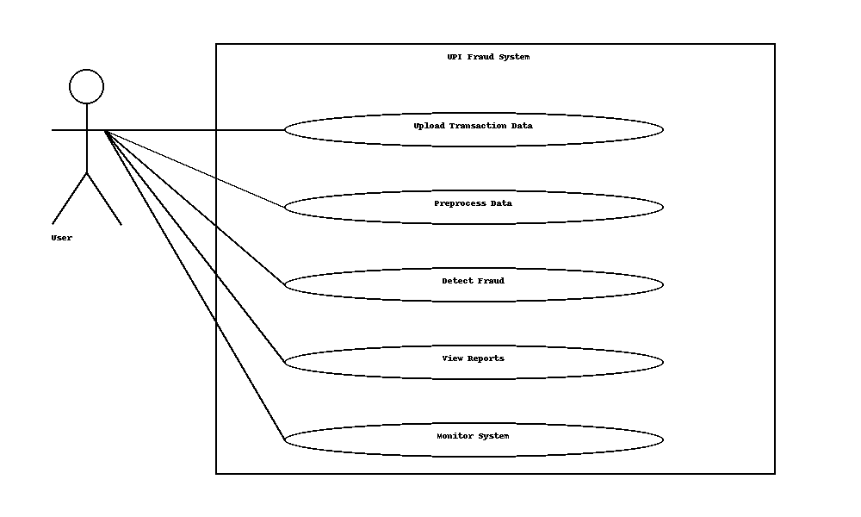
USE CASE DIAGRAM

Slide 22
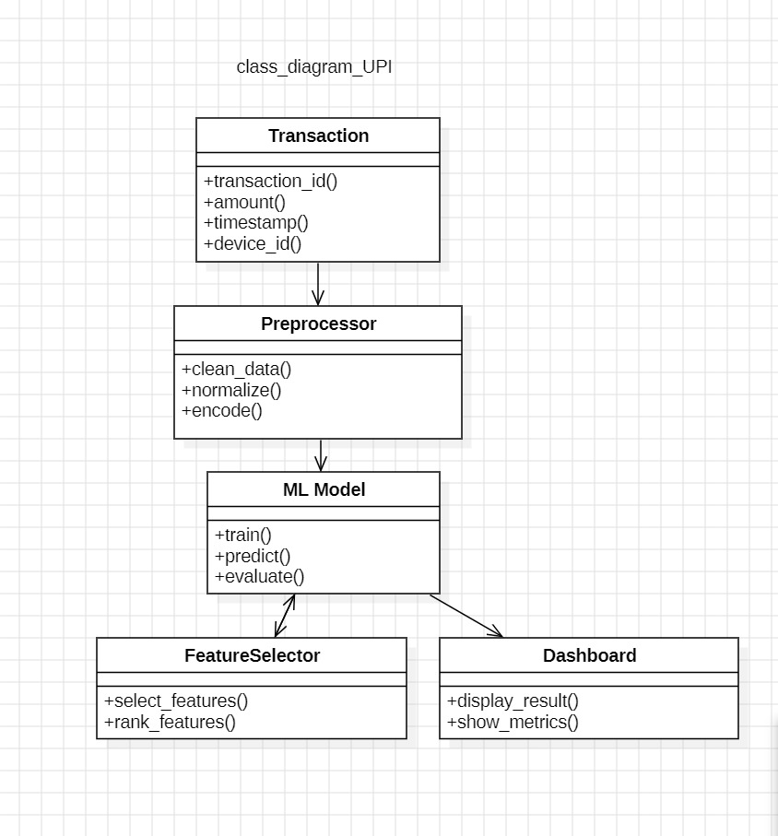
CLASS DIAGRAM

Slide 23
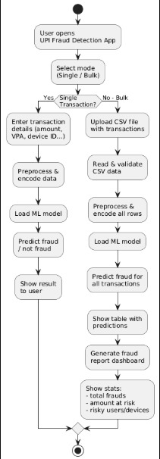
ACTIVITY DIAGRAM

Slide 24
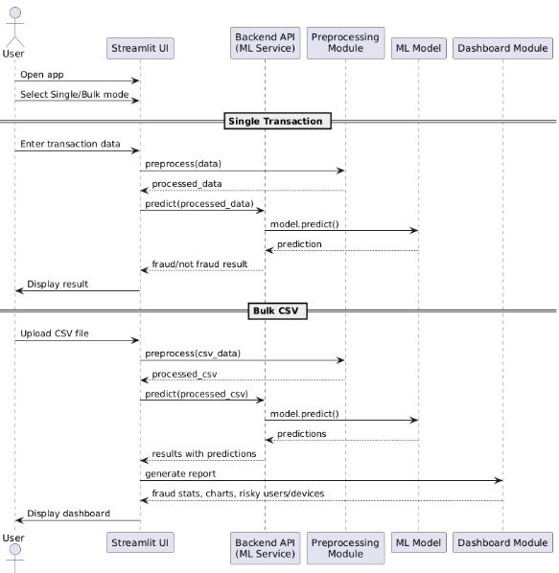
SEQUENCE DIAGRAM

Slide 25
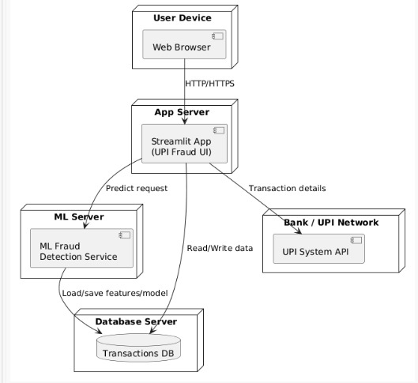
DEPLOYMENT DIAGRAM

Slide 26
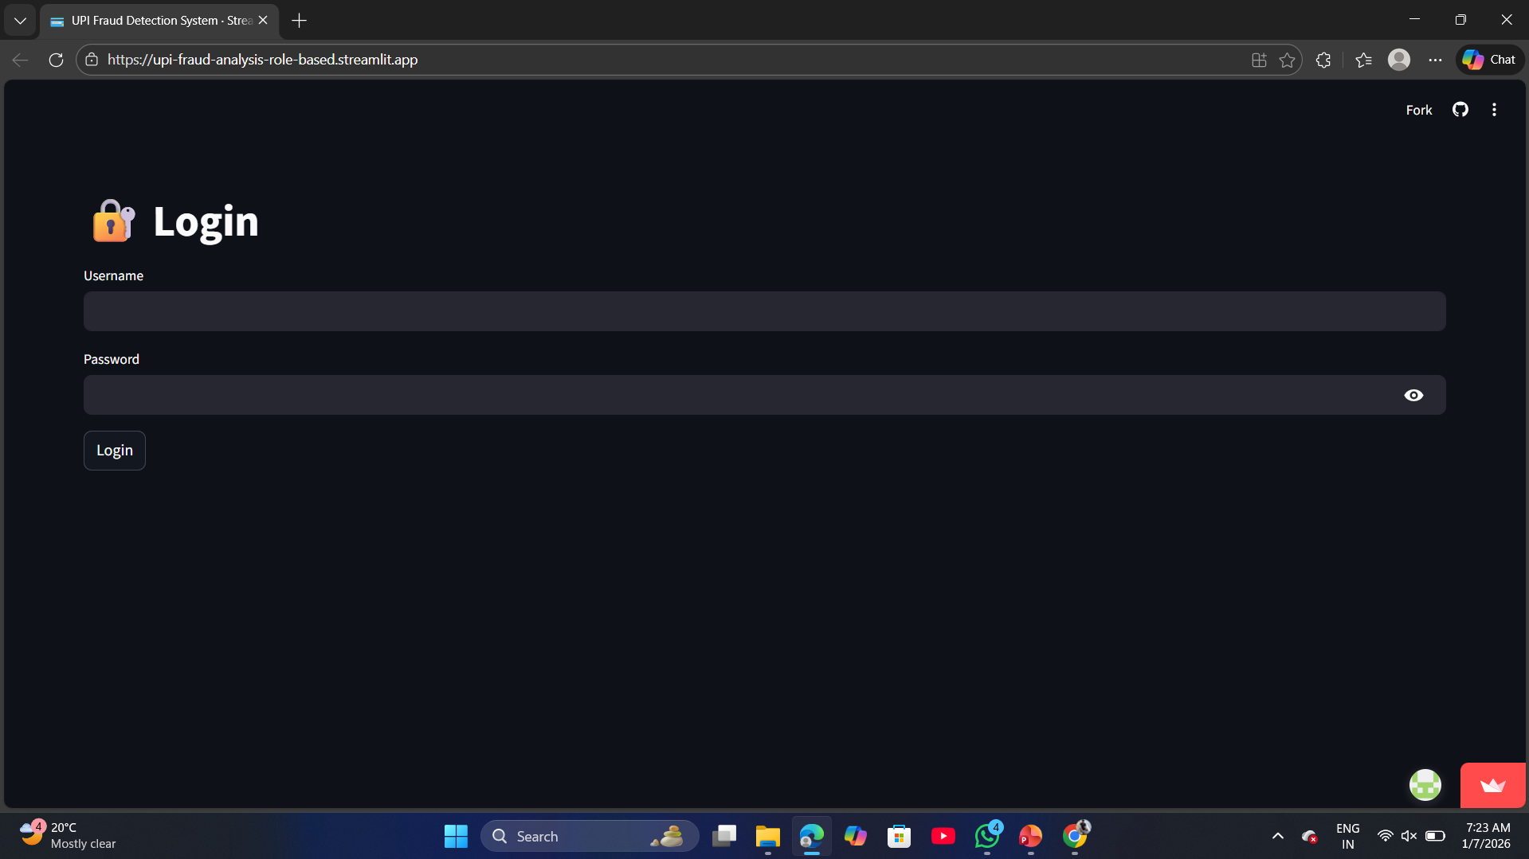
RESULTS
AUTHENTICATION

Slide 27
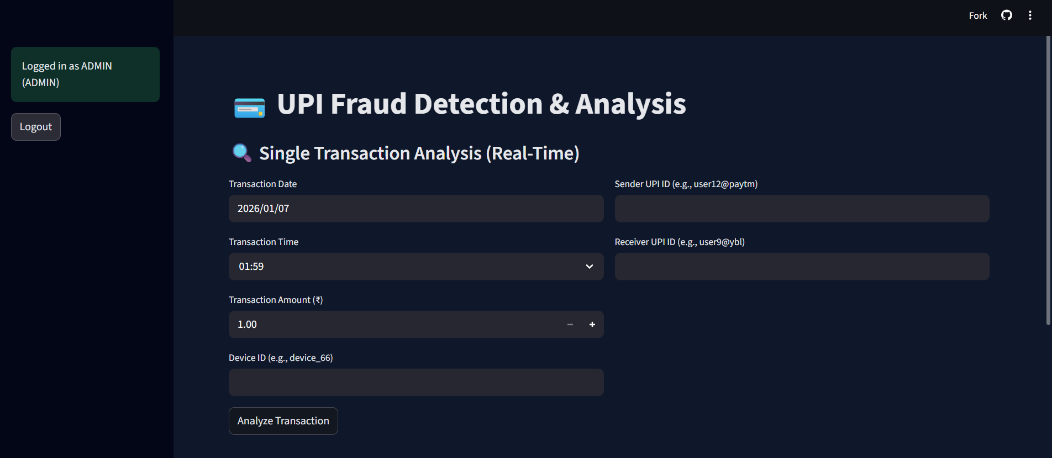
INTERFACE

Slide 28
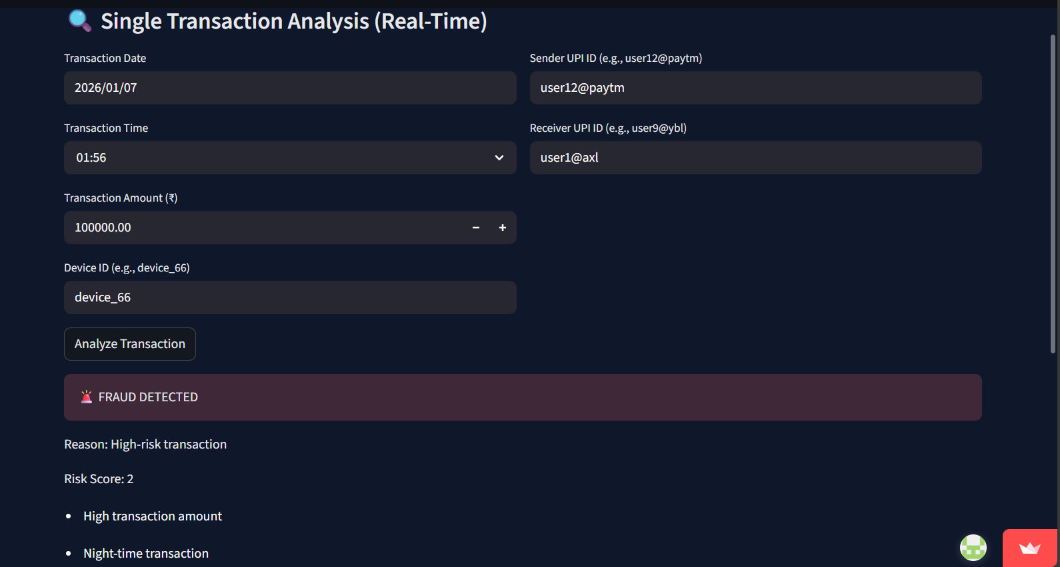
SINGLE TRANSACTION ANALYSIS

Slide 29
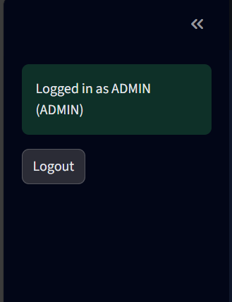
ROLE-BASED AUTHENTICATION

Slide 30
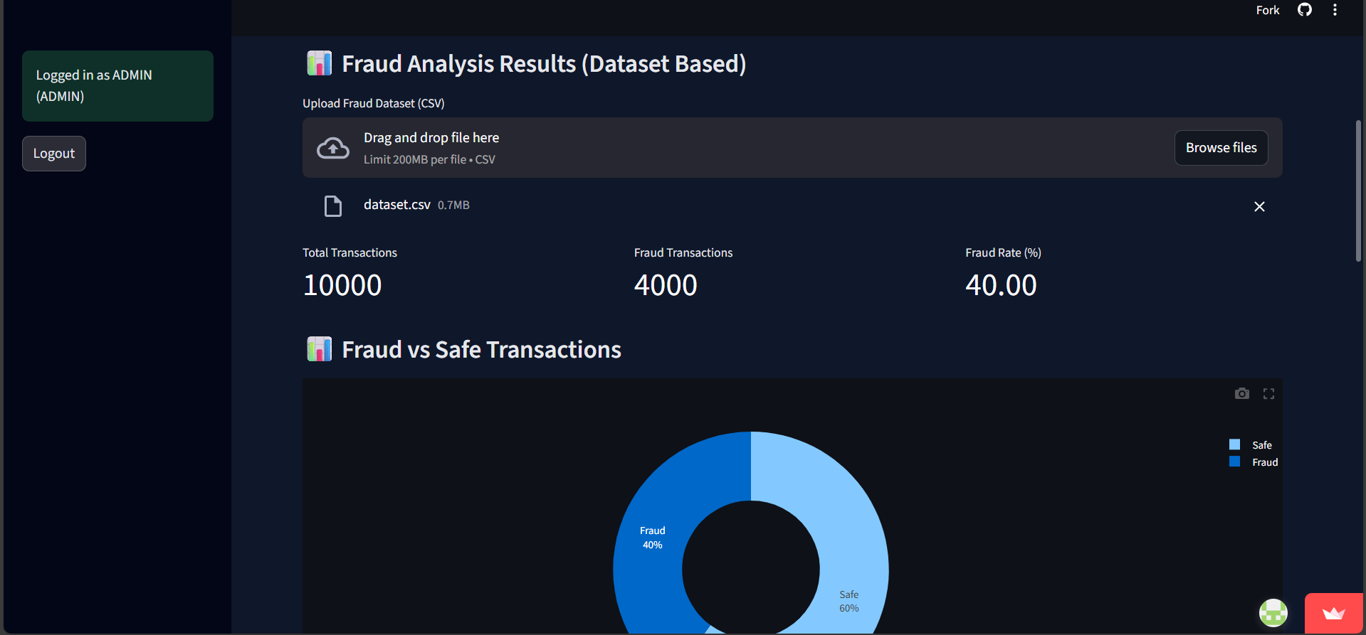
BATCH ANALYSIS

Slide 31
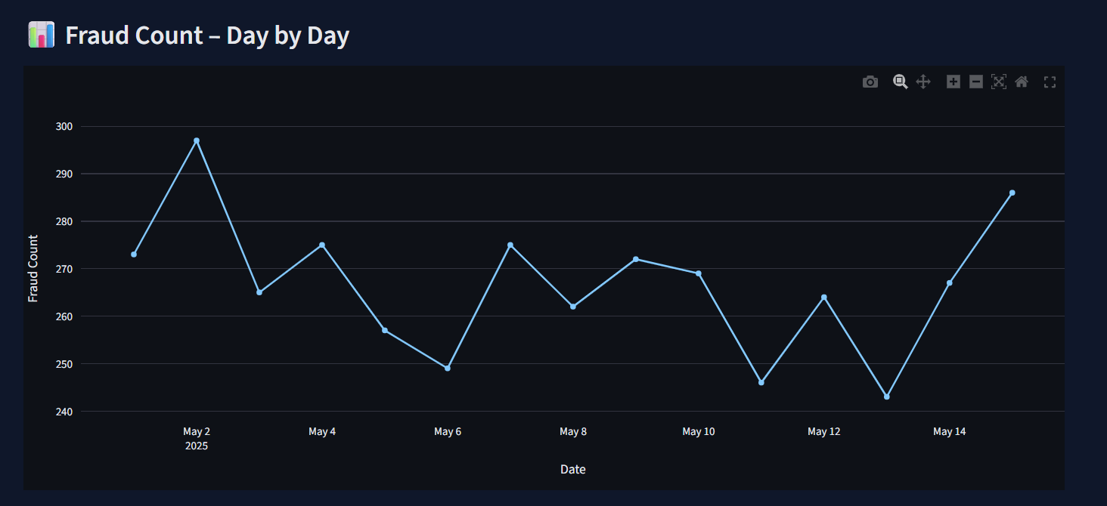
FRAUD COUNT DAY BY DAY

Slide 32
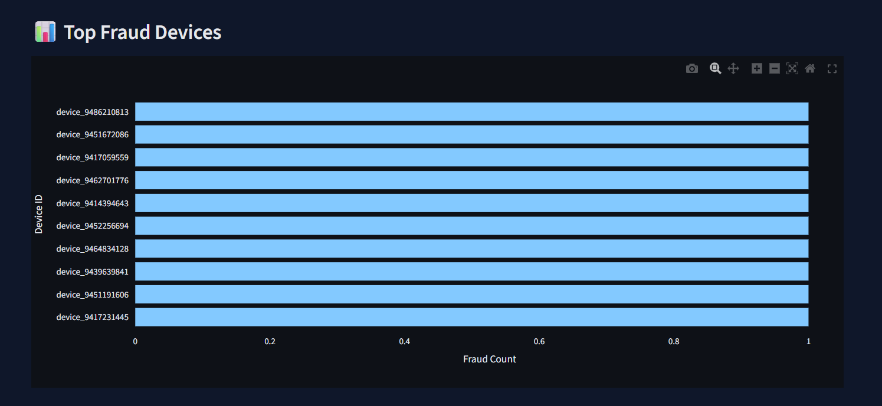
TOP FRAUD DEVICES

Slide 33
THANK YOU

