Slide 1
Ayudantía #1
Lógica Digital
Ayudantes:
Tomás Contreras
Susana Figueroa
Andrés González
Jorge Schenke
Sebastian Ramos
Rocio

Slide 2
Convierte de base decimal a base 2
(10)₁₀
(457)₁₀
(2)₁₀

Slide 3
(10)₁₀

Slide 4
(10)₁₀
Resto
10 : 2 = 5
0

Slide 5
(10)₁₀
Resto
10 : 2 = 5
0
5 : 2 = 2
10

Slide 6
(10)₁₀
Resto
10 : 2 = 5
0
5 : 2 = 2
10
2 : 2 = 1
010

Slide 7
(10)₁₀
Resto
10 : 2 = 5
0
5 : 2 = 2
10
2 : 2 = 1
010
1 : 2 = 0
1010

Slide 8
(10)₁₀
Resto
10 : 2 = 5
0
5 : 2 = 2
10
2 : 2 = 1
010
1 : 2 = 0
1010
R: (1010)₂

Slide 9
(10)₁₀
En 8 bits?

Slide 10
(10)₁₀
En 8 bits?
R: (00001010)₂

Slide 11
2) (457)₁₀

Slide 12
2) (457)₁₀
Resto
457 : 2 = 228
1

Slide 13
2) (457)₁₀
Resto
457 : 2 = 228
1
228 : 2 = 114
01

Slide 14
2) (457)₁₀
Resto
457 : 2 = 228
1
228 : 2 = 114
01
114 : 2 = 57
001

Slide 15
2) (457)₁₀
Resto
457 : 2 = 228
1
228 : 2 = 114
01
114 : 2 = 57
001
57 : 2 = 28
1001

Slide 16
2) (457)₁₀
Resto
457 : 2 = 228
1
228 : 2 = 114
01
114 : 2 = 57
001
57 : 2 = 28
1001
28 : 2 = 14
01001

Slide 17
2) (457)₁₀
Resto
457 : 2 = 228
1
228 : 2 = 114
01
114 : 2 = 57
001
57 : 2 = 28
1001
28 : 2 = 14
01001
...
...
1 : 2 = 0
R: (111001001)₂

Slide 18


2) 457₁₀
Tiene más de 8 bits???

Slide 19
2) (457)₁₀
Tiene más de 8 bits???
Desde el 256 ya supera los 8 bits

Slide 20
3) (2)₁₀

Slide 21
3) (2)₁₀
Resto
2 : 2 = 1
0

Slide 22
3) (2)₁₀
Resto
2 : 2 = 1
0
1 : 2 = 0
10

Slide 23
3) (2)₁₀
Resto
2 : 2 = 1
0
1 : 2 = 0
10
R: (10)₂

Slide 24
3) (2)₁₀
En 8 bits?

Slide 25
3) (2)₁₀
En 8 bits?
R: (00000010)₂

Slide 26

Convierte de base 2 a base 16
(1000)₂
(00101001)₂
(0101100)₂

Slide 27
(1000)₂

Slide 28
(1000)₂
en base 10!
1 0 0 0
x2³ x2² x2¹ x2⁰

Slide 29
(1000)₂
en base 16!
1 0 0 0
x2³ x2² x2¹ x2⁰

Slide 30
(1000)₂
en base 16!
1 0 0 0
x2³ x2² x2¹ x2⁰
R: (8)₁₆

Slide 31
2) (00101001)₂

Slide 32
2) (00101001)₂
en base 10!
0 0 1 0 1 0 0 1
x2⁷ x2⁶ x2⁵ x2⁴ x2³ x2² x2¹ x2⁰

Slide 33
2) (00101001)₂
0 0 1 0 1 0 0 1
x2⁷ x2⁶ x2⁵ x2⁴ x2³ x2² x2¹ x2⁰

Slide 34
2) (00101001)₂
en base 16!
0 0 1 0 1 0 0 1
x2³ x2² x2¹ x2⁰ x2³ x2² x2¹ x2⁰

Slide 35
2) (00101001)₂
0 0 1 0 1 0 0 1
x2³ x2² x2¹ x2⁰ x2³ x2² x2¹ x2⁰
R1: 2
R2: 9

Slide 36
2) (00101001)₂
0 0 1 0 1 0 0 1
x2³ x2² x2¹ x2⁰ x2³ x2² x2¹ x2⁰
R1: 2
R2: 9
R: (29)₁₆

Slide 37
3) (0101100)₂

Slide 38

3) (0101100)₂
!!!?!?Solo tengo 7 bits???

Slide 39
3) (0101100)₂
0 0 1 0 1 1 0 0
x2⁷ x2⁶ x2⁵ x2⁴ x2³ x2² x2¹ x2⁰

Slide 40
3) (0101100)₂
0 0 1 0 1 1 0 0
x2⁷ x2⁶ x2⁵ x2⁴ x2³ x2² x2¹ x2⁰

Slide 41
3) (0101100)₂
0 0 1 0 1 1 0 0
x2³ x2² x2¹ x2⁰ x2³ x2² x2¹ x2⁰

Slide 42
3) (0101100)₂
0 0 1 0 1 1 0 0
x2³ x2² x2¹ x2⁰ x2³ x2² x2¹ x2⁰
R1: 2
R2: 12 = C

Slide 43
3) (0101100)₂
0 0 1 0 1 1 0 0
x2³ x2² x2¹ x2⁰ x2³ x2² x2¹ x2⁰
R1: 2
R2: 12 = C
R: (2C)₁₆

Slide 44
Cómo convertir de hexadecimal a binario?

Slide 45
Cómo convertir de hexadecimal a binario?
proceso inverso

Slide 46
Convierte de base 16 a base 2
(8)₁₆
(2C)₁₆
(98BA)₁₆

Slide 47
(8)₁₆

Slide 48
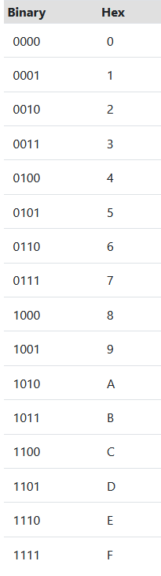
Binary Hex
(8)₁₆

Slide 49
Binary Hex
(8)₁₆

Slide 50
Binary Hex
(8)₁₆
R: (1000)₂

Slide 51
2) (2C)₁₆

Slide 52
Binary Hex
2) (2C)₁₆

Slide 53
Binary Hex
2) (2C)₁₆

Slide 54
Binary Hex
2) (2C)₁₆
R: (0010 1100)₂

Slide 55
3) (98BA)₁₆

Slide 56
Binary Hex
3) (98BA)₁₆

Slide 57
Binary Hex
3) (98BA)₁₆
segundo
primero
cuarto
tercero

Slide 58
Binary Hex
3) (98BA)₁₆
segundo
primero
cuarto
tercero
R: (1001 1000 1011 1010)₂

Slide 59
Repaso de las compuertas lógicas básicas

Slide 60
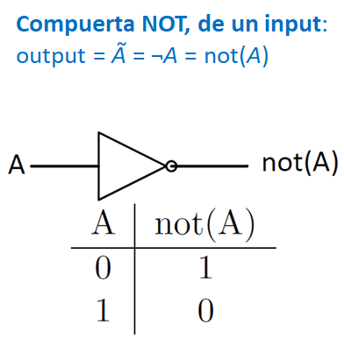

Slide 61
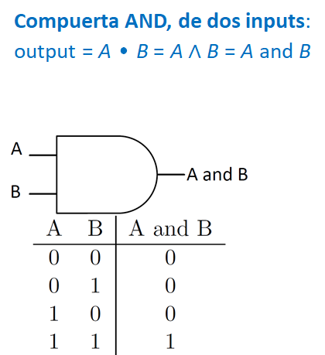

Slide 62
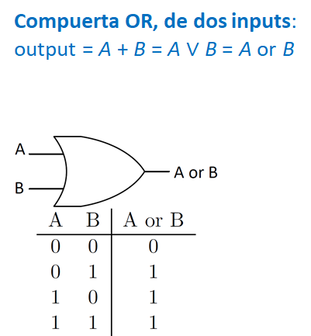

Slide 63
Construir la tabla de verdad de la siguiente expresión:

Slide 64
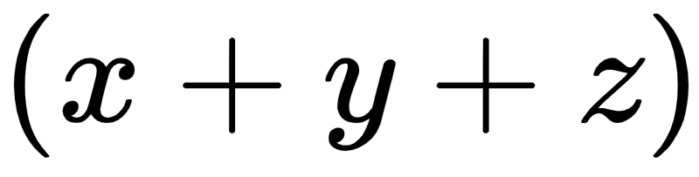
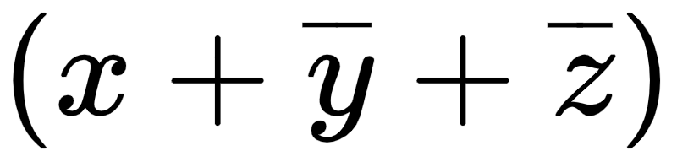
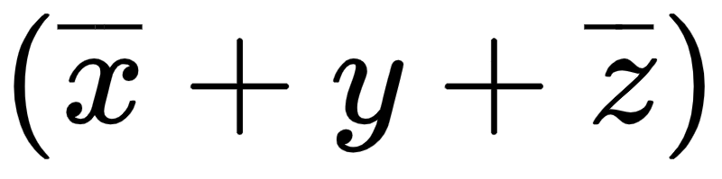
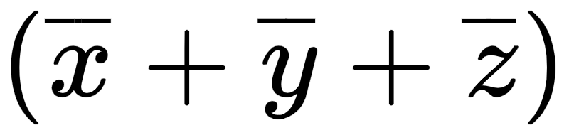
x | y | z | f (x, y, z)
0 | 0 | 0
0 | 0 | 1
0 | 1 | 0
0 | 1 | 1
1 | 0 | 0
1 | 0 | 1
1 | 1 | 0
1 | 1 | 1

Slide 65
x | y | z | f (x, y, z)
0 | 0 | 0
0 | 0 | 1
0 | 1 | 0
0 | 1 | 1
1 | 0 | 0
1 | 0 | 1
1 | 1 | 0
1 | 1 | 1
0

Slide 66
x | y | z | f (x, y, z)
0 | 0 | 0
0 | 0 | 1
0 | 1 | 0
0 | 1 | 1
1 | 0 | 0
1 | 0 | 1
1 | 1 | 0
1 | 1 | 1
0
1

Slide 67
x | y | z | f (x, y, z)
0 | 0 | 0
0 | 0 | 1
0 | 1 | 0
0 | 1 | 1
1 | 0 | 0
1 | 0 | 1
1 | 1 | 0
1 | 1 | 1
0
1
1

Slide 68
x | y | z | f (x, y, z)
0 | 0 | 0
0 | 0 | 1
0 | 1 | 0
0 | 1 | 1
1 | 0 | 0
1 | 0 | 1
1 | 1 | 0
1 | 1 | 1
0
1
1
1

Slide 69
x | y | z | f (x, y, z)
0 | 0 | 0 | 0
0 | 0 | 1
0 | 1 | 0
0 | 1 | 1
1 | 0 | 0
1 | 0 | 1
1 | 1 | 0
1 | 1 | 1

Slide 70
x | y | z | f (x, y, z)
0 | 0 | 0 | 0
0 | 0 | 1
0 | 1 | 0
0 | 1 | 1
1 | 0 | 0
1 | 0 | 1
1 | 1 | 0
1 | 1 | 1

Slide 71
x | y | z | f (x, y, z)
0 | 0 | 0 | 0
0 | 0 | 1
0 | 1 | 0
0 | 1 | 1
1 | 0 | 0
1 | 0 | 1
1 | 1 | 0
1 | 1 | 1
1

Slide 72
x | y | z | f (x, y, z)
0 | 0 | 0 | 0
0 | 0 | 1
0 | 1 | 0
0 | 1 | 1
1 | 0 | 0
1 | 0 | 1
1 | 1 | 0
1 | 1 | 1
1
1

Slide 73
x | y | z | f (x, y, z)
0 | 0 | 0 | 0
0 | 0 | 1
0 | 1 | 0
0 | 1 | 1
1 | 0 | 0
1 | 0 | 1
1 | 1 | 0
1 | 1 | 1
1
1
1

Slide 74
x | y | z | f (x, y, z)
0 | 0 | 0 | 0
0 | 0 | 1
0 | 1 | 0
0 | 1 | 1
1 | 0 | 0
1 | 0 | 1
1 | 1 | 0
1 | 1 | 1
1
1
1
1

Slide 75
x | y | z | f (x, y, z)
0 | 0 | 0 | 0
0 | 0 | 1 | 1
0 | 1 | 0
0 | 1 | 1
1 | 0 | 0
1 | 0 | 1
1 | 1 | 0
1 | 1 | 1

Slide 76
x | y | z | f (x, y, z)
0 | 0 | 0 | 0
0 | 0 | 1 | 1
0 | 1 | 0
0 | 1 | 1
1 | 0 | 0
1 | 0 | 1
1 | 1 | 0
1 | 1 | 1

Slide 77
x | y | z | f (x, y, z)
0 | 0 | 0 | 0
0 | 0 | 1 | 1
0 | 1 | 0
0 | 1 | 1
1 | 0 | 0
1 | 0 | 1
1 | 1 | 0
1 | 1 | 1
1

Slide 78
x | y | z | f (x, y, z)
0 | 0 | 0 | 0
0 | 0 | 1 | 1
0 | 1 | 0
0 | 1 | 1
1 | 0 | 0
1 | 0 | 1
1 | 1 | 0
1 | 1 | 1
1
1

Slide 79
x | y | z | f (x, y, z)
0 | 0 | 0 | 0
0 | 0 | 1 | 1
0 | 1 | 0
0 | 1 | 1
1 | 0 | 0
1 | 0 | 1
1 | 1 | 0
1 | 1 | 1
1
1
1

Slide 80
x | y | z | f (x, y, z)
0 | 0 | 0 | 0
0 | 0 | 1 | 1
0 | 1 | 0
0 | 1 | 1
1 | 0 | 0
1 | 0 | 1
1 | 1 | 0
1 | 1 | 1
1
1
1
1

Slide 81
x | y | z | f (x, y, z)
0 | 0 | 0 | 0
0 | 0 | 1 | 1
0 | 1 | 0 | 1
0 | 1 | 1
1 | 0 | 0
1 | 0 | 1
1 | 1 | 0
1 | 1 | 1

Slide 82
x | y | z | f (x, y, z)
0 | 0 | 0 | 0
0 | 0 | 1 | 1
0 | 1 | 0 | 1
0 | 1 | 1
1 | 0 | 0
1 | 0 | 1
1 | 1 | 0
1 | 1 | 1

Slide 83
x | y | z | f (x, y, z)
0 | 0 | 0 | 0
0 | 0 | 1 | 1
0 | 1 | 0 | 1
0 | 1 | 1
1 | 0 | 0
1 | 0 | 1
1 | 1 | 0
1 | 1 | 1
1

Slide 84
x | y | z | f (x, y, z)
0 | 0 | 0 | 0
0 | 0 | 1 | 1
0 | 1 | 0 | 1
0 | 1 | 1
1 | 0 | 0
1 | 0 | 1
1 | 1 | 0
1 | 1 | 1
1
0

Slide 85
x | y | z | f (x, y, z)
0 | 0 | 0 | 0
0 | 0 | 1 | 1
0 | 1 | 0 | 1
0 | 1 | 1
1 | 0 | 0
1 | 0 | 1
1 | 1 | 0
1 | 1 | 1
1
0
1

Slide 86
x | y | z | f (x, y, z)
0 | 0 | 0 | 0
0 | 0 | 1 | 1
0 | 1 | 0 | 1
0 | 1 | 1
1 | 0 | 0
1 | 0 | 1
1 | 1 | 0
1 | 1 | 1
1
0
1
1

Slide 87
x | y | z | f (x, y, z)
0 | 0 | 0 | 0
0 | 0 | 1 | 1
0 | 1 | 0 | 1
0 | 1 | 1 | 0
1 | 0 | 0
1 | 0 | 1
1 | 1 | 0
1 | 1 | 1

Slide 88
x | y | z | f (x, y, z)
0 | 0 | 0 | 0
0 | 0 | 1 | 1
0 | 1 | 0 | 1
0 | 1 | 1 | 0
1 | 0 | 0
1 | 0 | 1
1 | 1 | 0
1 | 1 | 1

Slide 89
x | y | z | f (x, y, z)
0 | 0 | 0 | 0
0 | 0 | 1 | 1
0 | 1 | 0 | 1
0 | 1 | 1 | 0
1 | 0 | 0
1 | 0 | 1
1 | 1 | 0
1 | 1 | 1
1

Slide 90
x | y | z | f (x, y, z)
0 | 0 | 0 | 0
0 | 0 | 1 | 1
0 | 1 | 0 | 1
0 | 1 | 1 | 0
1 | 0 | 0
1 | 0 | 1
1 | 1 | 0
1 | 1 | 1
1
1

Slide 91
x | y | z | f (x, y, z)
0 | 0 | 0 | 0
0 | 0 | 1 | 1
0 | 1 | 0 | 1
0 | 1 | 1 | 0
1 | 0 | 0
1 | 0 | 1
1 | 1 | 0
1 | 1 | 1
1
1
1

Slide 92
x | y | z | f (x, y, z)
0 | 0 | 0 | 0
0 | 0 | 1 | 1
0 | 1 | 0 | 1
0 | 1 | 1 | 0
1 | 0 | 0
1 | 0 | 1
1 | 1 | 0
1 | 1 | 1
1
1
1
1

Slide 93
x | y | z | f (x, y, z)
0 | 0 | 0 | 0
0 | 0 | 1 | 1
0 | 1 | 0 | 1
0 | 1 | 1 | 0
1 | 0 | 0 | 1
1 | 0 | 1
1 | 1 | 0
1 | 1 | 1

Slide 94
x | y | z | f (x, y, z)
0 | 0 | 0 | 0
0 | 0 | 1 | 1
0 | 1 | 0 | 1
0 | 1 | 1 | 0
1 | 0 | 0 | 1
1 | 0 | 1
1 | 1 | 0
1 | 1 | 1

Slide 95
x | y | z | f (x, y, z)
0 | 0 | 0 | 0
0 | 0 | 1 | 1
0 | 1 | 0 | 1
0 | 1 | 1 | 0
1 | 0 | 0 | 1
1 | 0 | 1
1 | 1 | 0
1 | 1 | 1
1

Slide 96
x | y | z | f (x, y, z)
0 | 0 | 0 | 0
0 | 0 | 1 | 1
0 | 1 | 0 | 1
0 | 1 | 1 | 0
1 | 0 | 0 | 1
1 | 0 | 1
1 | 1 | 0
1 | 1 | 1
1
1

Slide 97
x | y | z | f (x, y, z)
0 | 0 | 0 | 0
0 | 0 | 1 | 1
0 | 1 | 0 | 1
0 | 1 | 1 | 0
1 | 0 | 0 | 1
1 | 0 | 1
1 | 1 | 0
1 | 1 | 1
1
1
0

Slide 98
x | y | z | f (x, y, z)
0 | 0 | 0 | 0
0 | 0 | 1 | 1
0 | 1 | 0 | 1
0 | 1 | 1 | 0
1 | 0 | 0 | 1
1 | 0 | 1
1 | 1 | 0
1 | 1 | 1
1
1
0
1

Slide 99
x | y | z | f (x, y, z)
0 | 0 | 0 | 0
0 | 0 | 1 | 1
0 | 1 | 0 | 1
0 | 1 | 1 | 0
1 | 0 | 0 | 1
1 | 0 | 1 | 0
1 | 1 | 0
1 | 1 | 1

Slide 100
x | y | z | f (x, y, z)
0 | 0 | 0 | 0
0 | 0 | 1 | 1
0 | 1 | 0 | 1
0 | 1 | 1 | 0
1 | 0 | 0 | 1
1 | 0 | 1 | 0
1 | 1 | 0
1 | 1 | 1

Slide 101
x | y | z | f (x, y, z)
0 | 0 | 0 | 0
0 | 0 | 1 | 1
0 | 1 | 0 | 1
0 | 1 | 1 | 0
1 | 0 | 0 | 1
1 | 0 | 1 | 0
1 | 1 | 0
1 | 1 | 1
1

Slide 102
x | y | z | f (x, y, z)
0 | 0 | 0 | 0
0 | 0 | 1 | 1
0 | 1 | 0 | 1
0 | 1 | 1 | 0
1 | 0 | 0 | 1
1 | 0 | 1 | 0
1 | 1 | 0
1 | 1 | 1
1
1

Slide 103
x | y | z | f (x, y, z)
0 | 0 | 0 | 0
0 | 0 | 1 | 1
0 | 1 | 0 | 1
0 | 1 | 1 | 0
1 | 0 | 0 | 1
1 | 0 | 1 | 0
1 | 1 | 0
1 | 1 | 1
1
1
1

Slide 104
x | y | z | f (x, y, z)
0 | 0 | 0 | 0
0 | 0 | 1 | 1
0 | 1 | 0 | 1
0 | 1 | 1 | 0
1 | 0 | 0 | 1
1 | 0 | 1 | 0
1 | 1 | 0
1 | 1 | 1
1
1
1
1

Slide 105
x | y | z | f (x, y, z)
0 | 0 | 0 | 0
0 | 0 | 1 | 1
0 | 1 | 0 | 1
0 | 1 | 1 | 0
1 | 0 | 0 | 1
1 | 0 | 1 | 0
1 | 1 | 0 | 1
1 | 1 | 1

Slide 106
x | y | z | f (x, y, z)
0 | 0 | 0 | 0
0 | 0 | 1 | 1
0 | 1 | 0 | 1
0 | 1 | 1 | 0
1 | 0 | 0 | 1
1 | 0 | 1 | 0
1 | 1 | 0 | 1
1 | 1 | 1

Slide 107
x | y | z | f (x, y, z)
0 | 0 | 0 | 0
0 | 0 | 1 | 1
0 | 1 | 0 | 1
0 | 1 | 1 | 0
1 | 0 | 0 | 1
1 | 0 | 1 | 0
1 | 1 | 0 | 1
1 | 1 | 1
1

Slide 108
x | y | z | f (x, y, z)
0 | 0 | 0 | 0
0 | 0 | 1 | 1
0 | 1 | 0 | 1
0 | 1 | 1 | 0
1 | 0 | 0 | 1
1 | 0 | 1 | 0
1 | 1 | 0 | 1
1 | 1 | 1
1
1

Slide 109
x | y | z | f (x, y, z)
0 | 0 | 0 | 0
0 | 0 | 1 | 1
0 | 1 | 0 | 1
0 | 1 | 1 | 0
1 | 0 | 0 | 1
1 | 0 | 1 | 0
1 | 1 | 0 | 1
1 | 1 | 1
1
1
1

Slide 110
x | y | z | f (x, y, z)
0 | 0 | 0 | 0
0 | 0 | 1 | 1
0 | 1 | 0 | 1
0 | 1 | 1 | 0
1 | 0 | 0 | 1
1 | 0 | 1 | 0
1 | 1 | 0 | 1
1 | 1 | 1
1
1
1
0

Slide 111
x | y | z | f (x, y, z)
0 | 0 | 0 | 0
0 | 0 | 1 | 1
0 | 1 | 0 | 1
0 | 1 | 1 | 0
1 | 0 | 0 | 1
1 | 0 | 1 | 0
1 | 1 | 0 | 1
1 | 1 | 1 | 0

Slide 112
x | y | z | f (x, y, z)
0 | 0 | 0 | 0
0 | 0 | 1 | 1
0 | 1 | 0 | 1
0 | 1 | 1 | 0
1 | 0 | 0 | 1
1 | 0 | 1 | 0
1 | 1 | 0 | 1
1 | 1 | 1 | 0

Slide 113
Construyamos ahora el circuito a partir de la tabla de verdad….

Slide 114
x | y | z | f (x, y, z)
0 | 0 | 0 | 0
0 | 0 | 1 | 1
0 | 1 | 0 | 1
0 | 1 | 1 | 0
1 | 0 | 0 | 1
1 | 0 | 1 | 0
1 | 1 | 0 | 1
1 | 1 | 1 | 0

Slide 115
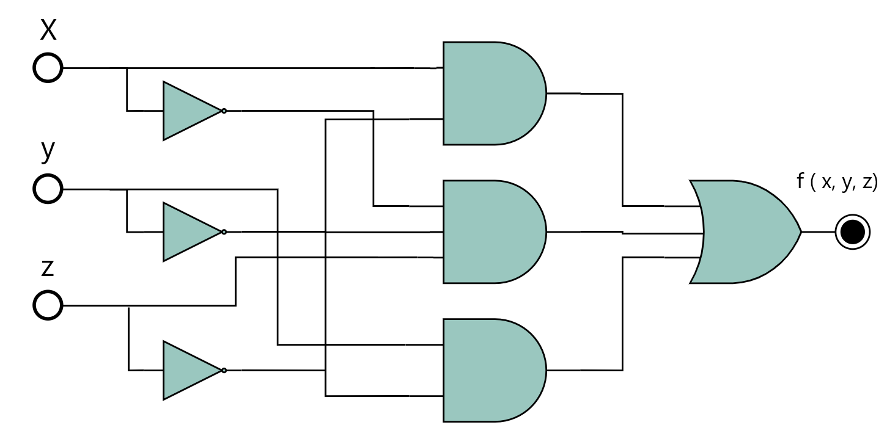

Slide 116
Binarios + compuertas

Slide 117
Se te entrega un número binario de 8 bits, construye un circuito con compuertas que contenga las siguientes salidas:
¿Es par?
¿Es impar?
¿Es ≥ 32?
¿Es <32?
¿Es ≥ 32 y par?

Slide 118
Ayudantía #1
Lógica Digital
Ayudantes:
Tomás Contreras
Susana Figueroa
Andrés González
Jorge Schenke
Sebastian Ramos
Rocio

Slide 119
Algebra Booleana

Slide 120
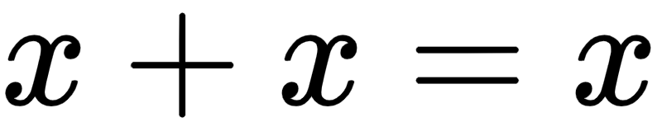
Demostrar la propiedad de Idempotencia 1:

Slide 122
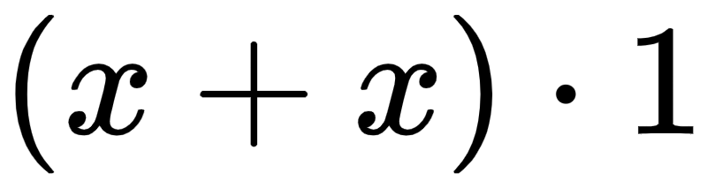

Slide 123
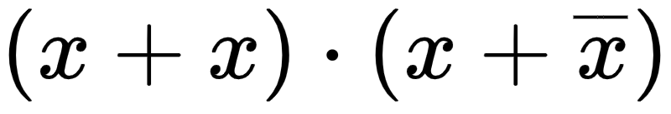

Slide 124
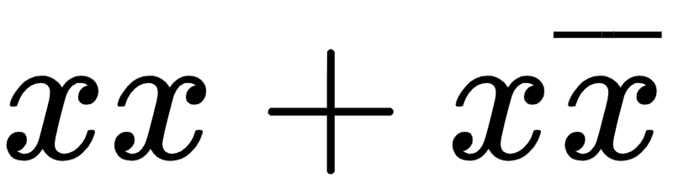

Slide 125
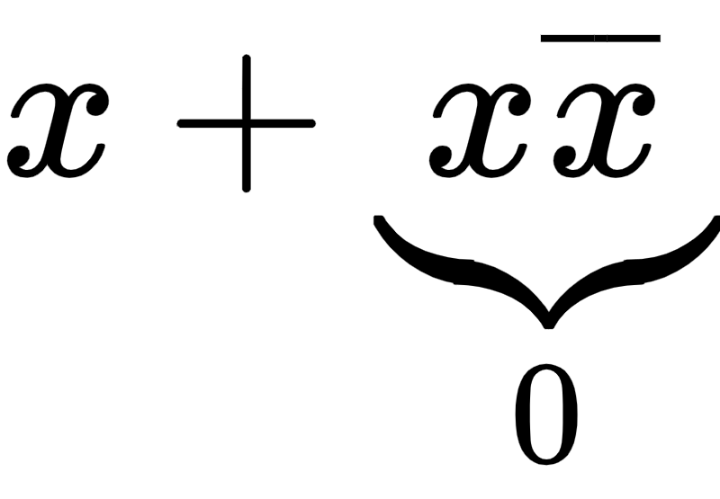

Slide 126


Slide 127
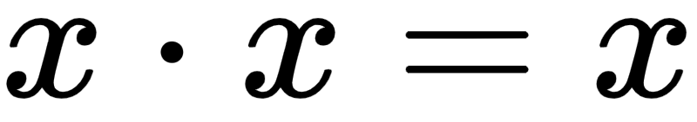
Demostrar la propiedad de Idempotencia 2:

Slide 129
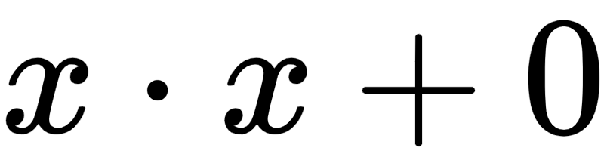

Slide 130
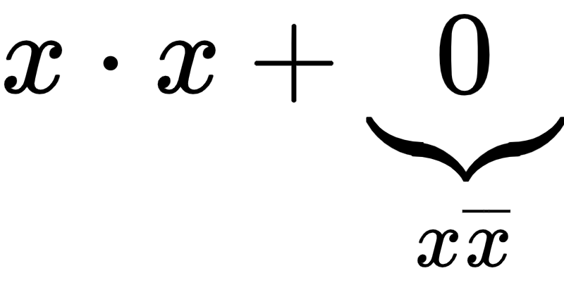

Slide 132
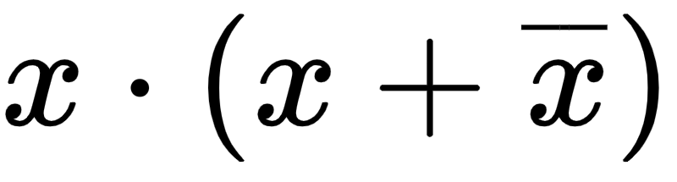

Slide 133
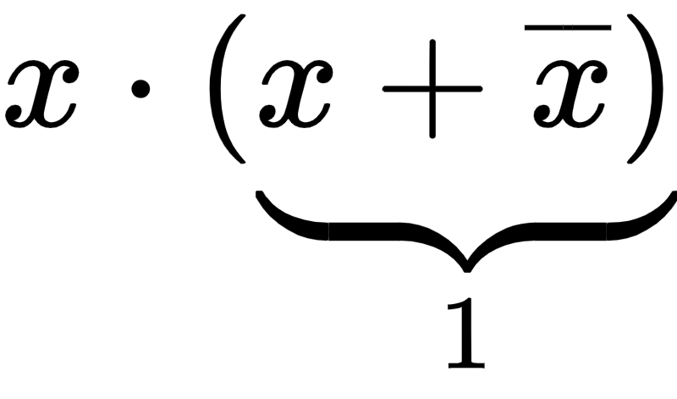

Slide 134
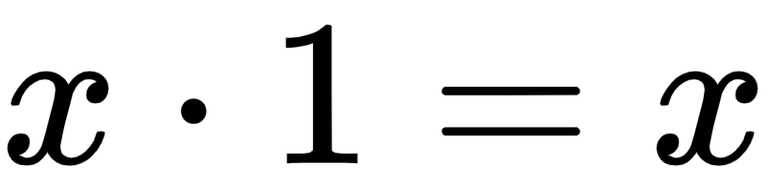

Slide 135
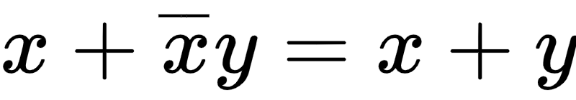
Demostrar la propiedad de Ley del consenso:

Slide 137

Por propiedad distributiva

Slide 138

Por propiedad distributiva

Slide 139
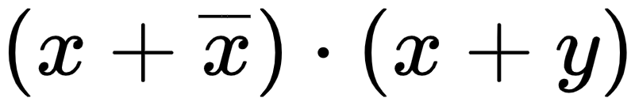

Slide 140
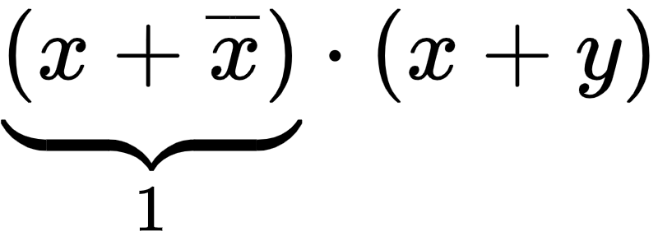

Slide 141
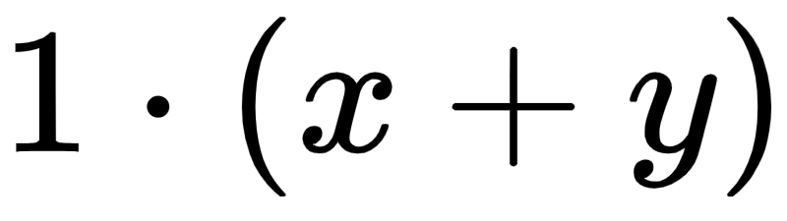

Slide 142
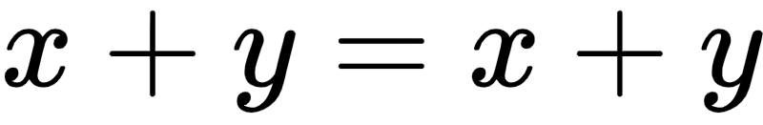

Slide 143
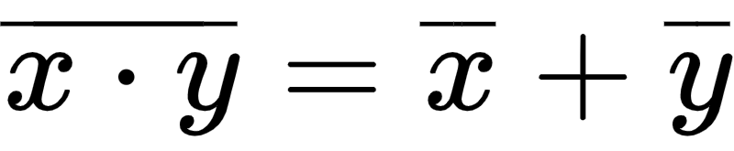
Demostrar la propiedad de Ley De-Morgan:

Slide 145
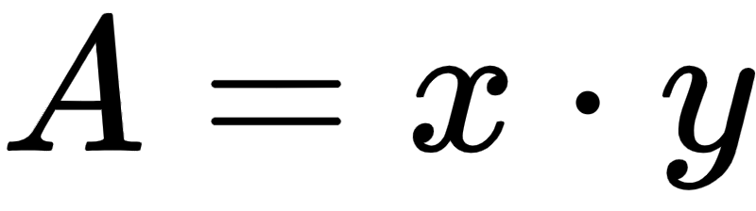
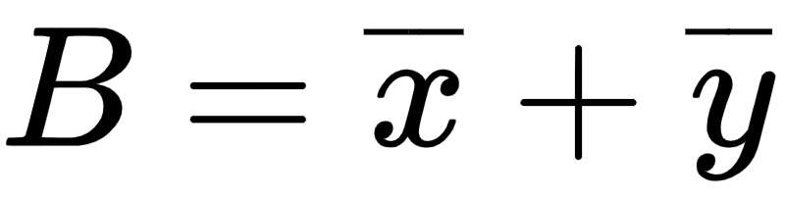

Slide 147
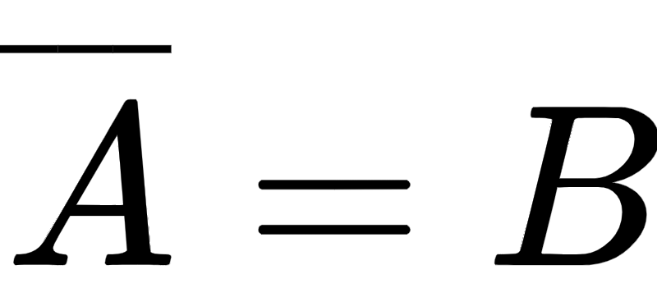

Slide 148
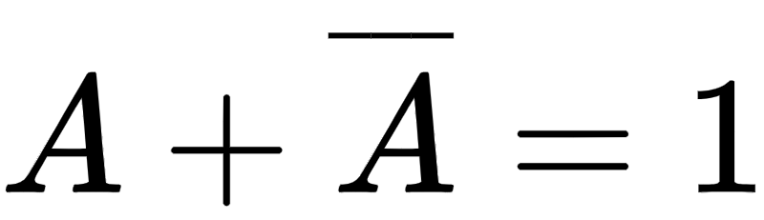
Se debe cumplir que:

Slide 149
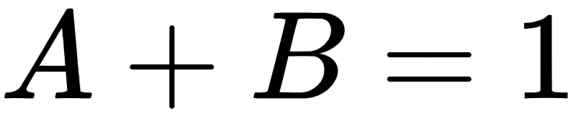
Se debe cumplir que:

Slide 150
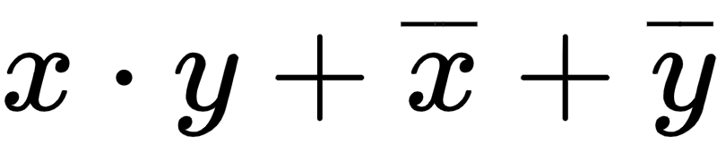
Se debe cumplir que:

Slide 151
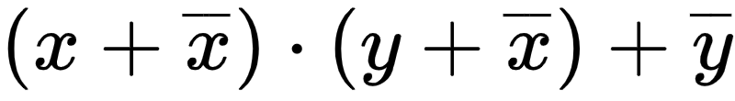
Se debe cumplir que:

Slide 152
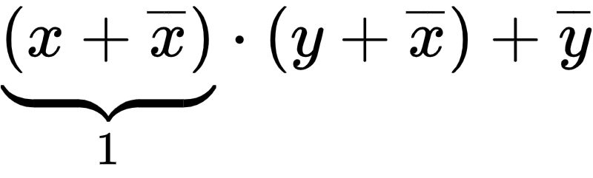
Se debe cumplir que:

Slide 153
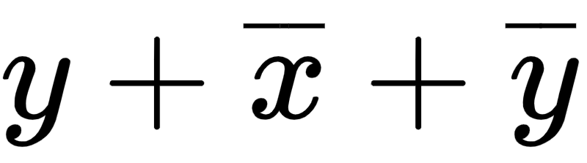
Se debe cumplir que:

Slide 154
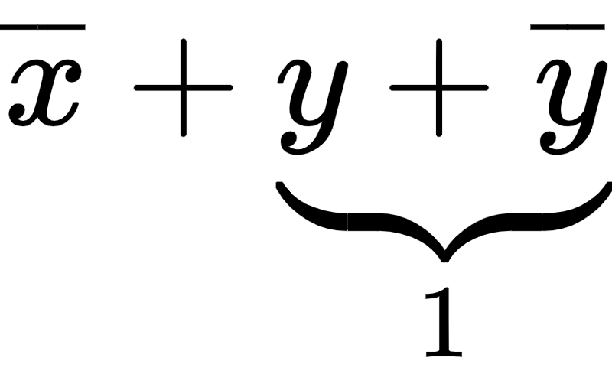
Se debe cumplir que:

Slide 155
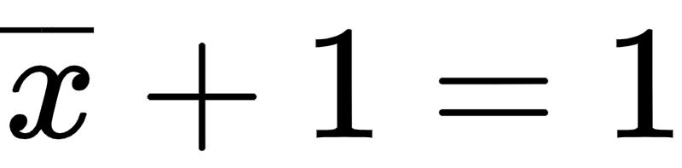
Se debe cumplir que:

Slide 156
Se debe cumplir que:

Slide 157
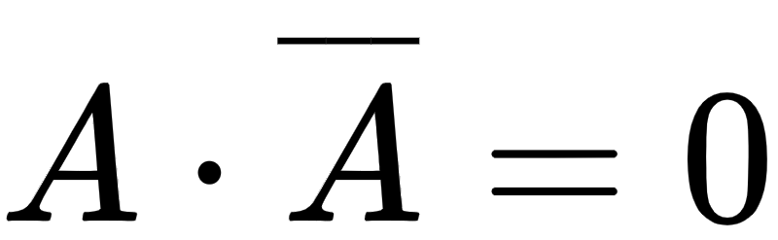
Simultáneamente se debe cumplir que:

Slide 158
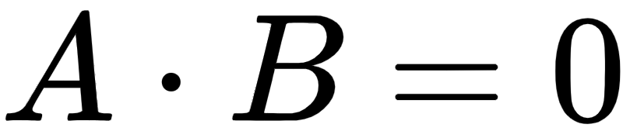
Simultáneamente se debe cumplir que:

Slide 159
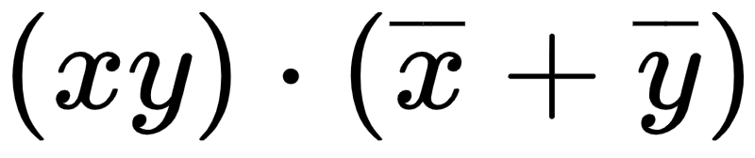
Simultáneamente se debe cumplir que:

Slide 160
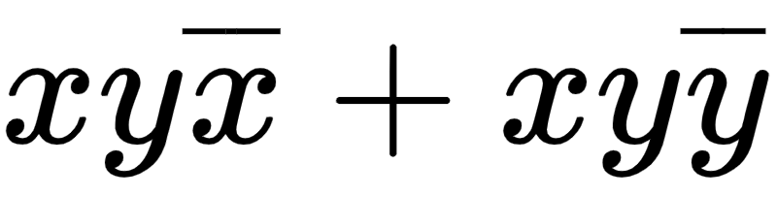
Simultáneamente se debe cumplir que:

Slide 161
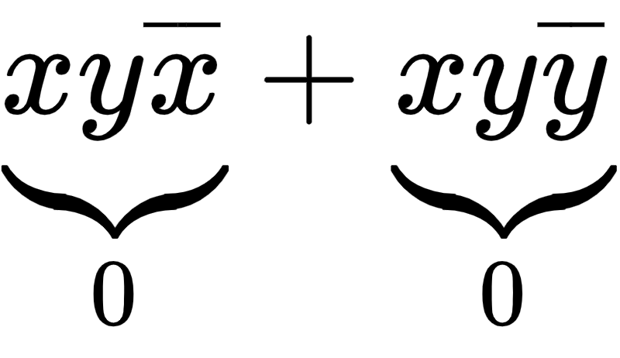
Simultáneamente se debe cumplir que:

Slide 162
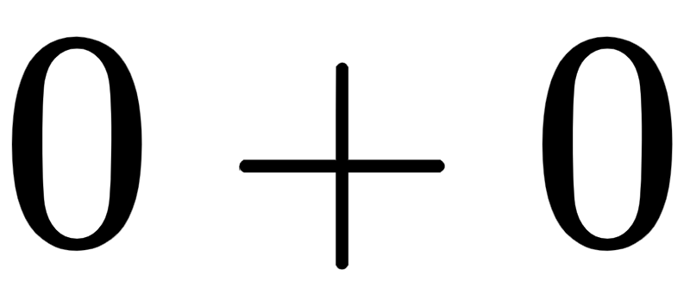
Simultáneamente se debe cumplir que:

Slide 163
Simultáneamente se debe cumplir que:

Slide 164
(1)
(2)
Como (1) y (2) se cumplen, se comprueba la igualdad.

