Slide 1
Git to Kubernetes In Jenkins using Ansible
Ashok Reddy Allu

Slide 2
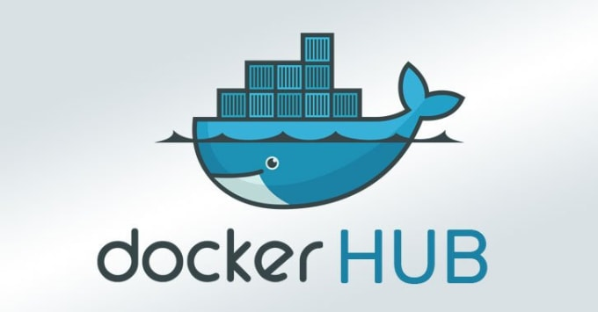
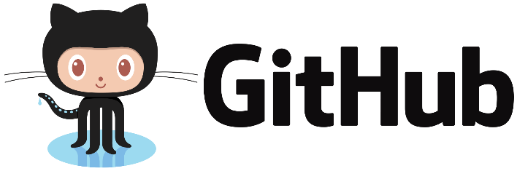

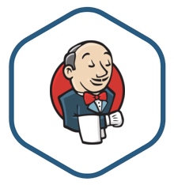
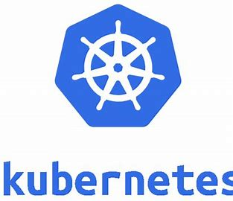


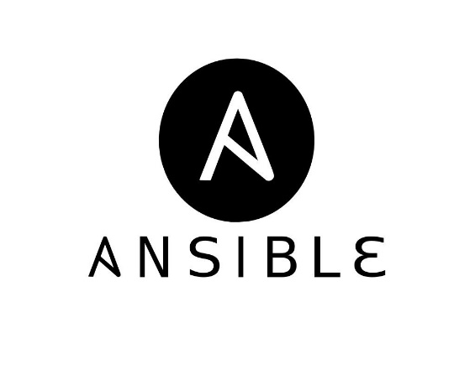
CI & CD
Pull Docker image
Git Push
Developers
Deployment Server

Slide 3
Prerequisites
AWS Account.
VM’s form AWS Server.
SCM
Docker Hub Account.
Install Jenkins one Server.
Ansible Server & Docker .
Kubernetes Cluster.

Slide 4
Jenkins Installation on Ubuntu:
Update package manager
sudo apt-get update
Install Java
sudo apt install openjdk-11-jdk
Install Jenkins
wget -q -O - https://pkg.jenkins.io/debian-stable/jenkins.io.key | sudo apt-
key add -
sudo sh -c 'echo deb https://pkg.jenkins.io/debian-stable binary/ > \
/etc/apt/sources.list.d/jenkins.list’
sudo apt-get update
sudo apt-get install jenkins

Slide 5
Docker Installation on Ubuntu:
Update package manager
sudo apt-get update
Install Docker
sudo apt install docker.io
Add ubuntu user into Docker group
sudo usermod –aG docker ubuntu

Slide 6
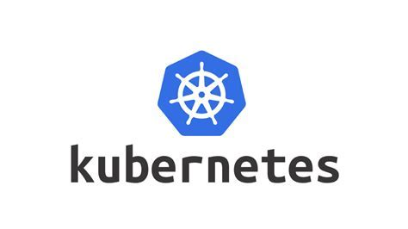

Slide 7
What is Kubernetes
Kubernetes is a open source container orchestration tool.
Kubernetes managing the containerized applications.
Kubernetes responsible for container deployment , scaling & descaling the containers.
Kubernetes is replacement of Docker-Swarm.
Stable release: 1.23.1

Slide 8
Kubernetes features
Automated Scheduling
Self healing capacity
Automated rollouts & roll backs
HPA
PAAS

Slide 9
Installation
Minikube
Kubedeam
KOPS
PASS
EKS
AKS
GKE

Slide 10
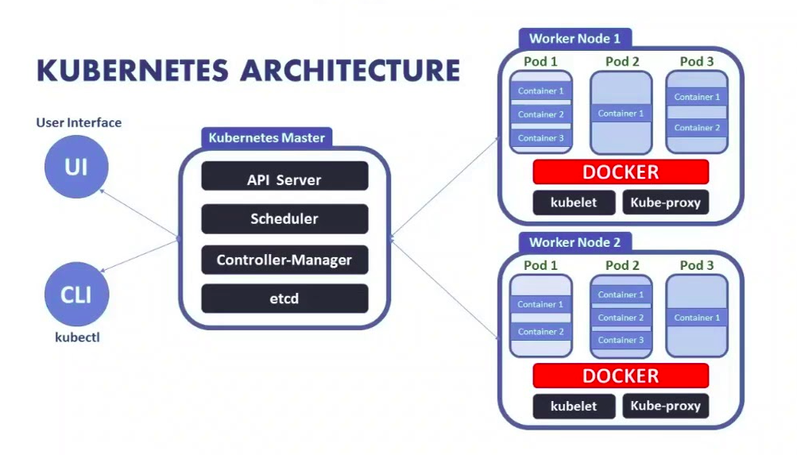
K8S Architecture

Slide 11
K8S Objects
Pod
Replication Controller
Replica Set
Daemon set
Deployment
Service

Slide 12
Namespace
Namespace Is a virtual cluster inside the K8s cluster.
Default
Kube-system
Kube-public

Slide 13
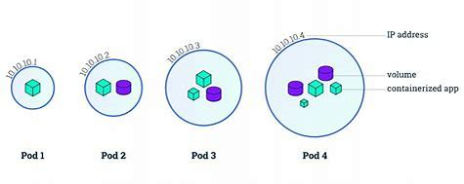
POD
Pod represents running process
Inside one pod you can have one or more pods
Each pod have unique ip address with in the cluser.

Slide 14
Replication controller
Replication controller manages the pod lifecycle
In RC you can scale up & scale down the pods
RC will always manage the desire capacity of pods
Replication set
RS is the next generation of RC
The only difference is selector support

Slide 15
Daemonset
A Daemonset make sure that all K8S nodes run a copy of pod.
Deployment
Deployment is a recommended way to deploy pods
It will again creates RS
In deployment we can roll back/roll out
1) Rolling update
2)Recreate

Slide 16
Service
Service is responsible for making our pod is discoverable
3 types of service
1) cluster IP
2) Node Port (30000 – 32767)
3)Load balancer

Slide 17
Let’s see the demo….

Slide 18
Thank you

