Slide 1

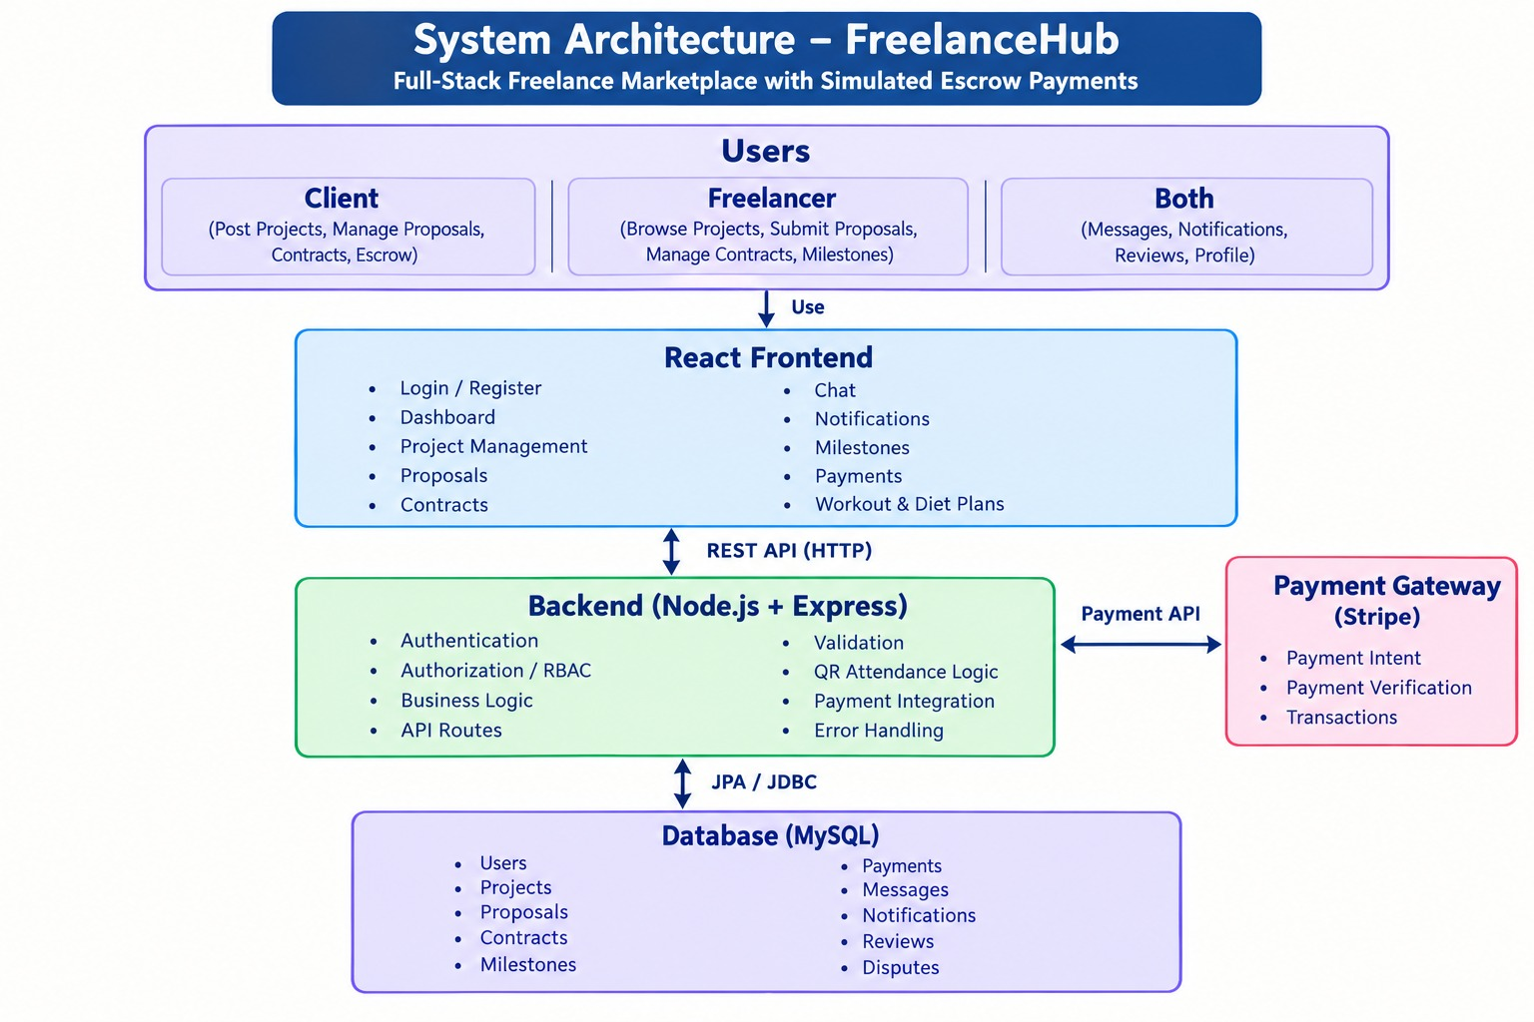
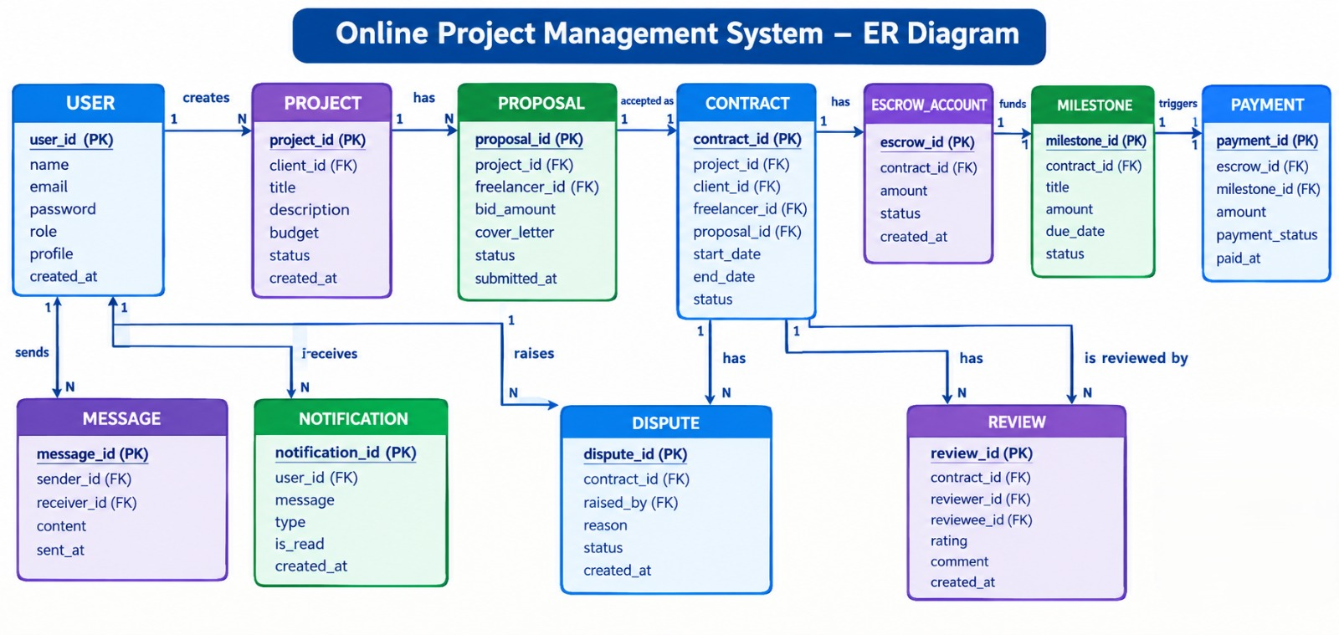

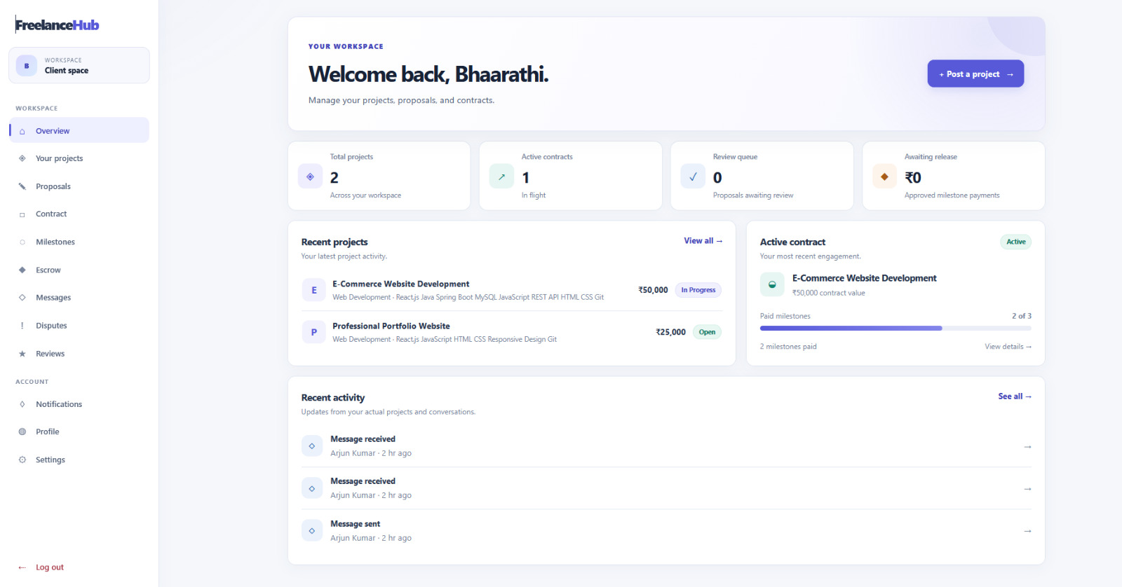

KLH Logo
[FREELANCE MARKETPLACE WITH ESCROW PAYMENTS]
Team ID: [14] | Section: [7] | Members: [A. Akshaya – 2520030189], [Y. Bhaarathi – 2520030211], [Madhan Gopal – 2520030263] | Guide: [Dr. S. Spandana]
Database Systems Engineering and Distributed Backend Development (25CS1302E) | KLH Bachupally Campus, CSE | PBL 2026-27
Abstract
Tools & Technologies
A web-based platform connecting clients and freelancers for project collaboration.
Supports job posting, proposal submission, contracts, milestones, and work approval.
Provides simulated escrow payments to improve payment transparency and trust.
Front-End: React
Back-End: Node.js
Database: MySQL
Tools: VS Code
Problem Statement & Objectives
Problem statement
Freelancers face delayed payments and unclear project requirements.
Clients may experience incomplete work, missed deadlines, and payment risks.
Objectives:
Create a centralized platform for clients and freelancers.
Simplify project posting, discovery, and proposal management.
Track contracts, milestones, and work submissions.
Provide simulated escrow payment management.
System Architecture
[Insert architecture diagram: Front-End – REST API – Database]
Existing vs Proposed System
Feature | Existing System | Proposed System
Project posting | Separate platforms | Centralized
Proposal management | Varies by platform | Organized
Project tracking | Limited | Milestone-based
Payment handling | Varies | Simulated escrow
Communication | Separate tools may be needed | Integrated messaging
ER Diagram & Database Design
[Insert ER diagram with entities, keys and relationships]
Feasibility Study
Technical: Uses React, Node.js, Express, and JSON storage.
Economic: Uses open-source tools and requires no paid database.
Operational: Provides simple dashboards and organized project tracking.
Schedule: Can be developed and tested within the project timeline.
Implementation Screenshots
[Screenshot 1]
[Screenshot 2]
Results & Testing
Conclusion
Future Scope
User registration and login APIs tested.
Project creation and proposal management supported.
Contract and milestone tracking implemented.
Escrow payment flow simulated and tested.
Provides a centralized platform for managing freelance projects.
Organizes the process from project posting to completion.
Improves transparency through milestone tracking and simulated escrow payments.
Real payment gateway integration.
AI-based freelancer and project recommendations.
Real-time chat and notifications.
Advanced analytics and identity verification.
References:
[1] Meta, React Documentation, https://react.dev/
[2] Open JS Foundation, Node.js Documentation, https://nodejs.org/docs/
[3] Open JS Foundation, Express.js Documentation, https://expressjs.com/
QR: GitHub

