Slide 1

NETWORK INTRUSION DETECTION USING RANDOM FOREST AND GRADIENT-BOOSTED TREES
“Ensemble Learning for Intrusion Detection”
SECTION – 09
Batch - 10
2520030211 – Y . Bhaarathi
2520030189 – A . Akshaya
Under the guidance of
Dr. Rani
Professor, Department of CSE

Slide 2
Introduction & Problem
Introduction
Network attacks are increasing in number and complexity.
Intrusion Detection Systems (IDS) monitor network traffic to identify malicious activities.
Traditional systems mainly depend on predefined rules or signatures.
Machine Learning can learn attack patterns from network traffic.
Problem Statement
To develop a machine-learning-based system that can detect and classify malicious network traffic accurately using Random Forest and Gradient-Boosted Trees.

Slide 3
Objectives
Objectives
Collect a suitable network intrusion dataset.
Preprocess and clean the network traffic data.
Analyse important network traffic features.
Train Random Forest and Gradient-Boosted Trees models.
Detect normal and malicious network traffic.
Compare both models using performance metrics.
Identify the better-performing model for intrusion detection.
We are using Dataset Named “CIC-IDS2017” created by Canadian Institute for CyberSecurity

Slide 4
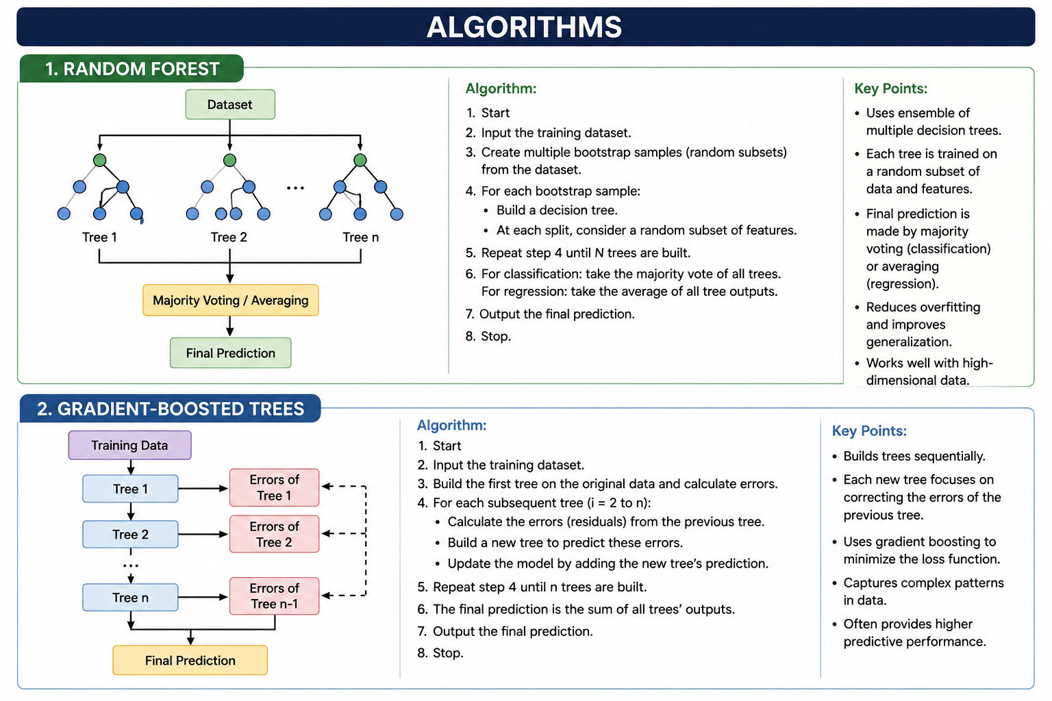

Slide 5
Expected Results & Conclusion
Expected Results
Accurate Traffic Classification – Classify network traffic as Normal or Malicious.
Attack Detection – Detect different types of cyberattacks available in the dataset.
Effective Model Training – Train both Random Forest and Gradient-Boosted Trees using the prepared network data.
Performance Comparison – Compare both models using Accuracy, Precision, Recall, and F1-score.
Best Model Selection – Identify the model that provides better and more reliable intrusion detection.
Improved Network Security – Provide an automated solution that helps detect potential threats Conclusion
In this project, we will develop a network intrusion detection system that uses machine learning to identify cyberattacks. We will collect and clean network traffic data, train Random Forest and Gradient-Boosted Trees and use them to classify network traffic as normal or malicious. Finally, we will compare both models to determine which performs better in detecting network attacks.

Slide 6
Thank You

