Slide 1
NETWORK INTRUSION DETECTION USING RANDOM FOREST AND GRADIENT-BOOSTED TREES
2520030211 – Y . Bhaarathi
2520030189 – A . Akshaya
SECTION – 09
Batch - 10

Slide 2
1.Problem Definition
Problem Definition
Network intrusion occurs when unauthorized or malicious activities are detected in a computer network.
Cyberattacks such as DDoS, DoS, Brute Force, Botnet, PortScan, and Web Attacks can affect network security and system availability.
It is difficult for organizations to continuously monitor large amounts of network traffic and identify attacks manually.
Machine learning can analyze network traffic data and identify patterns associated with normal and malicious activities.
This project develops a Network Intrusion Detection system using Random Forest and Gradient-Boosted Trees.
Why is this problem important?
Helps organizations identify malicious network traffic.
Supports early detection of cyberattacks.

Slide 3
Helps protect systems and sensitive information.
Reduces the effort required for manual network monitoring.
Who will use the solution?
Network administrators
Cybersecurity teams
Security analysts
Network monitoring teams
Expected Output
Input:
Network traffic information
↓
Machine Learning Models:
Random Forest + Gradient-Boosted Trees
↓
Output:
Normal / Benign or Malicious / Attack prediction
Detection of suspicious network traffic

Slide 4
2. Dataset Collection
Dataset Name: CIC-IDS2017
Dataset Source: Canadian Institute for Cybersecurity (CIC), University of New Brunswick. The dataset was downloaded from Kaggle.
Dataset Download: The dataset was downloaded as a ZIP file containing 8 Parquet files, which were converted to CSV format for analysis.
Dataset Files:
  Benign-Monday
  Botnet-Friday
  Bruteforce-Tuesday
  DDoS-Friday
  DoS-Wednesday
  Infiltration-Thursday
  Portscan-Friday
  WebAttacks-Thursday

Slide 5
Features/Columns: The dataset contains network traffic features such as flow duration, source/destination information, ports, protocol, packet statistics, byte statistics, timing information, and TCP/flow characteristics.
Target Column: Label
Target Values:
  BENIGN → Normal network traffic
  Attack labels → Malicious network traffic
Number of Rows and Columns:
Loading: Benign-Monday-no-metadata.parquet Rows: 458831 | Columns: 78
Loading: Botnet-Friday-no-metadata.parquet Rows: 176038 | Columns: 78
Loading: Bruteforce-Tuesday-no-metadata.parquet Rows: 389714 | Columns: 78
Loading: DDoS-Friday-no-metadata.parquet Rows: 221264 | Columns: 78
Loading: DoS-Wednesday-no-metadata.parquet Rows: 584991 | Columns: 78
Loading: Infiltration-Thursday-no-metadata.parquet Rows: 207630 | Columns: 78
Loading: Portscan-Friday-no-metadata.parquet Rows: 119522 | Columns: 78
Loading: WebAttacks-Thursday-no-metadata.parquet Rows: 155820 | Columns: 78

Slide 6
3. Data Understanding
From the CIC-IDS2017 dataset:
Records:2313810
Features: Network traffic features such as flow, packet, byte, protocol, port, timing, and TCP-related features.
Target: 1 (Label)
Target Column: Label
Total Columns:78
Duplicate Records:82004
Missing Values: 0 No missing values found.
Statistical Summary
For numerical features, statistical analysis can include:
Mean
Median
Standard deviation
Minimum
Maximum
Quartiles

Slide 7
Important Network Features
Flow Duration : Represents how long a network connection or flow continues.
Total Fwd Packets : Represents the number of packets sent in the forward direction.
Total Backward Packets : Represents the number of packets sent in the backward direction.
Flow Bytes/s : Represents the rate of bytes transferred during a network flow.
Flow Packets/s : Represents the rate of packets transferred during a network flow.
Unique Values
Label : The Label column contains different types of network traffic, such as:
BENIGN ,Botnet , Bruteforce , DDoS , DoS , Infiltration , PortScan , Web Attacks
Protocol : Different network protocols used in the traffic.
Source/Destination Information : Different source and destination IP addresses and ports.
Purpose : Checking unique values helps us understand the different categories and types of network traffic present in the dataset.

Slide 8
4. Data Preprocessing
1. Remove irrelevant attributes
•Remove:
•Flow ID , Source IP , Destination IP
•because they mainly identify individual network connections.
2. Handle missing/blank values
•Check for missing and blank values.
•For example: Numerical features , Categorical features
•Missing numerical values are handled using median.
•Missing categorical values are handled using mode.
3. Handle infinite/incorrect values
•Check for:
•Infinite values , Negative values , Invalid numerical values
•Replace infinite values with missing values and handle them.

Slide 9
4. Handle categorical variables
•Categorical variables need to be converted into numerical form.
•Therefore, encoding techniques such as One-Hot Encoding are used.
•Example:
•Protocol
•TCP
5. Handle numerical variables
•Numerical variables are identified and prepared for model training.
•Examples:
•Flow Duration
Outlier Detection
•IQR method can be used to identify unusual values in:
•Flow Duration
•Total Fwd Packets
•Flow Bytes/s

Slide 10
Incorrect Data
Check for:
•Missing values
•Infinite values
•Negative values
•Duplicate records
•Incorrect data types
Final preprocessing flow
Raw Dataset
↓
Remove irrelevant attributes
↓
Handle missing/blank values
↓
Handle incorrect values
↓
Encode categorical variables
↓
Detect outliers
↓
Create target variable
↓
Preprocessed Dataset

Slide 11
Numerical Variables | Categorical Variables
Protocol Flow Duration Total Fwd Packets Total Backward Packets Fwd Packets Length Total Bwd Packets Length Total Fwd Packet Length Max Fwd Packet Length Min Flow Bytes/s Flow Packets/s Bwd PSH Flags Fwd URG Flags Bwd URG Flags Down/Up Ratio Avg Packet Size Bwd Avg Packets/Bulk Bwd Avg Bulk Rate Subflow Fwd Packets Active Max Active Min Idle Mean Idle Std Idle Max | Label

Slide 12
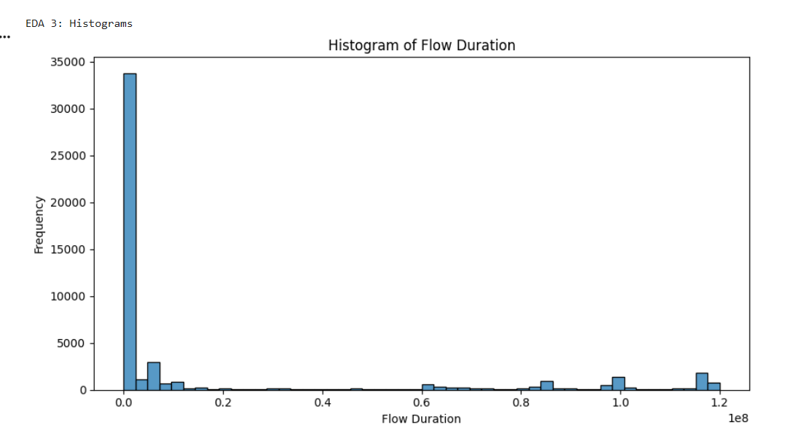
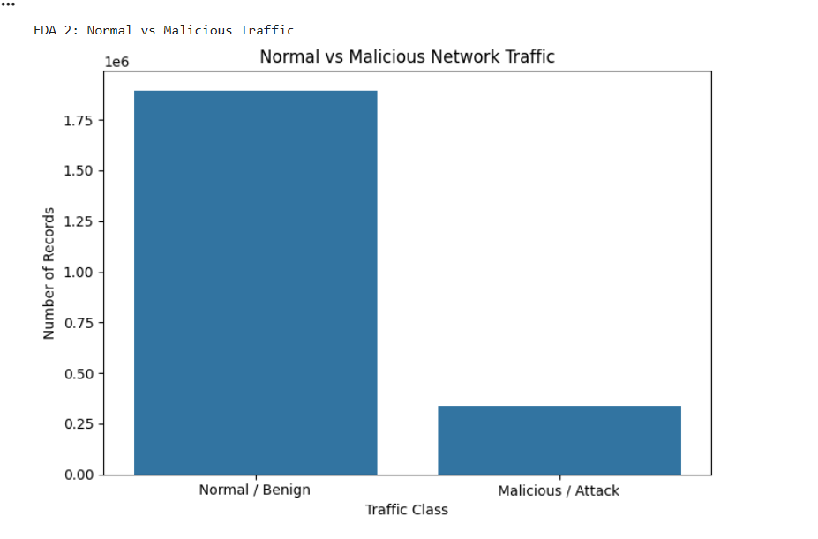
5. Exploratory Data Analysis — EDA
Histogram
Bar chart

Slide 13
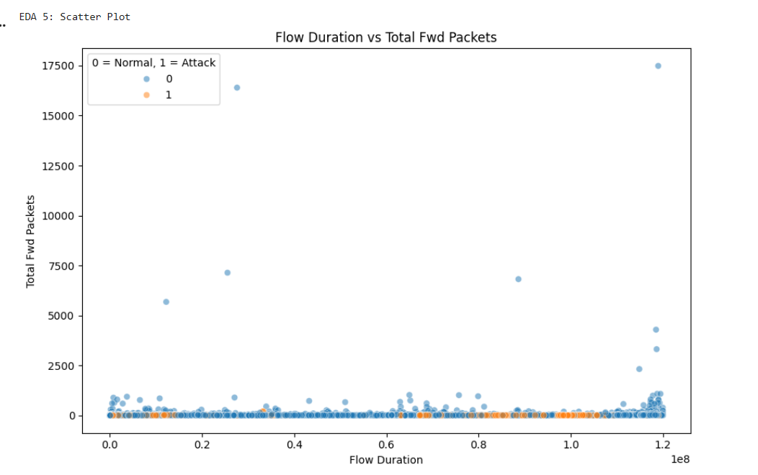
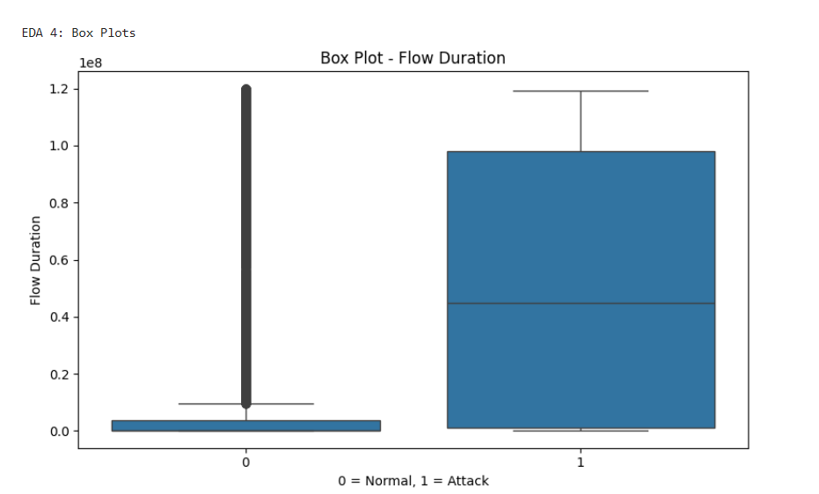
Scatter plot
Box plot

Slide 14
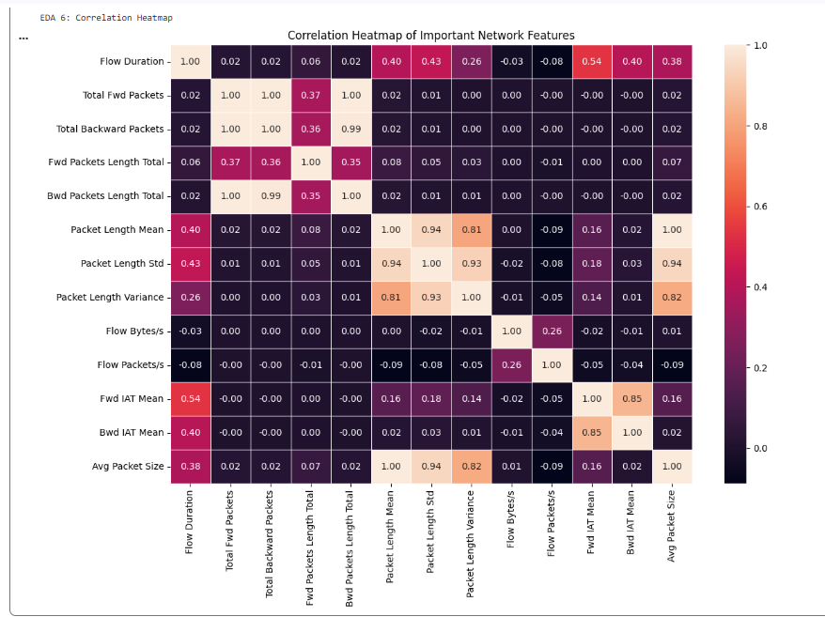
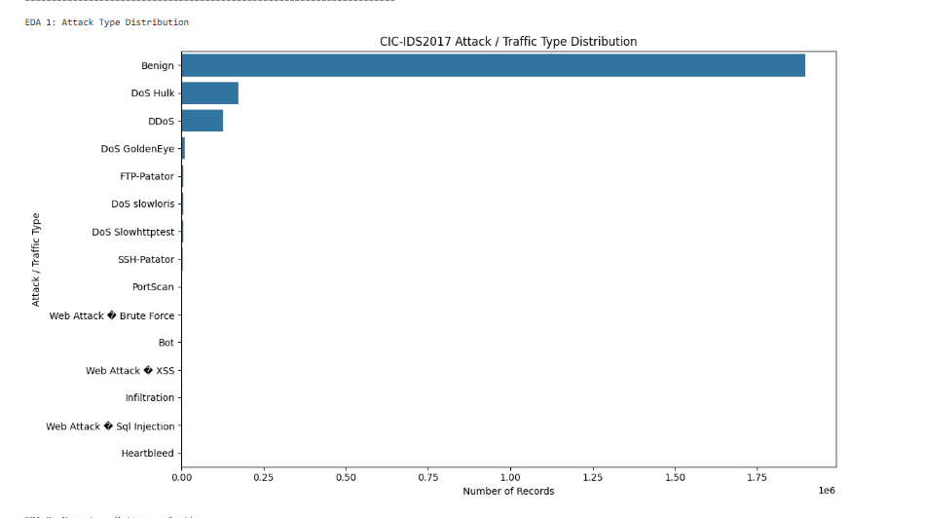
Correlation heatmap
Count plot

Slide 15
Thank You

