Slide 1
UE20CS461A – Project Phase – 2
END SEMESTER ASSESSMENT
Project Title : Machine Intelligence Based Quality Of Service Framework to Address Network Slicing Issues in 5G
Project ID : 100
Project Guide : Dr.Vinodha K
Project Team :
A Mohan Kumar PES2UG20CS002
Allu Vineela Sravanthi PES2UG20CS036
Sathyanarayana RK PES2UG20CS315
Suhas TJ PES2UG20CS355

Slide 2
Outline
Abstract
Summary of Requirements and Design ( Phase - 1)
Summary of Methodology / Approach (Phase - 1)
Design Description
Modules and Implementation Details
Project Demonstration and Walkthrough
Test Plan and Strategy
Results and Discussion
Lessons Learnt
Conclusion and Future Work
References

Slide 3
Abstract
Introduction to 5G Network Slicing and QoS Challenges:
5G advancements bring network slicing, creating customized virtual networks for various applications.
Challenge: Ensuring Quality of Service (QoS) for these network slices in dynamic 5G scenarios.
Project Objective: Comparative Analysis and Dynamic Prediction
Objective: Conduct a comparative study among: Traditional algorithms, Supervised models, and Techniques involving neural networks (primarily LSTM). Using Simpy simulation to establish a baseline traditional approach.
Goal: Identify the most accurate resource allocation method for network slices.

Slide 4
Abstract
Findings: LSTM outperforms other methods.
Highlights: Superior adaptability and predictive accuracy, especially in dynamic conditions and ensuring the satisfaction of QoS Parameters.
Project Contribution: Proving that machine learning can accurately and flawlessly predict the right network slice for the given application and handle the dynamic allocation of resources for the slice in the 5G environment.
Benefits: Provides real-time insights , Offers practical recommendations for optimal slice selection , Crucial for managing complexities in 5G networks.
Project Impact: Development of a system which greatly aids the network administrator to assign the best suited network slice for the user.
Purpose:
Ensures uninterrupted service in the intricate landscape of 5G network slicing.

Slide 5
PROBLEM STATEMENT
5G networks are expected to support a wide range of diverse applications with varying QoS requirements, which makes it challenging to allocate network resources efficiently.
Network slicing is a promising solution that enables the creation of virtual networks meeting the needs of specific applications and services.
However, managing and allocating resources dynamically among network slices is a complex task that requires an intelligent QoS framework.
The aim of this project is to develop a machine intelligence-based QoS framework that correctly predicts the right network slice for the application and optimizes dynamic resource allocation for the chosen network slice.

Slide 6
INTRODUCTION
As the world is moving towards a more connected future, the demand for faster and more reliable communication networks is rapidly increasing. 5G is the next generation of wireless network technology, offering high bandwidth, lower latency, and increased network capacity.
Network slicing is a key feature of 5G networks that enables the creation of multiple virtual networks on a single physical network infrastructure. Each network slice can be tailored to meet specific requirements, such as latency, bandwidth, and security. However, implementing network slicing in 5G networks presents several challenges, such as managing and optimizing network resources, ensuring quality of service (QoS), and providing seamless connectivity across different network slices
To overcome these challenges, this project proposes a Machine intelligence-based framework that can dynamically allocate network resources, predict network traffic patterns, and optimize network performance based on real-time data analysis

Slide 7
OBJECTIVE
In the rapidly advancing realm of 5G networks, the proliferation of 5G technologies has introduced a critical feature known as network slicing, allowing the creation of specialized virtual networks tailored to diverse applications. However, the challenge lies in ensuring Quality of Service (QoS) metrics for each slice in dynamic scenarios. To address this, a comprehensive comparative analysis was conducted, exploring traditional algorithms, plain supervised models, and deep learning techniques using the Simpy simulation tool to construct a basic architecture for a traditional approach. Traditional algorithms and supervised models serve as benchmarks, highlighting their constraints in the dynamic 5G landscape. The study aims to compare traditional and machine intelligence approaches, focusing on determining which method offers the most accurate resource allocation to the slices and utilizes that technique to predict the correct slice type for the application. This research endeavors to provide insights into the efficacy of different approaches in addressing the intricate challenges of resource allocation in the context of 5G network slicing, contributing to the advancement of this transformative technology.

Slide 8
OVERVIEW
The landscape of communication systems underwent a seismic shift with the advent of 5G technology, introducing unparalleled advancements in speed, latency, and overall efficiency, surpassing its predecessor, 4G. Among the groundbreaking innovations within the domain of 5G, the concept of "network slicing" stands as a transformative paradigm. This pioneering approach allows for the creation of distinct and virtualized network segments, finely tailored to meet the requirements of each application by allocating the right network slice type which are enhanced mobile broadband (eMBB), ultra-reliable low latency communications (uRLLC), and massive machine type communications (mMTC). Each slice assigned is meticulously designed to fulfill unique service-level agreement (SLA) requirements, effectively dedicating resources and services for optimized network efficiency.

Slide 9
APPROACH
We are demonstrating a comparative analysis between traditional and machine intelligence based approach. By performing a traditional based allocation of resources for each individual slice by using different allocation methods such as priority based ,proportional fairness, dynamic allocation and weighted based allocation. And for machine learning many algorithms like supervised, deep learning and reinforcement approaches have been used, in the end we are comparing the performance and efficiency of individual slices by both approaches and stating the advantages of highly preferred type of allocation.

Slide 10
Summary of Requirements and Design
System Features:
Machine Intelligence Based QoS Framework:
Utilization of machine learning algorithms for granular resource allocation.
Management of network slices to accommodate diverse QoS exigencies.
Real-time monitoring for prompt anomaly detection and resolution.
Granular user management ensuring optimal resource allotment.
Elasticity and adaptability to fluid network dynamics.
Operating Environment:
Deployment Flexibility: Cross-compatibility across multiple hardware platforms and OS.
Key Software Components: ML algorithms, network slicing modules, real-time monitoring tools.
Minimalistic network infrastructure requirements ensuring accessibility.
Constraints, Assumptions, and Dependencies:
Regulatory Adherence: Compliances dictating system design and implementation.
Hardware Optimization: Mitigating system performance impacts due to hardware limitations.
Simulation Refinement: Augmenting simulation accuracy for dependable outcomes.
Seamless Interface Integration: Compatibility assurance with existing applications.
Critical Application Focus: Prioritizing performance for mission-critical applications.
Security Measures: Implementation of stringent safety and data protection protocols.

Slide 11
Summary of Requirements and Design
4. Risks:
Resource Optimization Challenge: Balancing resource needs for optimal system performance.
Technical Integration Complexity: Overcoming challenges in system integration.
Security Vulnerability Mitigation: Addressing risks of system breaches and user adoption hurdles.
Regulatory Compliance Management: Aligning with diverse regulatory frameworks.
5. Functional Requirements:
Slice Management: Creation, allocation, and dynamic scaling of network slices.
QoS Management: Emphasizing QoS adherence, fault tolerance, and proactive monitoring.
Robust Error Handling: Ensuring resilient error recovery and insightful parameter analysis.
6. Hardware Requirements:
Cross-Platform Compatibility:
Adherence to stringent hardware specifications for optimal performance.
7. Software Requirements:
Machine Learning Framework Integration: Incorporation of ML frameworks for model training and deployment.
OS and Tool Compatibility: Ensuring compatibility with various OS and essential libraries.
8. Performance Requirements:
Reliability Assurance: Continuous and consistent system functionality under normal operations.
- Robustness and Availability: Seamless operation despite unforeseen events or errors.
- Scalability and Security: Ensuring scalability while upholding stringent security protocols.

Slide 12
Summary of Requirements and Design
Strengths:
Machine learning advancements in dynamic QoS optimization.
Real-time monitoring enabling agile resource allocation.
Network slicing's adaptability and scalability for varied demands.
Weaknesses:
Regulatory constraints influencing system design.
Challenges in seamless integration with existing systems.
Security vulnerabilities impacting user adoption.

Slide 13
REQUIREMENTS
A powerful computer with high-performance CPUs and GPUs capable of handling large amounts of data and running computationally intensive machine learning and artificial intelligence algorithms.
Sufficient memory and storage capacity to accommodate the data sets and software applications required for the project.
Programming languages such as Python or C++, MATLAB for developing and implementing machine learning and artificial intelligence algorithms.
Data management tools and libraries such as Pandas, NumPy, and SciPy for data preprocessing and analysis.
Machine learning and artificial intelligence frameworks such as TensorFlow, Keras, and PyTorch for developing and training models.
Network simulation software such as NS-3, Simpy to simulate the 5G network environment.

Slide 14
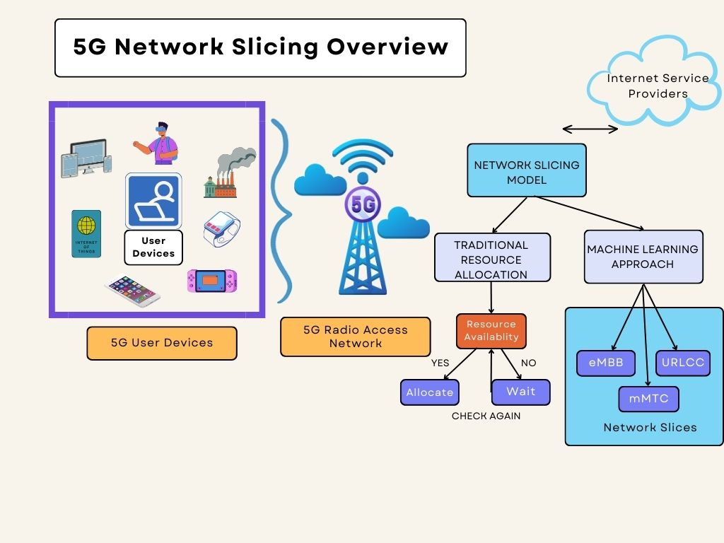
DESIGN DETAILS

Slide 15
Summary of Methodology / Approach
Research Project
Proposed Methodology
Model Architecture
Details of the approach- benefits/drawbacks

Slide 16
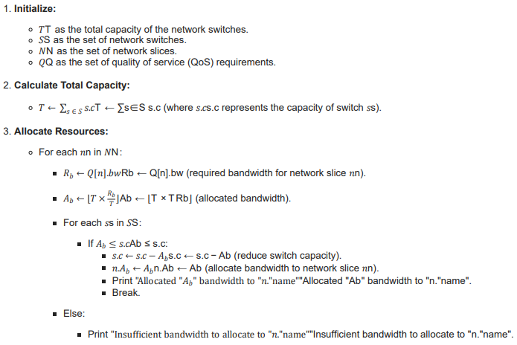
Design Description
Research Project
Algorithm used and explain the logical workflow.
WEIGHTED FAIRNESS: A resource allocation method which allocates resources as per the weight associated with the applications requirement.

Slide 17
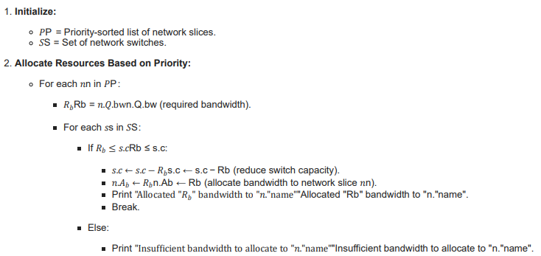
PRIORITY BASED ALLOCATION: A resource allocation method in which
resources are allocated based on the priority of the application.

Slide 18
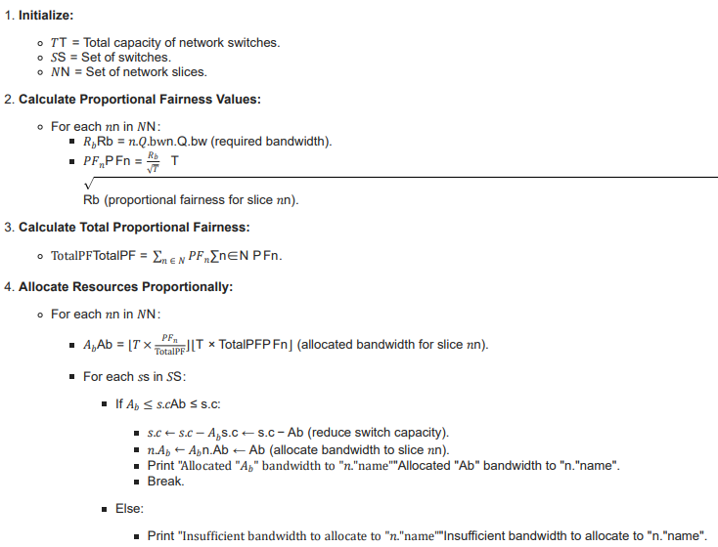
PROPORTIONAL FAIRNESS: A resource allocation method in which all the applications are treated fairly and equal importance is associated with them.

Slide 19
Dynamic Capacity Resource Allocation – Allocates resources based on real-time demand, scales resources for network slices and responds to application requirements.

Slide 20
Modules and Implementation Details
Enlist all the modules/ features of the application.
Module-wise implementation details that include
Module name, Technology used, code explanation.
Interpretation with Algorithms & Pseudocode used. (applicable for Research projects)

Slide 21
Project Demonstration
Exhibit the working demonstration of complete project.
It has to be complete in all aspects
Data set creation needs to be showed wherever applicable.
Note :
If any special facility required, please make sure that you have that set up. For example, if Internet connectivity is required, please have your mobile or hotspot set up.

Slide 22
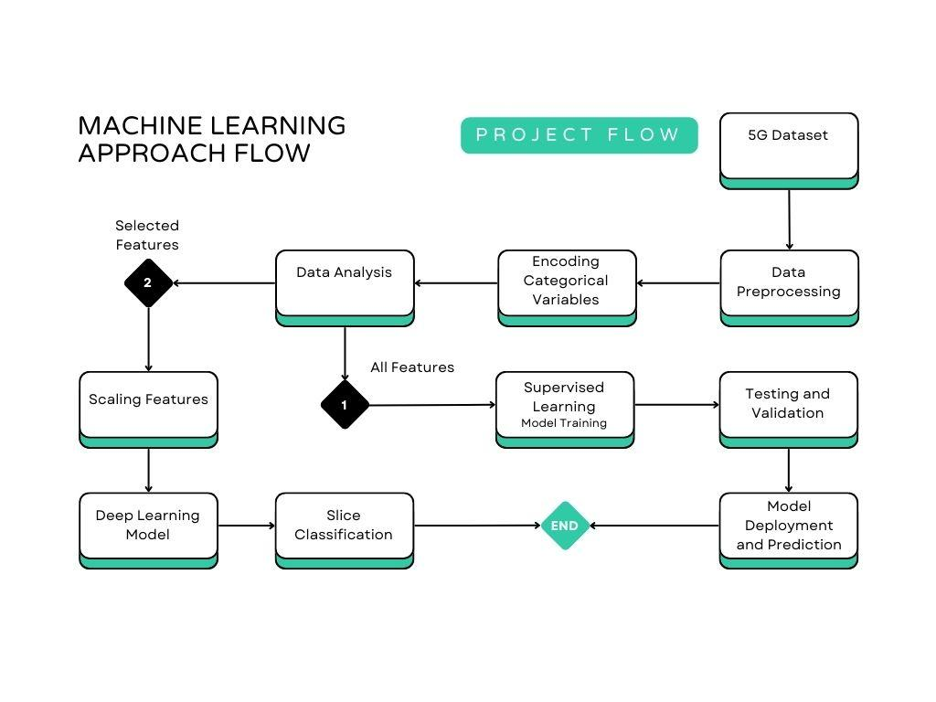
Project Demonstration
Exhibit the working demonstration of complete project.
It has to be complete in all aspects
Data set creation needs to be showed wherever applicable.
Note :
If any special facility required, please make sure that you have that set up. For example, if Internet connectivity is required, please have your mobile or hotspot set up.

Slide 23
Walkthrough
Demo and Product walk thru

Slide 24
Results and Discussion
Algorithm | slices allocated(%) | Fully allocated slices | remaining slices | Remarks
Priority-based allocation | 70 % | 63 | 27 | Efficiently prioritized slices based on specified priorities.
weight fair queue | 80% | 72 | 18 | Allocated resources based on weight factors, giving priority to slices with higher weights.
Proportional fairness | 100% | 90 (partially filled requirements) | 0 | Ensured fair resource distribution by allocating 60 - 70% of resource requirements for all slices.
Dynamic (over time) ( Dynamic Resource allocation algorithm ) | 100% | 90 (fully filled requirements) | 0 | Dynamically allocated and deallocated resources over time based on changing demand and network conditions.

Slide 25
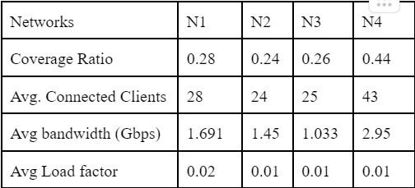
Results and Discussion

Slide 26
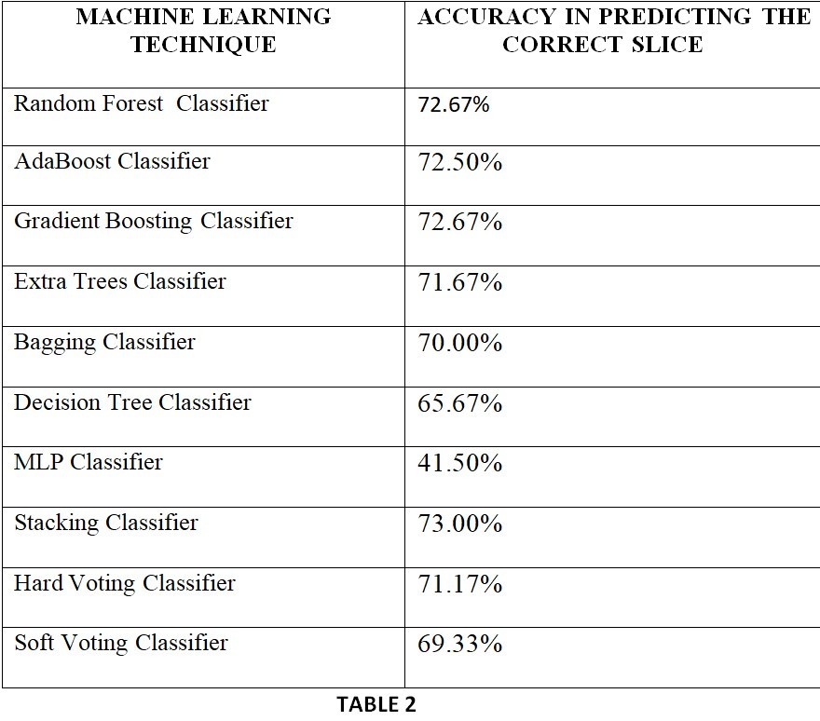
Results and Discussion

Slide 27
Schedule
Discussion of how well the schedule was met.
You can add a table,
planned efforts (as per initial estimates) and actual efforts.
If there is a deviation, what is the reason for the change.

Slide 28
Lessons Learnt
Resource Allocation Strategies: Understanding the complexity of resource allocation strategies in network slicing was crucial. Initially, more emphasis on various machine learning models could have enhanced optimization.
Real-world Simulation: Simulations played a pivotal role, yet earlier access to diverse real-world datasets could have provided a more comprehensive perspective.
Interdisciplinary Collaboration: Stronger interdisciplinary collaboration could have enhanced the project's depth, incorporating diverse insights from networking, AI, and optimization experts.
Dynamic Network Conditions: Adapting to dynamic network conditions requires a robust learning model. The incorporation of adaptable algorithms at an early stage might have been beneficial.
Regulatory and Ethical Considerations: Deeper insight into the legal and ethical implications of network slicing would have provided a more comprehensive approach.

Slide 29
Overview of Issues Overcome
Resource Scarcity: The challenge of efficient resource utilization was mitigated through sophisticated resource allocation models.
Network Complexity: Dealing with the intricate nature of networks was addressed through advanced machine learning techniques and simulations.
Dynamic Adaptation: Coping with dynamic network changes was tackled by implementing adaptable algorithms and dynamic resource allocation strategies.
Isolation and Security: Ensuring isolation between network slices and guaranteeing security was achieved through rigorous encryption protocols and slice separation measures.
Service Quality Optimization: Optimizing service quality for various applications was achieved by fine-tuning allocation policies based on specific requirements.

Slide 30
Conclusion and Future work
Key Findings:
Ensemble Techniques:
Stacking Classifier outperformed Voting Classifier, highlighting the benefit of combining models.
Model Performance:
Random Forest, AdaBoost, Gradient Boosting: Competitive accuracies.
MLP Classifier: Lower accuracy, needs optimization.
Stacking Classifier:
Emerged as top-performing model, showcasing enhanced predictive accuracy.

Slide 31
Conclusion and Future work
Conclusions:
Recommendations:
Encourages further exploration of ensemble techniques and model combinations.
Future work involves hyperparameter tuning, additional models, and advanced deep learning.
Continuous Improvement:
Emphasizes dynamic nature of ML models, requiring regular updates for accuracy.

Slide 32
Conclusion and Future work
Future Work:
Traffic Prediction:
Utilizing 5G capabilities for real-time traffic prediction and adaptive systems.
Security Enhancement:
Integration of predictive analytics to strengthen urban security frameworks.
Integrated Approach:
Interconnecting traffic and security prediction models for agile urban ecosystems.
Challenges & Collaboration:
Prioritizing data security, collaborating with stakeholders for seamless integration.
Overall Goal:
Pioneering smart and secure urban environments by leveraging 5G connectivity and predictive analytics for network slicing advancements in 5G.

Slide 33
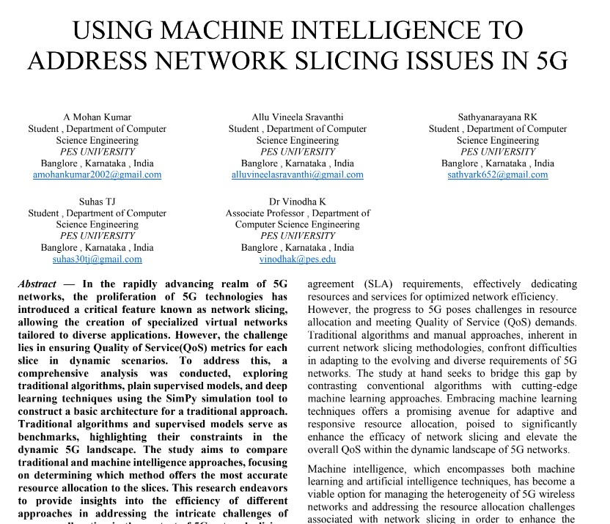
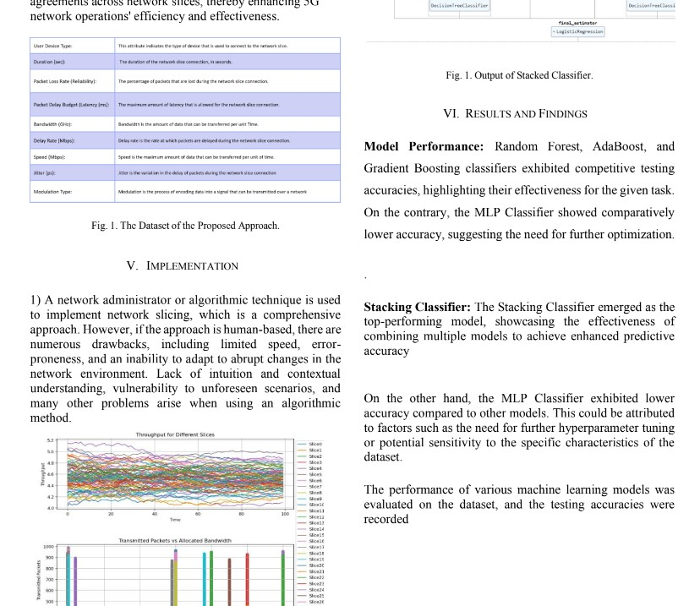
IEEE RESEARCH PAPER DRAFT

Slide 34
Documentation
Show the evidences, status of the below documents:
Project report submitted in department?
IEEE (similar) Format of Paper current status? Which Conferences are you targeting?
Video (2-3 minutes) of your project? Please Play.
Add the Github repository link.
All artifacts of your project uploaded in the CSE Project repository?

Slide 35
References
[1] R. Li et al., "Deep Reinforcement Learning for Resource Management in Network Slicing," in IEEE Access, vol. 6, pp. 74429-74441, 2018, doi: 10.1109/ACCESS.2018.2881964.(RP -1)
[2] Y. Kim and H. Lim, "Multi-Agent Reinforcement Learning-Based Resource Management for End-to-End Network Slicing," in IEEE Access, vol. 9, pp. 56178-56190, 2021, doi: 10.1109/ACCESS.2021.3072435. (RP-5)
[3] M. Yan, G. Feng, J. Zhou, Y. Sun and Y. -C. Liang, "Intelligent Resource Scheduling for 5G Radio Access Network Slicing," in IEEE Transactions on Vehicular Technology, vol. 68, no. 8, pp. 7691-7703, Aug. 2019, doi: 10.1109/TVT.2019.2922668. (RP – 9)
[4] F. Song, J. Li, C. Ma, Y. Zhang, L. Shi and D. N. K. Jayakody, "Dynamic Virtual Resource Allocation for 5G and Beyond Network Slicing," in IEEE Open Journal of Vehicular Technology, vol. 1, pp. 215-226, 2020, doi: 10.1109/OJVT.2020.2990072. (RP – 4)
[5] A. Huang, Y. Li, Y. Xiao, X. Ge, S. Sun and H. -C. Chao, "Distributed Resource Allocation for Network Slicing of Bandwidth and Computational Resource," ICC 2020 - 2020 IEEE International Conference on Communications (ICC), Dublin, Ireland, 2020, pp. 1-6, doi: 10.1109/ICC40277.2020.9149296. (RP – 2)
[6] L. U. Khan, I. Yaqoob, N. H. Tran, Z. Han and C. S. Hong, "Network Slicing: Recent Advances, Taxonomy, Requirements, and Open Research Challenges," in IEEE Access, vol. 8, pp. 36009-36028, 2020, doi: 10.1109/ACCESS.2020.2975072. (RP – 3)
[7] A. Thantharate, R. Paropkari, V. Walunj, C. Beard and P. Kankariya, "Secure5G: A Deep Learning Framework Towards a Secure Network Slicing in 5G and Beyond," 2020 10th Annual PESU Confidential Page 13 of 14 HIGH LEVEL DESIGN DOCUMENT Computing and Communication Workshop and Conference (CCWC), Las Vegas, NV, USA, 2020, pp. 0852-0857, doi: 10.1109/CCWC47524.2020.9031158. (RP – 6)
[8] S. Rathore, J. H. Park and H. Chang, "Deep Learning and Blockchain-Empowered Security Framework for Intelligent 5G-Enabled IoT," in IEEE Access, vol. 9, pp. 90075-90083, 2021, doi: 10.1109/ACCESS.2021.3077069. (RP – 7)
[9] Khan, S., Khan, S., Ali, Y. et al. Highly Accurate and Reliable Wireless Network Slicing in 5th Generation Networks: A Hybrid Deep Learning Approach. J NetwSyst Manage 30, 29 (2022).
[10] V. P. Kafle, P. Martinez-Julia and T. Miyazawa, "Automation of 5G Network Slice Control Functions with Machine Learning," in IEEE Communications Standards Magazine, vol. 3, no. 3, pp. 54-62, September 2019, doi: 10.1109/MCOMSTD.001.1900010. (RP – 8)
[11] X. Li et al., "Network Slicing for 5G: Challenges and Opportunities," in IEEE Internet Computing, vol. 21, no. 5, pp. 20-27, 2017, doi: 10.1109/MIC.2017.3481355.

Slide 36
Thank You

Slide 37
Test Plan and Strategy
Provide,
Testing activities that are carried out along with timeline.
What are the test methods followed? and Why?
(Example) – Functional Testing (Unit, Integration,…)
Non – Functional Testing (Performance, Security,…)
What is the test environment? (Explain the role of each member in the team)
Benefits of this approach & are there any drawbacks?
Test tools used? Automated test tools? Open-source tools?
Note:
Appropriate modifications can be done for Research Projects
Add as many slides as required

