Slide 1
PHP SNMP (Windows)
Yen-Cheng Chen
Department of Information Management
National Chi Nan University

Slide 2
References
PHP
  http://www.php.net/
PHP Manual: SNMP
  http://www.php.net/manual/en/book.snmp.php
Example Programs
  http://ycchen.im.ncnu.edu.tw/nm/phpsnmp.zip

Slide 3
PHP 5 Installation (Windows)
Download (Windows Installer)
http://windows.php.net/downloads/releases/php-5.4.15-nts-Win32-VC9-x86.zip
http://ycchen.im.ncnu.edu.tw/php-5.4.15-nts-Win32-VC9-x86.zip

Slide 4
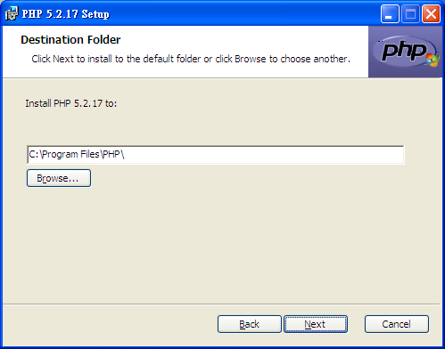
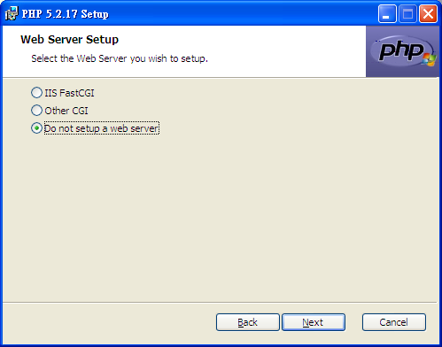

Slide 5
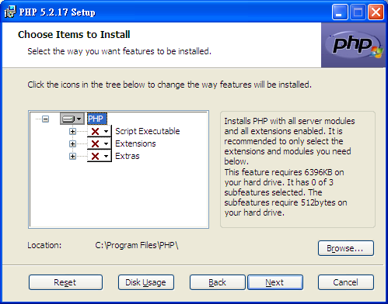
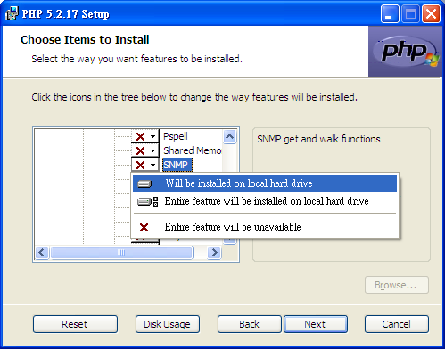

Slide 6
手動安裝PHP
Download (Manual Installation) http://windows.php.net/downloads/releases/php-5.2.17-nts-Win32-VC6-x86.zip
Extract the distribution file into a directory.
  C:\php
add C:\php to the PATH
Set up configuration file php.ini
  Find php.ini-recommended in C:\php
  Copy to php.ini and modify it.

Slide 7
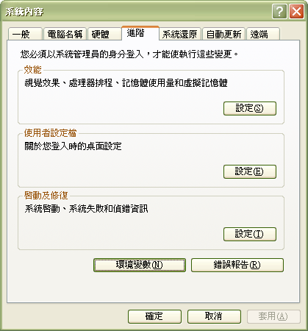
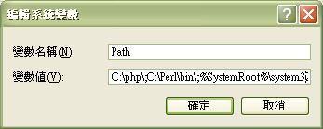
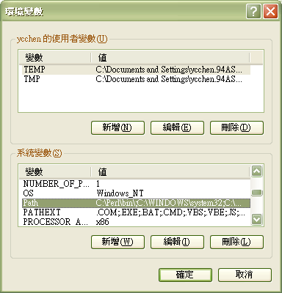
控制台 ➔ 效能及維護 ➔ 系統
1
5
C:\php\;
2
3
➔
4

Slide 8
PHP SNMP Configuration
php.ini
  ;extension=php_snmp.dll
  extension=php_snmp.dll
  extension_dir = "C:/xampp/php/ext"
Copy mibs directory
  Copy C:\php\extras\mibs to C:\usr
  C:\usr\mibs
If you have troubles in using GetIf after installing php_snmp,
  http://ycchen.im.ncnu.edu.tw/nm/macroRemoved.zip
  Uncompress it to C:\usr\mibs to overwrite some mib files.

Slide 9
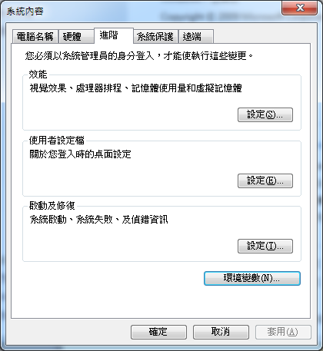
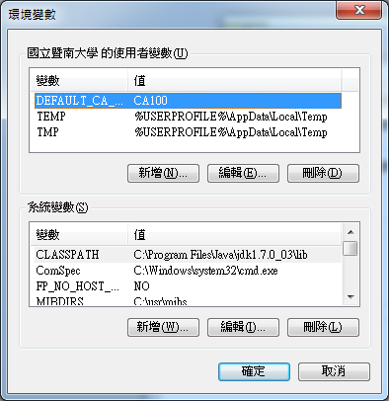
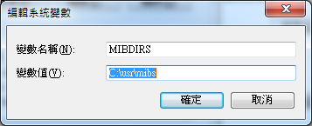

Slide 10
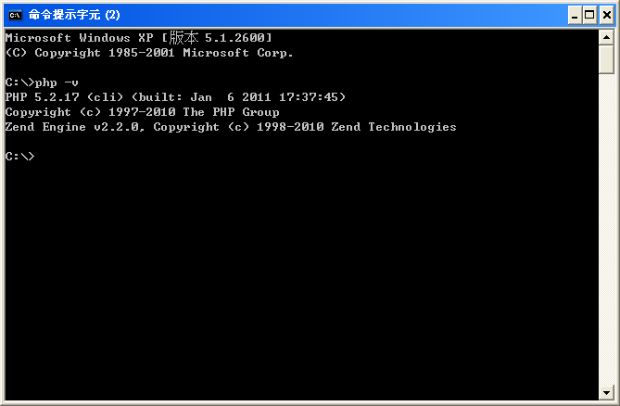
C:\>php -v

Slide 11
snmp_set_quick_print
ssqp.php
<?php
snmp_set_quick_print(true);
$sysUpTime=snmpget("127.0.0.1", "public", "system.sysUpTime.0");
$sOID=snmpget("127.0.0.1", "public", "system.sysObjectID.0");
echo "$sysUpTime\n";
echo "$sOID\n";
snmp_set_quick_print(false);
$sysUpTime=snmpget("127.0.0.1", "public", "system.sysUpTime.0");
$sOID=snmpget("127.0.0.1", "public", "system.sysObjectID.0");
echo "$sysUpTime\n";
echo "$sOID\n";
?>
C:\snmp>php ssqp.php
13:11:40:00.61
enterprises.311.1.1.3.1.1
Timeticks: (116520061) 13 days, 11:40:00.61
OID: enterprises.311.1.1.3.1.1

Slide 12
snmp_set_valueretrieval
ssvr.php
<?php
snmp_set_quick_print(true);
snmp_set_valueretrieval(SNMP_VALUE_LIBRARY);
$ipForwarding = snmpget("127.0.0.1", "public", ".1.3.6.1.2.1.4.1.0");
echo "SNMP_VALUE_LIBRARY: $ipForwarding\n";
snmp_set_valueretrieval(SNMP_VALUE_PLAIN);
$ipForwarding = snmpget("127.0.0.1", "public", ".1.3.6.1.2.1.4.1.0");
echo "SNMP_VALUE_PLAIN: $ipForwarding\n";
snmp_set_valueretrieval(SNMP_VALUE_OBJECT);
$ipForwarding = snmpget("127.0.0.1", "public", ".1.3.6.1.2.1.4.1.0");
echo "SNMP_VALUE_OBJECT:\n";
print_r($ipForwarding);
//echo $ipForwarding->value;
?>
SNMP_VALUE_LIBRARY: notForwarding
SNMP_VALUE_PLAIN: 2
SNMP_VALUE_OBJECT:
stdClass Object
(
[type] => 2
[value] => 2
)

Slide 13
ipForwarding OBJECT-TYPE
SYNTAX INTEGER {
forwarding(1), -- acting as a gateway
not-forwarding(2) -- NOT acting as a gateway
}
ACCESS read-write
STATUS mandatory
DESCRIPTION
"The indication of whether this entity is acting
as an IP gateway in respect to the forwarding of
datagrams received by, but not addressed to, this
entity. IP gateways forward datagrams. ..."
::= { ip 1 }

Slide 14
snmpget
get1.php
string snmpget ( string $hostname, string $community, string $object_id [, int $timeout [, int $retries ]] )
time unit of timeout: 10⁻⁶ sec
(μs)
<?php
$host = "127.0.0.1";
$community = "public";
$descr = snmpget($host, $community, "sysDescr.0");
echo "$descr\n";
$descr = snmpget($host, $community, "system.1.0");
echo "$descr\n";
$descr = snmpget($host, $community, ".1.3.6.1.2.1.1.sysDescr.0");
echo "$descr\n";
?>
HOST-RESOURCES-MIB::host.hrSystem.1.0
HOST-RESOURCES-MIB::hrSystemUptime.0

Slide 15
Use of $argv
get2.php
<?php
$host = $argv[1];
$community = $argv[2];
$oid=$argv[3];
$val = snmpget($host, $community, $oid);
echo "$oid = $val\n";
?>
$argv[0] $argv[1] $argv[2] $argv[3]
C:\phpSNMP>php get2.php 127.0.0.1 public ip.ipDefaultTTL.0
ip.ipDefaultTTL.0 = 128

Slide 16
snmpgetnext
getnext.php
string snmpgetnext ( string $host , string $community, string $object_id [, int $timeout [, int $retries ]] )
<?php
$host = "163.22.34.197";
$community = "nm2008";
snmp_set_quick_print(true);
$sysOID = snmpgetnext($host, $community, "sysDescr.0");
echo "$sysOID\n";
?>
C:\phpSNMP>php getnext.php
enterprises.171.10.36.1.11

Slide 17
snmpset
set.php
bool snmpset ( string $hostname , string $community , string $object_id , string $type , mixed $value [, int $timeout [, int $retries ]] )
<?php
$host = "127.0.0.1";
$community = "private";
$oid = ".1.3.6.1.2.1.2.2.1.ifAdminStatus.65539";
$isSet = snmpset($host, $community, $oid, "i", 2);
if ($isSet) {
$adminStatus = snmpget($host, $community, $oid);
echo "$adminStatus\n";
}
?>
$type:
i INTEGER
u unsigned INTEGER
t TIMETICKS
a IPADDRESS
o OBJID
s STRING
x HEX STRING
d DECIMAL STRING
"x", "00 1a 30 74 e4 1b"

Slide 18
snmpwalk
walk.php
array snmpwalk ( string $hostname , string $community , string $object_id [, int $timeout
[, int $retries ]] )
<?php
snmp_set_quick_print(true);
$host = "127.0.0.1";
$community = "public";
$oid = "interfaces.ifTable";
$arr = snmpwalk($host, $community, $oid);
print_r($arr);
?>

Slide 19
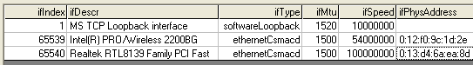
Array
(
[0] => 1
[1] => 65539
[2] => 65540
[3] => MS TCP Loopback interface
[4] => Intel(R) PRO/Wireless 2200BG Network Connection
[5] => Realtek RTL8139 Family PCI Fast Ethernet NIC
[6] => softwareLoopback
[7] => ethernetCsmacd
[8] => ethernetCsmacd
[9] => 1520
[10] => 1500
[11] => 1500
[12] => 10000000
[13] => 54000000
[14] => 100000000
[15] =>
[16] => 0:12:f0:9c:1d:2e
[17] => 0:13:d4:6a:ea:8d
…

Slide 20
snmprealwalk
realwalk.php
<?php
snmp_set_quick_print(true);
$host = "127.0.0.1";
$community = "public";
$initOid = "interfaces.ifTable";
$arr = snmprealwalk($host, $community, $initOid);
foreach ($arr as $oid => $val) {
echo "$oid = $val\n";
}
// print_r($arr);
?>

Slide 21
interfaces.ifTable.ifEntry.ifIndex.1 = 1
interfaces.ifTable.ifEntry.ifIndex.65539 = 65539
interfaces.ifTable.ifEntry.ifIndex.65540 = 65540
interfaces.ifTable.ifEntry.ifDescr.1 = MS TCP Loopback interface
interfaces.ifTable.ifEntry.ifDescr.65539 = Intel(R) PRO/Wireless 2200BG Net…
interfaces.ifTable.ifEntry.ifDescr.65540 = Realtek RTL8139 Family PCI Fast …
interfaces.ifTable.ifEntry.ifType.1 = softwareLoopback
interfaces.ifTable.ifEntry.ifType.65539 = ethernetCsmacd
interfaces.ifTable.ifEntry.ifType.65540 = ethernetCsmacd
interfaces.ifTable.ifEntry.ifMtu.1 = 1520
interfaces.ifTable.ifEntry.ifMtu.65539 = 1500
interfaces.ifTable.ifEntry.ifMtu.65540 = 1500
interfaces.ifTable.ifEntry.ifSpeed.1 = 10000000
interfaces.ifTable.ifEntry.ifSpeed.65539 = 54000000
interfaces.ifTable.ifEntry.ifSpeed.65540 = 100000000
interfaces.ifTable.ifEntry.ifPhysAddress.1 =
interfaces.ifTable.ifEntry.ifPhysAddress.65539 = 0:12:f0:9c:1d:2e
interfaces.ifTable.ifEntry.ifPhysAddress.65540 = 0:13:d4:6a:ea:8d
…

Slide 22
Retrieval of a Table
Define a function named “snmptable”
function snmptable($host, $comm, $oid, $numCols) {
for ($i=1;$i<=$numCols;$i++) {
$arr[$i] = snmpwalk($host, $comm, "$oid.1.$i");
$ret[$i] = $arr[$i];
}
$numRows = count($ret[1]);
for ($i=1; $i<=$numRows; $i++) {
for ($j=1;$j<=$numCols;$j++)
$table[$i][$j] = $ret[$j][$i-1];
}
return $table;
}
$numCols: number of columns in the table

Slide 23
Table as a 2-dimensioal Array
snmptable1.php
snmp_set_quick_print(true);
$host = "127.0.0.1";
$community = “public";
$oid = "ip.ipNetToMediaTable";
$arr = snmptable($host, $community, $oid, 4);
for ($i=1; $i<=count($arr); $i++)
echo "{$arr[$i][1]}\t{$arr[$i][2]}\t{$arr[$i][3]}\t{$arr[$i][4]}\n";
65540 0:8:9b:a9:a8:cf 10.10.13.192 dynamic
65540 0:8:9b:a9:a8:b7 10.10.13.196 dynamic
65540 0:1a:30:74:e4:0 10.10.13.254 dynamic

Slide 24
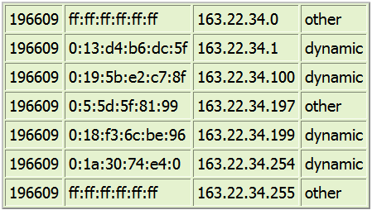
snmptable Example
Column 1
Row 1

Slide 25
function PadMAC($mac) {
$mac_arr = explode(':',$mac);
foreach($mac_arr as $atom) {
$atom = trim($atom);
$newarr[] = sprintf("%02s",$atom);
}
$newmac = implode(':',$newarr);
return $newmac;
}
snmptable2.php
…
for ($i=1; $i <= count($arr); $i++) {
$mac = PadMAC($arr[$i][2]);
echo "{$arr[$i][1]}\t$mac\t{$arr[$i][3]}\t{$arr[$i][4]}\n";
}
65540 00:08:9b:a9:a8:cf 10.10.13.192 dynamic
65540 00:08:9b:a9:a8:b7 10.10.13.196 dynamic
65540 00:1a:30:74:e4:00 10.10.13.254 dynamic

Slide 26
realtable
function realtable($host, $comm, $oid, $numCols) {
for ($j=1; $j <= $numCols; $j++) {
$arr[$j] = snmprealwalk($host, $comm, "$oid.1.$j");
$ret[$j] = $arr[$j];
}
for ($j=1; $j <= $numCols; $j++) {
$i=1;
foreach ($ret[$j] as $oid => $val) {
$oTable[$i][$j] = explode(".", $oid);
$table[$i][$j] = $val;
$i++;
}
}
$cl = col($oTable[1][1], $oTable[1][2]);
$table[0][0] = "Index";
for ($j=1; $j <= $numCols; $j++)
$table[0][$j] = $oTable[1][$j][$cl];
for ($i=1; $i <= count($ret[1]); $i++) {
$iId = "";
for ($j=($cl+1); $j<count($oTable[$i][1]); $j++)
$iId = $iId . "." . $oTable[$i][1][$j];
$table[$i][0] = substr($iId,1);
}
return $table;
}
realtable.php
function col($arr1, $arr2) {
$i=0;
while ($arr1[$i]==$arr2[$i])
$i++;
return $i;
}

Slide 27
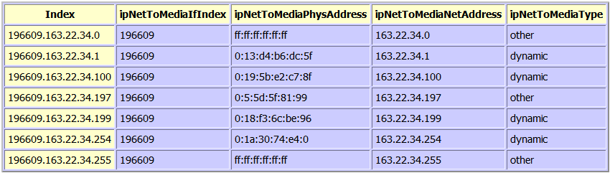
realtable Example
Column 0 (Instance Identifier)
Row 0
C:\snmp\php realtable.php > ipNTM.html

Slide 28
function getCols($host, $comm, $oid, $colArr) {
$j=1;
foreach ($colArr as $id) {
$arr[$j] = snmprealwalk($host, $comm, "$oid.1.$id");
$ret[$j] = $arr[$j];
$j++;
}
for ($j=1; $j <= count($colArr); $j++) {
$i=1;
foreach ($ret[$j] as $oid => $val) {
$oTable[$i][$j]=explode(".",$oid);
$table[$i][$j]=$val;
$i++;
}
}
$cl = col($oTable[1][1], $oTable[1][2]);
$table[0][0] = "Index";
for ($j=1; $j <= count($colArr); $j++)
$table[0][$j] = $oTable[1][$j][$cl];
for ($i=1;$i <= count($ret[1]);$i++) {
$iId ="";
for ($j=($cl+1);$j < count($oTable[$i][1]);$j++)
$iId = $iId . "." . $oTable[$i][1][$j];
$table[$i][0] = substr($iId,1);
}
return $table;
}
getCols.php
$host = "127.0.0.1";
$community = “public";
$oid = "ipRouteTable";
$idArr = array(1, 2, 3, 11, 8, 7);
$arr = getCols($host, $community, $oid, $idArr);
$colArr: array of column IDs

Slide 29
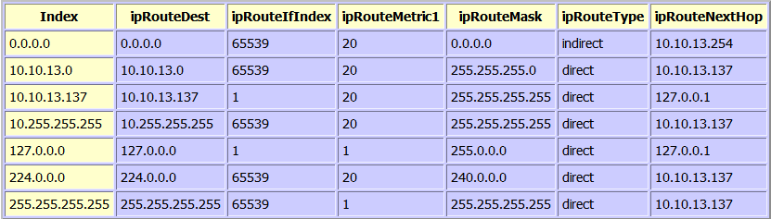
Get columns 1, 2, 3, 11, 8, and 7 of the ipRouteTable table
C:\snmp\php getCols.php > ipRoute.html

Slide 30
snmp_read_mib
readmib.php
<?php
snmp_set_quick_print(true);
snmp_read_mib("LanMgr-Mib-II-MIB");
$host = "127.0.0.1";
$community = "public";
$oid = "LanMgr-Mib-II-MIB::svSvcTable";
$arr = realtable($host, $community, $oid, 5);
htmlTable($arr);
…

Slide 31
SNMPv2c
string snmp2_get(string host, string community, string object_id [, int timeout [, int retries]]);
string snmp2_getnext(string host, string community, string object_id [, int timeout [, int retries]]);
array snmp2_walk(string host, string community, string object_id [, int timeout [, int retries]]);
array snmp2_real_walk(string host, string community, string object_id [, int timeout [, int retries]]);
int snmp2_set(string host, string community, string object_id, string type, mixed value [, int timeout [, int retries]]);

Slide 32
PHP SNMP on Web
Web-based SNMP applications developed in php.
XAMPP
  X (meaning any operating system)
  Apache (web server)
  MySQL (database)
  PHP
  Perl
XAMPP for Windows
  http://www.apachefriends.org/en/xampp-windows.html
Download
  http://ycchen.im.ncnu.edu.tw/xampp-win32-1.8.1-VC9-installer.exe

Slide 33
XAMPP Installation
Suppose XAMPP is installed in C:\xampp
Document Root: | C:\xampp\htdocs
httpd.conf: | C:\xampp\apache\conf\httpd.conf
php.ini: | C:\xampp\php\php.ini
extension dir: | C:\xampp\php\ext
MIB dir: | C:\usr\mibs
(copy C:\xampp\php\extras\mibs to C:\usr\mibs)

Slide 34
C:\xampp\php\php.ini
  ;extension=php_snmp.dll
  extension=php_snmp.dll
  Find php_snmp.dll in C:\xampp\php\ext
  php_snmp.dll
  http://www.im.ncnu.edu.tw/ycchen/nm/php_snmp.zip

Slide 35
httpd.conf Configuration
Configure a virtual directory for your SNMP application.
Suppose
  Virtual directory: nmapp1
  Physical directory: C:\snmp\app1
http://127.0.0.1/nmapp1/mywalk.php
<IfModule alias_module>
...
Alias /nmapp1 "C:/snmp/app1"
...
</IfModule>
<Directory "C:/snmp/app1">
AllowOverride None
Options None
Require all granted
</Directory>

Slide 36
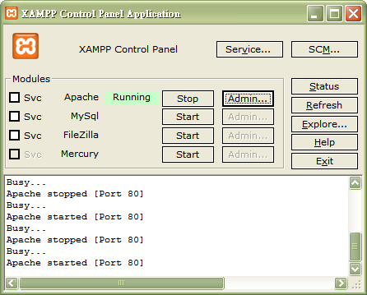
Run XAMPP

Slide 37
walk.html
<form method="post" action="webwalk.php">
<table width=400 border=3 cellspacing=2 cellpadding=2
bgColor="#ffffcc" align=center>
<tr><td align=right>Host: </td>
<td> <input type=text name="host"></td></tr>
<tr><td align=right>Community Name: </td>
<td> <input type=text name="comm"></td></tr>
<tr><td align=right>OID: </td>
<td> <input type=text name="oid"></td></tr>
<tr><td align=center colspan=2>
<input type=submit value="OK">
<input type=reset value="Cancel"></td></tr>
</table>
</form>

Slide 38
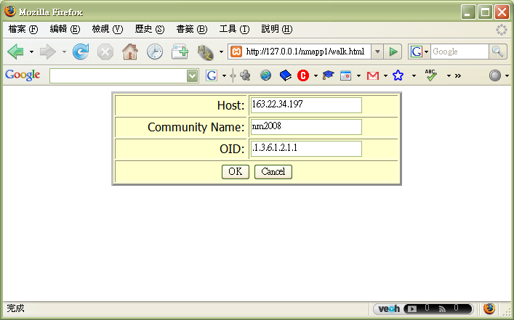
http://127.0.0.1/nmapp1/walk.html

Slide 39
webwalk.php
<?php
snmp_set_quick_print(true);
$host = $_POST['host'];
$comm = $_POST['comm'];
$oid = $_POST['oid'];
if ($_POST['comm']=="") $comm="public";
$arr = snmprealwalk($host, $comm, $oid);
echo "<h3 align=center>SNMPWALK of $host</h3>";
echo "<table align=center cellspacing=2 border=2>";
foreach ($arr as $oid => $val)
echo "<tr><td bgColor=#ffffcc>$oid</td><td bgColor=#ccffff>$val</td></tr>";
?>
</table>

Slide 40
