Slide 1

DocAssist AI
An AI voice receptionist that answers every patient call, day or night
Clinic Assistant · 2026
Notes:
Hello everyone. This is DocAssist AI: a voice receptionist powered by AI. It picks up every patient call, books the appointment, and shows it to the doctor right away.

Slide 2




The problem: clinics miss patient calls
Busy lines
Calls ring out during peak hours.
Problem statement
Patients book by phone, but one receptionist can only take one call at a time.
When the line is busy, the clinic is closed, or staff are with a patient, the call is missed and the patient goes to another clinic.
Closed after hours
Nobody answers in the evening or on weekends.
Staff stretched thin
Front desk handles walk-ins, files and phones at once.
Booking mistakes
Paper or manual diaries cause double bookings.
Notes:
Here is the problem in simple words. Patients still call to book. But a clinic usually has one person at the front desk, and that person is also busy with walk-in patients and paperwork. So many calls are simply missed.

Slide 3
Up to 1 in 3 clinic calls is never answered
32%
35%
44%
of calls to healthcare practices are missed: the highest of any small business
of 4,415 test calls went to voicemail during normal business hours
of patient calls failed to reach the practice team
CallRail industry data
Aegis Dental Network study, 2015
Converso survey, UK, 2011
Every unanswered call is a patient who may book with someone else.
Notes:
These are numbers from published studies. In healthcare, around one third of calls are not answered by a person. One study made over four thousand test calls and 35 percent went to voicemail, during normal working hours.

Slide 4
Survey snapshot: patients won't wait on hold
8.5 min
average time patients wait on hold to book with their doctor
10 min
the most people will wait before hanging up on a new clinic
Sources: Klara / Talker Research survey of 2,000 US adults (hold times, switching doctors); Statlinx (voicemail call-backs, "up to 30%").
Notes:
This slide brings together survey results. A survey of 2,000 adults found people wait about eight and a half minutes on hold, and give a new clinic about ten minutes before hanging up. Up to 30 percent of patients who reach voicemail never call back.

Slide 5


What missed calls cost one clinic
~100
patients lost every month
40
13
4
calls a day
missed (32%)
patients lost a day (30% never call back)
A busy clinic can lose around a hundred new bookings a month just because nobody picked up the phone.
Example: a clinic with 40 calls a day and 26 working days a month, using the 32% missed-call rate (CallRail) and 30% no-call-back rate (Statlinx).
Notes:
Let's make it real. Take a clinic that gets 40 calls a day. About 13 are missed. About 4 of those patients never call back. Over a month, that is around one hundred lost patients.

Slide 6




Our solution: Steven Smith, the AI receptionist
Answers 24/7
Day, night, weekends and holidays. No call goes unanswered.
Books, checks and cancels
Handles the full appointment job from start to finish.
Talks like a real receptionist
Patients just speak. The AI understands, checks the doctor's diary and books the slot in seconds.
Many calls at once
No busy tone and no hold music, even at peak hours.
Keeps a record
Every call is saved as a transcript next to the appointment.
Powered by VAPI + OpenAI GPT-4.1
Notes:
Our answer is Steven Smith, an AI voice receptionist. It answers every call, at any time, and can talk to many patients at once. It books, checks and cancels appointments, and saves the conversation.

Slide 7





How it works, step by step
1. Patient calls
2. AI listens
3. Rules check
4. Saved
5. Doctor sees it
Speaks in plain words: "Book me tomorrow at 10."
VAPI turns speech to text and GPT-4.1 understands it.
Our backend checks hours, breaks and free slots.
The booking and call transcript go into the database.
The appointment appears on the dashboard right away.
Built with
Next.js dashboard
FastAPI (Python)
PostgreSQL
VAPI voice AI
OpenAI GPT-4.1
Live WebSocket updates
Notes:
This is the journey of one call. The patient talks. VAPI listens and GPT-4.1 understands. Our backend checks the clinic rules. The booking is saved, and the doctor sees it on the dashboard immediately.

Slide 8

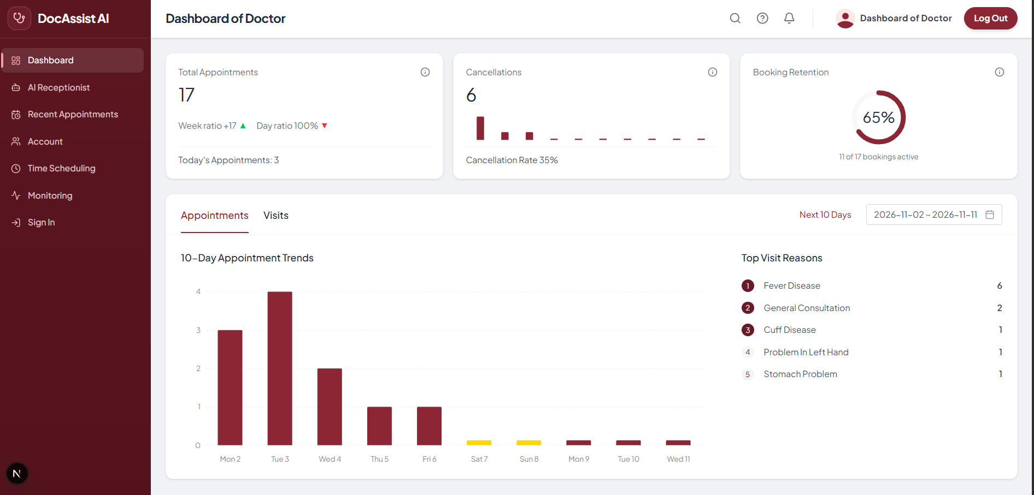



What we built: a complete clinic dashboard
Dashboard
Today's bookings, cancellations and trends
AI Receptionist
Call the agent and watch the live transcript
Appointments
Upcoming, today, past, with call transcripts
Time Scheduling
Hours per day, breaks, holidays, slot length
Monitoring
Calls per week and month, with cost
The doctor's dashboard, live from the app
Notes:
Here is what we built. A full web dashboard with five parts: the main dashboard, the AI Receptionist page where you can call the agent, the appointments list, the time scheduler, and monitoring for calls and cost.

Slide 9





Smart rules keep the diary clean
Fixed time slots
Hours and breaks per day
Holidays and days off
Books only at 15, 30, 45 or 60-minute steps the doctor chooses.
Different hours each day, and never during a lunch break.
Closed dates are blocked automatically.
10-day booking window
No double booking
Suggests a free time
No bookings in the past or too far ahead.
One patient per slot, and no duplicate bookings.
If a slot is taken, it offers the nearest free times.
Notes:
The AI does not book anything blindly. It follows the doctor's own rules: fixed slot lengths, working hours for each day, breaks, holidays and a ten-day window. If a time is taken, it suggests the closest free time.

Slide 10
It costs about Rs 26 per minute of talk
$0.094
per minute, about Rs 26
Rs 52–78
for a normal 2 to 3-minute booking call
Free
phone line: calls run in the web browser
Rates from the current VAPI assistant setup. Rs 278 per US dollar.
Notes:
Now the cost. One minute of conversation costs about 9 cents, around 26 rupees. Most of that is the VAPI platform fee. A normal booking call of two to three minutes costs about 52 to 78 rupees, and the phone line is free because calls run in the browser.

Slide 11
Human front desk vs DocAssist AI
 | Human receptionist | DocAssist AI
Available | Office hours only | 24 hours, 7 days a week
Calls at the same time | One | Many
Missed calls | Up to 1 in 3 | None while the agent is online
Waiting on hold | Minutes | No waiting
Records | Written by hand | Automatic transcript and dashboard
Follows the diary rules | Can make mistakes | Checks every rule, every time
The AI does not replace your staff. It takes the phone load off them so they can care for the patients in front of them.
Notes:
A simple comparison. A person works office hours and takes one call at a time. The AI works all day and night and takes many calls together. It doesn't replace staff; it frees them to care for patients in the clinic.

Slide 12




What's next
Real phone number
Patients call a normal clinic number, not only the website.
Urdu and English
Talk to patients in the language they prefer.
SMS and WhatsApp reminders
Fewer no-shows with automatic reminders.
Live cost data
Monitoring reads real call counts and cost from VAPI.
Thank you
Questions? Let's try a live call with the AI receptionist.
Notes:
Next, we want a real phone number, Urdu support, reminders by SMS or WhatsApp, and live cost data from VAPI. Thank you. I'm happy to take questions, or we can try a live call right now.

