Slide 1
Caffeine and Calorie Content of
Drinks
Ally Blitch, Cagan Abney, Fabi Estrada

Slide 2
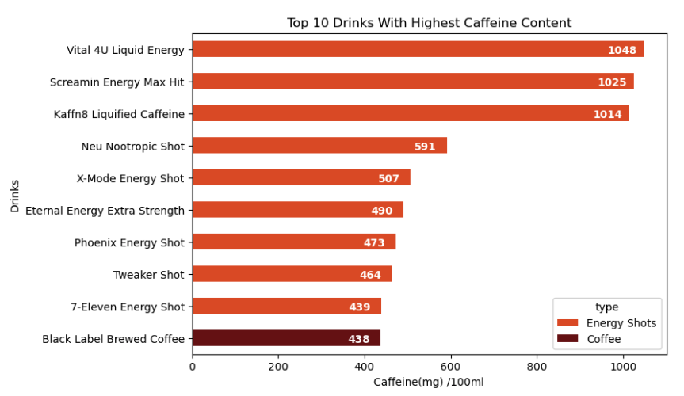
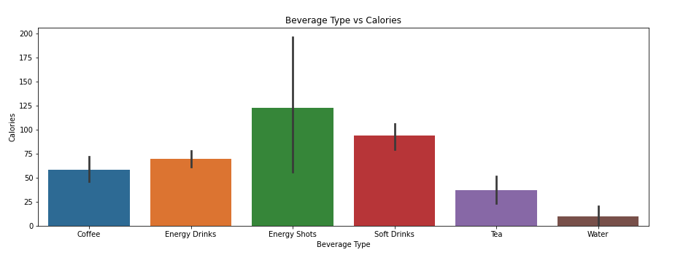
Inspiration
We chose the Caffeine Content in Drinks Dataset because we are familiar with caffeinated drinks, and it is important to know the calorie and caffeine content of beverages that we often consume. The dataset has a high usability rating and has had other visualization projects completed off of it.
Similar EDAs:
https://www.kaggle.com/code/darshitapangam/caffeinated-drinks-eda-content-based-recommender
https://www.kaggle.com/code/bngphmhu/analysis-of-data-on-caffeine-content-in-beverage
https://www.kaggle.com/code/yadhua/caffeine-content-eda-and-clustering
Notes:
Cagan

Slide 3
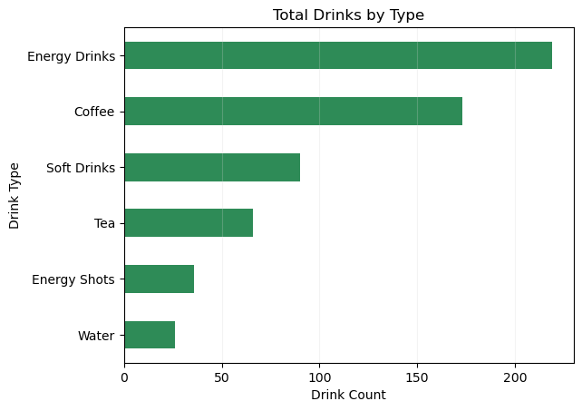
Dataset
Caffeine Content of Drinks
This dataset is 29.21 kB which consists of 5 columns and 611 rows. The data includes volume of drinks (mL), calorie content, caffeine content, drink name and type.
GitHub Link
https://github.com/allyb3/SMU-Project-1-Caffeine
Notes:
Ally

Slide 4
Research Questions
Does coffee/tea have a lower volume to caffeine ratio than other drink categories?
Does soda have a higher calorie to caffeine ratio than other drink categories?
Which drink type has the most caffeine per 100 mL?
Notes:
Fabi

Slide 5
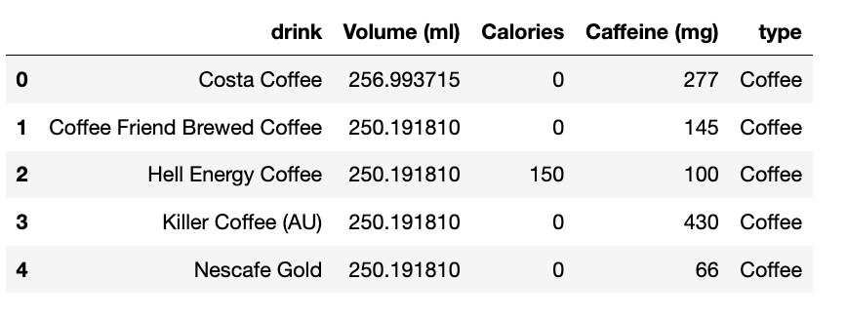
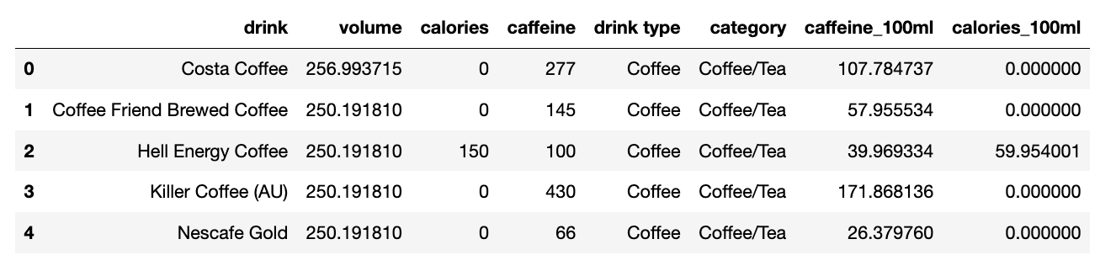
Data Engineering
Initial Dataset
Final Dataset
Cleaned up column titles
Added columns to show the calories and caffeine per 100 mL to get a better comparison
Notes:
Fabi

Slide 6
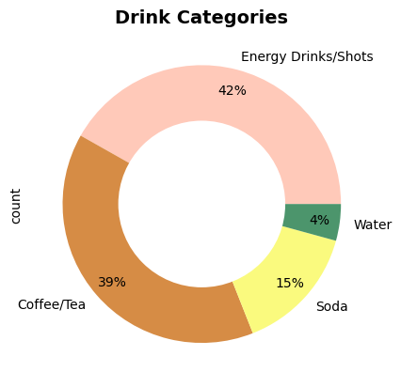
Data Engineering Cont.
Created categories for the drink types
Wanted to combine the 3 smaller drink types with the 3 larger ones to create 3 big categories
We decided to separate them back into 4 categories because the data for soda and water ran bimodally in our violin plots
Notes:
Cagan

Slide 7
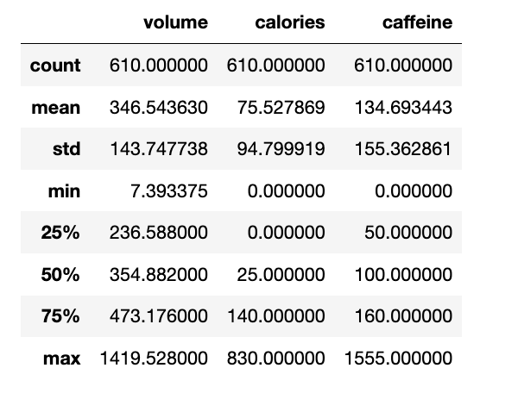
Data Engineering Cont.
We noticed we had some outliers (max values) when running our .describe
We then ran each column in descending order to check where the outliers were coming from (see next slide)
Notes:
Ally

Slide 8
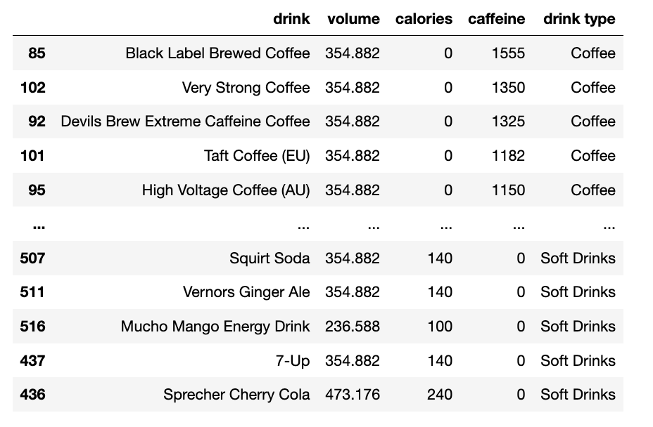
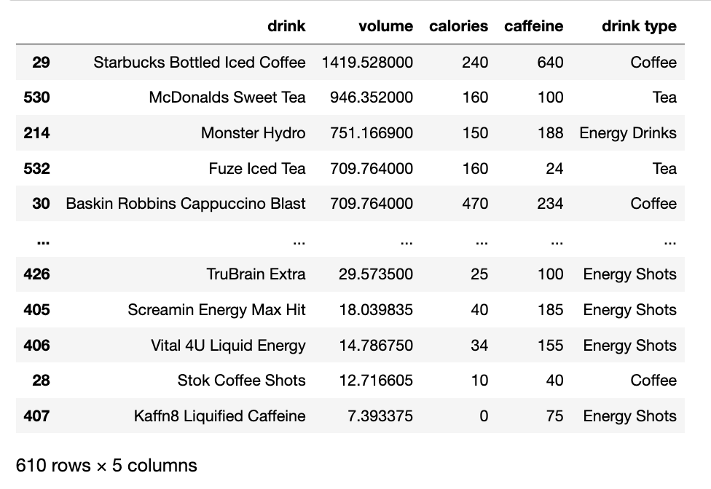
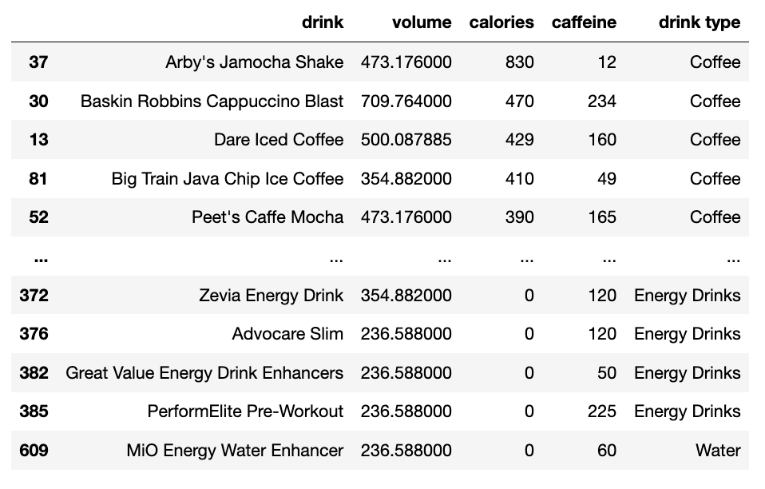
Data Engineering
Cont.
After looking at these outliers we decided they were still representative of the variations in drink options on the market and chose to include them in our analysis
Notes:
Ally

Slide 9
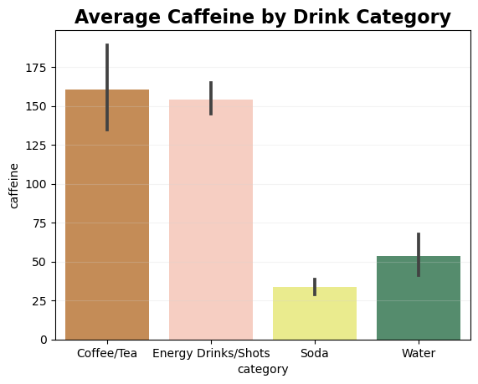
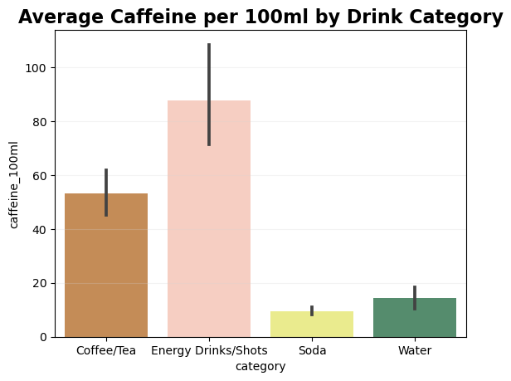
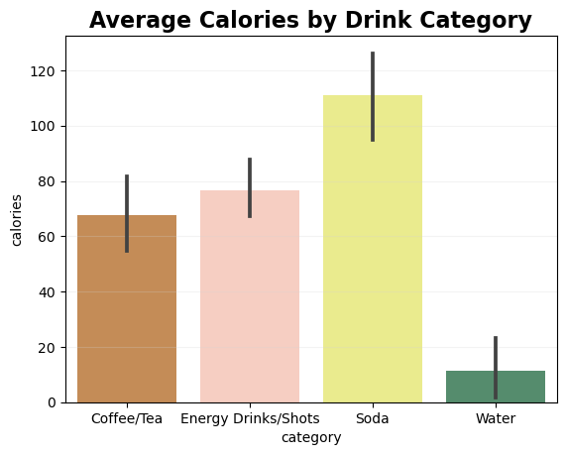
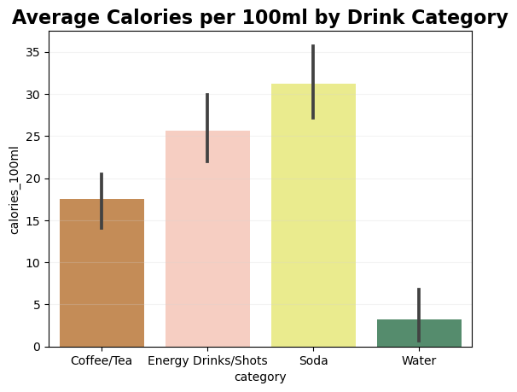
Coffee/Tea’s average caffeine dropped significantly in comparison to the other categories when looking at average caffeine per 100mL.
Soda is statistically significant in terms of calories compared to the other categories in both average calories and average calories per 100ml.
Notes:
Fabi:

Slide 10
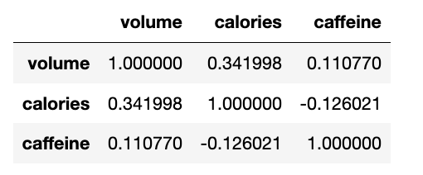
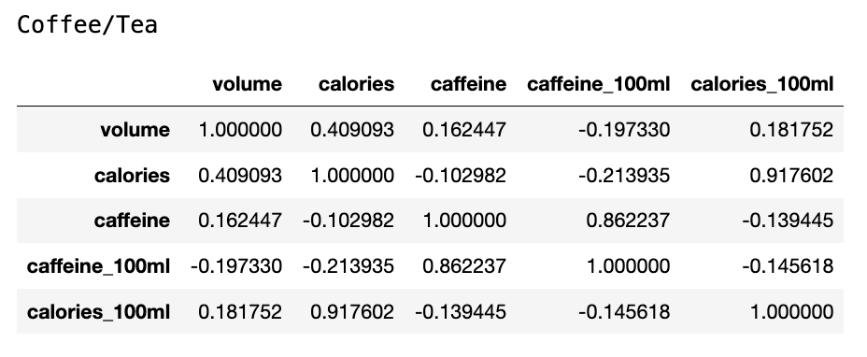
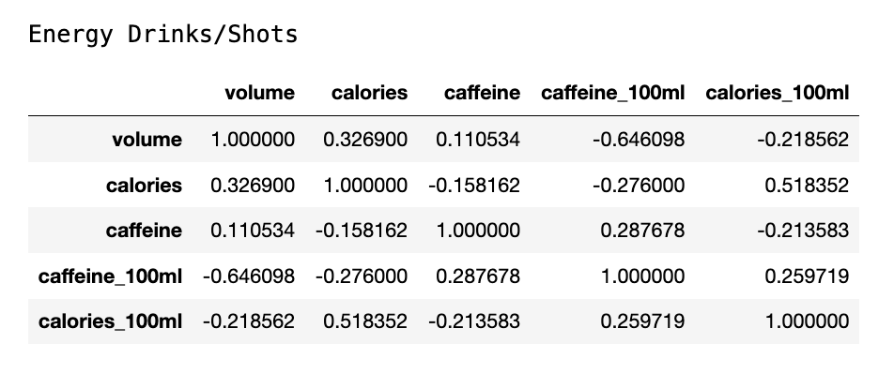
Checking for Correlations:
Original Dataset:
Coffee/Tea:
Calories & Volume: stronger correlation than original dataset
Caffeine & Volume: stronger correlation than original dataset
Calories & Caffeine: slightly weaker correlation than original dataset
Energy Drinks/Shots:
Calories & Volume: slightly weaker correlation than original dataset
Caffeine & Volume: about equal correlation as original dataset
Calories & Caffeine: stronger correlation than original dataset
Notes:
Cagan:
Here we compared correlations of calories and volume, caffeine and volume, and calories and caffeine between each category and the original dataset
**Caffeine and volume correlations

Slide 11
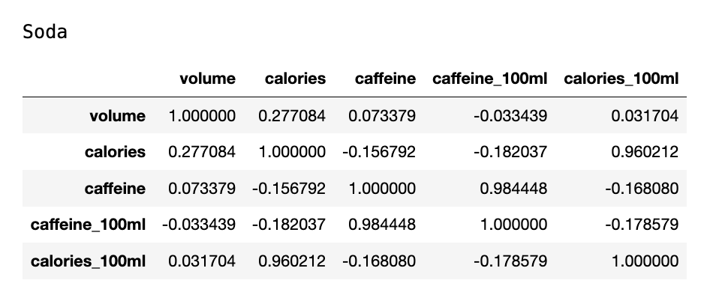
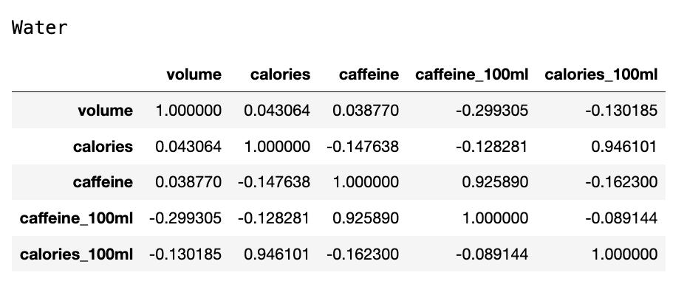
Checking for correlations:
Original Dataset:
Soda:
Calories & Volume: weaker correlation than original dataset
Caffeine & Volume: weaker correlation than original dataset
Calories & Caffeine: slightly stronger correlation than original dataset
Water:
Calories & Volume: much weaker correlation than original dataset
Caffeine & Volume: weaker correlation than original dataset
Calories & Caffeine: slightly stronger correlation than original dataset
Notes:
Cagan
**Caffeine and volume correlations

Slide 12
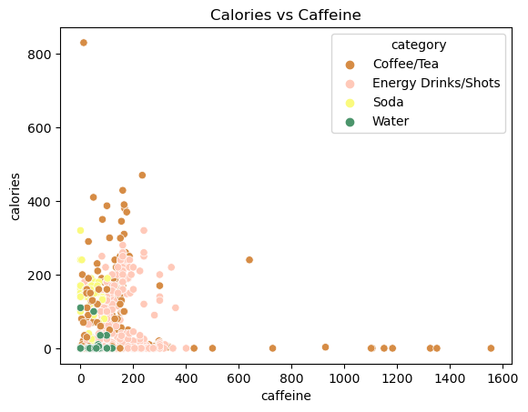
Notes:
Ally
Highly caloric, low caffeine coffee/tea drink = Arby’s Jamocha Shake.
A few different “extreme” coffee drinks that have over 1000 mg of caffeine in a 0 calorie, 354 mL beverage.

Slide 13
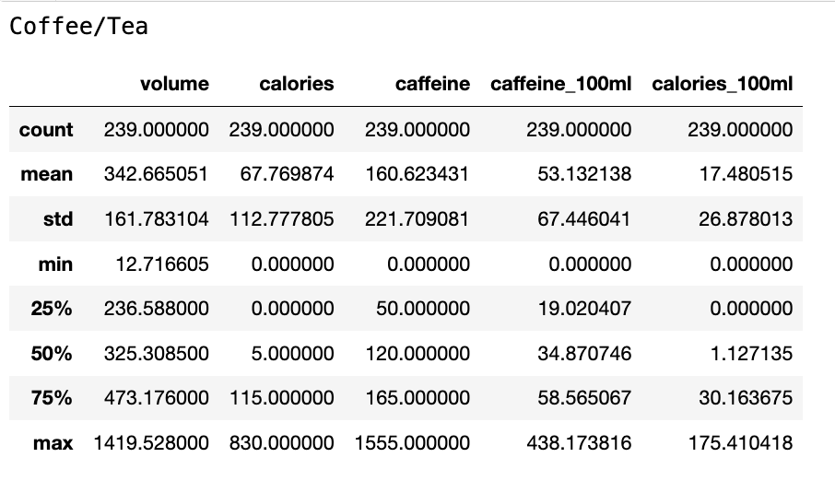
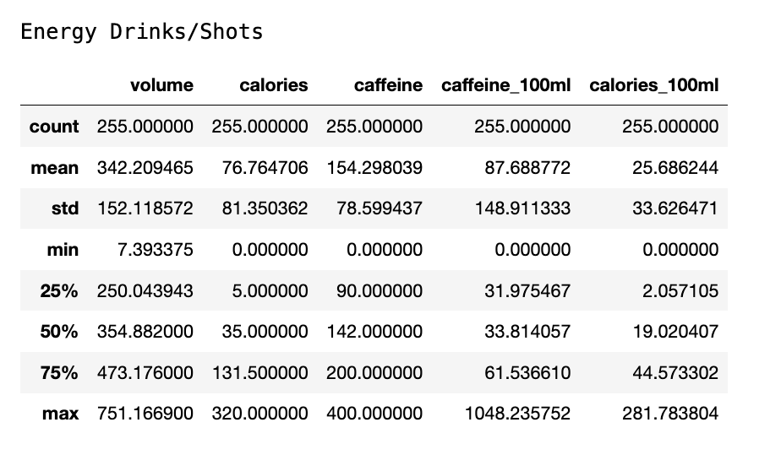
Original Dataset:
Coffee/Tea is lower in calories and higher in caffeine on average
Skews right in calories and caffeine
Energy Drinks/Shots is about equal in calories and higher in caffeine on average
Skews right in calories and caffeine
Notes:
Cagan

Slide 14
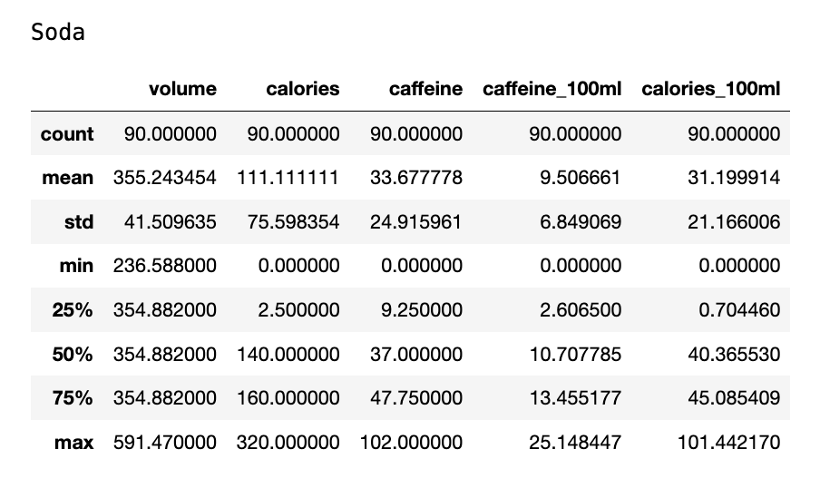
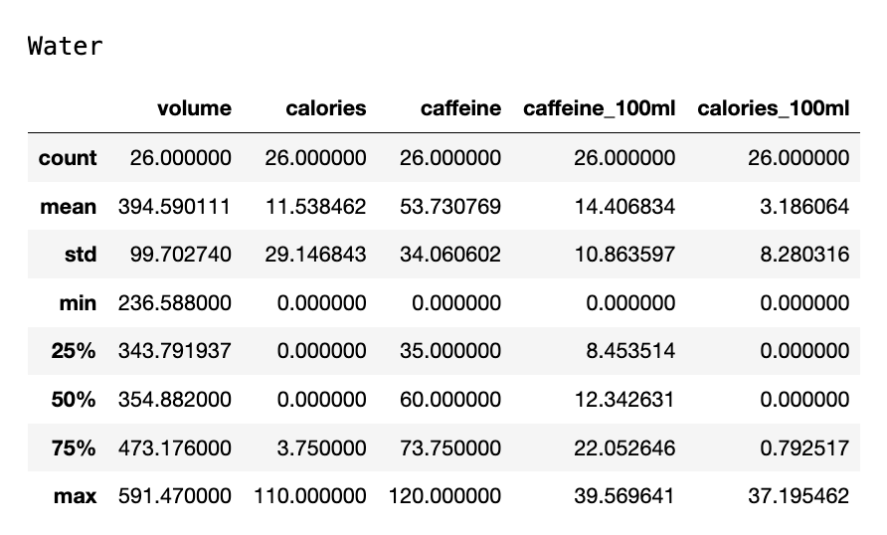
Original Dataset:
Soda is higher in calories and lower in caffeine on average
Skews left in calories and caffeine
Water is lower in calories and caffeine on average
Skews right in calories and slightly left in caffeine
Notes:
Cagan

Slide 15
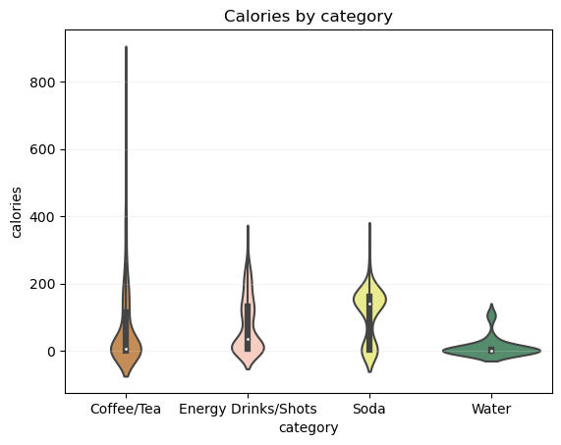
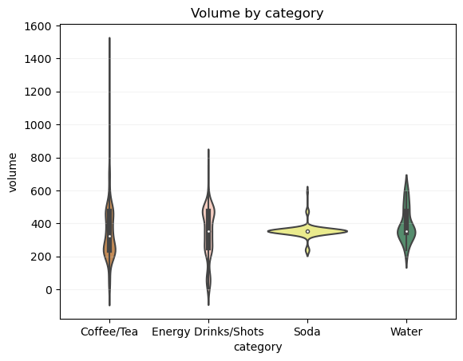
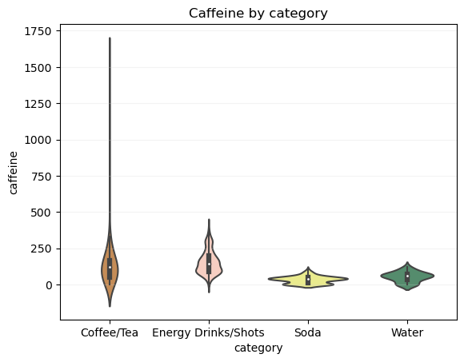
Data Analysis
We created violin plots to visually compare calories, caffeine, and volume across the different categories
Notes:
Fabi:
Note how different the calories by category plots are for soda and water. This is what led us to separate out soda and water rather than combine them into one category.

Slide 16
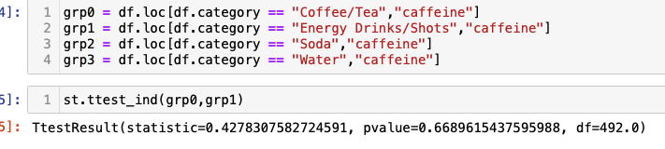

T-test Results
The p-value comparing the caffeine of soda and water is below 0.05
This result shows the caffeine values are statistically significantly different
Notes:
Fabi

Slide 17
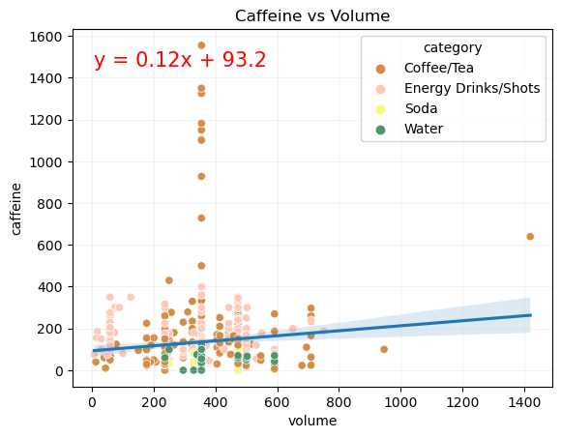
Research Question 1:
Does Coffee/Tea have a lower volume to caffeine ratio than other drink categories?
According to the data, coffee/tea does have a lower volume to caffeine ratio than other drink types.
Notes:
Fabi

Slide 18
Research Question 2:
Does Soda have a higher calorie to caffeine ratio than other drink categories?
According to the data, soda does have a higher calorie to caffeine ratio than other drink types.
Notes:
Ally

Slide 19
Research Question 3:
Which drink type has the most caffeine per 100 mL?
According to the graph, “Energy Drinks/Shots” has the most caffeine per 100mL.
Notes:
Cagan

Slide 20

Regression
The relationship between caffeine and volume is not highly significant because the slope is only 0.12
This is caused by energy drinks/shots, soda, and water all having weak correlations between caffeine and volume
Notes:
Ally
Ex: energy shots stay between 200-400 mg of caffeine regardless of volume (Monster energy vs 5 hour energy). This shows lack of correlation

Slide 21
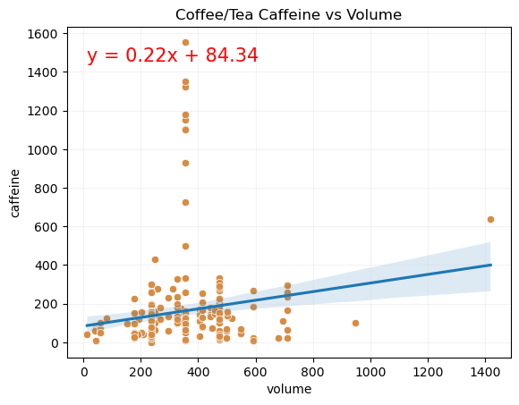
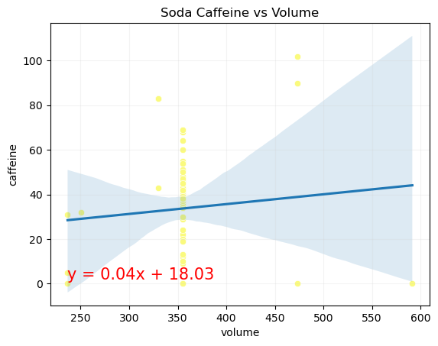
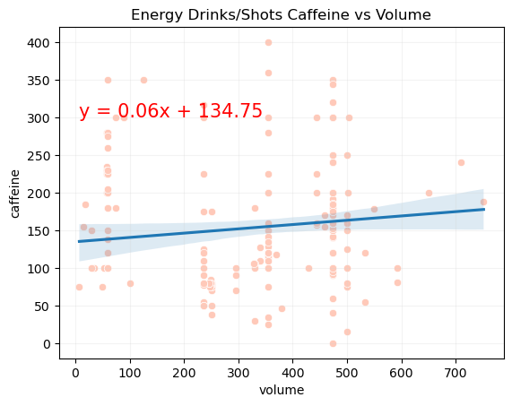
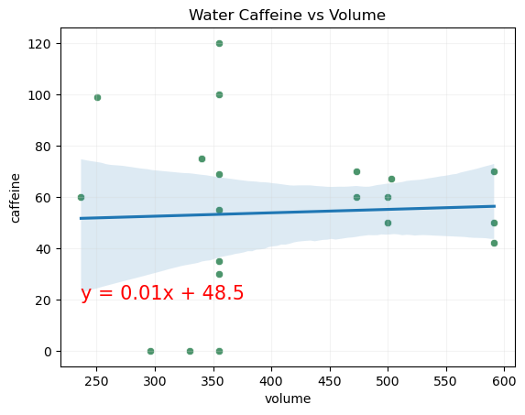
Notes:
Ally

Slide 22
Conclusions
Coffee/tea drinks are typically the most highly caffeinated, but energy drinks/shots have more caffeine per 100mL
Soda has significantly lower caffeine levels compared to calories on average.
Water is lower in calories and caffeine on average.
Notes:
Fabi

Slide 23
Future Work
A future study may be more effective comparing only personal sized/canned beverages or only beverages found in restaurants and coffee shops.
This data includes bulk sizes sold at grocery stores that are not expected to be consumed entirely in one sitting, therefore caffeine and calorie count may be more useful to view at a serving size level
Further work could involve grouping together brands to compare within a certain brand or between brands
Another future study could include prices to further compare value of drink options
Notes:
Ally

