Slide 1
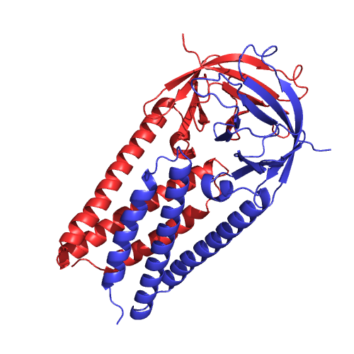


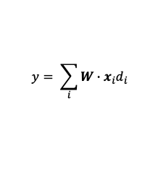
j
$$d_{ij}$$
i
Atom Coordinates
AA Contact Graph
$$y= \sum_{i}{W∙x_{i}d_{i}}$$
$$y$$
GraphCNN extracts structural features

