Slide 1
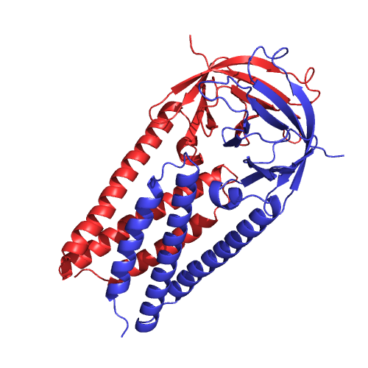
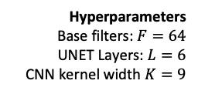




$$N × 20$$
$$N × 20$$
One-hot Sequence
Sigmoid: Classification
Softmax: PSSM
Contact Graph
(Optional)
GraphCNN
Input
Predictions
$$\frac{N}{2} × F$$
1D Convolution
2x Max Pooling
Repeat for L layers
Up Sampling
$$\frac{N}{2^{L}} × (2^{L}F)$$
Hyperparameters
Base filters: $F=64$
UNET Layers: $L=6$
CNN kernel width $K=9$
Concatenate

