Slide 1

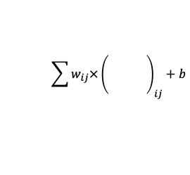
$$\sum{w_{ij}×}{\left(\begin{matrix} & \\ & \\ & \end{matrix}\right)}_{ij}+b$$
Input
Output Features

Slide 2
Max Pool
Upsample
Receptive Field

