Slide 1
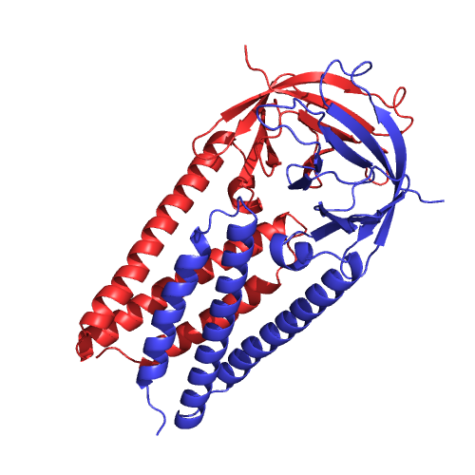




$$N × 20$$
$$N × 20$$
One-hot Sequence
Sigmoid: Classification
Softmax: PSSM
Contact Graph
(Optional)
GraphCNN
Input
Predictions
$$\frac{N}{2} × 48$$
1D Convolution
2x Max Pooling
Repeat for L layers
Up Sampling
$$\frac{N}{2^{L}} × (48 ×2^{L})$$
Concatenate

