Slide 1
React Web Apps
A Codess 2018 Workshop
Led by: Allison Durkan and Ben Fersenheim

Slide 2
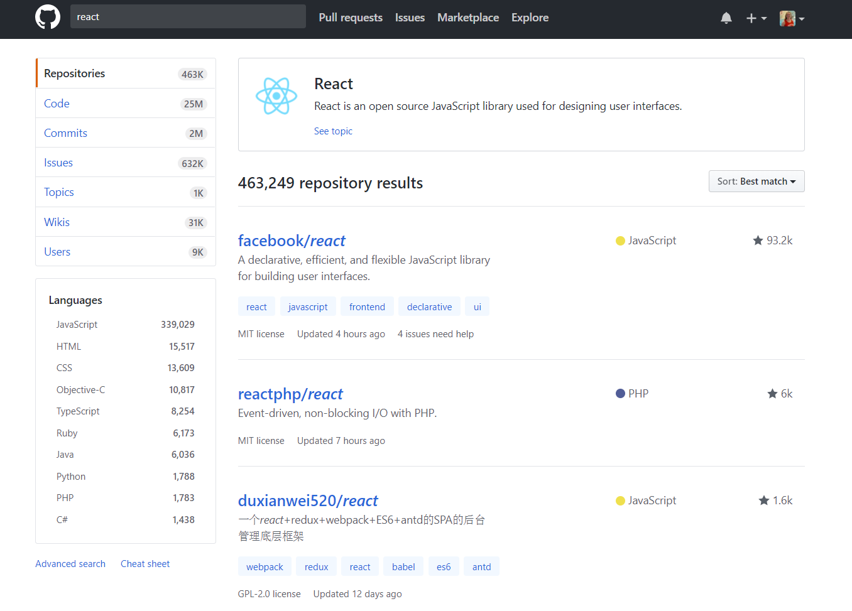
Why React?

