Slide 1



Predicting Financial difficulty and hardship with machine learning AT anz
DATA601 Project Presentation
Presented by Ally Hassell

Slide 2
Scope
Notes:
Three sections: Why, how, what it showed

Slide 3
aNZ Project proposal
  ANZ Bank is one of Aotearoa’s leading financial service groups.
  Over 1 million New Zealand customers and over 100 million transactions a month.
  Good Customer Outcomes team – research to advocate for the interests and wellbeing of ANZ’s customers.
  Good Customer Outcomes team wanted to explore the use of advanced data analytics and machine learning to improve customer outcomes.
  Constraint: avoid topics already researching
  Best way to leverage the data? Financial difficulty and hardship.

Slide 4
Financially struggling
  Difficulty (4,000 people a year)
    Missing repayments
    Excess arrears
    Marginal transactional history
  Financial hardship (450 people each year)
    Risk of defaulting
  Why this topic?
  Often, customers aren’t going to tell their bank if the are struggling financially
  Psychological barriers like shame, fear etc.
  Currently experiencing, no warning

Slide 5
Research goal
  Objective
  Use ANZ’s large amount of financial data to engineer new features, and use these to train a machine learning model to predict financial difficulty and hardship.
  Why
  Currently, ANZ can only identify customers who are already experiencing difficulty and hardship. If financial issues can be predicted then ANZ can provide pre-emptive support to help customers prevent this unfavourable outcome.

Slide 6
ethics
  Privacy - ANZ privacy statement
  Informs customers it will analyse data and generate insights
  Customers can review and correct their personal data
  Legal contract signed when opening account
  Privacy - During data analysis
  Anonymized with ID numbers
  Rules and procedures to protect data
  Not used for anything which would violate their rights
  Use of model
  Handed off to Good Customer Outcomes
  Proof of concept and not in production
  Only accessible to people who understand the contents

Slide 7
Methodology

Slide 8
METHODOLOGY
Exploration
Feature engineering
Machine learning
Results analysis
- Scope
- Data exploration
- Feature ideas
- Extract
- Manipulate
- Transform
- SAS/SQL
- Trail models
- Test/train
- Python
- Features importance
- Patterns
- What does this mean?
- Apply insights

Slide 9
exploration
  Data
  New features
Customer information 1.9 million
Transactions 450 million
Credit cards 230 million
Financial hardship labelled
Expense categories credit
Expense categories debit
  Spending velocity: how fast a customer spends 75% of their income.
  Pay later: number and amount spent through pay later schemes (Afterpay and PayPal).
  Credit card: spending credit on discretionary or necessities.
Notes:
Customers: 1.9 million
Transactions: 450 million
After-pay: 6 million
Creditcard transactions: 230 million

Slide 10
Feature engineering and Wrangling
  Programming
  Code: SAS software using SQL queries
  Retrieving from Teradata
  Wrangling using methods such as retrieval, transforming, merging, manipulating and consolidating.
  Timeline
  Collect 6 months from date of difficulty/hardship or today
  Each feature was collected for three intervals two months from this date
  Feature reduction (went from 234 to 47)
  Correlation
  Overlapping values
  Reduced timescale
  One row for each customer
Notes:
Number of features used in final table was xxx, and number

Slide 11
Machine learning
  Step 1) Performance metrics
  F1 score because it optimises recall and precision
  Recall and precision
  Step 2) Many models were trailed
  Why? Gain an idea of what models performed best
  Models trialled were: decision trees, random forest, LDA, SVM, Naïve Bayes, quadratic discriminant classifier, logistic regression, KNN, extra trees
  Python package called lazytrain
  Step 3) Detailed machine learning models
  Took best model from trials and ran more detailed machine learning code
  Used Python PyCaret package
  Ten-fold cross validation

Slide 12
Results

Slide 13
Best performing Models
 | Model | F1 score | Recall | Precision
Difficulty | Random forest | 0.689 | 0.567 | 0.872
Hardship | Extra trees | 0.059 | 0.0315 | 0.172

Slide 14
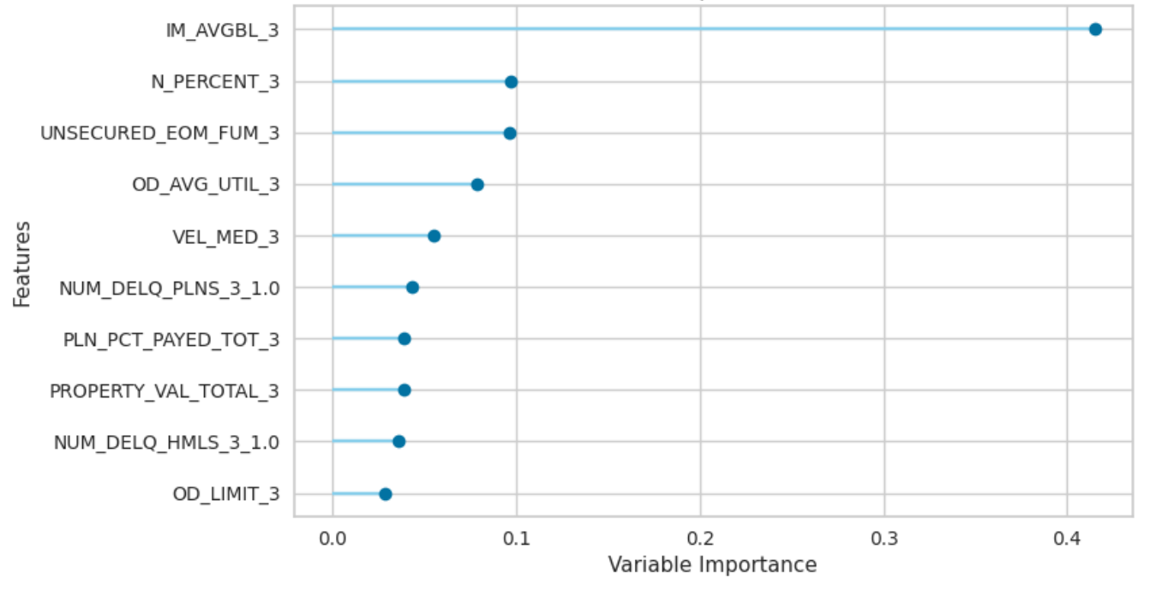
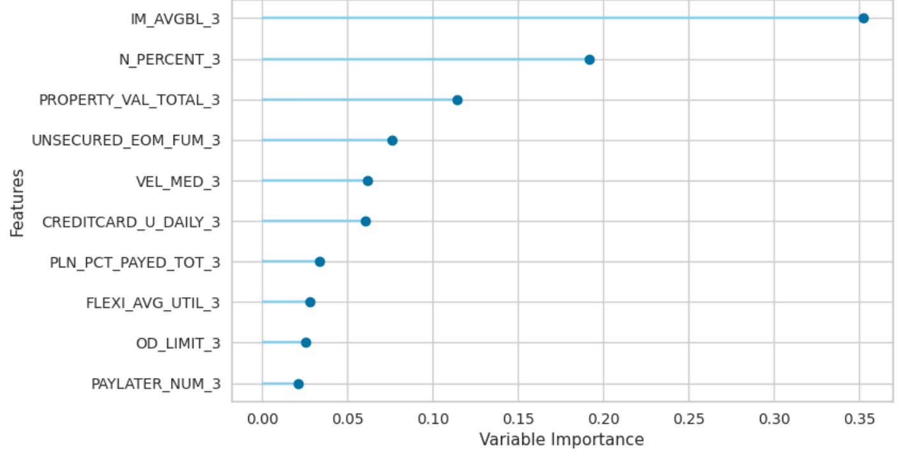
Difficulty - random forest model
  Important features
Confusion matrix
 |  | Actual
 |  | Positive | Negative
Predicted | Positive | 7,153 | 1,049
 | Negative | 5,462 | 1,881,137

Slide 15
hardship - random forest model
  Important features
Confusion matrix
 |  | Actual
 |  | Positive | Negative
Predicted | Positive | 47 | 226
 | Negative | 1,452 | 1,894,575

Slide 16
Conclusions
  Financial difficulty is easier to predict
  Hardship may be hard to predict because it is an acute situation
  Next steps
  Tune model to improve its performance
  Remove features which add not benefit to the model
  Class imbalance – under or over sampling techniques

Slide 17
THANK YOU
Presented by Ally Hassell

