Slide 1

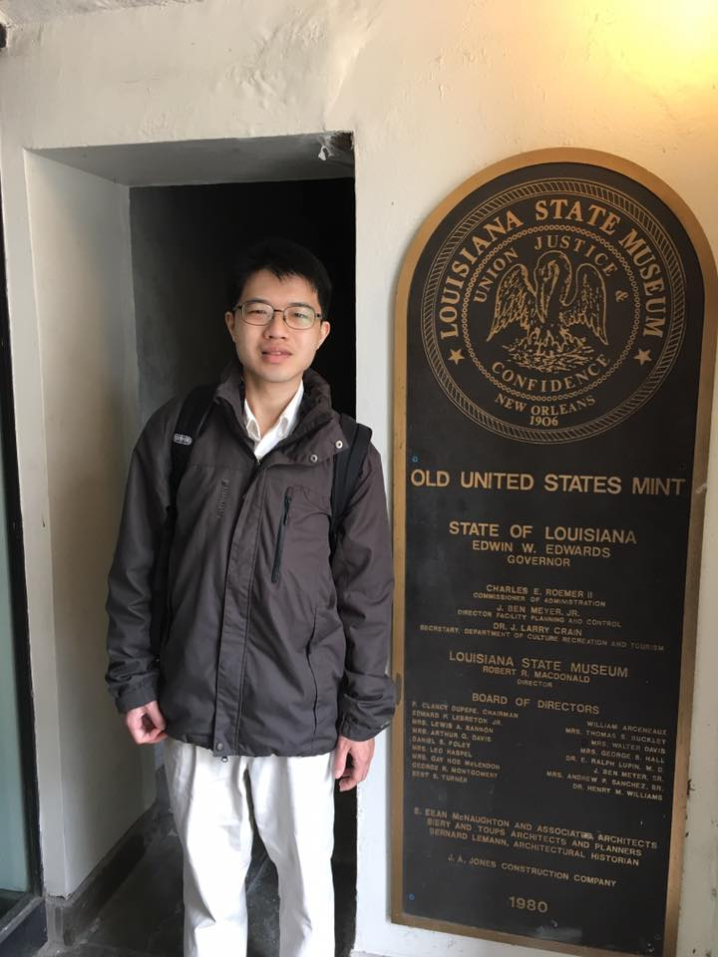
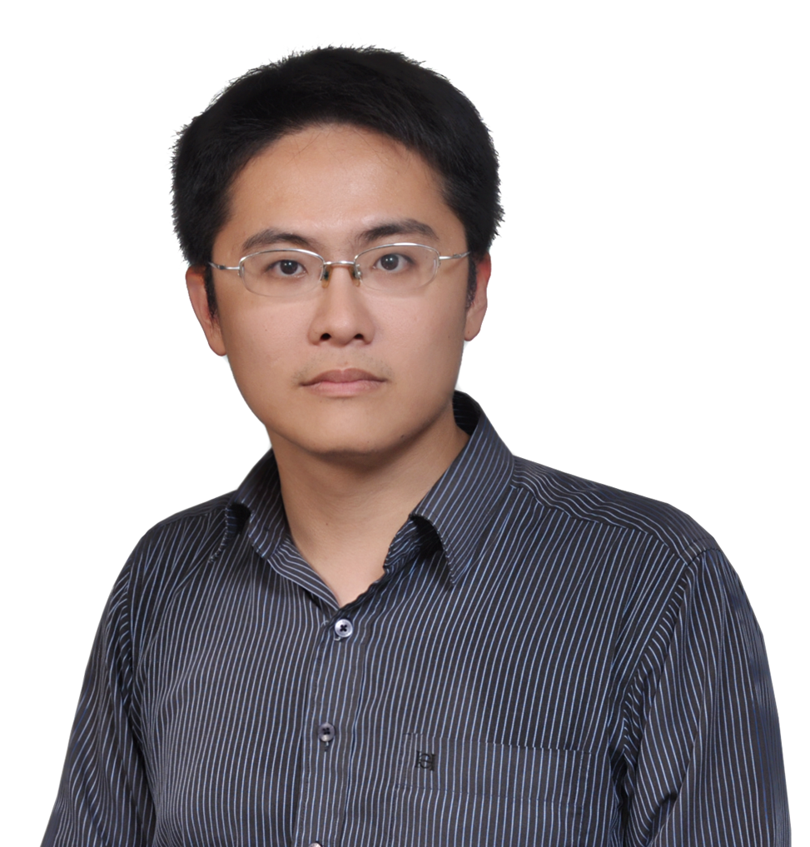
Gate Activation Signal Analysis for Gated Recurrent Neural Networks and Its Correlation with Phoneme Boundaries
Yu-Hsuan Wang, Cheng-Tao Chung, Hung-yi Lee
(presented by Hung-yi Lee)
Yu-Hsuan Wang
Cheng-Tao Chung
Hung-yi Lee
Notes:
3:00
https://arxiv.org/abs/1703.07588
Intro: 1
Intro: 1

Slide 2
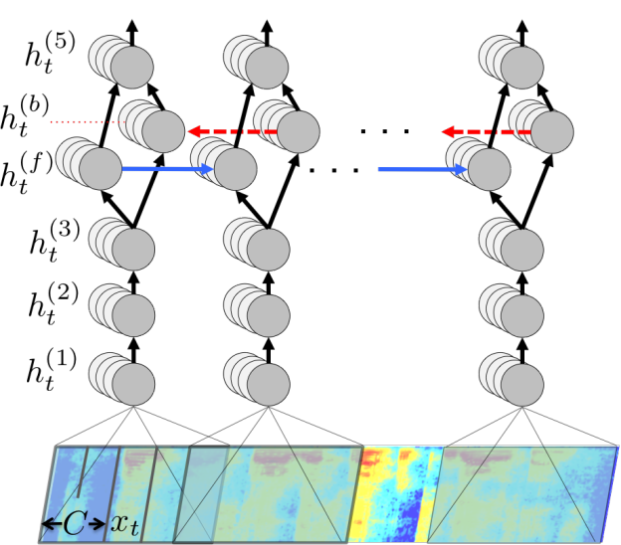
Motivation
https://devblogs.nvidia.com/parallelforall/deep-speech-accurate-speech-recognition-gpu-accelerated-deep-learning/
Gated RNNs (e.g. LSTM, GRU) are widely used.
Slot filing
Intent Detection
Sentiment Analysis
Summarization
Data Augmentation
End point detection
Speaker Change Detection
……
Speech Recognition
Usually we don’t know how the gated RNN works.
Notes:
care
Don’t think too much.
Just train it.

Slide 3
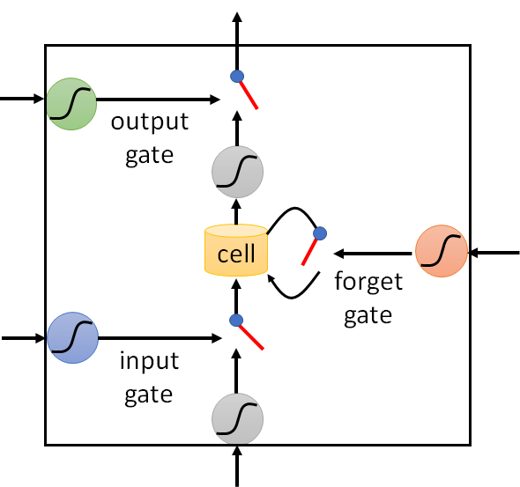
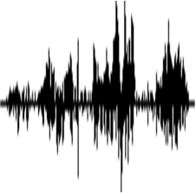
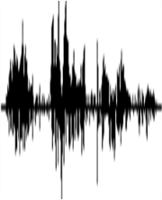
Overview
LSTM, GRU
0.2
RNN
RNN
RNN
…
0.5
0.9
x₁
x₂
x₃
acoustic features
Analyze the gate activation signals (GAS)
audio signals
Learned without supervision
The temporal structure of GAS is highly correlated with the phoneme boundaries.
This correlation is further verified by improving phoneme segmentation.
Notes:
2:00
How to train RNN without supervision? to see what will obtain

Slide 4
Previous Work
Notes:
Andrej Karpathy, Justin Johnson, Li Fei-Fei, Visualizing and Understanding Recurrent Networks, https://arxiv.org/abs/1506.02078
LSTMVis
https://pdfs.semanticscholar.org/f9de/c7997949d45daa44027199f54708255d0230.pdf
https://arxiv.org/pdf/1506.01066.pdf

Slide 5
Previous Work
Zhizheng Wu, Simon King, Investigating gated recurrent neural networks for speech synthesis, ICASSP, 2016
Statistical parametric speech synthesis (SPSS)
The pulses of the forget gate activation have a strong correspondence with the phoneme boundaries
Notes:
志勝

Slide 6
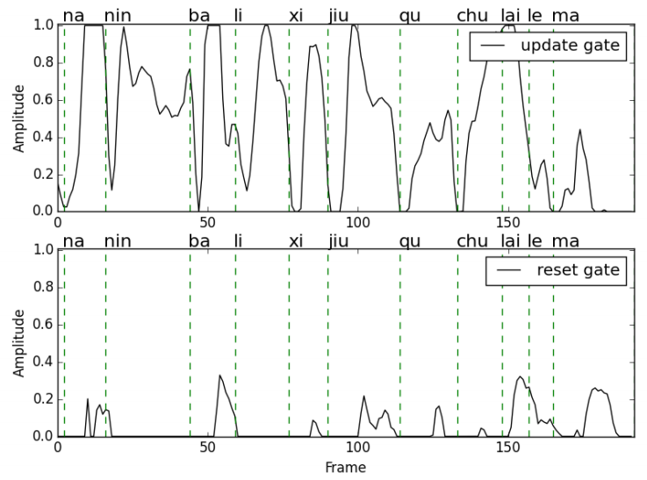
Previous Work
Yaodong Tang, Zhiyong Wu, Helen M. Meng, Mingxing Xu, Lianhong Cai, Analysis on Gated Recurrent Unit Based Question Detection Approach. Interspeech, 2016
Gated RNN for question detection:
Input: acoustic features in an utterance
Output: question or not
Both update and reset gates in GRU react when people begin to pronounce a word.
We consider RNN learned in an unsupervised way here.
Notes:
We find that both update gate and reset gate
in GRU blocks react when people begin to pronounce a word.
http://www1.se.cuhk.edu.hk/~hccl/publications/pub/2016_IS16_TangYaodong.PDF

Slide 7
Approach

Slide 8
Unsupervised Training of RNN
Auto-encoder (AE)
AE-RNN
feature x
x₁
x₂
x₃
Decoder
Feedforward
network
code
RNN
RNN
RNN
…
Encoder
x₁
x₂
x₃
feature x
Notes:
How to train RNN without supervision?

Slide 9
Unsupervised Training of RNN
Recurrent Prediction Model (RPM)
AE-RNN
x₁
x₂
x₃
x₂
x₃
x₄
RNN
RNN
RNN
…
RNN
RNN
RNN
…
x₁
x₂
x₃
x₁
x₂
x₃
Self prediction
Predict the next frame
Notes:
Both are studied in this paper.

Slide 10
Details
4 layers
Feed-forward
64
2 layers
RNN layer
32
x₁
x₂
x₃
RNN layer
32
RNN layer
32
Feed-forward
Feed-forward
64
64
RNN
RNN
RNN
…
ReLU for feed-forward layers
32 cells for RNN layers, 64 neurons for feed-forward layers.
x₁
x₂
x₃
Dropout rate = 0.3
Adam as optimizer
39-dim MFCCs with utterance-level CMVN
TIMIT: train & test sets are standard setup

Slide 11
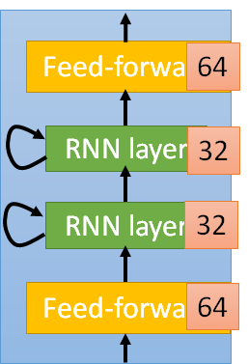
At each time step t
RNN
RNN
RNN
…
x₁
x₂
x₃
0.1
0.3
0.2
…
0.5
0.5
0.5
0.7
0.8
0.9
averaged the value of a specific gate
Notes:
g_{t}

Slide 12
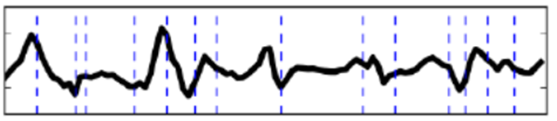
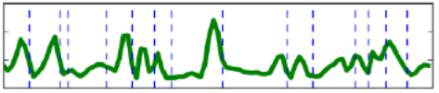
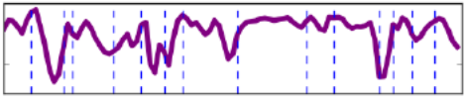
time step 1
time step 2
time step 3
…
Averaged values of input gate
Averaged values of output gate
Averaged values of forget gate
Notes:
LSTM

Slide 13
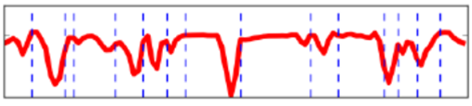
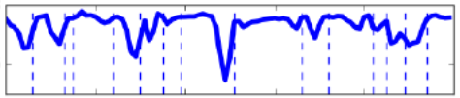
GRU
cell
=
hidden-layer output
Update
gate
Reset
gate
keep the values in the cells
Averaged values of update gate
update the values in the cells
Averaged values of reset gate
The previous cell values do not influence this time step.
Notes:
5:00
valley
Merge the hidden state and cell state

Slide 14
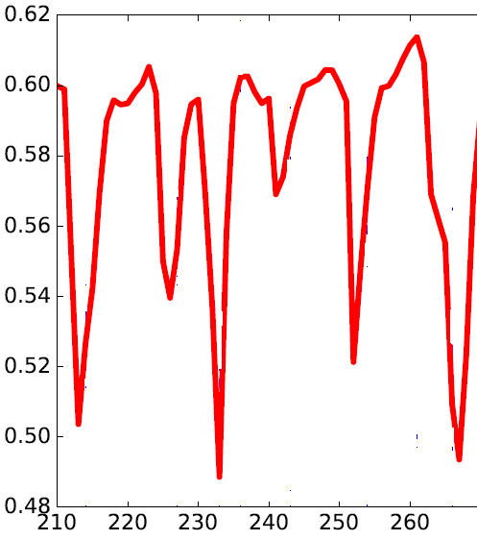
Observation
Averaged update gate value in GRU
When would the update gate be closed?
Frame Index

Slide 15

Observation
Averaged update gate value in GRU
When would the update gate be closed?
The dashed lines are phoneme boundaries.
Frame Index
Using GAS as an indicator of boundaries in phoneme segmentation
w
aa
sh
w
ah
dx
axr
wash
water
Notes:
quantitative
The “valleys” are next to the phoneme boundaries.

Slide 16
Phoneme Segmentation

Slide 17





GAS for Phoneme Segmentation
Averaged values of a specific gate
$$g_{1}$$
$$g_{2}$$
$$g_{3}$$
Phoneme boundary
Delta of the averaged values
$${∆g}_{2}=g_{3}−g_{2}$$
Pick the local maxima
$${∆g}_{1}=g_{2}−g_{1}$$
Larger than a threshold

Slide 18
Different Gates in LSTM and GRU
Models |  | R-value
LSTM | Input Gate | 70.8
 | Output Gate | 62.0
 | Forget Gate | 79.2
GRU | Reset Gate | 78.9
 | Update Gate | 82.5
TIMIT
R value is used as the evaluation measure.
The larger, the better.
Okko Johannes Räsänen, Unto Kalervo Laine, and Toomas Altosaar. "An improved speech segmentation quality measure: the R-value." Interspeech. 2009.
Tolerance window = 20ms

Slide 19
Different Gates in LSTM and GRU
Models |  | R-value
LSTM | Input Gate | 70.8
 | Output Gate | 62.0
 | Forget Gate | 79.2
GRU | Reset Gate | 78.9
 | Update Gate | 82.5
TIMIT
forget
gate
boundary
Among the gates of LSTM, forget gate obtains the best performance.
When LSTM reads a frame near to phoneme boundary, forget gate is closed to forget the previous information.

Slide 20
Different Gates in LSTM and GRU
Models |  | R-value
LSTM | Input Gate | 70.8
 | Output Gate | 62.0
 | Forget Gate | 79.2
GRU | Reset Gate | 78.9
 | Update Gate | 82.5
TIMIT
Among the gates of GRU, update gate obtains the best performance.
The functionality of update gate in GRU is similar to forget gate in LSTM.
Update gates is the best among all the gated RNN.

Slide 21
Baseline: Hierarchical Agglomerative Clustering (HAC)
HAC: Group consecutive acoustically similar feature vectors into a segment
Each segment is considered as a phoneme.
Step 1: build a tree
Step 2: pick a threshold
Notes:
https://www.semanticscholar.org/paper/Integrating-frame-based-and-segment-based-dynamic-Chan-Lee/7d8eaf612500420a125b3cfca98701114cf68873/pdf

Slide 22

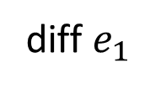

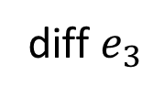

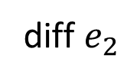

Baseline: Prediction Error
(larger than a threshold)
x₂
x₃
x₄
The local maxima of prediction error is considered as phoneme boundary.
diff $e_{1}$
diff $e_{2}$
diff $e_{3}$
$$e_{3}$$
$$e_{2}$$
$$e_{4}$$
$$e_{1}$$
RNN
RNN
RNN
…
If a frame is hard to predict, it may be the begin of a new phoneme.
x₁
x₂
x₃
Paul Michel, Okko Räsänen, Roland Thiollière, Emmanuel Dupoux, “Blind phoneme segmentation with temporal prediction errors”, ACL SRW 2017
Notes:
米

Slide 23
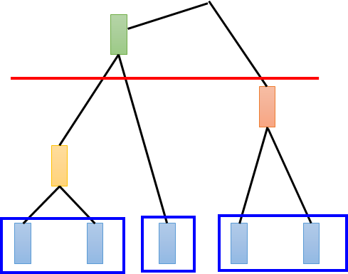
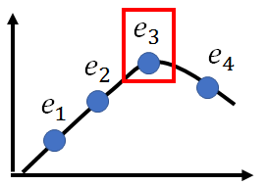
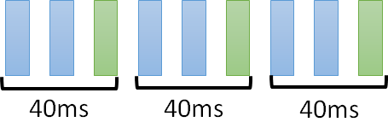
Baselines
Approach |  | Clean | Noisy
Periodic Segment |  | 62.2 | 62.2
HAC |  | 81.6 | 80.4
RPM (Error) | 2 layers | 76.0 | 73.7
 | 4 layers | 76.1 | 73.7
TIMIT:
HAC
Error Prediction
Periodic Segment

Slide 24
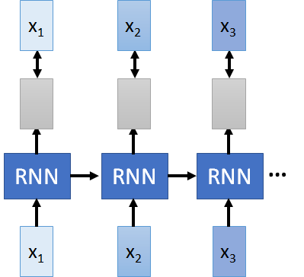






Results
Approach |  | Clean | Noisy
Periodic Segment |  | 62.2 | 62.2
HAC |  | 81.6 | 80.4
RPM (Error) | 2 layers | 76.0 | 73.7
 | 4 layers | 76.1 | 73.7
AE-RNN (GAS) |  | 82.5 | 81.2
TIMIT:
Delta of GRU update gate
$${∆g}_{4}$$
$${∆g}_{2}$$
$$∆g_{5}$$
$${∆g}_{1}$$
$${∆g}_{3}$$
$${∆g}_{6}$$

Slide 25
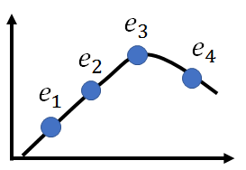




Results
GAS improves the baseline performance without extra efforts (because GAS already exists in the prediction model).
Approach |  | Clean | Noisy
Periodic Segment |  | 62.2 | 62.2
HAC |  | 81.6 | 80.4
RPM (Error) | 2 layers | 76.0 | 73.7
 | 4 layers | 76.1 | 73.7
AE-RNN (GAS) |  | 82.5 | 81.2
RPM (Error + GAS ) | 2 layers | 79.9 | 79.2
 | 4 layers | 83.2 | 81.5
TIMIT:
$${∆g}_{3}$$
Prediction
Error
Delta of the values of update gates
+
$${∆g}_{1}$$
$${∆g}_{2}$$
$$∆g_{4}$$

Slide 26
Results
Approach |  | Clean | Noisy
Periodic Segment |  | 62.2 | 62.2
HAC |  | 81.6 | 80.4
RPM (Error) | 2 layers | 76.0 | 73.7
 | 4 layers | 76.1 | 73.7
AE-RNN (GAS) |  | 82.5 | 81.2
RPM (Error + GAS ) | 2 layers | 79.9 | 79.2
 | 4 layers | 83.2 | 81.5
TIMIT:
Noisy: white noise with 6dB SNR
Noise has larger influence on error, but smaller influence on GAS.
Notes:
5:30

Slide 27
AE-RNN (GAS)
Precision (%)
HAC
RPM (Error):
4 layers
RPM (Error):
2 layers
HAC
RPM (Error): 2 layers
RPM (Error): 4 layers
Recall (%)
AE-RNN (GAS)

Slide 28
RPM (Error+GAS):
2 layers
RPM (Error+GAS):
4 layers
Precision (%)
RPM (Error):
4 layers
RPM (Error):
2 layers
HAC
RPM (Error): 2 layers
RPM (Error): 4 layers
Recall (%)
AE-RNN (GAS)
RPM (Error+GAS): 2 layers
RPM (Error+GAS): 4 layers

Slide 29
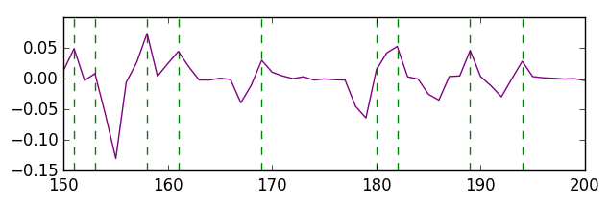
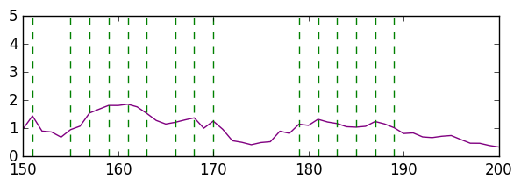
GAS v.s. Prediction Error
Delta of the values of update gates
(averaged over cells)
Prediction
Error
relatively smooth
(The dashed lines are predicted phoneme boundaries.)

Slide 30
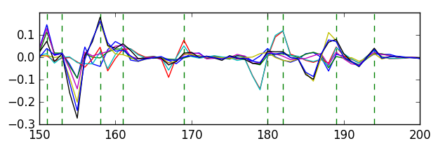
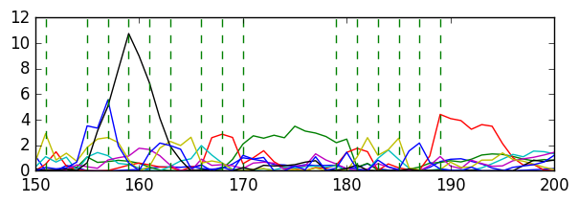
GAS v.s. Prediction Error
Delta of the values of update gates
(individual cells)
relatively more correlated
(Each curve corresponds to a cell.)
…
Prediction
Error
…
(Each curve corresponds the error of one dimension.)

Slide 31
Different Languages
Global Phone
Approach |  | Czech | German | French | Spainish
RPM (Error) | 2 layers | 74.7 | 80.3 | 77.8 | 78.5
 | 4 layers | 74.6 | 79.9 | 77.4 | 78.4
AE-RNN (GAS) |  | 77.1 | 81.1 | 81.1 | 79.3
RPM (Error + GAS ) | 2 layers | 77.9 | 81.8 | 80.2 | 80.5
 | 4 layers | 77.6 | 80.9 | 82.6 | 81.7
GAS improves the performance.

Slide 32
Concluding Remarks

Slide 33
Conclusions
Analyzing gate activation signals (GAS) of gated RNN learned in an unsupervised fashion.
GAS highly correlated with the phoneme changes
GAS improves phoneme segmentation
Outperforming baselines including HAC and prediction errors
In both clean and noisy conditions
The results are consistent on different languages.
Notes:
GAS improve the baseline performance without additional parameters (It's free! Since GAS lies in all models with RNN)

Slide 34
Thank You for Your Attention
Notes:
We do have analysis on each phone

Slide 35

Unsupervised Training of RNN
x₁
x₂
x₃
x₄
Sequence-to-sequence auto-encoder is one way to train RNN without supervision.
y₁
y₂
y₃
y₄
RNN Encoder
RNN Decoder
x₁
x₂
x₃
x₄
Interesting results are obtained by visualization
https://arxiv.org/abs/1603.00982
https://arxiv.org/abs/1707.06519
Notes:
https://arxiv.org/abs/1603.00982
https://arxiv.org/abs/1707.06519
The RNN encoder and decoder are jointly trained.

