Slide 1




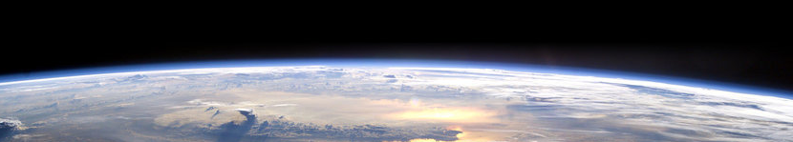

The pale blue dot: Simulations of Earth as an exoplanet
Ally Payne, Vincent Kofman
Geronimo Villanueva, Thomas Fauchez,
Avi Mandell, Ravi Kopparapu & Giada Arney

Slide 2
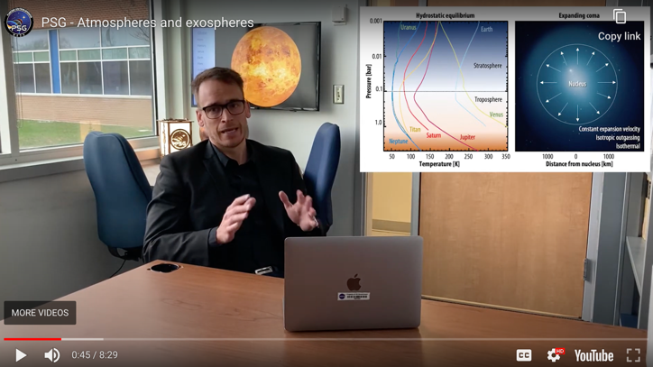
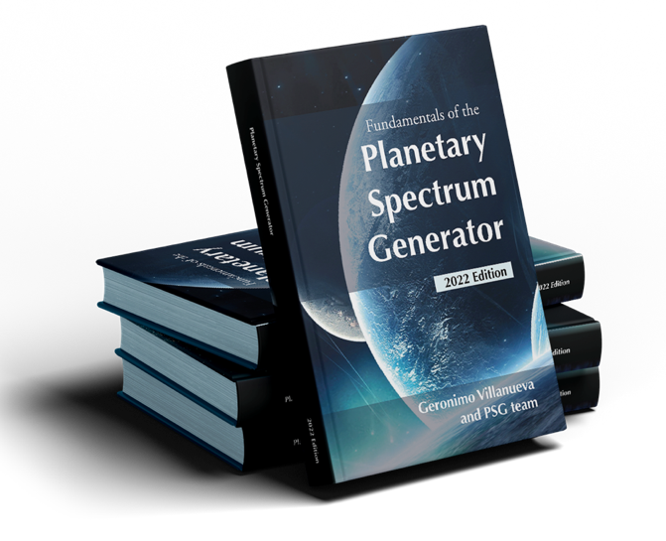
Motivation HWO and tool development
Developing science case of interest to community
Interfacing radiative transfer with climate model outputs
Applying the outcome to simulations of detectabilities HWO
PSG is a widely used community resource ~1.3M hits/yr over 24K users
Freely available, enabling science for all
Extensive documentation: Free planetary spectroscopy textbook, online guides, tutorial videos, and a thriving support community
Villanueva et al., 2018, 2022

Slide 3
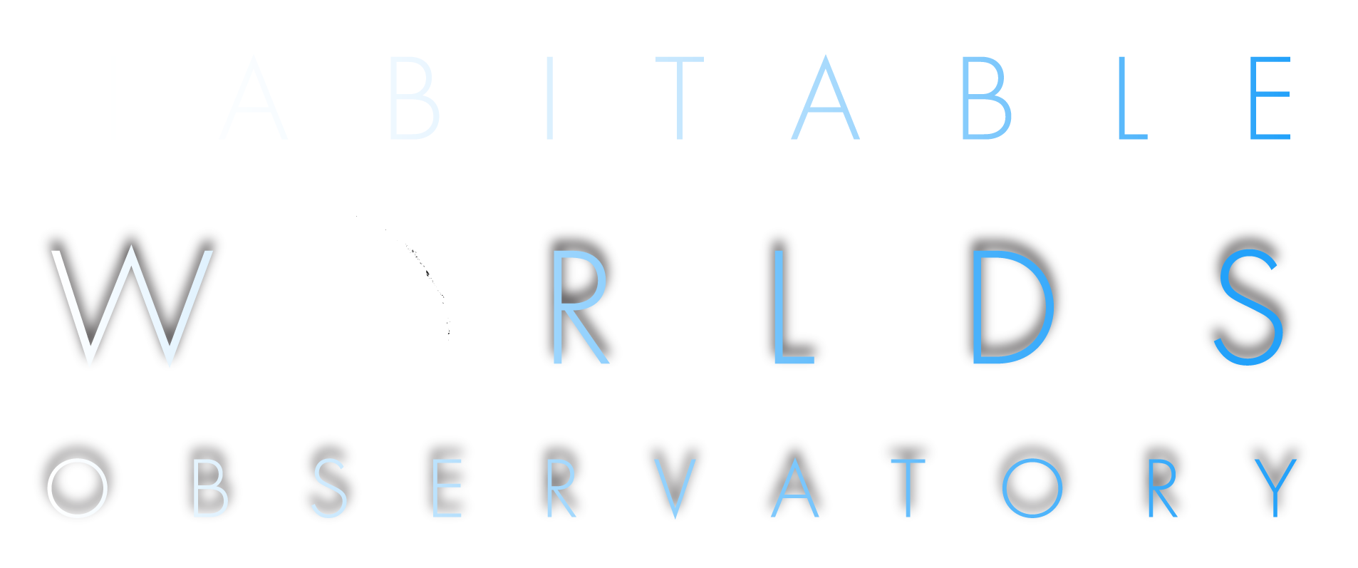
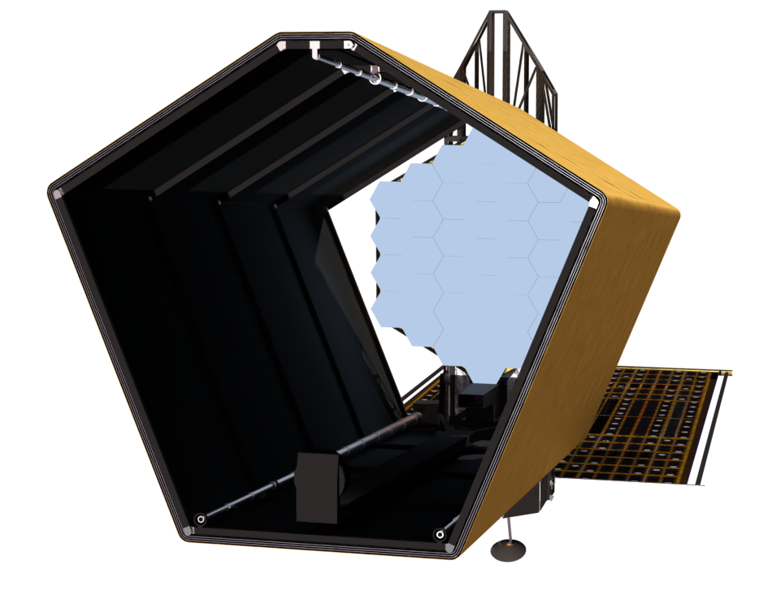
NASA’s next flagship mission concept recommended by Astro2020 Decadal Survey
First telescope designed to search for signs of life on planets outside our solar system
- Goal: Study 25 Earth-like planets, sun-like stars
- Will also study galaxies
Large-aperture UV / Optical / NIR observatory performing transformative astrophysics
Slide from Giada Arney & HWO team

