Slide 1
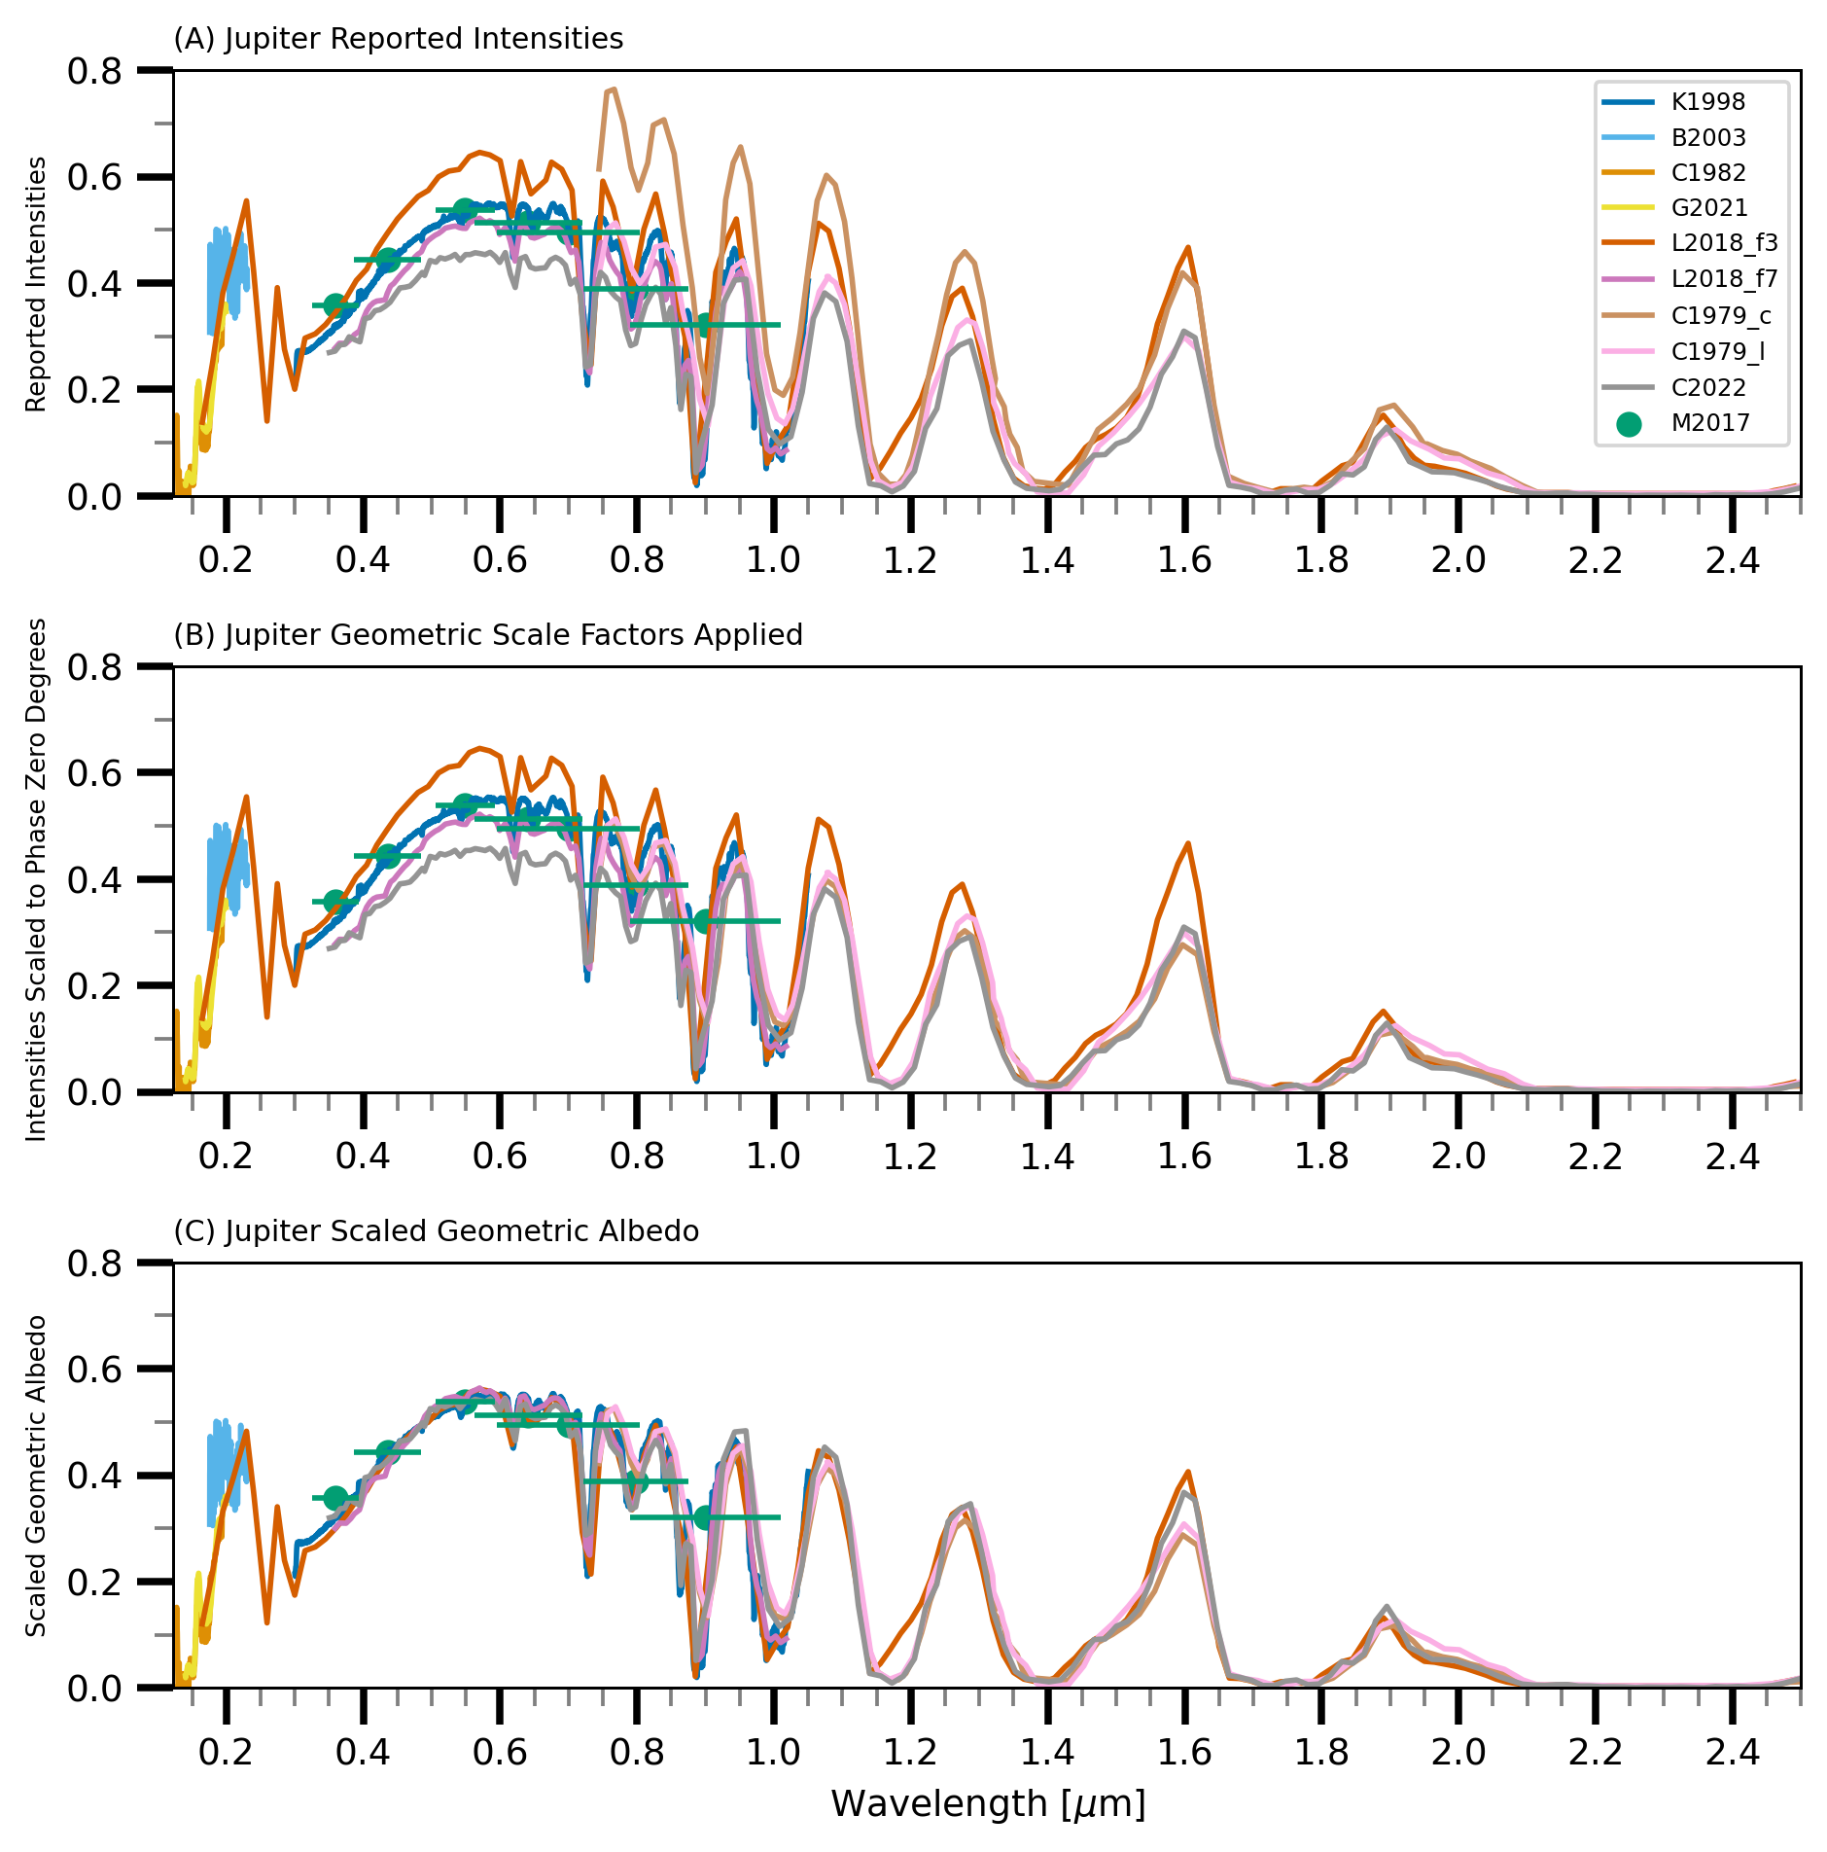
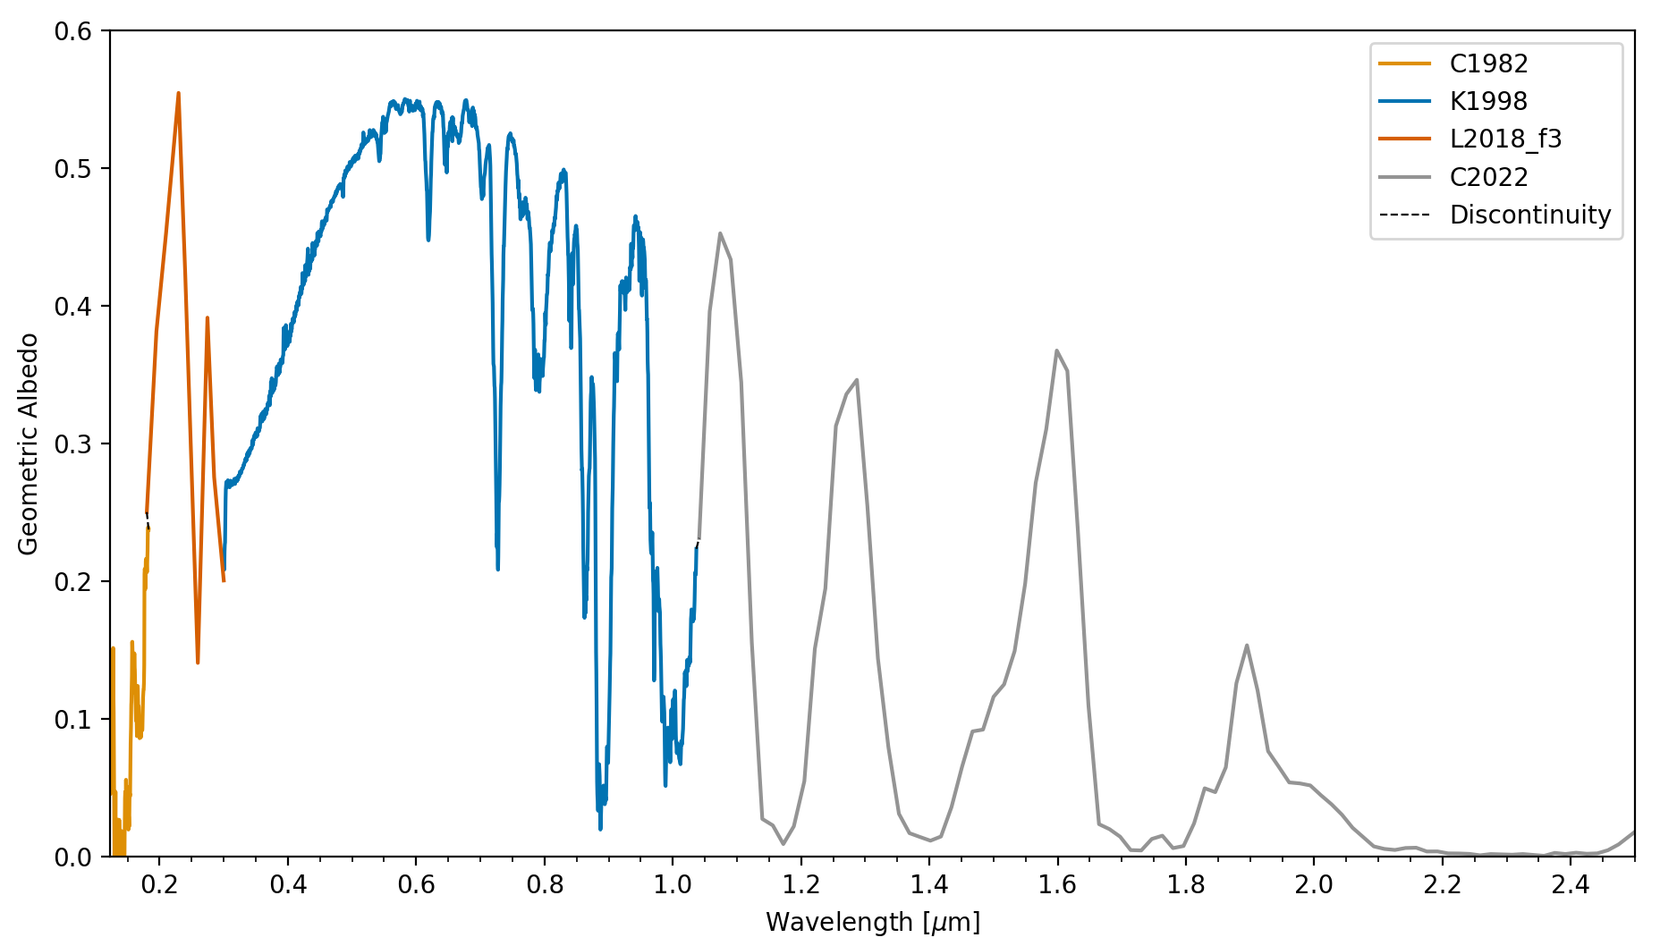
Ally Payne: Comparative Planetology of Solar System Spectra Supporting Direct-Imaging of Exoplanets
Jupiter data is displayed as the example planet for this slide
Legend displays publication that produced the spectral data
This work combines spectra from ground- and space-based missions to create an extensive baseline for the reflectance signatures of each of the solar system planets and Titan. The diversity of planets in our solar system is key to developing this framework for comparative planetology. By comparing new exoplanet observations to known planetary spectra, we can begin to classify them based on similarities with the planets that we know best.
1: Original Data Original reflected light intensities are shown
2: Geometric Adjustments
Data are adjusted to phase zero and Lambertian limb darkening corrections are applied
Jupiter final data output:
Composite Geometric Albedo Spectrum (0.15-2.5 microns)
3: Adjusted Geometric Albedo Sources are scaled to match the intensity of the chosen reference spectrum

