Slide 1
Varying Parameters Code
Ally Payne
February 13th, 2024

Slide 2
Motivation of the code
Code designed to vary the position (altitude)/ abundance of the various types of clouds on a planet (1D Modeling)
Starting with Jupiter
By varying the position/ increasing or decreasing the abundance of given molecules as a function of “atmospheric layer” in the config file for Jupiter on PSG
Will also try adjusting the PT profiles using the same code
The goal is that the resultant PSG spectrum will match the planetary albedo values that are presented in Madden’s 2018 paper for solar system atmospheric reflectance curves

Slide 3
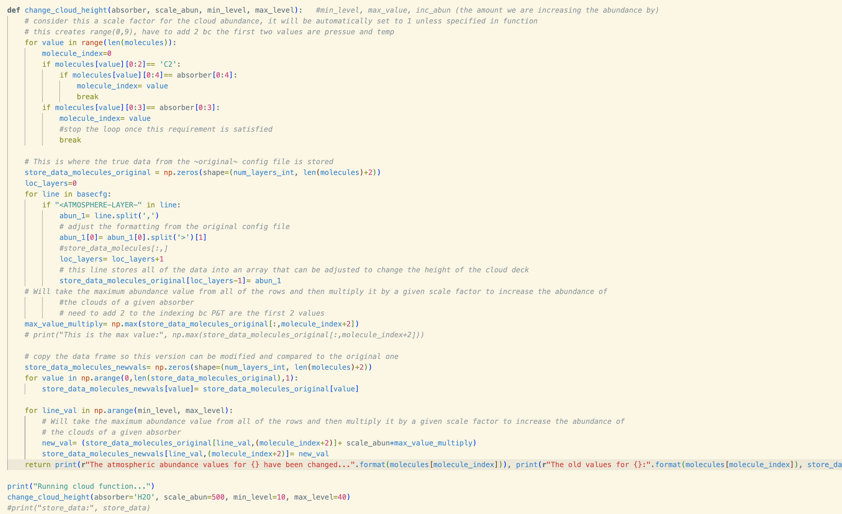
Scaling absorbance values…

Slide 4
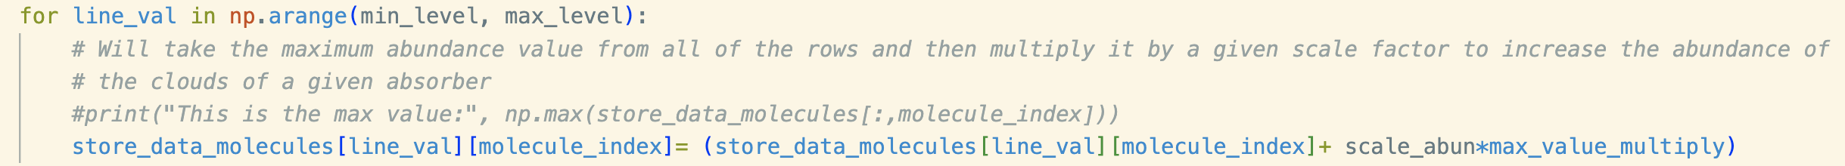
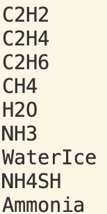
This is what the code looks like originally:
1. This goes through each atmospheric layer in the Jupiter cfg file from PSG
2. It is directed specifically to the absorber that is designated at the start of the function
These absorbers come from the “<ATMOSPHERE-LAYERS-MOLECULES>” line in the default config file for Jupiter in PSG. To choose the value you want to vary with the function I have created, you type “absorber= ” + a string value of any of these:
This molecule is identified here when calling the function

Slide 5
Now to vary the values using change_cloud_height…
If original value is zero: you can’t multiple it by a scale factor.
If original value is much smaller than 1 (ie. 0.000x): it wouldn’t make sense to add an integer value (ie. 1 or 2) (they will be too large)

Slide 6
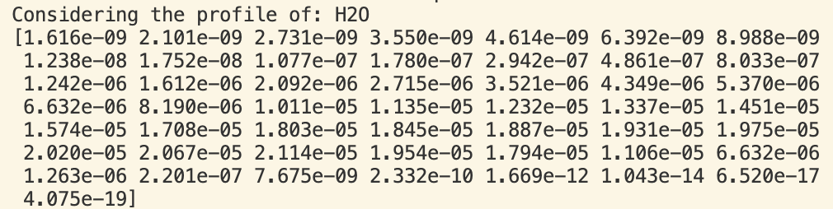

H2O Profile for reference:

Slide 7
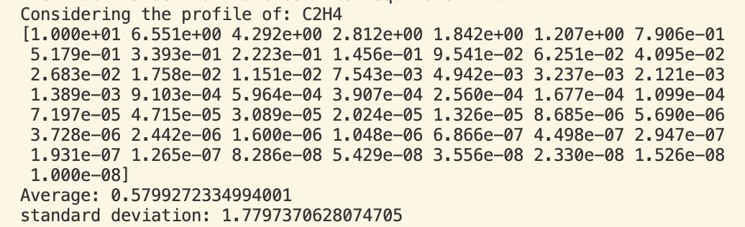
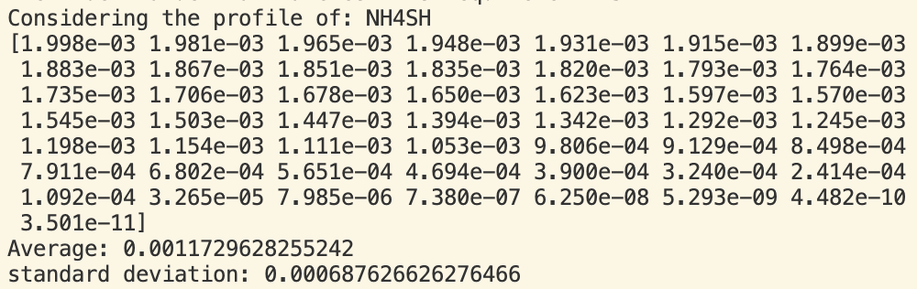
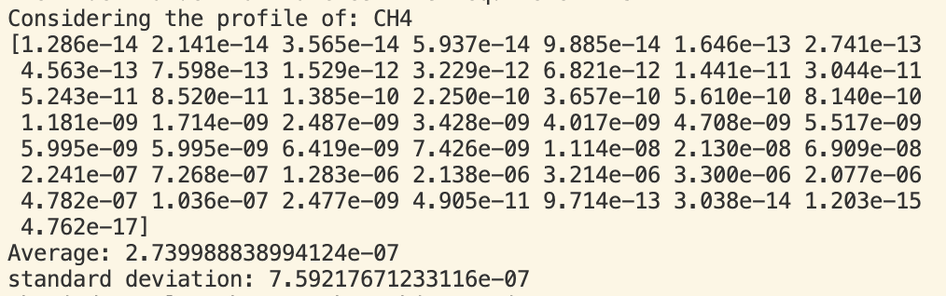
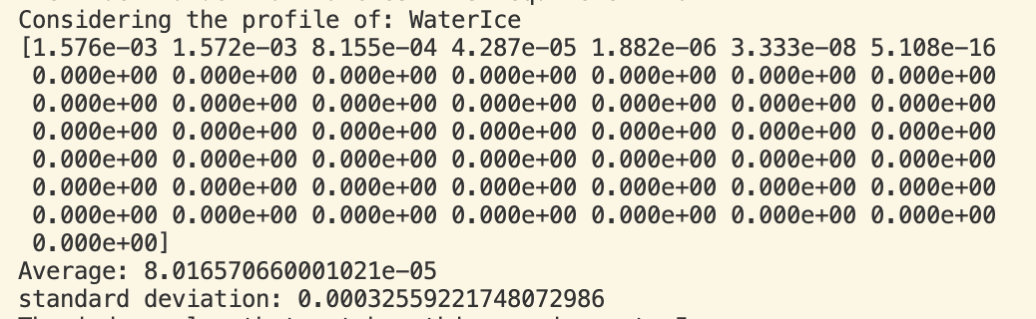
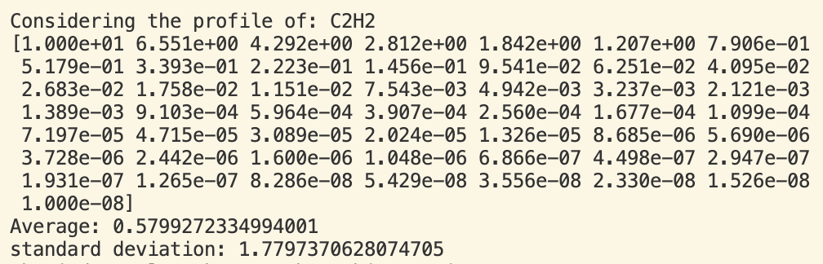
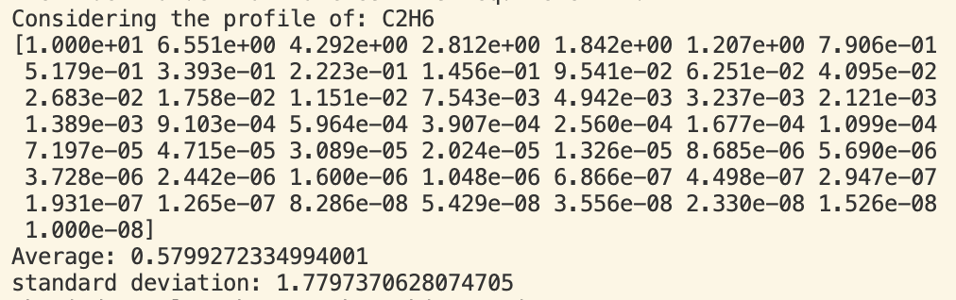
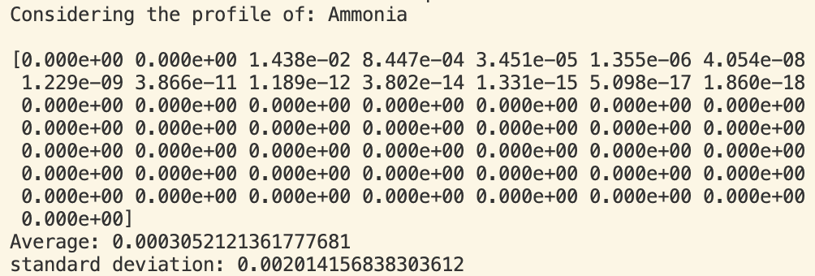
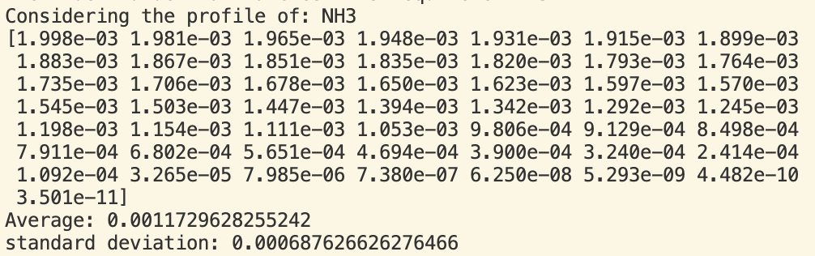
ALL MOLECULES

Slide 8
Now to vary the values using change_cloud_height…
Method: multiply it by a multiple of one of the abundance values that already exist within the data set.
- This function will take the maximum value in the data set for the chosen absorber and multiply it by the scale_abun value chosen in the change_cloud_height function

Slide 9
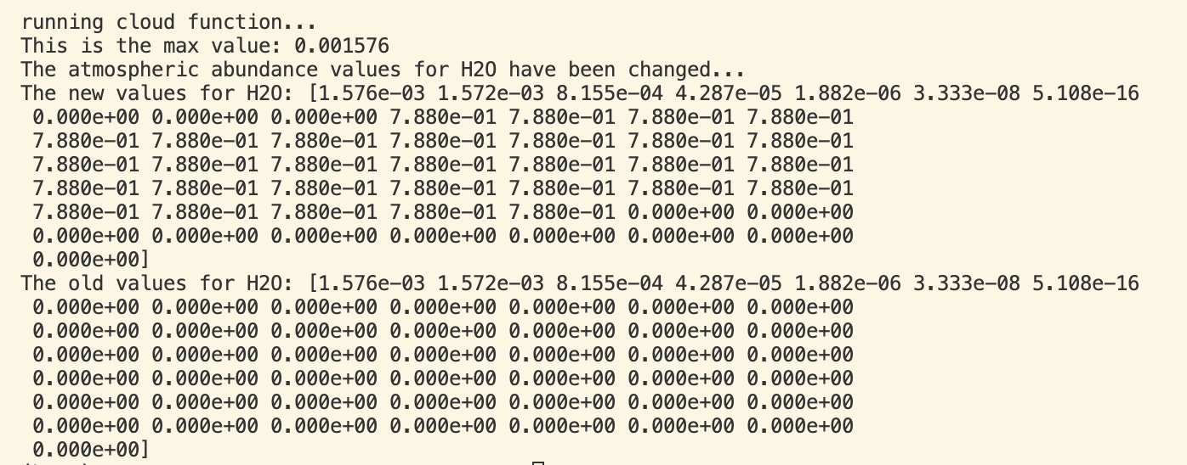
Running the Function
INPUT:
Choose the absorber from the options in this list:
There are 50 atmospheric layers in the Jupiter config file. The abundance values are adjusted within the range of min_level to max_level. As an example, I chose to add clouds to layers: 10-40 by taking the max. abundance value that already exists for a given absorber and choosing a ”scale_abun” value seems reasonable
OUPUT:
The output function will show the old values from the config file and the new ones for comparison of how they have changed

Slide 10
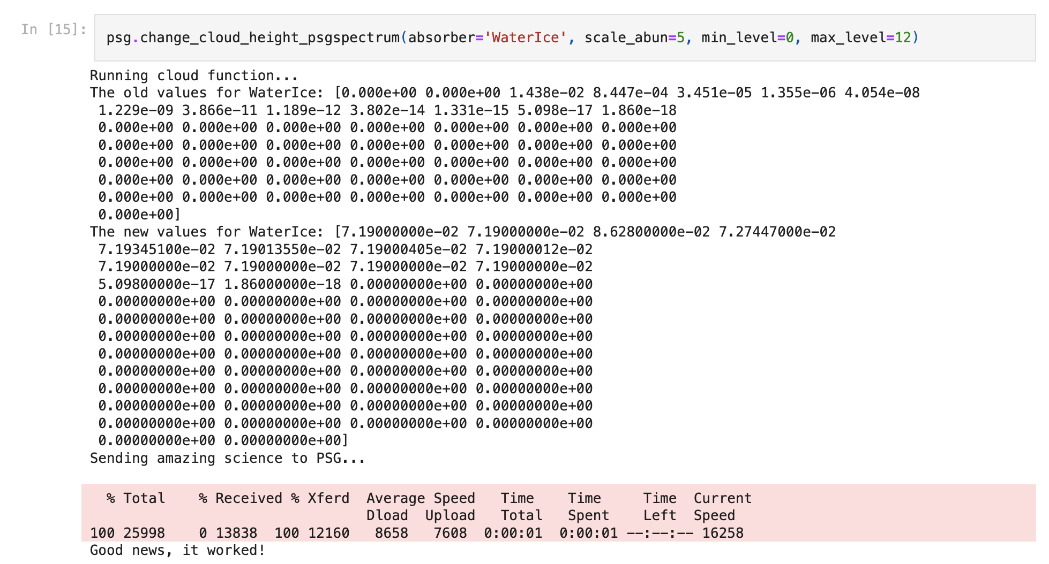
Running the function in a Jupiter notebook
Choose the absorber, scale, layers to be present
The function creates the new values based on this information and then sends the configuration file to PSG directly (this only takes a second)
It will then download the resultant I/F spectrum

Slide 11
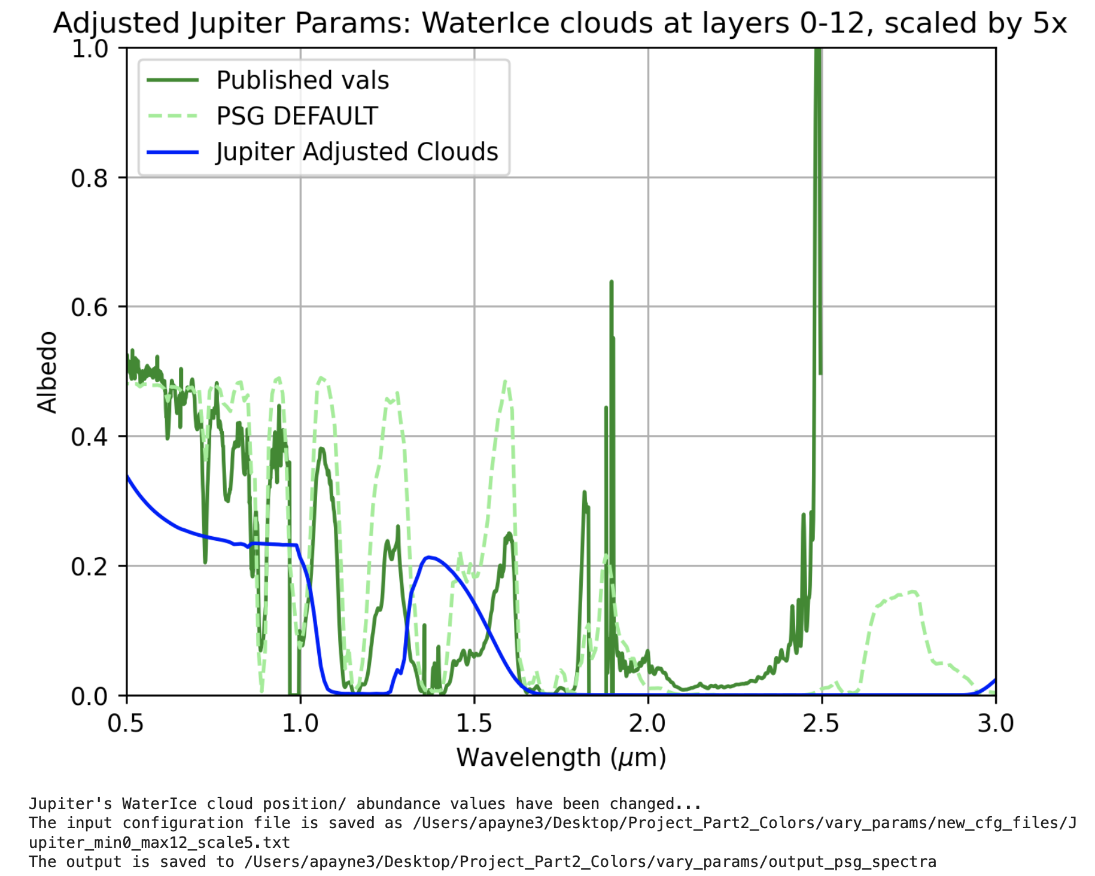
The Result!
A plot will automatically be created to compare how this variation alters the original PSG (default) planetary reflectance spectrum and how it compares to the published (Madden) values for Jupiter
The file name and location will be determined in the .py file and the location is specified after running successfully

