Slide 1
Neural Networks Basics

Slide 2
What is a neural Network?
In terms of usage, a neural network is just another family of predictive algorithms.
We can use neural networks to classify, predict, and forecast.
Neural networks are based on a conception of how a brain works:
The conception didn’t end up being particularly brain like, but it still works well.
Neural networks are made of a bunch of “neurons”.
Neurons have connections with each other.
Neurons take some inputs, do some math, and output some value.

Slide 3
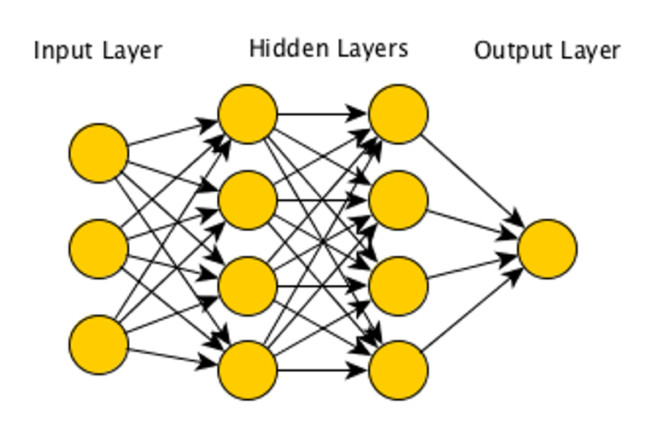
X1
X2
Y
X3

Slide 4
Why a Neural Network?
Neural networks, as a concept, are old – dating back to the 1940s.
Neural networks have exploded in popularity and usage over the past few years.
Libraries have gotten easier to use.
Datasets have gotten larger and cheaper.
Processing power (specifically GPUs and derivatives) has gotten better and cheaper.
Neural networks tend to excel with data that is unstructured and large.
Many/most interesting problems fall into this!
Image and speech based problems have been revolutionized by modern neural networks.

Slide 5
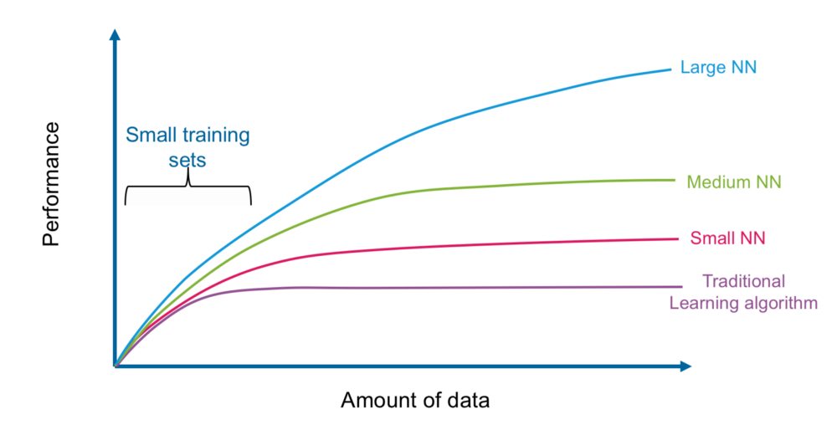

Slide 6
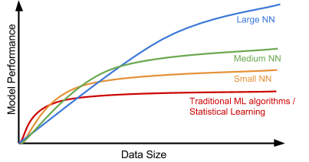

Slide 7
Neural Network Components
A neural network is made up of multiple layers of neurons, which are then connected.
Neurons – each neuron takes in inputs, does a calculation, and produces an output.
Layers – each layer is one ‘step’ in the calculation process.
Inside this framework, there are a few important parts:
Weights – modifies the contribution for an input value. The m in y = m*x + b
Bias – shifts the entire function. The b in y = m*x +b
Activation function – translates the linear output of a neuron. The sigmoid in log reg.
Inputs/output – the same as we are used to.

Slide 8
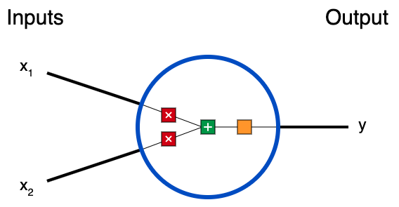



Structure of a neural Network: Neuron
3 things happen in each neuron:
First, each input is multiplied by a weight.
Next, all the weighted inputs are added together with a bias b.
Finally, the sum is passed through an activation function (e.g. sigmoid).
This process is called “forward propagation”.

Slide 9
Single Neuron Example
We can manually perform an execution of our NN, assume:
x1, x2 = 2,3
Weights = 0,1
Bias = 4
Multiply by weights (also a dot product: x· w):
x1 * w1 = 2 * 0 = 0
X2 * w2 = 3 * 1 = 3
Add bias:
0 + 3 + 4 = 7
Produce final output with activation function:
1/(1+e^-x) = 1/(1+e^-7) = .999

Slide 10
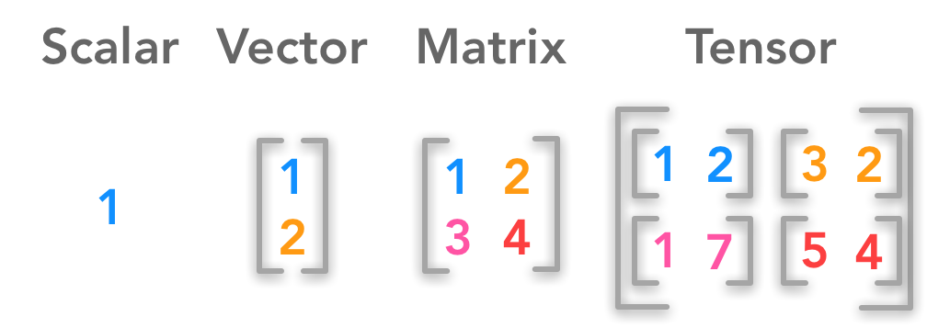
Tensors
Neural networks require us to pay a little more detail to the shape of data.
We can and will abstract some of this out later on with the Keras package.
NN are dependent on multidimensional arrays, called tensors. Tensors are largely interchangeable with np arrays.
Internal calculations frequently use tensor math. We don’t need all the details, but we do need to understand some of it.

Slide 11
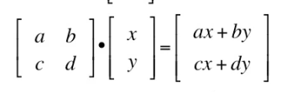
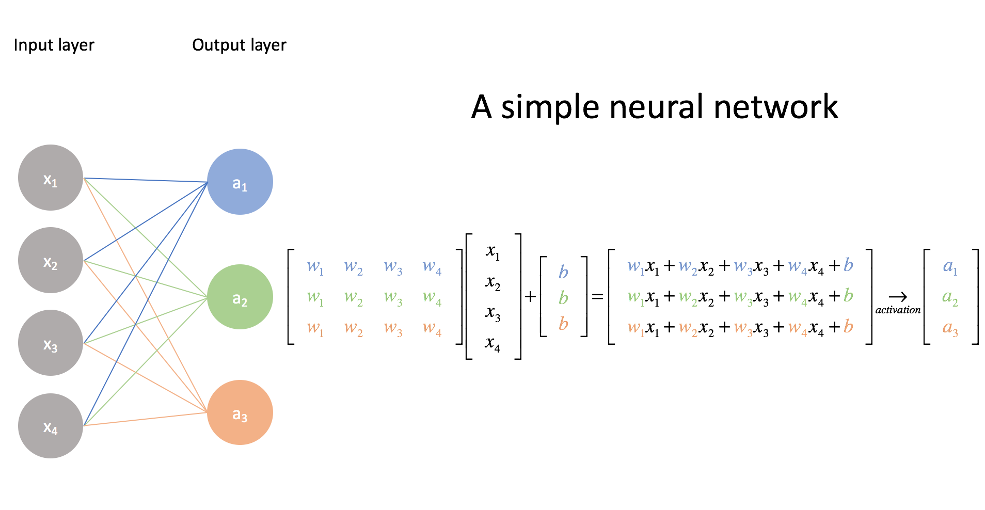
Dot Product
One very common operation is a dot product.
A dot product multiplies the items at the same position of two sequences.
Think – the python zip command, but with multiplication.
We can use a dot product in bulk to multiply each x by each weight in a neural network.

Slide 13
Neural Network Structure: Layers
As we can see in the diagrams, a neural network is made up of layers.
Each layer represents one “step” of the processing.
A set of linear transformations, followed by processing through the activation function.
Every network has an input layer and an output layer:
Input layer’s input shape is sized to the number of features in the feature set.
Output layer output shape is sized to the # of outputs. 1 for regression, # classes for classification.
There can be an arbitrary number of hidden layers in between the two.
“Deep Learning” networks have many, over 3, potentially 100s.
The main layer we’ll use is Dense – meaning that each neuron in a layer is connected to each neuron in the next.

Slide 14
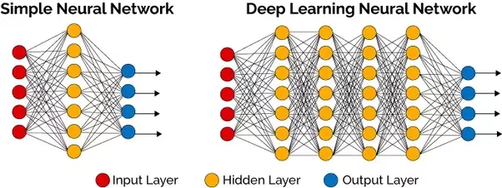

Slide 15
Neural Network Structure: Layers
Each layer does “a thing”. Most layers perform one set of the neuron calculations above.
There are other layers that can do other stuff as well:
E.g. normalization, regularization, flattening, etc…
We generally aren’t referring to these when talking about the NN’s calculation execution.
The number of layers and the number of neurons in each layer are configurable.
The number of neurons a NN has is it’s capacity. Larger capacity networks can model more complex relationships.
Number of neurons is the width, number of layers is the depth.
“Proper” size of a network is an open question. We’ll look at some guidelines later.
For the moment, try hidden 2-4 layers, each with the same # of neurons as features.

Slide 16
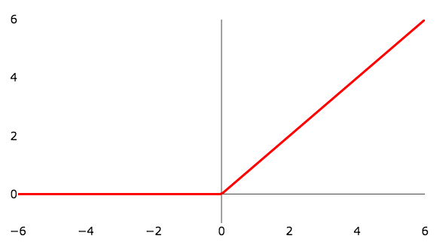
Activation Function
Each layer of the NN calculates the linear combination, then runs it through an activation function.
We can think of the activation function as the sigmoid, though we’ll usually use others.
This activation function determines in the neuron “fires”:
Easiest to visualize is the ReLU function pictured in the top right.
This allows the network to learn complex, non-linear patterns.
A network with no activation functions would be reducible to a linear equation.
Each neuron calculation sums the weights*inputs, then the output is determined by that value run through the activation function.
Introduces non-linearity.

Slide 17
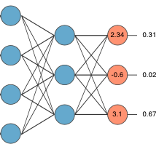
Output Activation
One different scenario we need to pay attention to is the activation on the output.
This is analogous to using the sigmoid to do a logistic regression.
If the problem is a regression, we don’t need one (linear activation). We want raw values.
If the problem is a classification, we need one to produce class estimates:
Multiclass – Softmax activation, one output neuron per class. (pictured)
Binary – Sigmoid activation, one output neuron. (Or a 2 class version of above).
Multilabel – Sigmoid activation, one output neuron per class.

Slide 18
Neural Network Execution
Now we have the main pieces of a neural network, we can look at the execution.
Training a neural network has two parts – forward propagation and backward propagation.
Forward propagation:
start at the input, do all calculations to make a prediction.
This is what we walked through with one neuron above.
At the end, calculate loss – the error of our prediction.
Backward propagation:
Work backwards from the error to the input layer.

Slide 19
NN Execution: Backwards Propagation
Backwards propagation takes the error from the prediction and translates it to errors in the weights and biases.
We start the FP with a set of inputs, and sets of weights and biases.
To minimize the error we need to adjust the weights and biases.
BP uses derivitives to translate the error w.r.t. y from our prediction, to gradients of error w.r.t. each weight and bias.
The weights and biases are then adjusted with these gradients and gradient descent.
This process repeats through each layer. Error w.r.t. output -> error w.r.t. inputs.

Slide 20
Neural Network Process
Forward propagation:
Use the inputs, weights, and activation function to generate a prediction.
Loss calculation:
Evaluate the error of that prediction.
Backwards propagation:
Use the error and the derivatives of the function to figure out how to adjust the weights.
Repeat until final prediction error flattens, or limit is reached.
This process allows large networks to become very well fitted to complex patterns if given enough data.

Slide 21
Logistic Regression -> Neural Network
We can look at logistic regression as a framework for a neural network.
Think of an image, like the digits we used for classification:
Each pixel is a feature/input. The x values in a NN.
The classification outcome is the output.
The slopes (m) are the weights.
The sigmoid is the activation function.
The linear calculation is the calculation of weights and inputs.
The error is the loss function in the NN.
The gradient descent to find the optimal solution is the backpropagation in the NN.

Slide 22
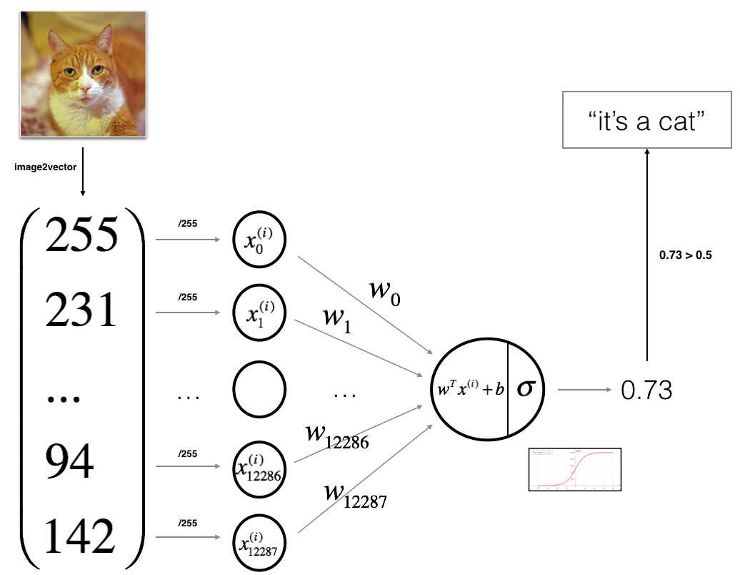

Slide 23
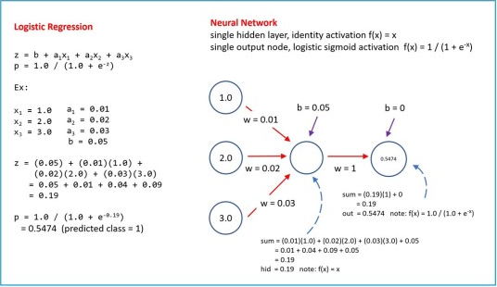

Slide 24
Conclusion
To make sense of how a neaural network functions, it is good to look at the detail a little.
In practice we’ll use libraries (Keras/Tensorflow) to make it easier.
Key points that we need to be comfortable with:
Data shape to feed the network.
Layers and neurons – size and function, not math.
Errors and loss.

