Slide 1
Time Series Forecasting

Slide 2
Exponential Smoothing
Exponential smoothing is one of the simplest forms of time series forecasts.
Weighted averaging with a smoothing term.
Can be either Additive or Multiplicative:
If every December we sell 10,000 more apartments than we do in November, the seasonality is additive in nature. However, if we sell 10% more apartments in the summer months than we do in the winter months the seasonality is multiplicative in nature.
Can also incorporate:
Trends – are we moving up or down over time.
Cyclicality – are there seasonal patterns.

Slide 3
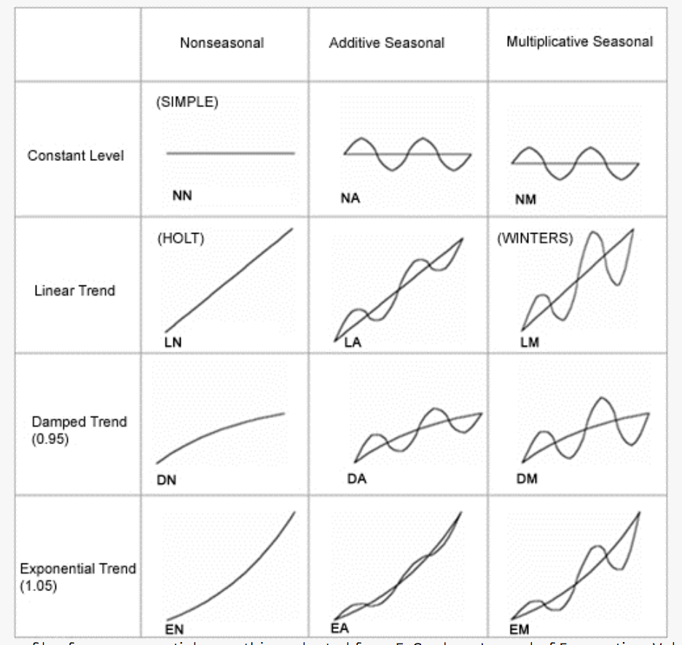

Slide 4
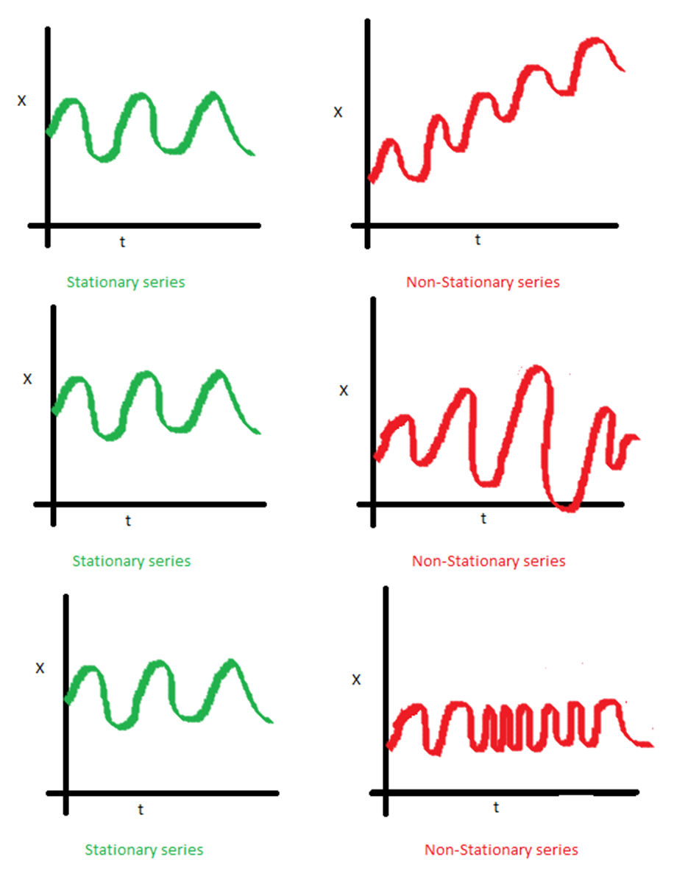
Stationary
A time series being stationary means that its major stats (mean, std) are not changing over time.
We can transform data to make it stationary:
Differencing.
difference(T) = observation(T) – observation(T-1)
.diff() in code.
Other transformations (e.g. log). We won’t cover this stuff in detail.
We generally need to make a time series stationary, or provide arguments for it to be made stationary.

Slide 5
ARIMA
ARIMA is a common time series model, it has 3 parts:
AR (p) – Autoregressive. Regresses on its own prior or lagged values. In other words, it predicts future values based on past values.
I (d) – Integrated. Observes the difference between static data values and previous values. The goal is to achieve stationary data that is not subject to seasonality.
MA (q) – Moving Average. A moving average.
Uses differencing to become stationary – removes seasonality.

Slide 6
Creating ARIMA
D term - Augmented Dickey Fuller test.
P < .05 for significance test is normal cutoff.
P and Q Terms from autocorrelation and partial autocorrelation graphs.
Next page…
If in doubt, default to lower values first.

Slide 7
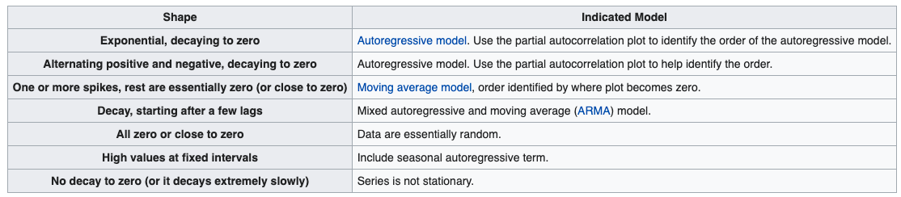

Slide 8
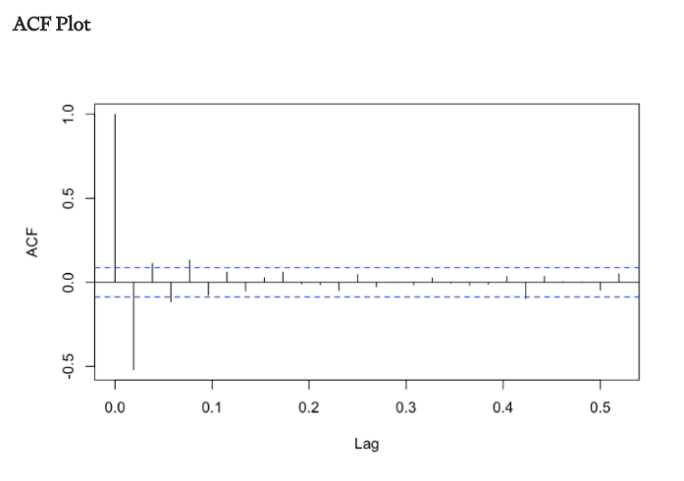
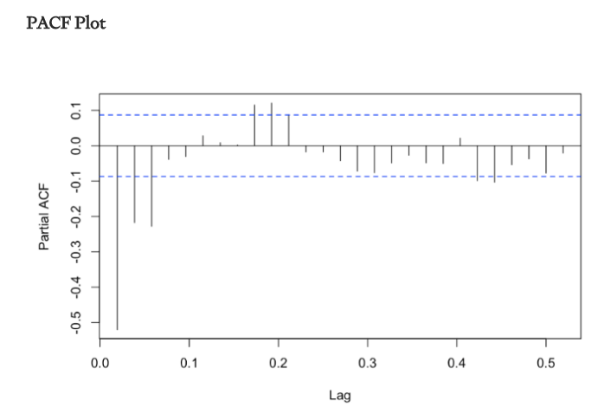
AR – 0 MA – 1

Slide 9
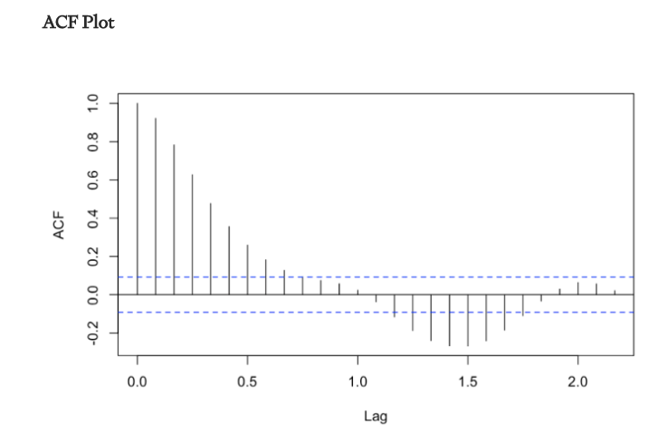
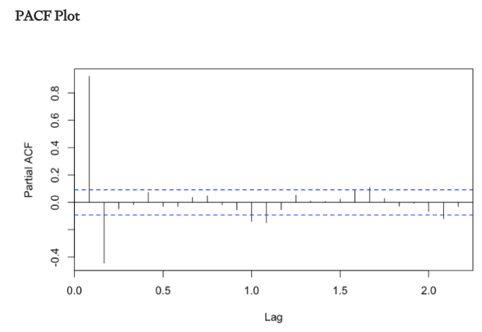
AR – 1 MA – 0

Slide 10
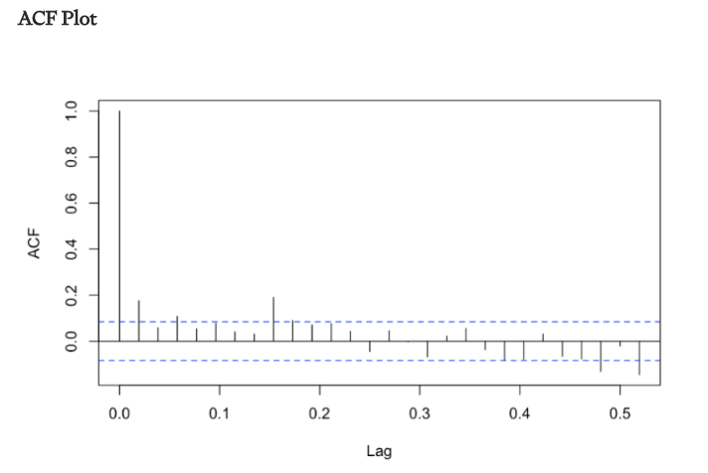
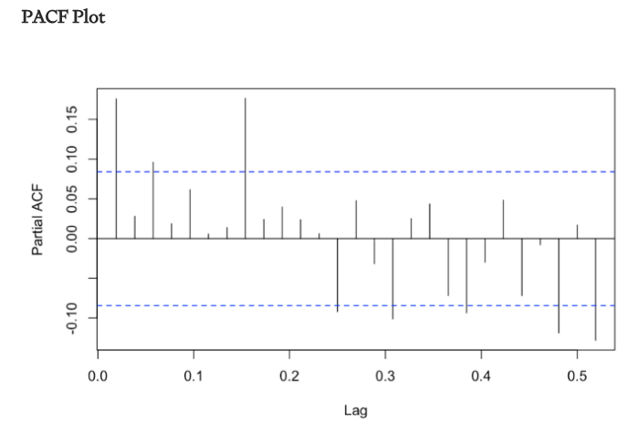
AR = 1 MA = 1

Slide 11
Implementation
Sktime is a wrapper that packages time series functionality, largely from statsmodels, into a sklearn-ish format.
Statsmodels documentation is not the best.
Statsmodels code is structured quite differently.
Allows us to do basic time series at a higher level, much more easily.

