Slide 1
Boosting Ensembles

Slide 2
Boosting vs Bagging
Early in the semester we looked at some ensembles – bagging:
E.g. Random forest.
Employed many models in parallel, “averaged” their predictions to make final prediction.
Generally outperforms individual models, particularly in preventing overfitting.
Each individual model runs independent of the others.
Another ensemble technique is boosting:
Multiple copies of a model used.
Results of one model are used to improve the next, sequentially.
Utilizes weak learners.

Slide 3
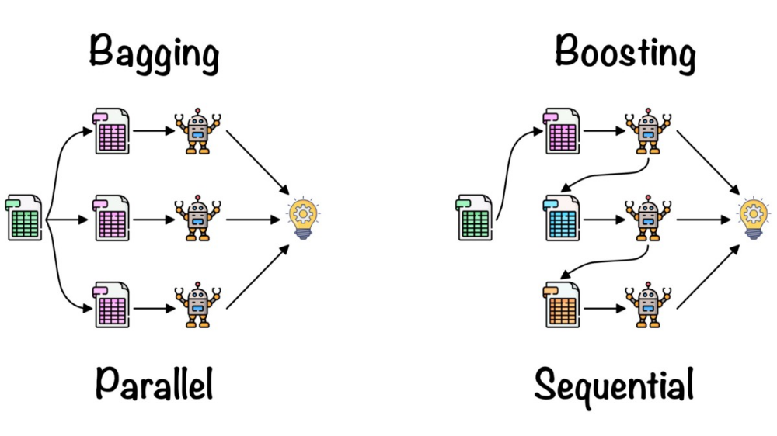

Slide 4
Weak vs Strong Learners
Weak learners are models that are slightly better than a guess.
Simple and fast.
Very underfitted.
Strong learners are models that have “high” accuracy.
Everything we’ve done has been with strong learners.
More complex, slower, and can tend to overfit.
The “goal” of machine learning – we want to predict accurately.
Boosting usually uses a simple decision tree, a stump, as the base learner.
Other simple versions of SVM, regression, or even neural networks can be used.

Slide 5
From Weak to Strong
Boosting algorithms create a strong learner from many weak ones.
Each learner contributes a little, subsequent ones focus on the mistakes.
Each learner does a slightly different thing, so they compensate for each other’s weaknesses.

Slide 6
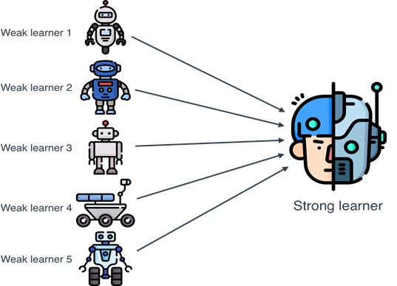

Slide 7
Boosting Ensembles
Boosting algorithms take a combination of weak learners and combine them.
Result is a strong learner.
Some of the currently most accurate non-neural network models are ensembles.

Slide 8
Boosting Implementation

Slide 9
AdaBoost
One ensemble algorithm is Adaboost – adaptive boosting.

Slide 10
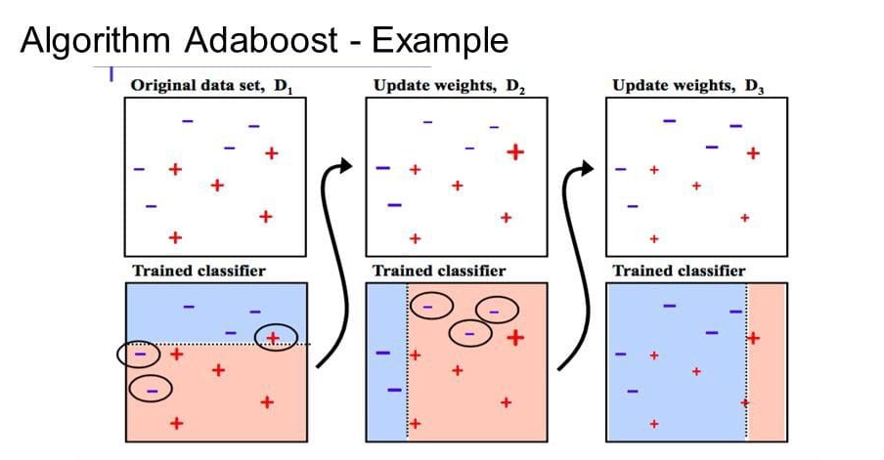

Slide 11
Gradient Boosting
Gradient boosting is an ensemble that focuses on loss (residuals) to train the models.

Slide 12
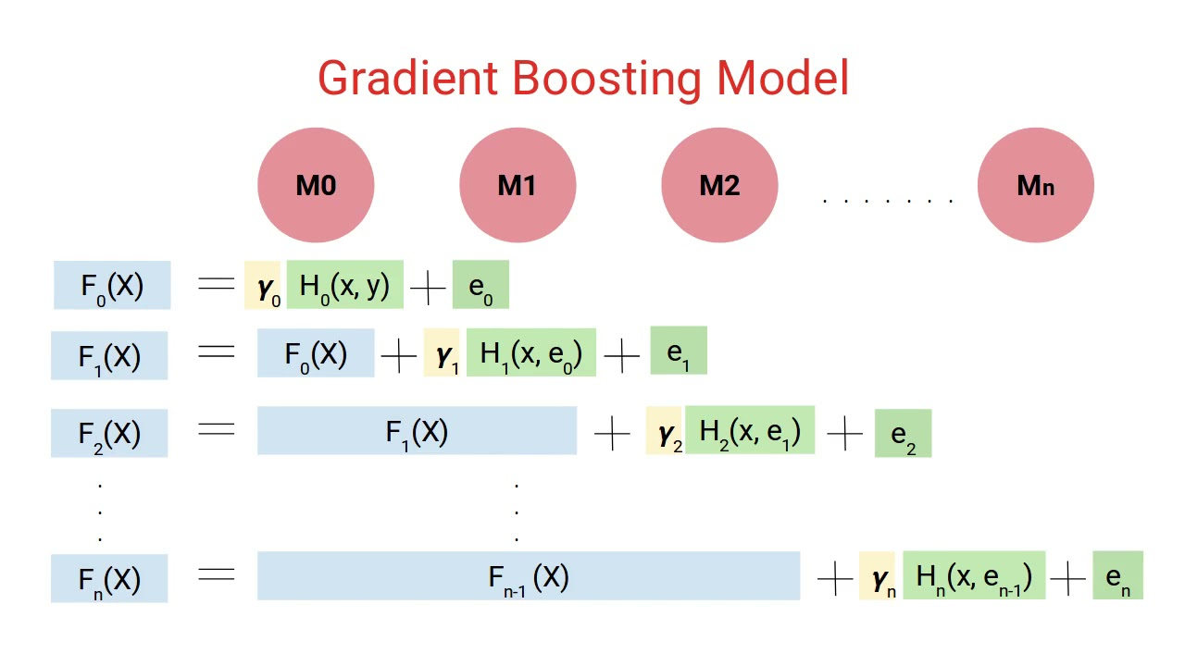

Slide 13
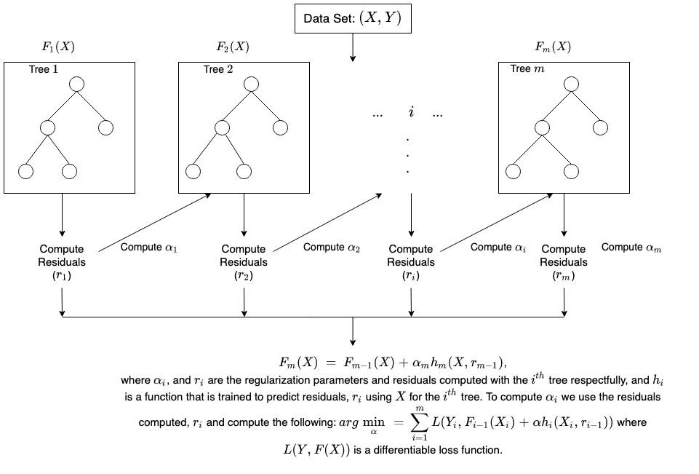

Slide 14
XGBoost – Extreme Gradient Boosting
XGboost is a current “champion” of non-neural network algorithms.
LightGBM (by MS) is similar to xgboost, but often faster. Trees get deeper.
New – only developed in 2014. Mostly by one dude!
Applies many tricks/optimizations to gradient boosting.
Parallelized and written to optimally utilize hardware for speed.
Built in cross validation and regularization.
Handles sparse or dense data by default, as well as data that is too large for memory.
Revised methods to efficiently find internal calculations like tree split points.
Effectively – gradient boosting + all the “extra stuff” that can make algorithms faster and better.

Slide 15
Other Ensembles - Stacking
Stacking is an ensemble technique that uses another model that is used to do the “blending” step for the final predictions.
I.e. rather than taking a “vote” of all the predictions like one would for a random forest classification, those predictions are the feature set of another model (e.g. log. reg.)

Slide 16
Ensembles Conclusion
Boosting is extremely effective – boosted trees are the best overall models in many cases.
Weak learners prevent excessive overfitting.
Multiple learners and weighting allow for good fitting, and not underfitting.
XGboost (and competitors) incorporate a suite of optimizations to maximize performance.
Smaller/structured -> xgboost/lgbm. Larger/unstructured -> neural network.
Are less parallelizable, due to sequential calculations, than other models.
Partially mitigated by xgboost/lgbm.

