Slide 1
Final Projects
EE P 596 Computer Vision: Classic and Deep Methods

Slide 2
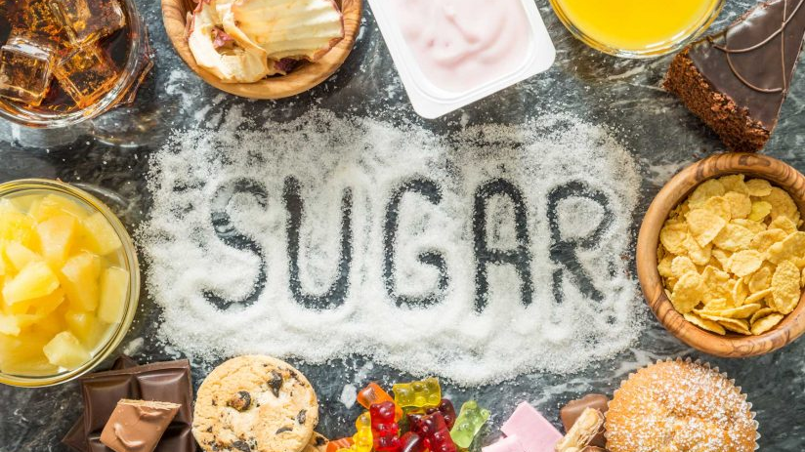
Using Optical Character Recognition to Read Nutrition Labels By Allysa Nguyen and Nomita Lama

Slide 3
Objective: Detecting Hidden Sugars
Traditional nutrition labels don’t always separate from naturally occurring sugar and added sugar.
More than 60 words for sugar, many ending with “ose” or labeled as syrup

Slide 4

Using Optical Character Recognition (OCR)
We chose to use Pytesseract: user-friendly, coded in python
It reads through an image and outputs the “characters/words” it recognizes.

Slide 5
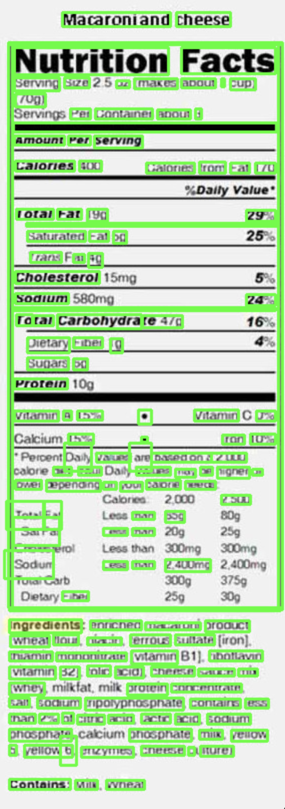
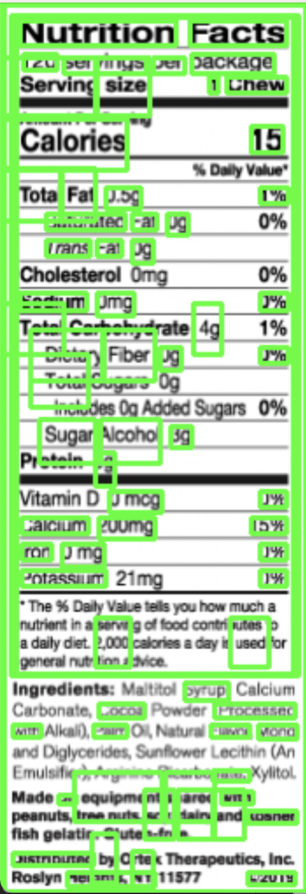
Examples

Slide 6
Data Parsing
The OCRs output is filtered through to look for key features:
Serving size
Servings per container
Calories
Fat calories
Total fat
Saturated fat
Cholesterol
Sodium
Total carbohydrates
Fiber
Sugars
Protein
Ingredients

Slide 7
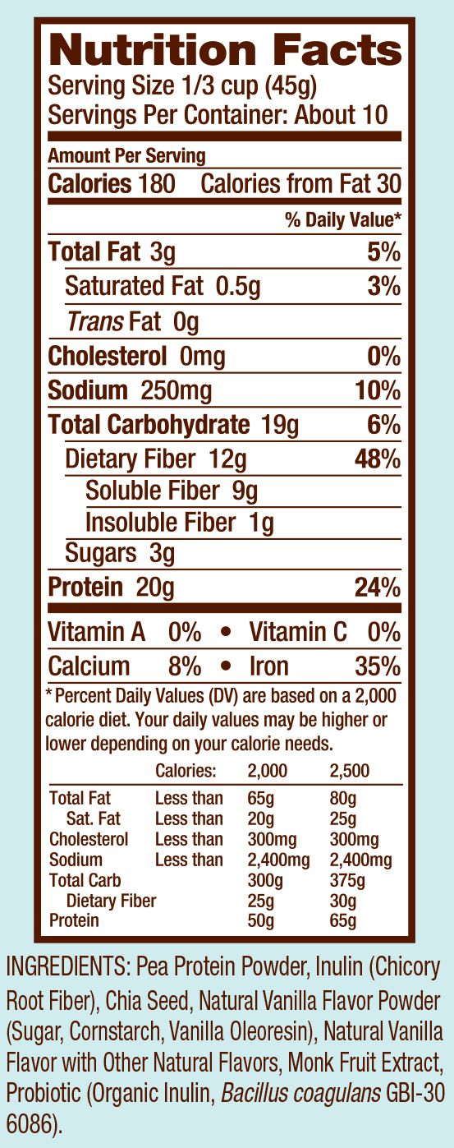
Raw OCR data and parsed data:
vanillaproteinpowder.jpg
********RAW DATA:*******
Nutrition Facts
Serving Size 1/3 cup (45g)
Servings Per Container: About 10
es
Amount Per Serving
Calories 180 Calories from Fat 30
% Daily Value*
Total Fat 3g 5%
Saturated Fat 0.5g 3%
Trans Fat 0g
Cholesterol Omg 0%
Sodium 250mg 10%
Total Carbohydrate 19g 6%
Dietary Fiber 12g 48%
Soluble Fiber 9g
Insoluble Fiber 19
Sugars 39
Protein 20g 24%
eee
VitaminA 0% ¢ VitaminC 0%
Calcium 8% @ Iron 35%
*Percent Daily Values (DV) are based on a 2,000
calorie diet. Your daily values may be higher or
lower depending on your calorie needs.
Calories: 2,000 —-2,500
Total Fat Lessthan 65g 80g
Sat. Fat Lessthan 20g 259
Cholesterol Lessthan 300mg 300mg
Sodium Lessthan 2,400mg 2,400mg
Total Carb 300g 375g
Dietary Fiber 259 30g
Protein 50g 65g
INGREDIENTS: Pea Protein Powder, Inulin (Chicory
Root Fiber), Chia Seed, Natural Vanilla Flavor Powder
(Sugar, Cornstarch, Vanilla Oleoresin), Natural Vanilla
Flavor with Other Natural Flavors, Monk Fruit Extract,
Probiotic (Organic Inulin, Bacillus coagulans GBI-30
6086).
**********PARSE DATA:*********
serving size:1/3 cup (45g)
servings per container:about 10
calories:180
fat calories:30
total fat:3g 5%
saturated fats:0.5g 3%
cholesterol:omg 0%
sodium:250mg 10%
total carbohydrates:19g 6%
fiber:12g 48%
sugars:39
protein:20g 24%
ingredients: Pea Protein Powder, Inulin (Chicory
Root Fiber), Chia Seed, Natural Vanilla Flavor Powder
(Sugar, Cornstarch, Vanilla Oleoresin), Natural Vanilla
Flavor with Other Natural Flavors, Monk Fruit Extract,
Probiotic (Organic Inulin, Bacillus coagulans GBI-30
6086).

Slide 8
Check for sugary ingredients:
Syrup
Sugar
Honey
Molasses
Caramel
Agave
-ose

Slide 9
Results:
For all our images, we were able to accurately detect if the food label contained added sugars or not.
What about the OCR’s accuracy?

Slide 10
OCR Accuracy:
Label Image | Added Sugars? | Accuracy
vanillaproteinpowder.jpg | True | 92.76
dietcoke.jpg | True | 64.46
ALMONDROCA.jpg | True | 87.38
cilantrolime.png | True | 92.44
mac.jpg | False | 95.44
chocolatepowder.jpg | True | 69.13
FrPebbles.jpg | True | 62.45
mochapowder.jpg | True | 99.57
chocolateBar.png | True | 96.21
chocolate.png | True | 89.18

Slide 11
Why such drastic difference?
Many reasons:
Overall quality of image
The spacing of characters/words
Font size
Font Type
Future improvements to improve accuracy of OCR:
Pre-processing image to optimize for OCR engine
smoothing, filtering, thresholding
Post-processing
Use of nutrition label standards, common language/words

