Slide 1
Bitcoin & The Guardian
Allyson Mackay
Goal: To explore the relationship, if any, between Bitcoin Values and the Media using published articles from The Guardian for a 6-month period
Bitcoin Values: Downloaded CSV file of daily market values, high, lows, close, USD value from www.bitcoincharts.com
The Guardian API: keyword query of published articles for set time period, returns JSON string of pub. date, article title, article url
Notes:
Interested to see if a general, non financial, newspaper has any sort of predictive value on bitcoin value. Assumptions that The Guardian is neutral source reporting to a global audience

Slide 2
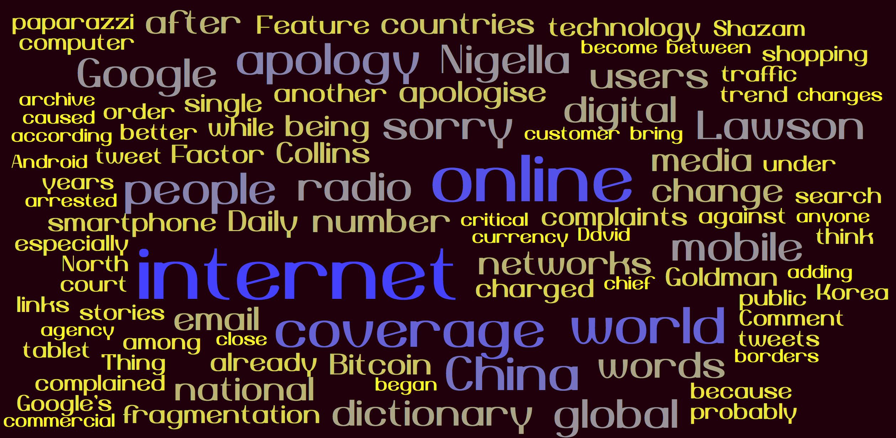
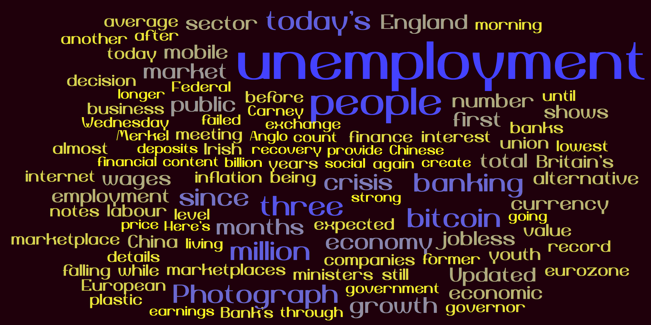
Highs, Lows, and Weighted Price
Of Bitcoin from 8/8/13-2/3/14
Before
After
Notes:
Also to note, Dow Jones Industrial Market had a significant increase from 12/17-12/18 so the drop in bitcoin is not related to overall financial trends.
Took top 150 words in articles before crash of bitcoin value (12/15-17/2013) and from day it crashed to +2 days after words (12/18-20/2013). Used worditout.com to create the word clouds
Used data from excel CSV files to chart Bitcoin

