Slide 1
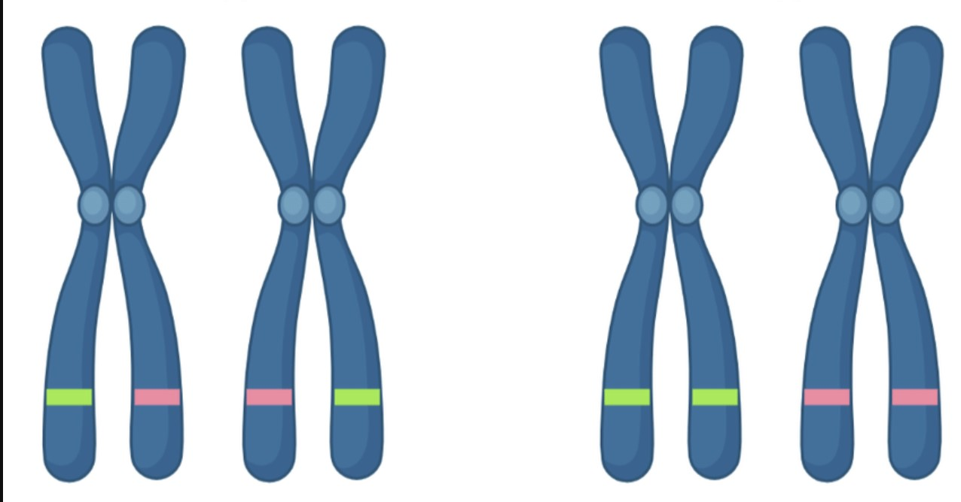
Exploring the Oncogenic Impact of TP53 Variants on Breast Cancer

Slide 2

WHY?
Breast Cancer - most common type
Variant identification to prioritize clinically relevant ones
Identification of biomarkers for personalized treatment
Notes:
OVERVIEW
Improved Prioritization of Variants: Machine learning models can consider multiple features simultaneously, including variant type, allele frequency, and clinical data, to prioritize TP53 variants more accurately. This can help researchers focus their efforts on investigating variants most likely to be clinically relevant.
Identification of Biomarkers: By identifying TP53 variants associated with disease progression or treatment response, this approach can lead to the discovery of biomarkers that could be used for patient stratification, prognosis prediction, and treatment selection.
Personalized Treatment Strategies: Ranking TP53 variants based on their predictive power can inform the development of personalized treatment strategies tailored to individual patients. For example, patients with certain TP53 variants associated with resistance to standard therapies could be directed towards alternative treatment options.
Clinical Decision Support: Insights gained from machine learning-driven variant ranking can be integrated into clinical decision support systems, providing oncologists with valuable information to guide treatment decisions and improve patient outcomes.
Overall, the impact of utilizing machine learning algorithms to rank TP53 variants in breast cancer extends from advancing our understanding of tumor biology to informing personalized treatment strategies and ultimately improving patient care.

Slide 3
HOW?
EDA: Relationship between TP53 variant allele frequencies and clinical characteristics, Identify potential patterns or trends in TP53 variant profiles
Variant Prioritization: Prioritize TP53 variants based on their predicted functional impact
Utilize machine learning algorithms, such as random forests or gradient boosting, to rank TP53 variants according to their likelihood of driving breast cancer progression (and treatment response).
Notes:
Perform descriptive statistics and visualization techniques
Investigate the relationship between TP53 variant allele frequencies and clinical characteristics, such as tumor stage, histological subtype, and patient survival outcomes
Identify potential patterns or trends in TP53 variant profiles
Variant Prioritization: Prioritize TP53 variants based on their pathogenicity, loss of function and gain of unwanted function
Utilize machine learning algorithms, such as random forests or gradient boosting, to rank TP53 variants according to their likelihood of driving breast cancer progression and treatment response.

Slide 4
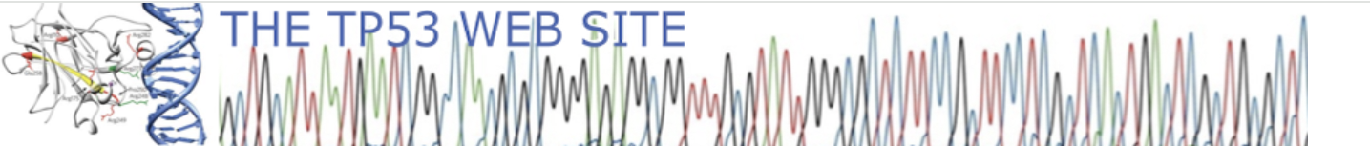


INTRO TO DATASETS

Slide 5

INTRO TO DATASETS
https://www.kaggle.com/datasets/kevinarvai/clinvar-conflicting
https://www.kaggle.com/datasets/dhanashreekelkar/tp53-status

Slide 6
cDNA_Variant | Mutation nomenclature according to HGVS standards using the coding sequence as reference (position 1 refers to the A of the start ATG): reference sequence NM_000546.5
COSMIC_ID | Mutation identifier used in COSMIC database
SNP_ID | The SNP database now includes several pathogenic variants of the TP53 gene
HG38_Variant | Mutation nomenclature according to HGVS standards using the genomic sequence as reference
Variant_Type | SNV, DNP, TNP, ONP, INS, DEL
Mutation Type | B: Single nucleotide variant D: Deletion I: insertion ID: complex event that involves an insertion and a deletion
Notes:
SNV: Single Nucleotide Variant
DNP: Change in two consecutive bases (dinucleotide variant)
TNP: Change in three consecutive bases (tri-nucleotide variant)
ONP: Change in four or more consecutive bases (oligo-nucleotide variant)
INS: Insertion
DEL: Deletion

Slide 7
Mutassessor_prediction | Functional impact of a variant : predicted functional (high, medium), predicted non-functional (low, neutral).
Mutassessor_score: | Score associated with the column above
Pathogenicity | Terminology for TP53 variants: ‘pathogenic’, ‘likely pathogenic’, ‘uncertain significance’ (VUS), ‘likely benign’.

Slide 8
Conserved WT function | Functional property of mutant that is similar to the activity of the wild-type protein.
AAchange | Amino-acid at codon 72 of p53 (polymorphism)
Loss of Function | WTp53 functional property that is lost by the mutant protein. Same annotations as in previous column, with partial" indicating that the loss of function is partial (residual activity).
Dominant negative activity | Inhibition of the wild-type protein by mutant proteins in transactivation or cell growth assays.
Gain of Function | Functional properties displayed by the mutant but not by the wild-type protein.

Slide 9
Remainder information like histology type, tumor origin, etc.

Slide 10
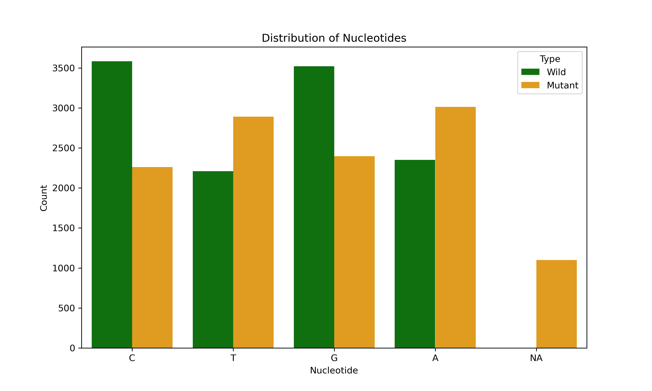
Notes:
Adenine is the most mutated nucleotide

Slide 11
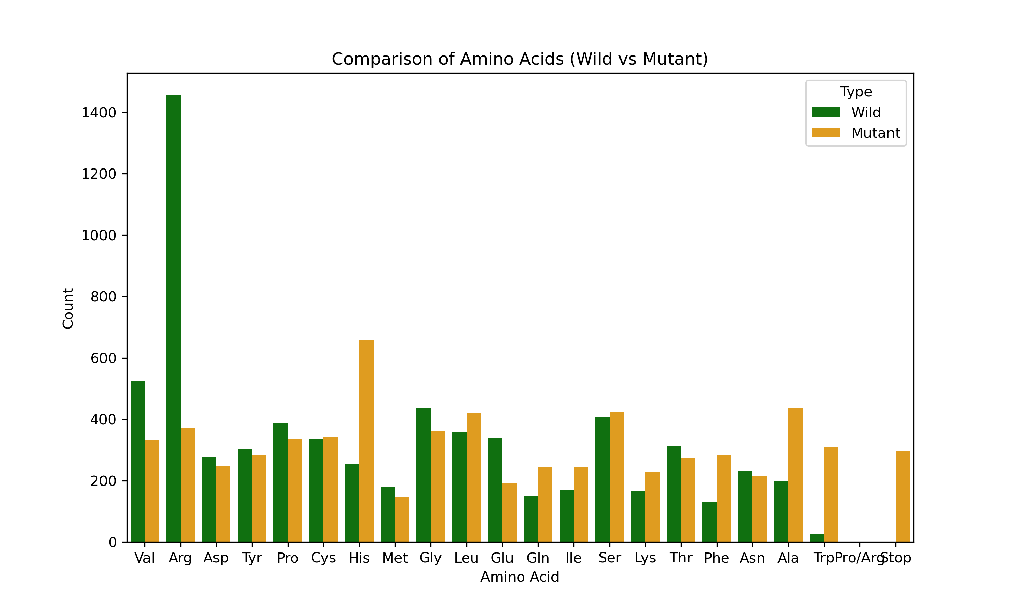
Notes:
Histidine is the highly produced by mutated TP53

Slide 12
CONCERNS FROM PRELIM EDA
Not all the data is available in one dataset
Complexity and missing values
Small datasets
Too ambitious
Splitting data for modeling

Slide 13
REFERENCES
1. Common Cancer Types
https://www.cancer.gov/types/common-cancers#:~:text=The%20most%20common%20type%20of,are%20combined%20for%20the%20list.
2. TP53 Website
https://p53.fr/download-the-database
3. TP53 Database
https://tp53.isb-cgc.org/get_tp53data
4. Kaggle
https://www.kaggle.com/datasets/kevinarvai/clinvar-conflicting
https://www.kaggle.com/datasets/dhanashreekelkar/tp53-status

