Slide 1


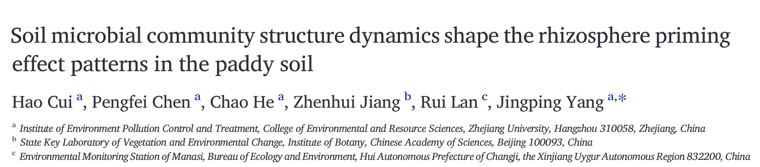
Computational Microbiology: BIOMI6300 Bioinformatic Workflow Applied to Data From Cui et al. 2023
BIOMI6300
Wednesday, May 1st,2024
Andrea Martinez

Slide 2
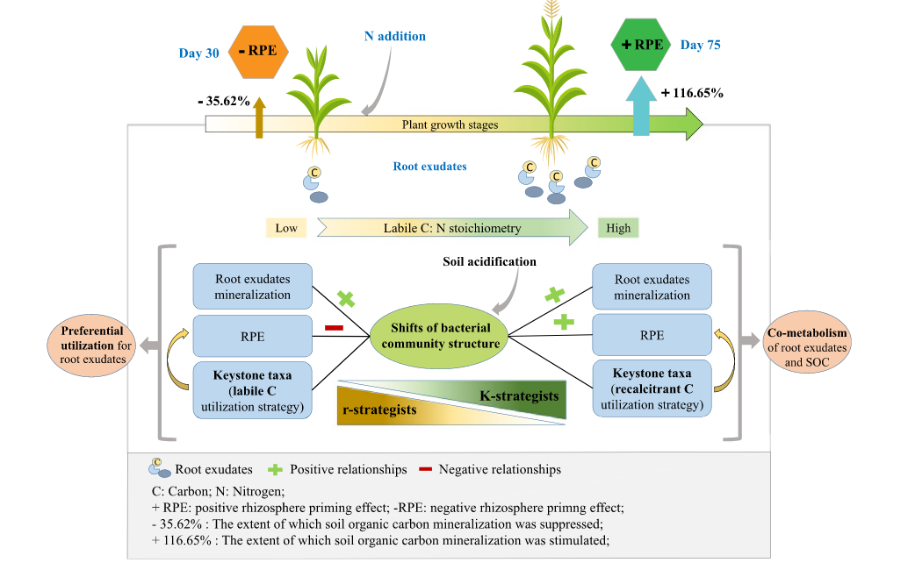

Plants, Priming, and Microbes
Rhizosphere Priming Effect (RPE)
Plant roots recruit soil microbes
Microbial community structure central to soil organic carbon stabilization and decomposition
Nitrogen availability has been shown to modulate RPE
Details of plant and microbial influence on RPE remain elusive
Cui et al., (2023)

Slide 3
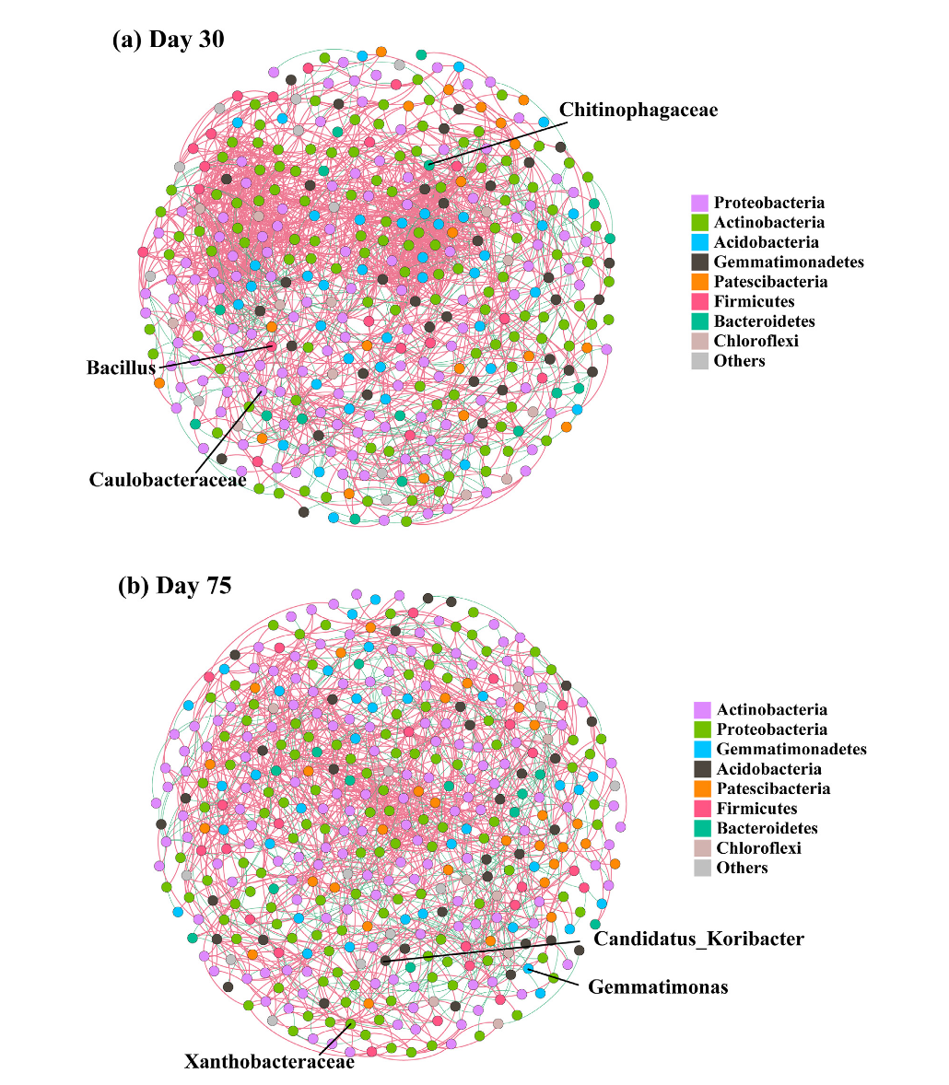
Cui et al – Study and Findings
Results – RPE
Day 30 – Negative Priming
Day 75 – Positive Priming
¹³C natural abundance tracing: Paddy soil / Maize plants
3 Levels of Nitrogen addition
0 Kg N Ha-1
150 Kg N Ha-1
300 Kg N Ha-1
16S rRNA sequencing
Results – Microbial Community
Significant shift from r- to K-strategists with change in labile C:N and soil pH during plant growth
Keystone taxa identified using co-occurrence network

Slide 4
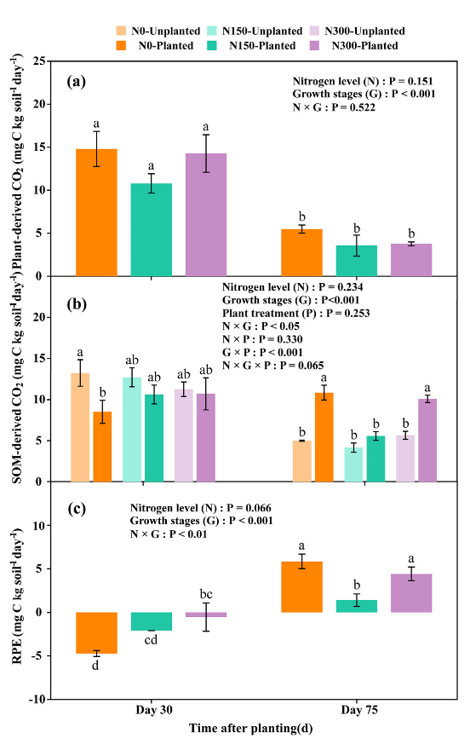
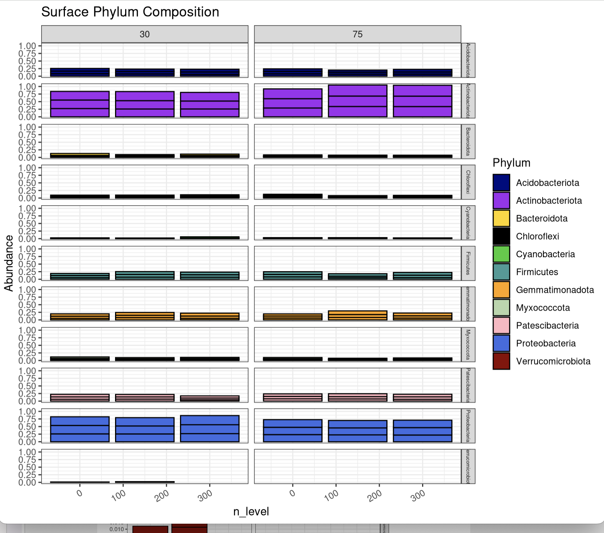
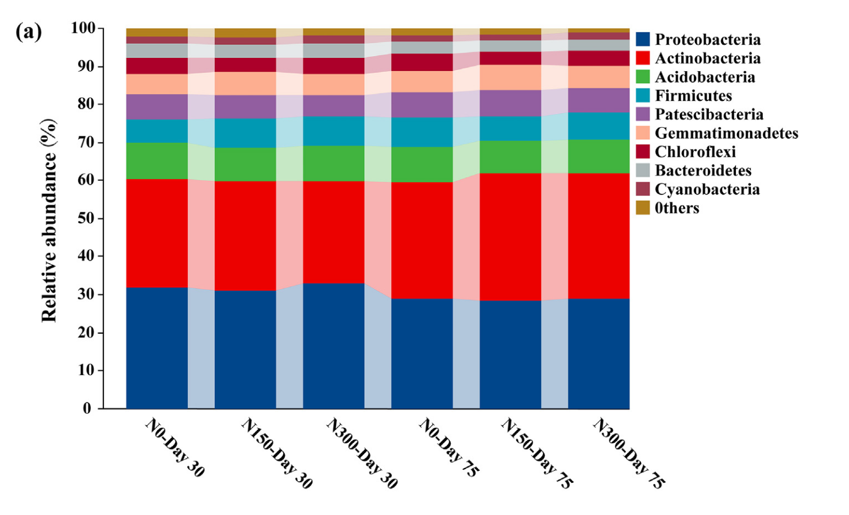
Effect of N addition and Growth Stage on Priming and Microbial Communities
Modified from Cui et al (2023)
Cui et al (2023)

Slide 5
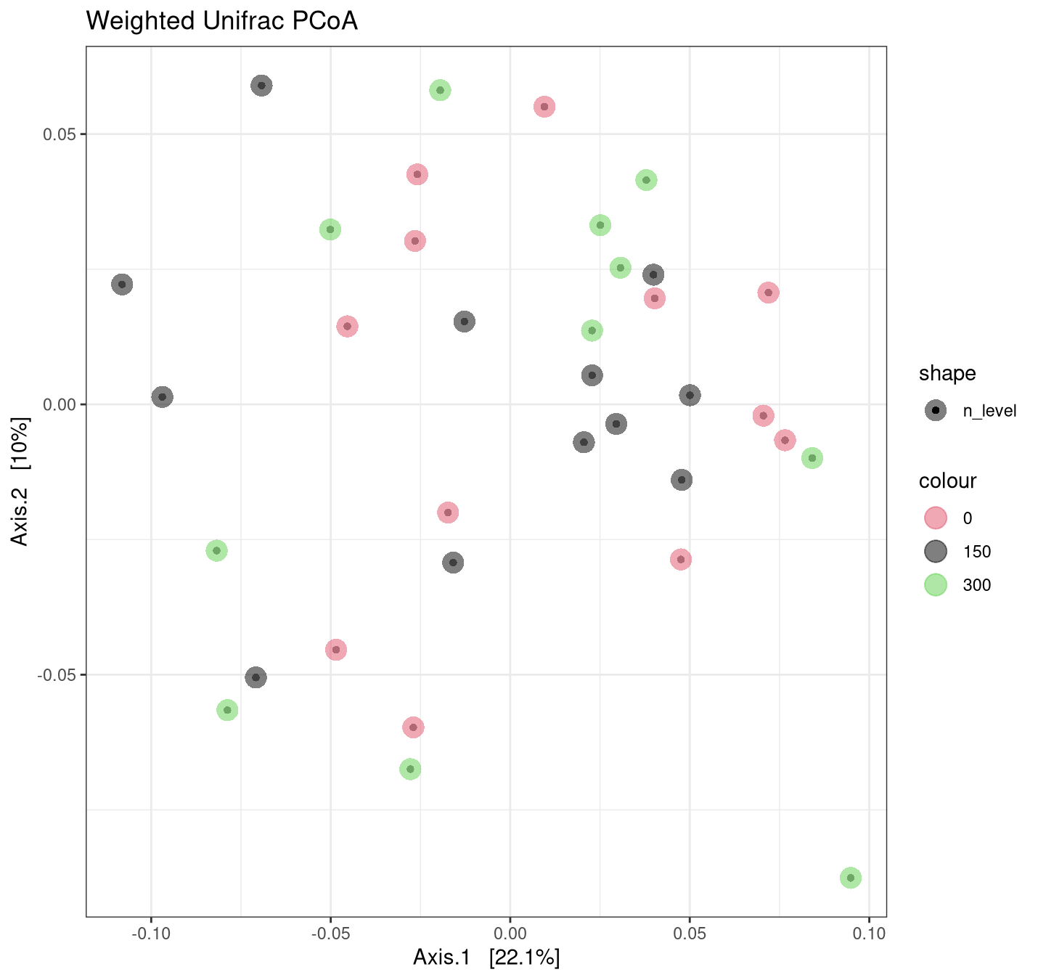
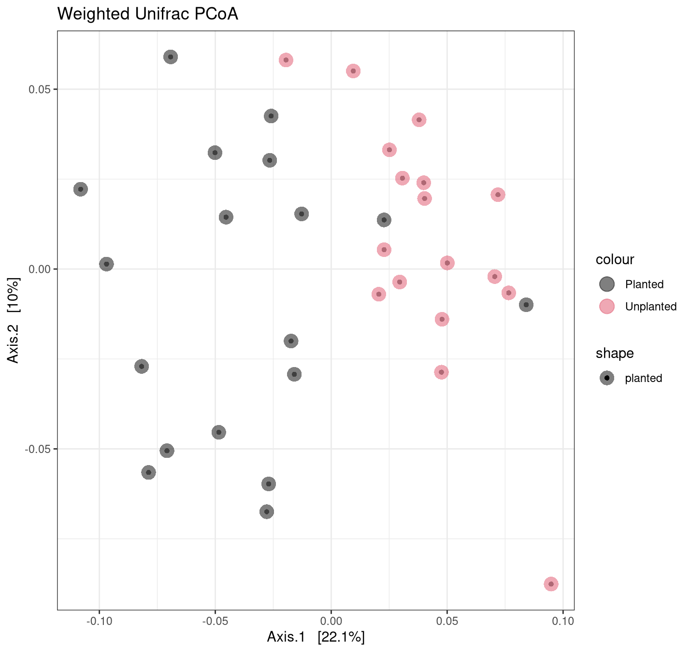
N Addition Level Less Influential than Plant Presence

Slide 6
Keystone Taxa
Do not need to be highly abundant
Co-occurrence patterns used to construct microbial networks
Gene significance
ASVs correlating to environmental traits
Module membership
gene-to-module associations

Slide 7
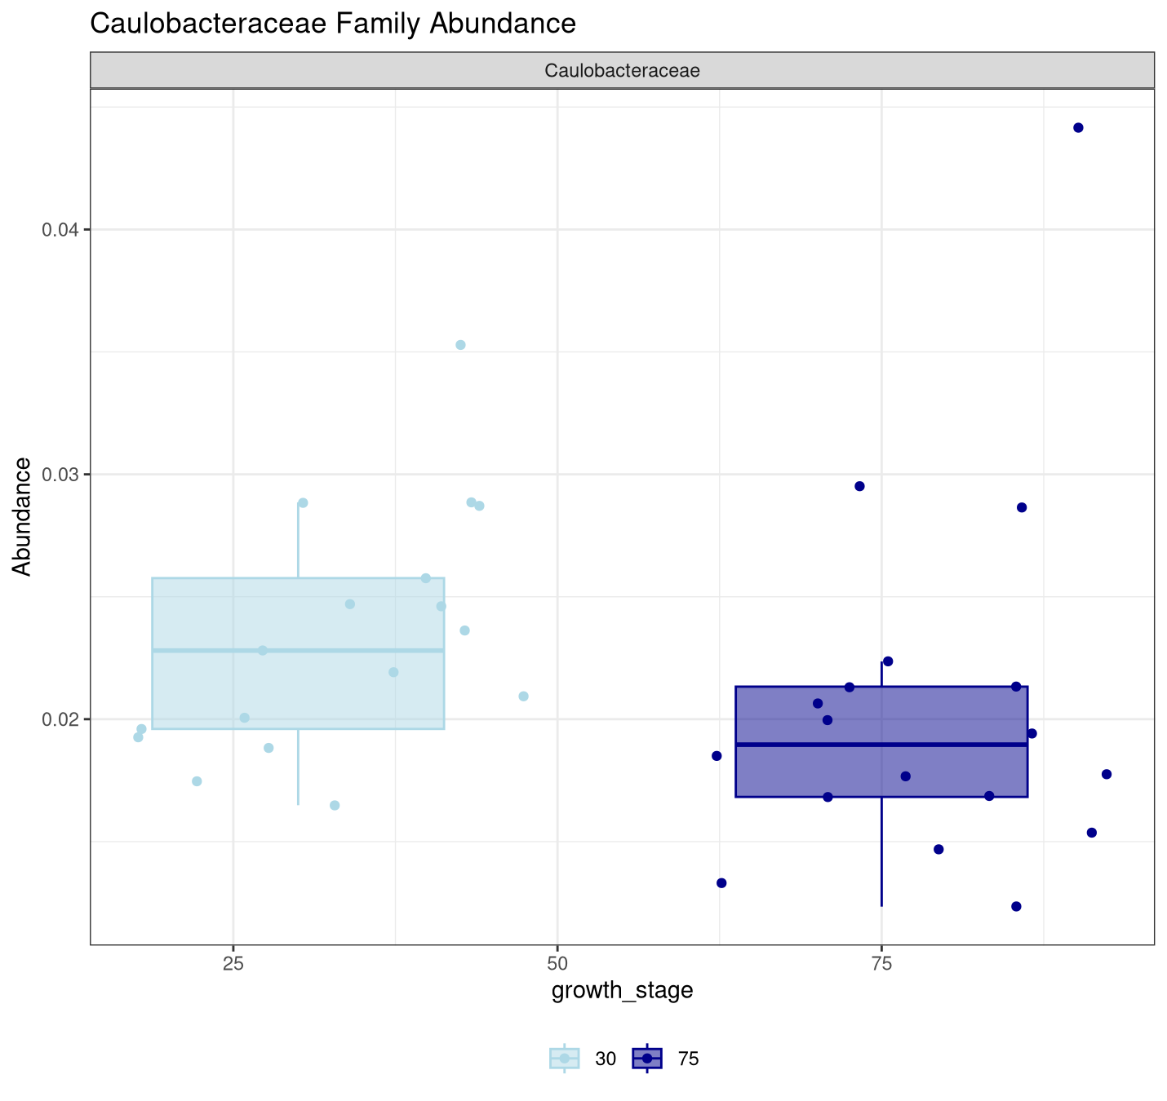
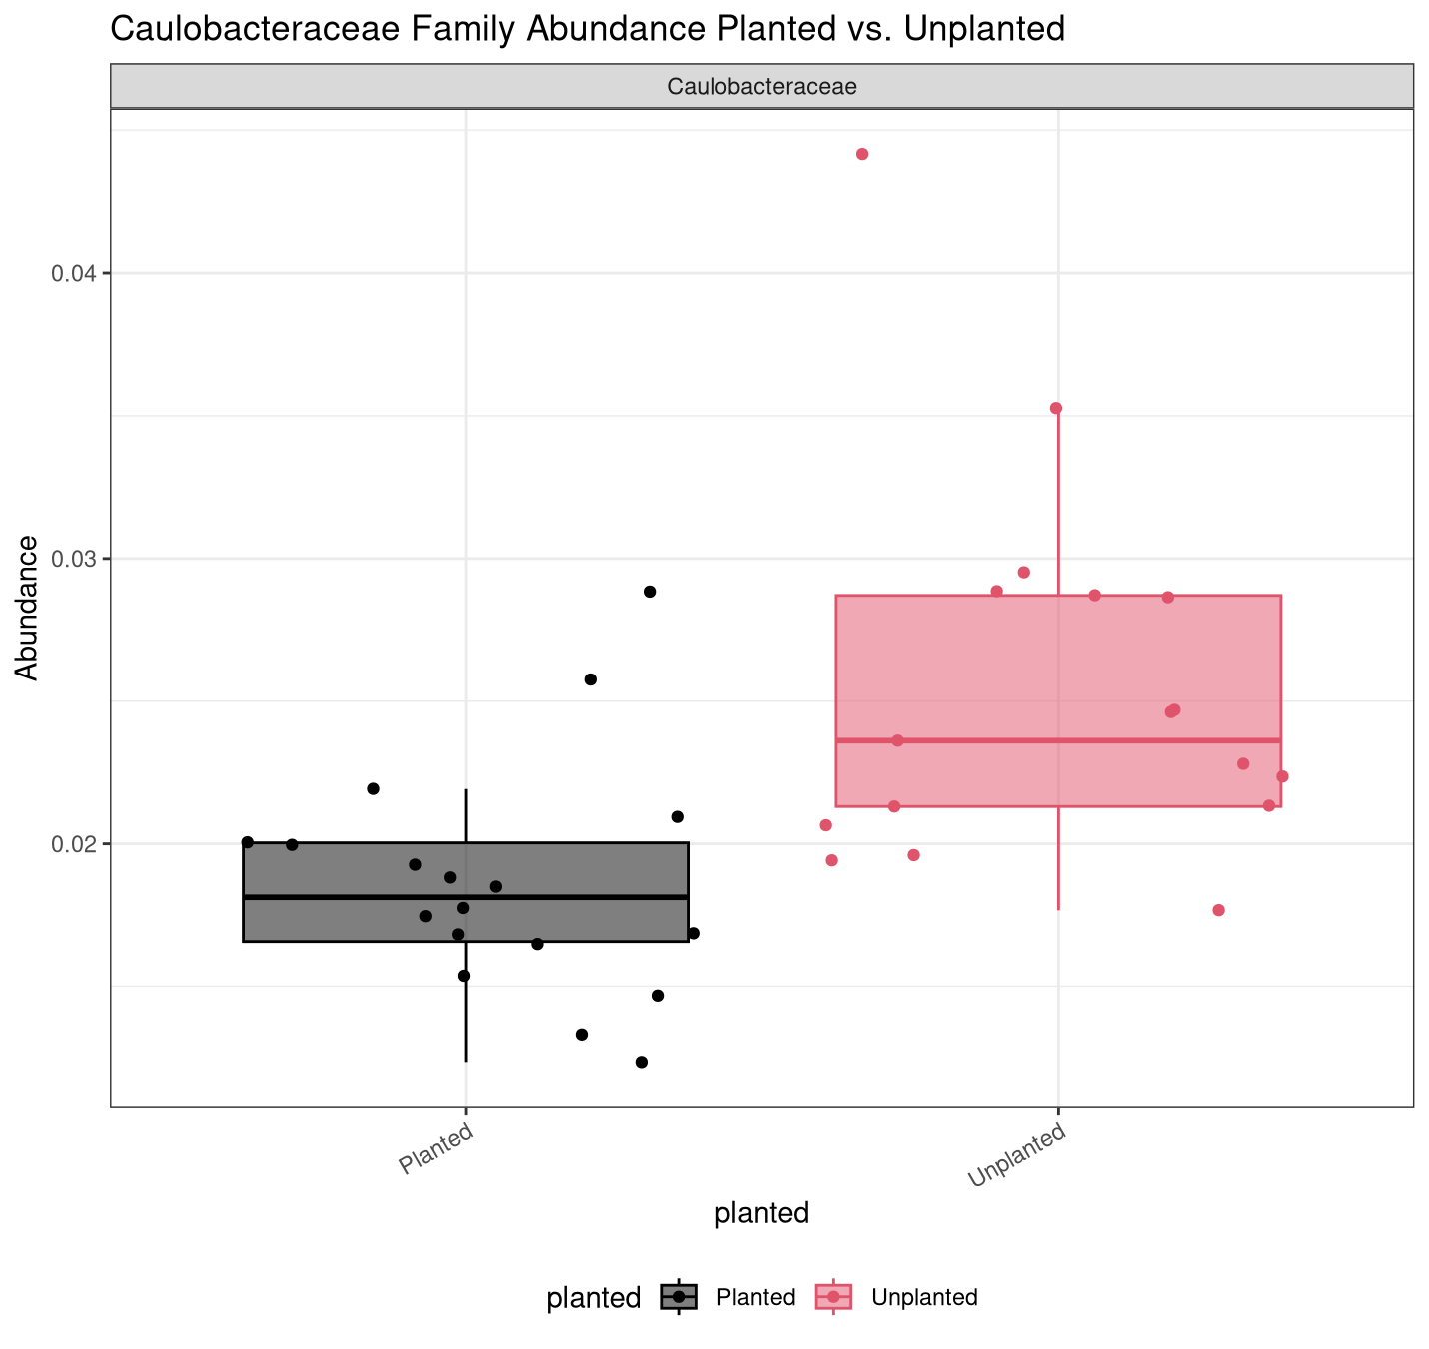
Keystone taxa day 30: Caulobacteraceae

Slide 8
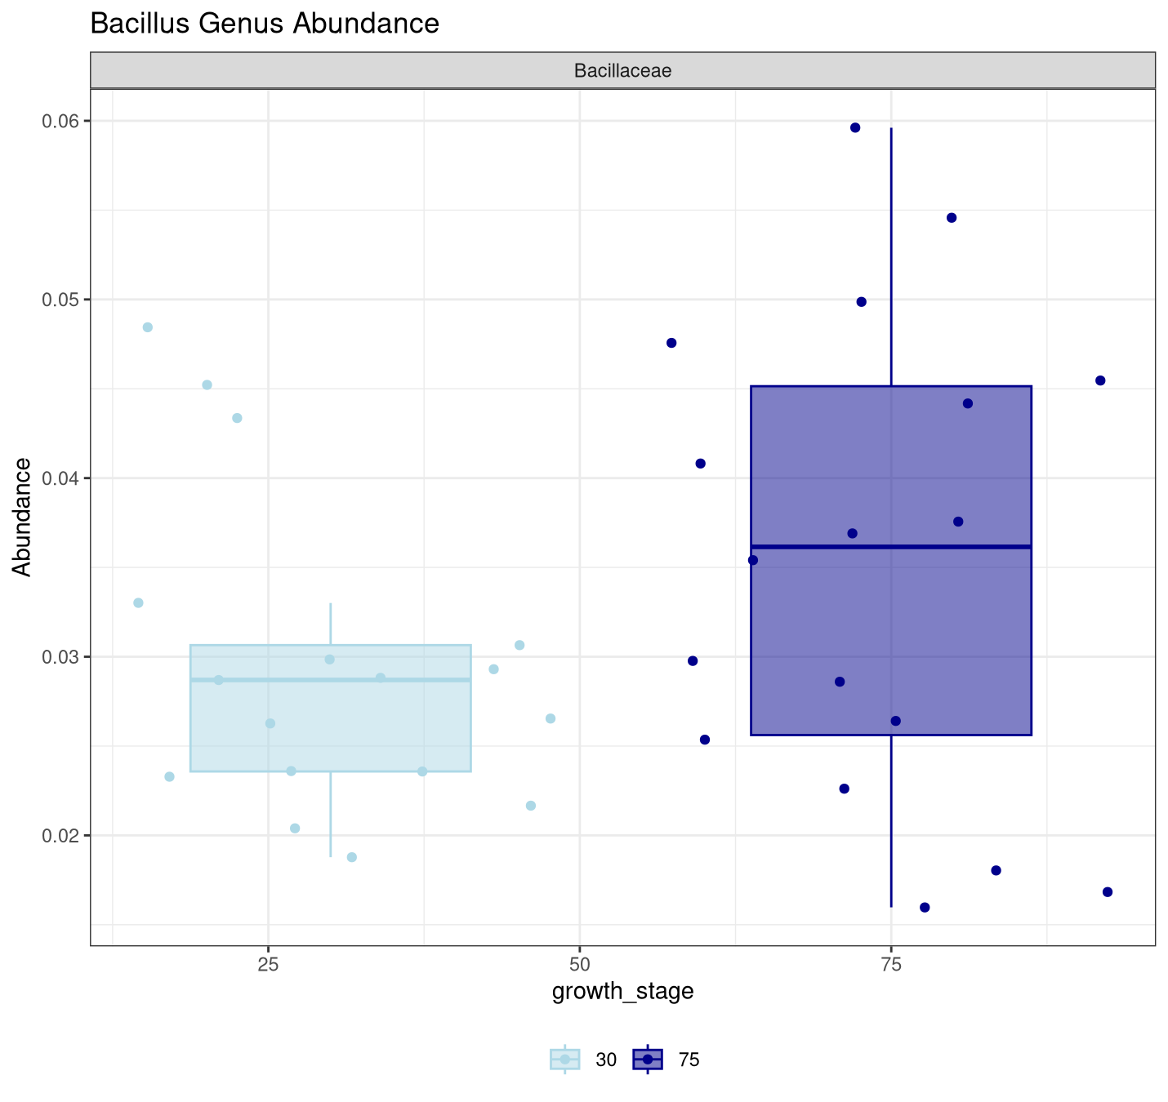
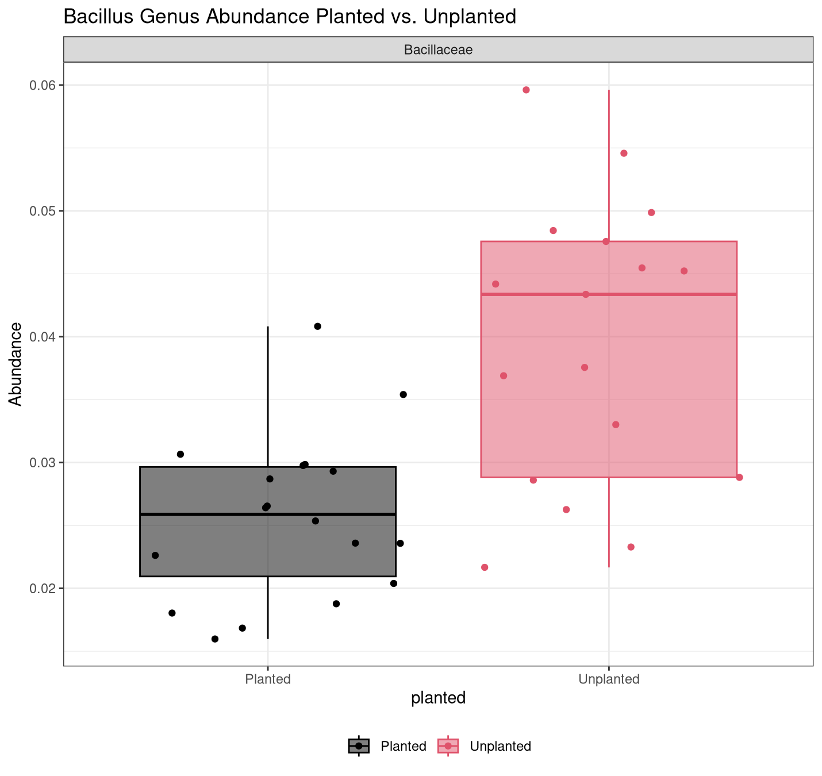
Keystone taxa day 30: Bacillus

Slide 9
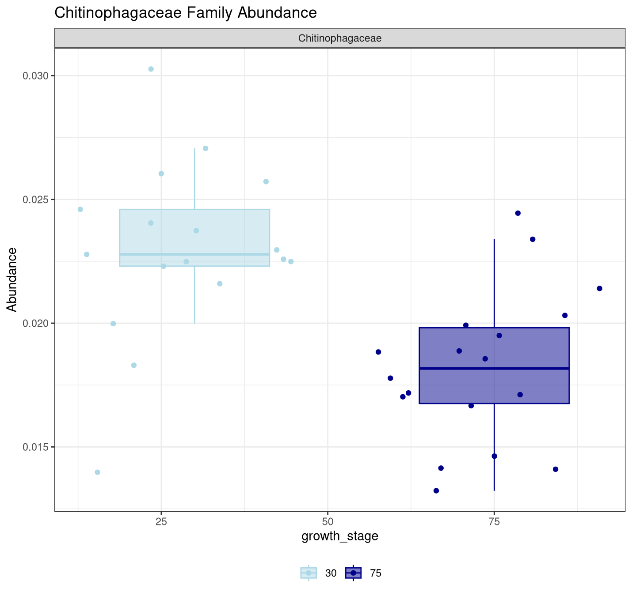
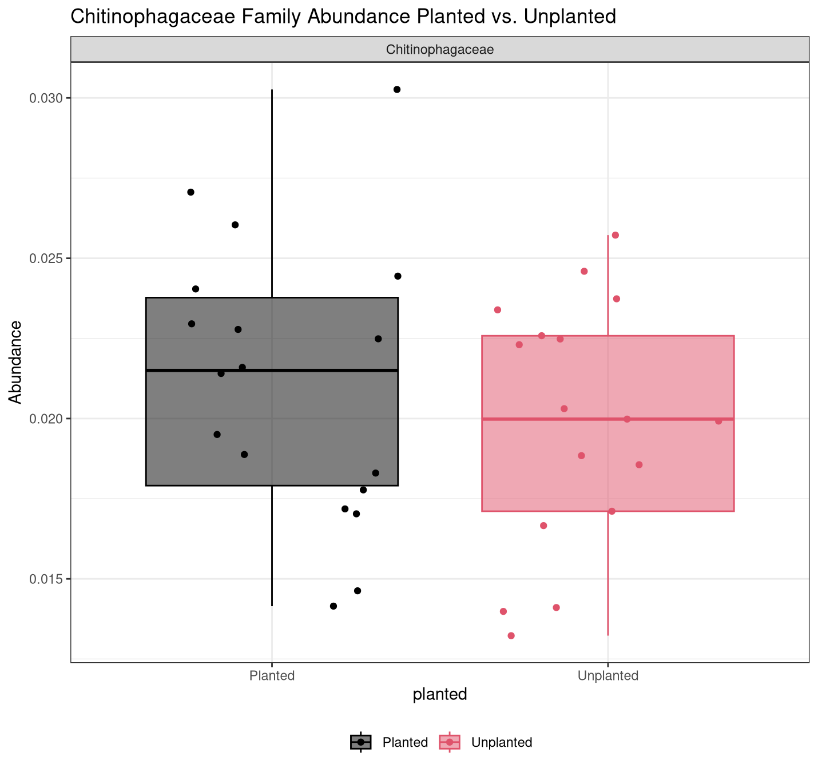
Keystone taxa day 30: Chitinophagaceae

Slide 10
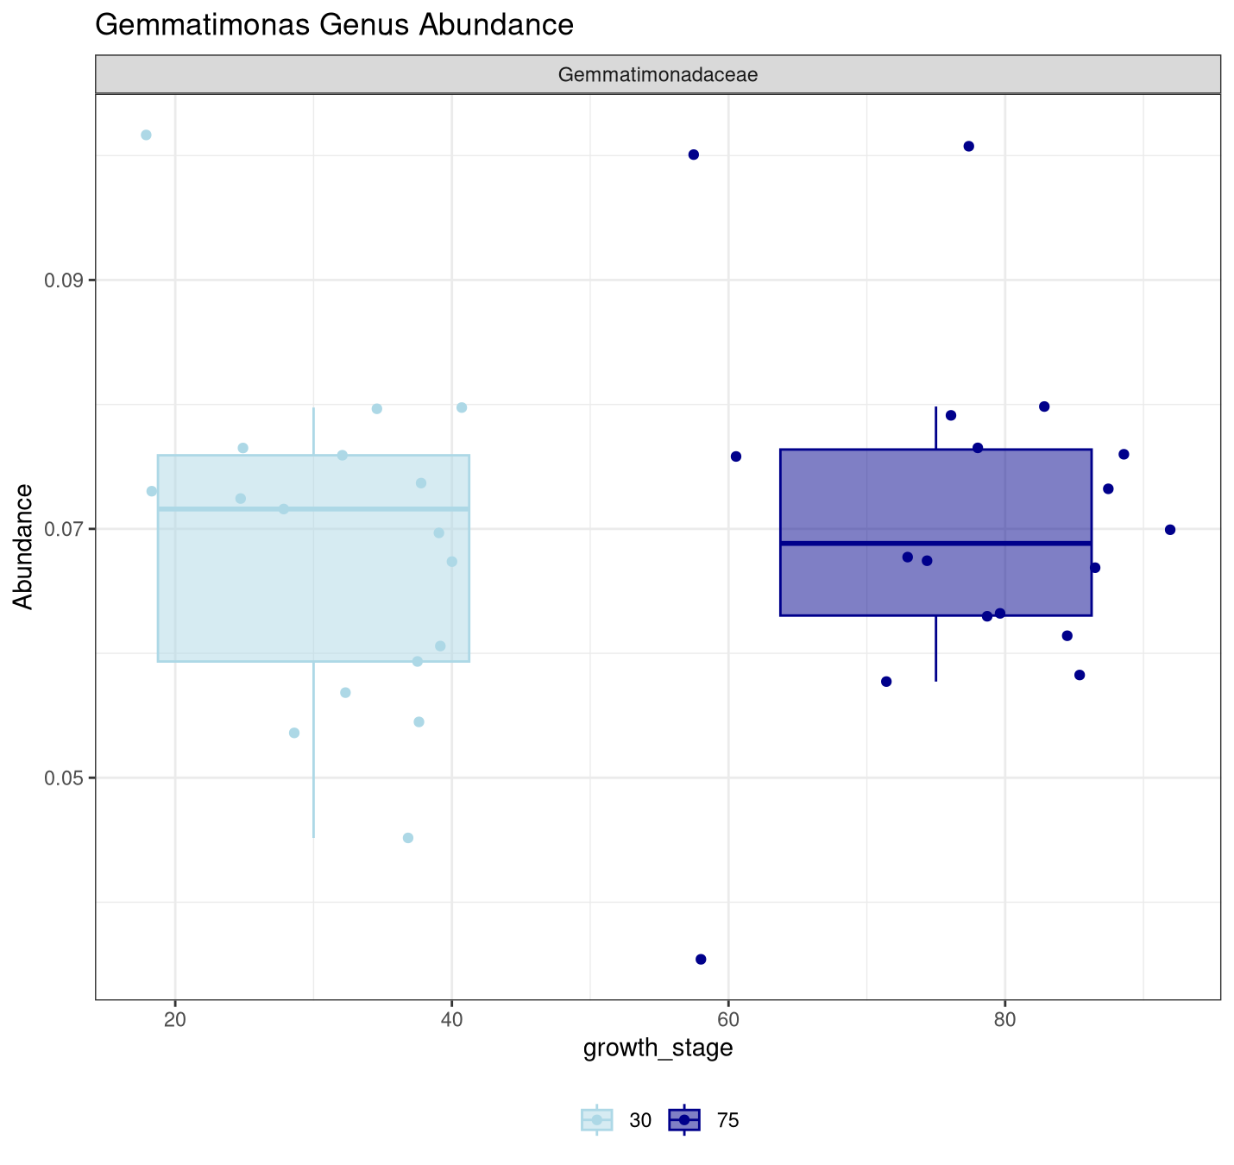
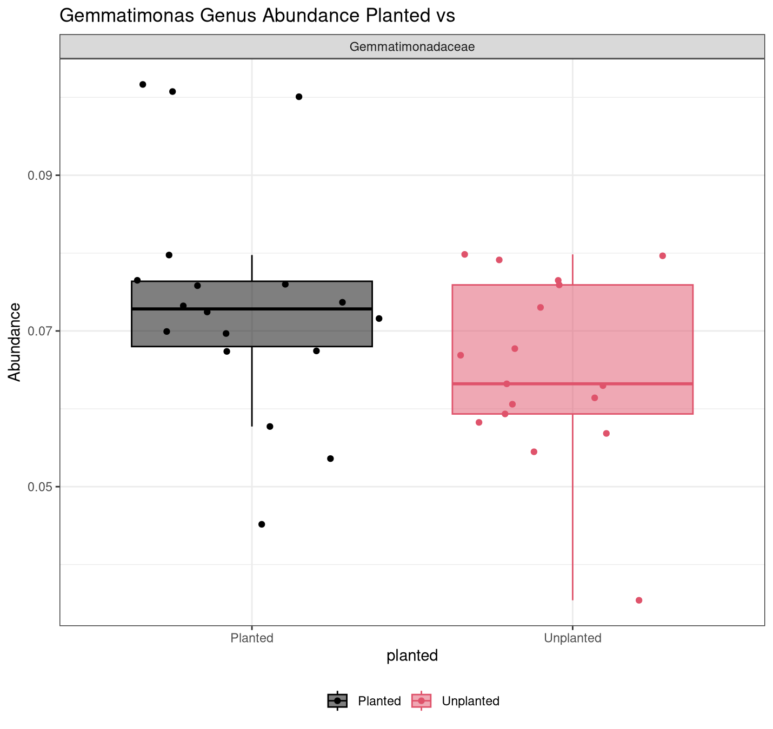
Keystone taxa day 75 : Gemmatimonas

Slide 11
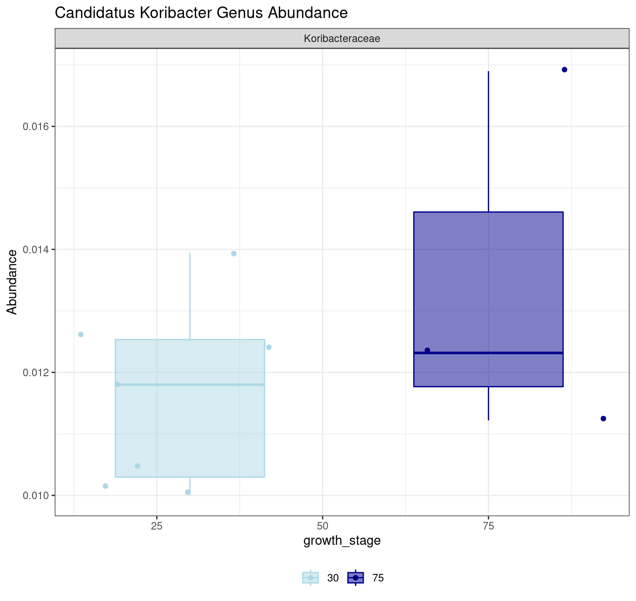
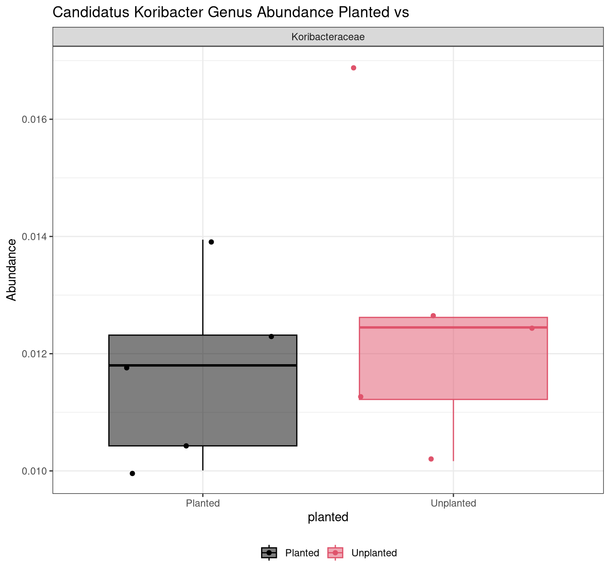
Keystone taxa day 75 : Candidatus Koribacter

Slide 12
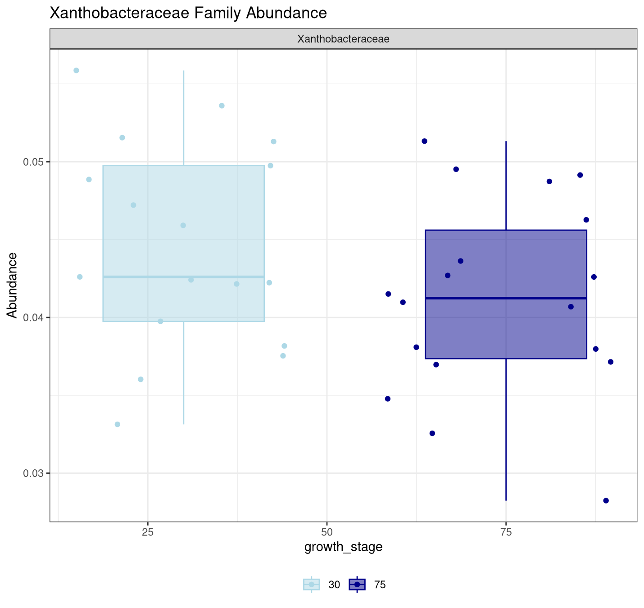
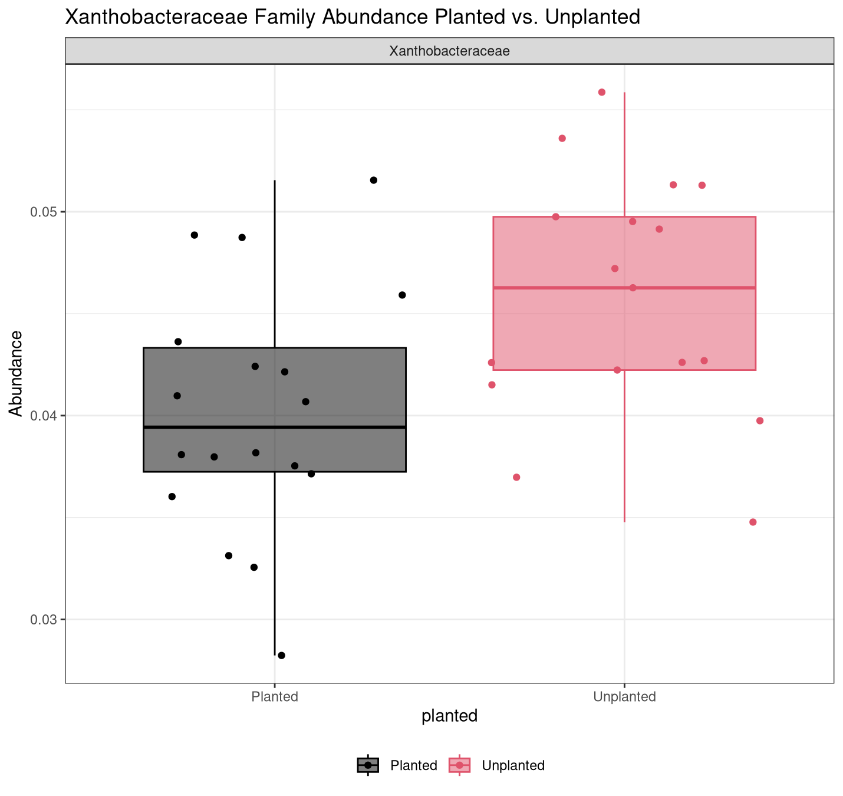
Keystone taxa day 75 : Xanthobacteraceae

Slide 13
Some Differences in Microbial Community Analysis Pipelines
Cui et al. Sequences trimmed with cutadapt tool
The Greengenes database was used instead of Silva
Co-occurance network analysis
r- vs. k-strategist ratio determination
Time & Experience

Slide 14
Thank You!

