Slide 1
TRUSTED AI.
INTERNATIONAL JOINT INITIATIVE
Advancing AI that is trustworthy, inclusive, sustainable and compliant
NAME SURNAME · EVENT NAME · DATE

Slide 2
What we will cover
AGENDA
01
Context and motivation
02
The five TRUST pillars
03
Results so far
04
Next steps

Slide 3
THE FIVE PILLARS
01
How TRUST-AI frames trustworthy AI

Slide 4
A content slide with a title and bullets
CONTEXT
Keep one message per slide; the title states it
Body text is 16 pt Space Grotesk on white, like the site’s pages
The eyebrow above the title is optional: delete it or leave it empty
  Second-level points work too

Slide 5
Two columns for side-by-side content
COMPARISON
Today
Fragmented guidance across sectors
Compliance treated as an afterthought
With TRUST-AI
Shared methods from design to deployment
Governance built in from the start

Slide 6
Cards with a hard shadow, as on the website
PILLARS
T
R
U
S
T
TRUST-
WORTHINESS
RESPONSIBLE GOVERNANCE
UNIVERSAL RIGHTS & INCLUSIVE DESIGN
SOCIETAL & SUSTAINABLE IMPACT
TRANSPARENCY & COMPLIANCE

Slide 7

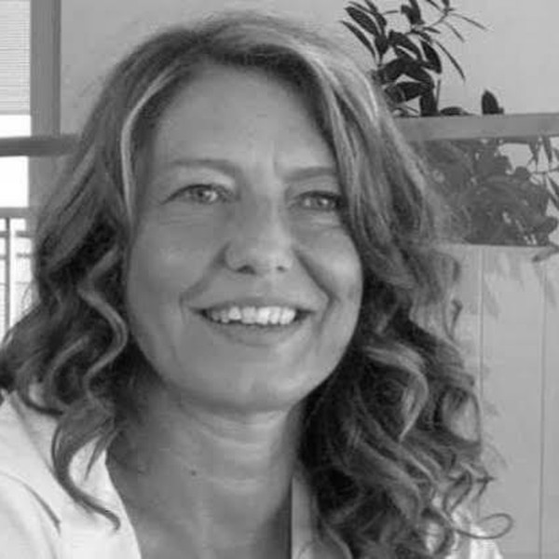
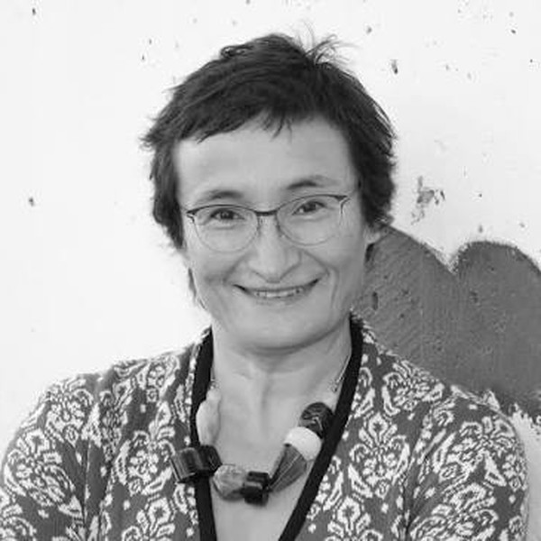
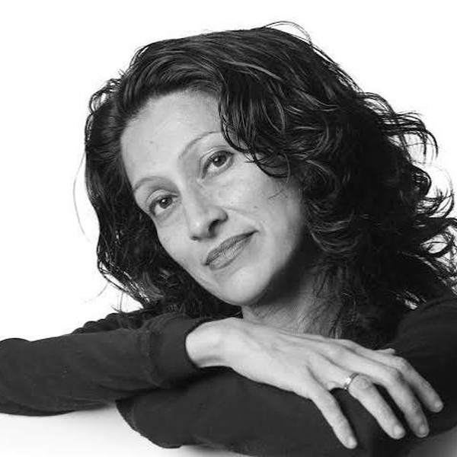
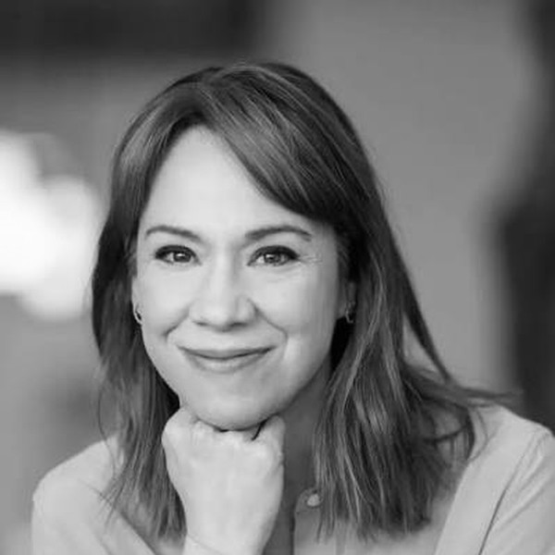





Five institutions, one initiative
FOUNDERS
Roberta Calegari
Michela Milano
Virginia Dignum
Payal Arora
Catherine Régis
UNIVERSITY OF BOLOGNA
ALMA AI
FONDAZIONE BRUNO KESSLER
DIGITAL SOCIETY CENTER
UMEÅ UNIVERSITY
AI POLICY LAB
UTRECHT UNIVERSITY
INCLUSIVE AI LAB
UNIVERSITÉ DE MONTRÉAL
CENTRE DE RECHERCHE EN DROIT PUBLIC
Trustworthy AI, fairness and AI compliance
Responsible AI engineering across the AI lifecycle
Responsible AI governance, ethics and policy
Inclusive AI, digital inclusion and global perspectives
AI regulation, policy and health-AI governance

Slide 8
Three numbers worth remembering
KEY FIGURES
12
5
30+
PARTNER INSTITUTIONS
RESEARCH PILLARS
EVENTS PLANNED FOR 2027
Placeholder figures, replace with real ones.

Slide 9
Native charts in the site palette
DATA

Slide 10
THANK YOU.
name.surname@example.org
trust-ai.example.org

