Slide 1
Lab 3 | Single cell RNA-seq analysis
Main responsible: Ludvig Larsson
Notes:
Sometimes used for good or for bad

Slide 2
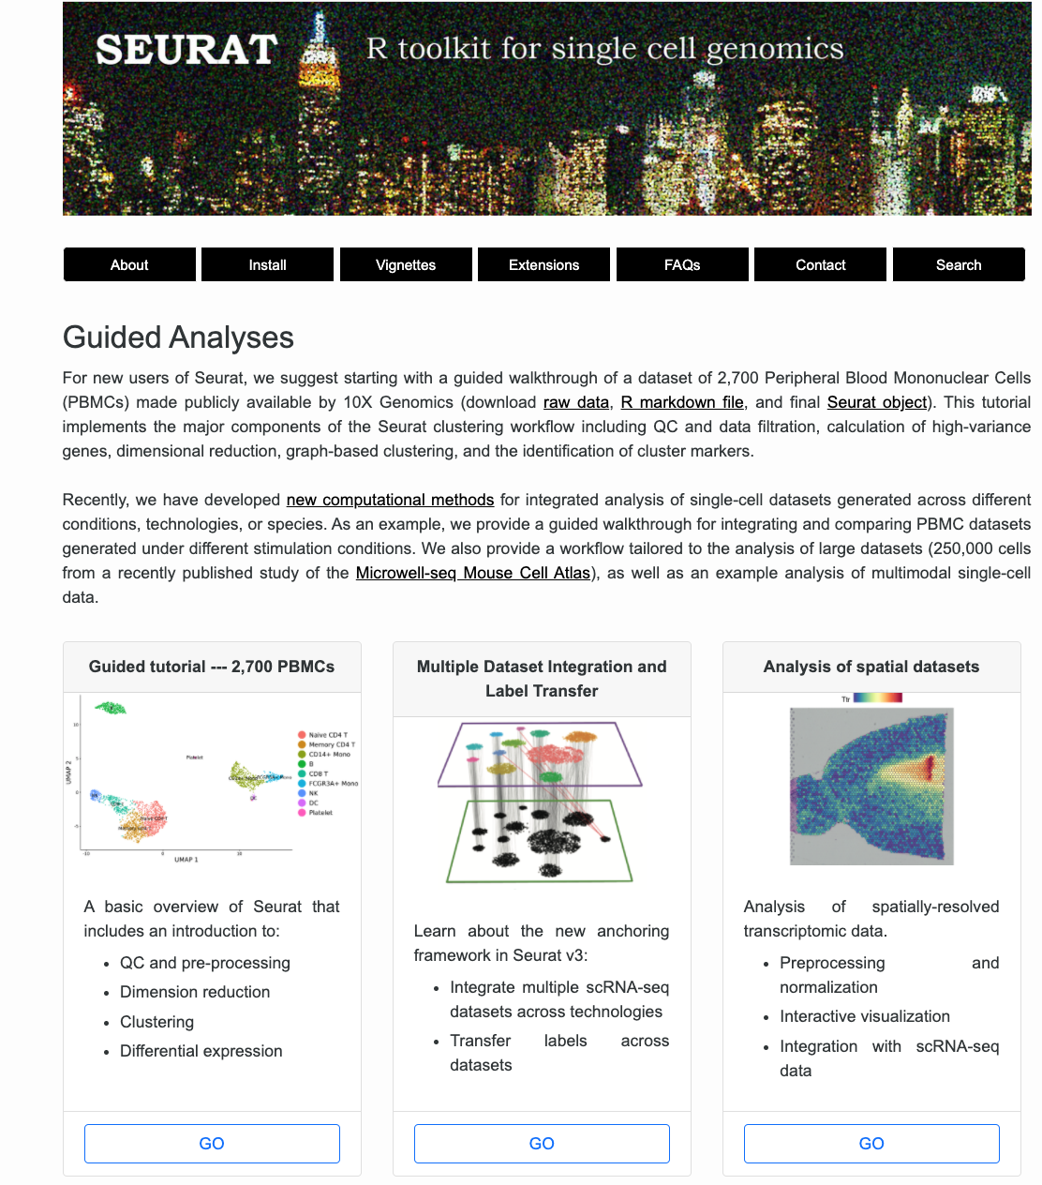
The Seurat R package
Pronunciation
UK: “SUR-ah”
US: “suu-RAH”
French: ???
One of the most popular toolbox for single cell genomics analysis
A lot of useful tutorials available
Support for many different data types
A very productive lab constantly updates the package to include more features

Slide 3
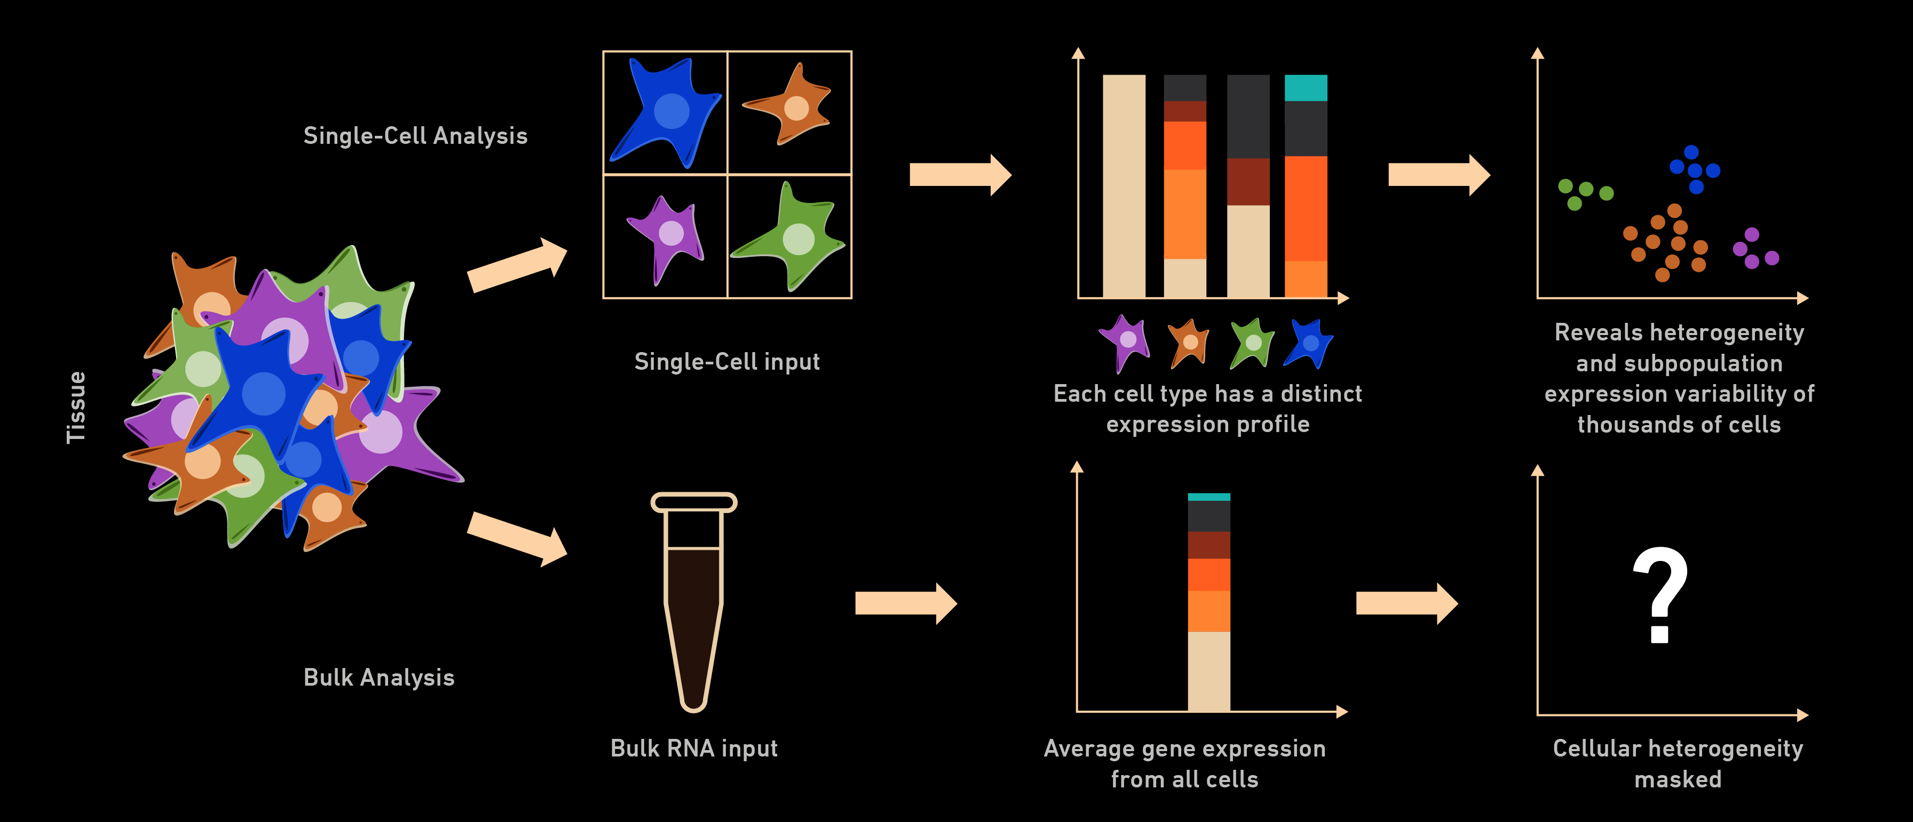
Bulk vs single cell

Slide 4
Bulk vs single cell

Slide 5
Input data
Expression matrix: [genes] x [cells]
cells ----->
 | Cell1 | Cell2 | Cell3 | … | CellN-2 | CellN-1 | CellN
Gene1 | 0 | 10 | 0 | 3 | 0 | 0 | 0
Gene2 | 3 | 7 | 5 | 0 | 0 | 0 | 1
Gene3 | 0 | 3 | 0 | 0 | 8 | 0 | 0
… | 8 | 0 | 2 | 0 | 20 | 0 | 1
GeneM-2 | 0 | 1 | 1 | 1 | 29 | 0 | 1
GeneM-1 | 0 | 3 | 0 | 0 | 2 | 0 | 0
GeneM | 7 | 0 | 4 | 1 | 0 | 2 | 1
<----- genes

Slide 6
Optional input: metadata
What is metadata?
> “data that provides information about other data”
Example 1: descriptive metadata
tissue
patient ID
treatment
gender
Example 2: statistical metadata
number of genes per cell
total number of transcripts per cell

Slide 7
Optional input: metadata
What is metadata?
> “data that provides information about other data”
Example 1: descriptive metadata
tissue
patient ID
treatment
gender
Example 2: statistical metadata
number of genes per cell
total number of transcripts per cell
expression matrix
 | Cell1 | Cell2 | Cell3 | … | CellN-2 | CellN-1 | CellN
Gene1 | 0 | 10 | 0 | 3 | 0 | 0 | 0
Gene2 | 3 | 7 | 5 | 0 | 0 | 0 | 1
Gene3 | 0 | 3 | 0 | 0 | 8 | 0 | 0
… | 8 | 0 | 2 | 0 | 20 | 0 | 1
GeneM-2 | 0 | 1 | 1 | 1 | 29 | 0 | 1
GeneM-1 | 0 | 3 | 0 | 0 | 2 | 0 | 0
GeneM | 7 | 0 | 4 | 1 | 0 | 2 | 1

Slide 8
Optional input: metadata
metadata
What is metadata?
> “data that provides information about other data”
Example 1: descriptive metadata
tissue
patient ID
treatment
gender
Example 2: statistical metadata
number of genes per cell
total number of transcripts per cell
 | Cell1 | Cell2 | Cell3 | … | CellN-2 | CellN-1 | CellN
tissue | lung | lung | lung | … | lung | lung | lung
Patient ID | XDD139 | XDD139 | XDD139 | … | XRC401 | XRC401 | XRC401
treatment | A | A | A | … | B | B | B
gender | male | male | male | … | female | female | female
expression matrix
 | Cell1 | Cell2 | Cell3 | … | CellN-2 | CellN-1 | CellN
Gene1 | 0 | 10 | 0 | 3 | 0 | 0 | 0
Gene2 | 3 | 7 | 5 | 0 | 0 | 0 | 1
Gene3 | 0 | 3 | 0 | 0 | 8 | 0 | 0
… | 8 | 0 | 2 | 0 | 20 | 0 | 1
GeneM-2 | 0 | 1 | 1 | 1 | 29 | 0 | 1
GeneM-1 | 0 | 3 | 0 | 0 | 2 | 0 | 0
GeneM | 7 | 0 | 4 | 1 | 0 | 2 | 1

Slide 9
 | Cell1 | Cell2 | Cell3 | … | CellN-2 | CellN-1 | CellN
tissue | lung | lung | lung | … | lung | lung | lung
Patient ID | XDD139 | XDD139 | XDD139 | … | XRC401 | XRC401 | XRC401
treatment | A | A | A | … | B | B | B
gender | male | male | male | … | female | female | female
In R, it is convenient to store metadata in the data.frame format. Here, each column represents some kind of descriptive or statistical information about the cells.
 | Cell1 | Cell2 | Cell3 | … | CellN-2 | CellN-1 | CellN
Gene1 | 0 | 10 | 0 | 3 | 0 | 0 | 0
Gene2 | 3 | 7 | 5 | 0 | 0 | 0 | 1
Gene3 | 0 | 3 | 0 | 0 | 8 | 0 | 0
… | 8 | 0 | 2 | 0 | 20 | 0 | 1
GeneM-2 | 0 | 1 | 1 | 1 | 29 | 0 | 1
GeneM-1 | 0 | 3 | 0 | 0 | 2 | 0 | 0
GeneM | 7 | 0 | 4 | 1 | 0 | 2 | 1
 | tissue | Patient ID | treatment | gender
Cell1 | lung | XDD139 | A | male
Cell2 | lung | XDD139 | A | female
Cell3 | lung | XDD139 | A | male
… | … | … | … | …
CellN-2 | lung | XRC401 | B | female
CellN-1 | lung | XRC401 | B | female
CellN | lung | XRC401 | B | female

Slide 10
Creating a Seurat object

Slide 11
1. Load an expression matrix (example from ex2)
data <- read.table(“data/tung”)
# Check class
class(data)
# Check dimensions
dim(data)
# Print top left corner (see what the content looks like)
data[1:5, 1:5]
[1] "data.frame"
[1] 18935 864
 | NA19098.r1.A01 <int> | NA19098.r1.A02 <int> | NA19098.r1.A03 <int> | NA19098.r1.A04 <int> | NA19098.r1.A05 <int>
A3GALT2 | 172 | 0 | 0 | 2 | 1
A4GNT | 5 | 0 | 0 | 0 | 0
AADAC | 1 | 1 | 84 | 0 | 99
AADACL2 | 0 | 0 | 0 | 0 | 0
AADACL2-AS1 | 8 | 0 | 3 | 61 | 0

Slide 12
2. Load metadata [optional] (example from ex2)
metadata <- read.table(file = "data/tung_metadata.tsv")
head(metadata)
 | individual <chr> | replicate <chr>
NA19098.r1.A01 | NA19098 | r1
NA19098.r1.A02 | NA19098 | r1
NA19098.r1.A03 | NA19098 | r1
NA19098.r1.A04 | NA19098 | r1
NA19098.r1.A05 | NA19098 | r1
NA19098.r1.A06 | NA19098 | r1

Slide 13
3. Create Seurat object
se <- CreateSeuratObject(counts = data, meta.data = metadata)
se
An object of class Seurat 18935 features across 864 samples within 1 assay Active assay: RNA (18935 features, 0 variable features)

Slide 14
number
of cells**
number
of assays
number
of genes*
> se
An object of class Seurat
45310 features across 2700 samples within 1 assays
Active assay: RNA (45310 features)
*A “feature” is a general term for observation which are common in single-cell genomics. This could for example be protein measurements or chromatin accessibility peaks. In this lab, a feature is equivalent to a gene.
**A “sample” in a Seurat object doesn’t necessarily have to represent a cell, although this is the most common type. A “sample” could also refer to a nucleus or as you will see in ex3, a spot.

Slide 15
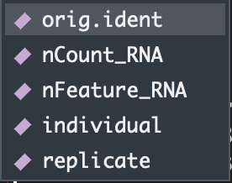
Using the `$` symbol, we can directly access metadata columns from our Seurat object. Remember that this works the same way as data.frame objects. This will come in handy throughout the lab!
> se$

Slide 16
Seurat methods
There are a number of different methods available to interact with the Seurat object. You can find a full list of the available methods here: https://satijalab.org/seurat/reference/index.html
It is possible to brute force changes to the object, but most of the time there is a method available to do whatever you want to do without risking to break the object.

Slide 17
Seurat methods
There are a number of different methods available to interact with the Seurat object. You can find a full list of the available methods here: https://satijalab.org/seurat/reference/index.html
It is possible to brute force changes to the object, but most of the time there is a method available to do whatever you want to do without risking to break the object.
Let’s illustrate this with an example. Below are two different ways of accessing the raw count data from a Seurat object:
# brute force way 🤔
counts <- se@assays$RNA@counts
# using a Seurat method 😀
counts <- GetAssayData(se, slot = “counts”, assay = “RNA”)

Slide 18
Seurat methods
There are a number of different methods available to interact with the Seurat object. You can find a full list of the available methods here: https://satijalab.org/seurat/reference/index.html
It is possible to brute force changes to the object, but most of the time there is a method available to do whatever you want to do without risking to break the object.
Let’s illustrate this with an example. Below are two different ways of accessing the raw count data from a Seurat object:
# brute force way 🤔
counts <- se@assays$RNA@counts
# using a Seurat method 😀
counts <- GetAssayData(se, slot = “counts”, assay = “RNA”)
If you don’t use the Seurat methods, there is a higher risk of messing things up!

Slide 19
generic functions
There are also “generic” functions available that you can use on a Seurat object
These are simple functions such as: dim(), colnames(), print(), …
Example:
# Get dimensions of Seurat object expression matrix
dim(se)
[1] 18935 864
# Get gene names from Seurat object expression matrix
genenames <- rownames(se)
head(genenames)
[1] "A3GALT2" "A4GNT" "AADAC" "AADACL2" "AADACL2-AS1" "AADACL3"

Slide 20
Hand-in
Return the knitted .html file by Fri 14^{h} of October by 23.59
GOOD LUCK WITH THE LAB 2!

