Slide 1

Information Technology Course Module Software Engineering by Damir Dobric / Andreas Pech
Presentation On
ML24/25-03: Implement Anomaly Detection Sample
Team Name: MatrixMasters
Hasan Ahmed hasan.ahmed@stud.fra-uas.de
Md Abdulla Al Mahamud Rosi abdulla.rosi@stud.fra-uas.de
Date: 28.03.2025

Slide 2


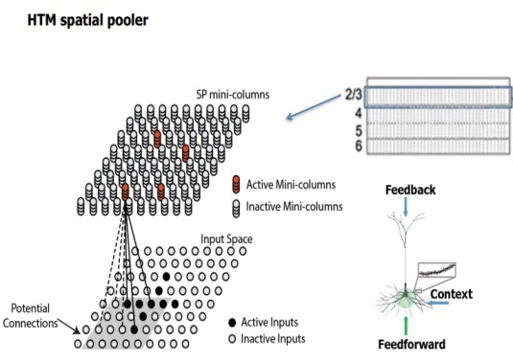

Presentation Topics
In this presentation our main goal will be on these below topics:
Introduction to the Project
Concept of NeoCortex API
Concept of HTM System
Multi Sequence Learning
Anomaly Detection
Result

Slide 3
Introduction and Objective
Anomaly detection is a crucial aspect of data analysis and machine learning.
It involves identifying patterns or instances that deviate significantly from normal behavior within a dataset.
Implementing effective anomaly detection techniques is essential for various applications, including fraud detection, cybersecurity, predictive maintenance, and fault detection.
In this presentation, we will explore the implementation of anomaly detection using NeoCortex API, HTM, MultiSequenceLearning .

Slide 4
Introduction and Objective
Our goal is to develop a robust anomaly detection system that can accurately identify and flag anomalies in real-time data streams or historical datasets.
By leveraging HTM algorithms and techniques, we aim to enhance decision-making, mitigate risks, and improve overall system reliability.

Slide 5
NeoCortex API
NeoCortex API focuses implementation of Hierarchical Temporal Memory Cortical Learning Algorithm.
Support for HTM Algorithms: Includes spatial pooling, temporal memory, sequence learning, and anomaly detection.
Sensory Input Processing: Encodes data into sparse distributed representations (SDRs).
Learning and Inference: Enables real-time learning, prediction, and anomaly detection

Slide 6
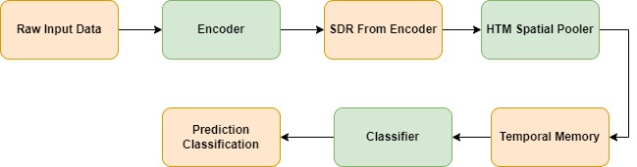
Hierarchical Temporal Memory (HTM)
Figure : HTM System Pipeline

Slide 7
Multi Sequence Learning
HTM CLA is good is finding patterns in data
We are using NeoCortex API, specifically multisequence class, which is based on htm CLA.
Multiple number of sequences can be trained with different datatypes.
We are going to use simple numerical integer sequences.
We have to tune hyper-parameters, like encoder and htmconfig, which facilitates training this type of data.

Slide 8
DataSet
For this project, we used two datasets from a weather dataset for Bangladesh. We took temperature of 20 days for different hours.
we give our data sequences where the sequences are in JSON files. We keep our dataset in two individual folders which are training_files (for training data where 4 files) and predicting_files (for predicting data where also 4 files).
Training data
38, 40, 46, 29, 33, 27, 42, 47, 30, 31
46, 36, 39, 34, 43, 28, 32, 25, 45, 26
44, 36, 37, 41, 30, 47, 28, 33, 27, 42
37, 46, 26, 47, 44, 36, 29, 42, 38, 27
45, 47, 28, 35, 29, 37, 31, 40, 45, 25
Predicting data
30, 18, 42, 19, 79, 20, 44, 16, 25, 17
19, 21, 3, 22, 41, 24, 39, 16, 34, 15
43, 32, 27, 35, 66, 30, 41, 23, 18, 31
42, 16, 30, 45, 22, 28, 76, 36, 39, 25
37, 42, 26, 24, 56, 41, 45, 28, 16, 32

Slide 9
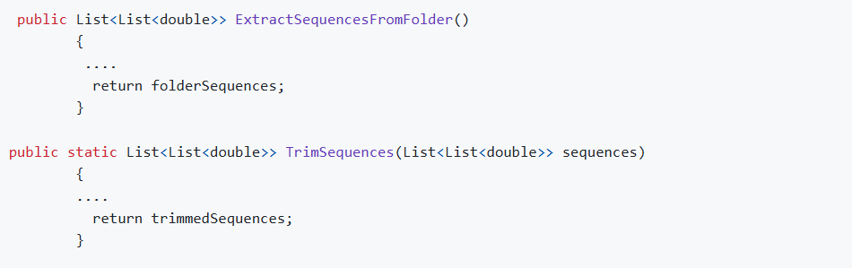
Execution of the project
At the beginning, we use the ExtractSequencesFromFolder method of the CsvSequenceFolder class to read all files inside a folder. These classes maintain a list of numerical sequences from the read data for repeated future use. To handle non-numeric data, exception handling is incorporated within certain classes. Additionally, the TrimSequences technique allows data trimming by removing one to four components (numbers 1 through 4) from the start, returning a numeric sequence.

Slide 10
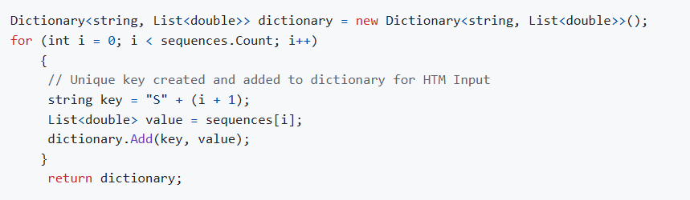
Execution of the project (Cont.)
Next, the ConvertToHTMInput method of the CSVToHTMInputConverter class is used to convert all the read sequences into a format suitable for HTM training.

Slide 11
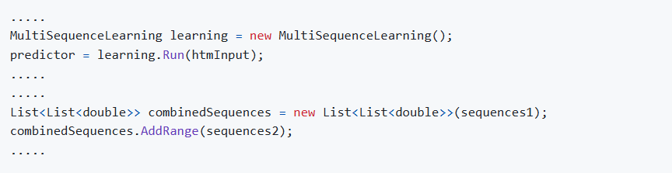
Execution of the project (Cont.)
After that, the ExecuteHTMModelTraining method of the HTMTrainingManager class is used to train the model using the converted sequences. The numerical data sequences from both the training (for learning) and predicting folders are combined before training the HTM engine. This class then returns the trained model object, which serves as the predictor.Next, the ConvertToHTMInput method of the CSVToHTMInputConverter class is used to convert all the read sequences into a format suitable for HTM training.

Slide 12
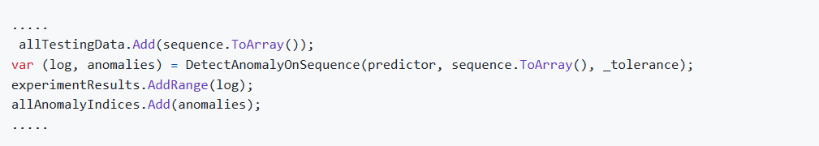
Execution of the project (Cont.)
In the end, we use the HTMAnomalyExperiment class to detect anomalies in sequences read from files inside the predicting folder. All the previously explained classes—CSV file reading (using CsvSequenceFolder), combining and converting them for HTM training (using CSVToHTMInputConverter), and training the HTM engine (via HTMTrainingManager)—are utilized here. The same CsvSequenceFolder class is used to read files for the predicting sequences. The TrimSequences method is then applied to trim sequences for anomaly testing, as explained earlier.

Slide 13

Execution of the project (Cont.)
The DetectAnomaly method, which is the main method of the ExtractSequencesFromFolder class, detects anomalies in our data. It traverses each value in the list one by one in a sliding window manner, using the trained model predictor to predict the next element for comparison. An anomaly score is used to quantify the comparison, and if the prediction exceeds a certain tolerance level, it is flagged as an anomaly.
We can obtain our prediction in a list of results in the format of NeoCortexApi.Classifiers.ClassifierResult1[System.String]` from our trained model predictor using the following method:

Slide 14
Execution of the project (Cont.)
We are using AnomalyScore, which is nothing, but the absolute value of the ratio of differences between HTM´s predicted number and actual number. If the ratio exceeds tolerancevalue, we mark it as an anomaly, otherwise, it is not. When an anomaly is detected, we skip that element in the list (we did not pass that value to HTM in the loop).
We use accuracyPerList to record accuracy per numerical sequence tested. recordAccuracy is collected from inside each loop run, which indicates HTM model´s accuracy. We also add index positions of anomalies to anomalyIndices, when we encounter indices of anomalies in loop. totalAccuracy and listCount is used to calculate average accuracy of the whole experiment.

Slide 15
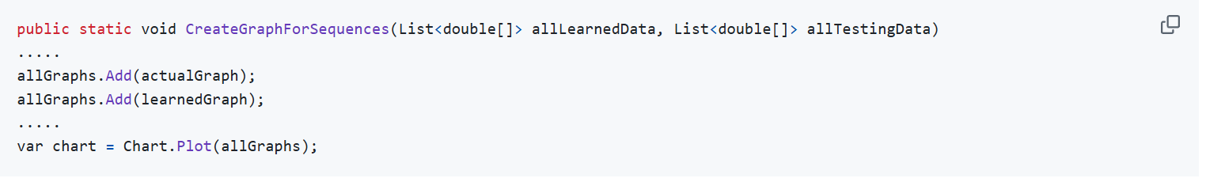
Execution of the project (Cont.)
The SequenceVisualizer class is used to plot graphs of sequences of data and their anomalies. This class used to show the visual result for detecting anomalies comparing to training sequences and the predicting sequence.

Slide 16
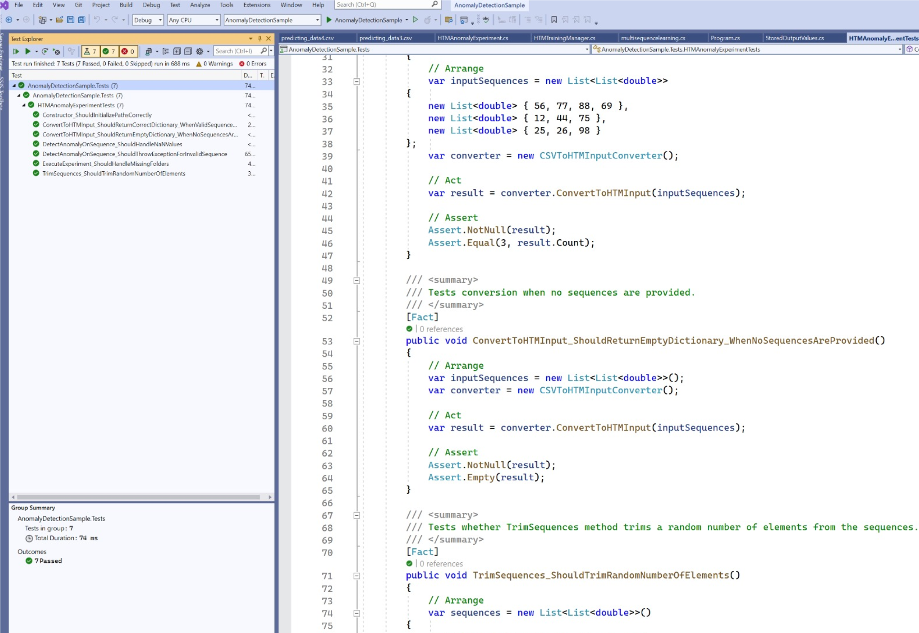
Unit Test project
We have developed a unit tests project to test different functionality of this anomaly project. During implemented the unit tests, we ensured the behavior of detection of anomalies in the project.

Slide 17
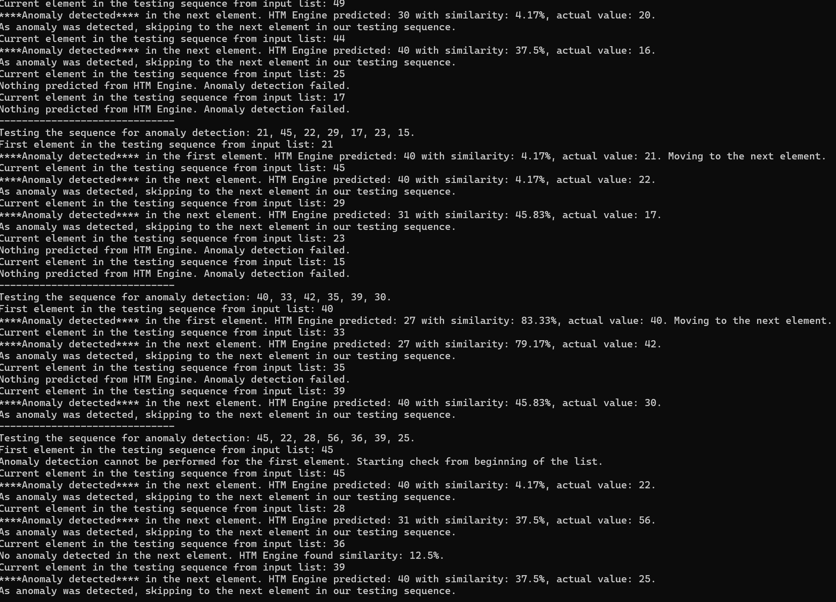
Results
Once the experiment concludes, the anomaly detection results are persisted to the screen, along with HTM accuracy for each individual number sequences and overall HTM accuracy for the whole experiment. We have uploaded the anomaly results of our data in this repository for reference. output result of combined numerical sequence data from training folder (without anomalies) and predicting folder (with anomalies) can be found in the output folder as well.

Slide 18
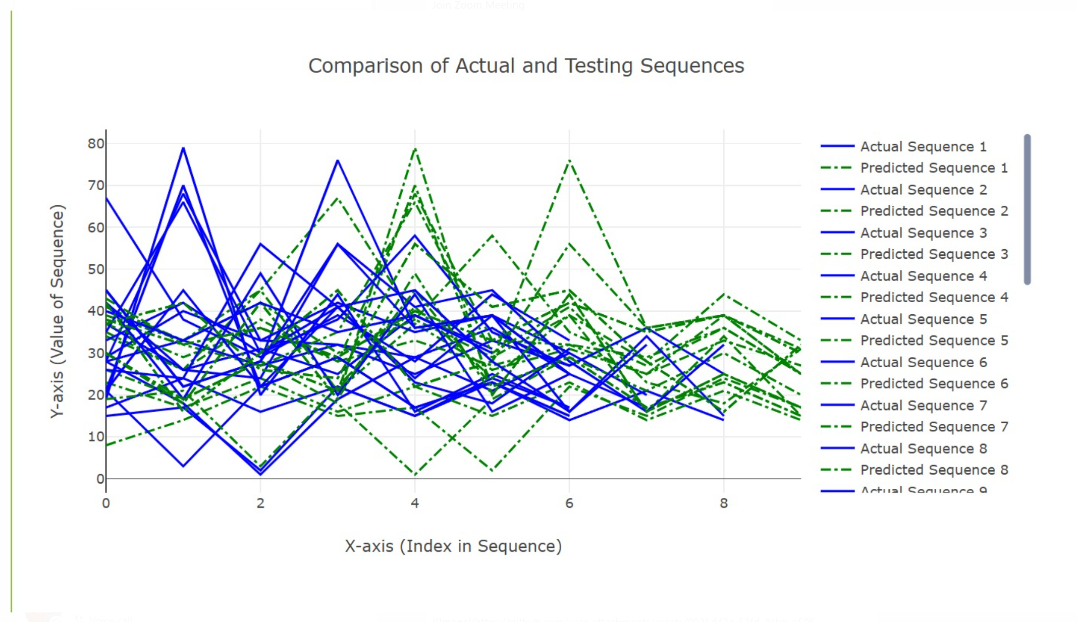
Graphical Results
We shown the graphical view of the training and predicting sequences along with anomalies. After successfully running the projects, we are generating the plots in html format in the browser as well as saving the files in the output graph folder. We generated 2 kind of plots
Training and predicting sequence plot

Slide 19
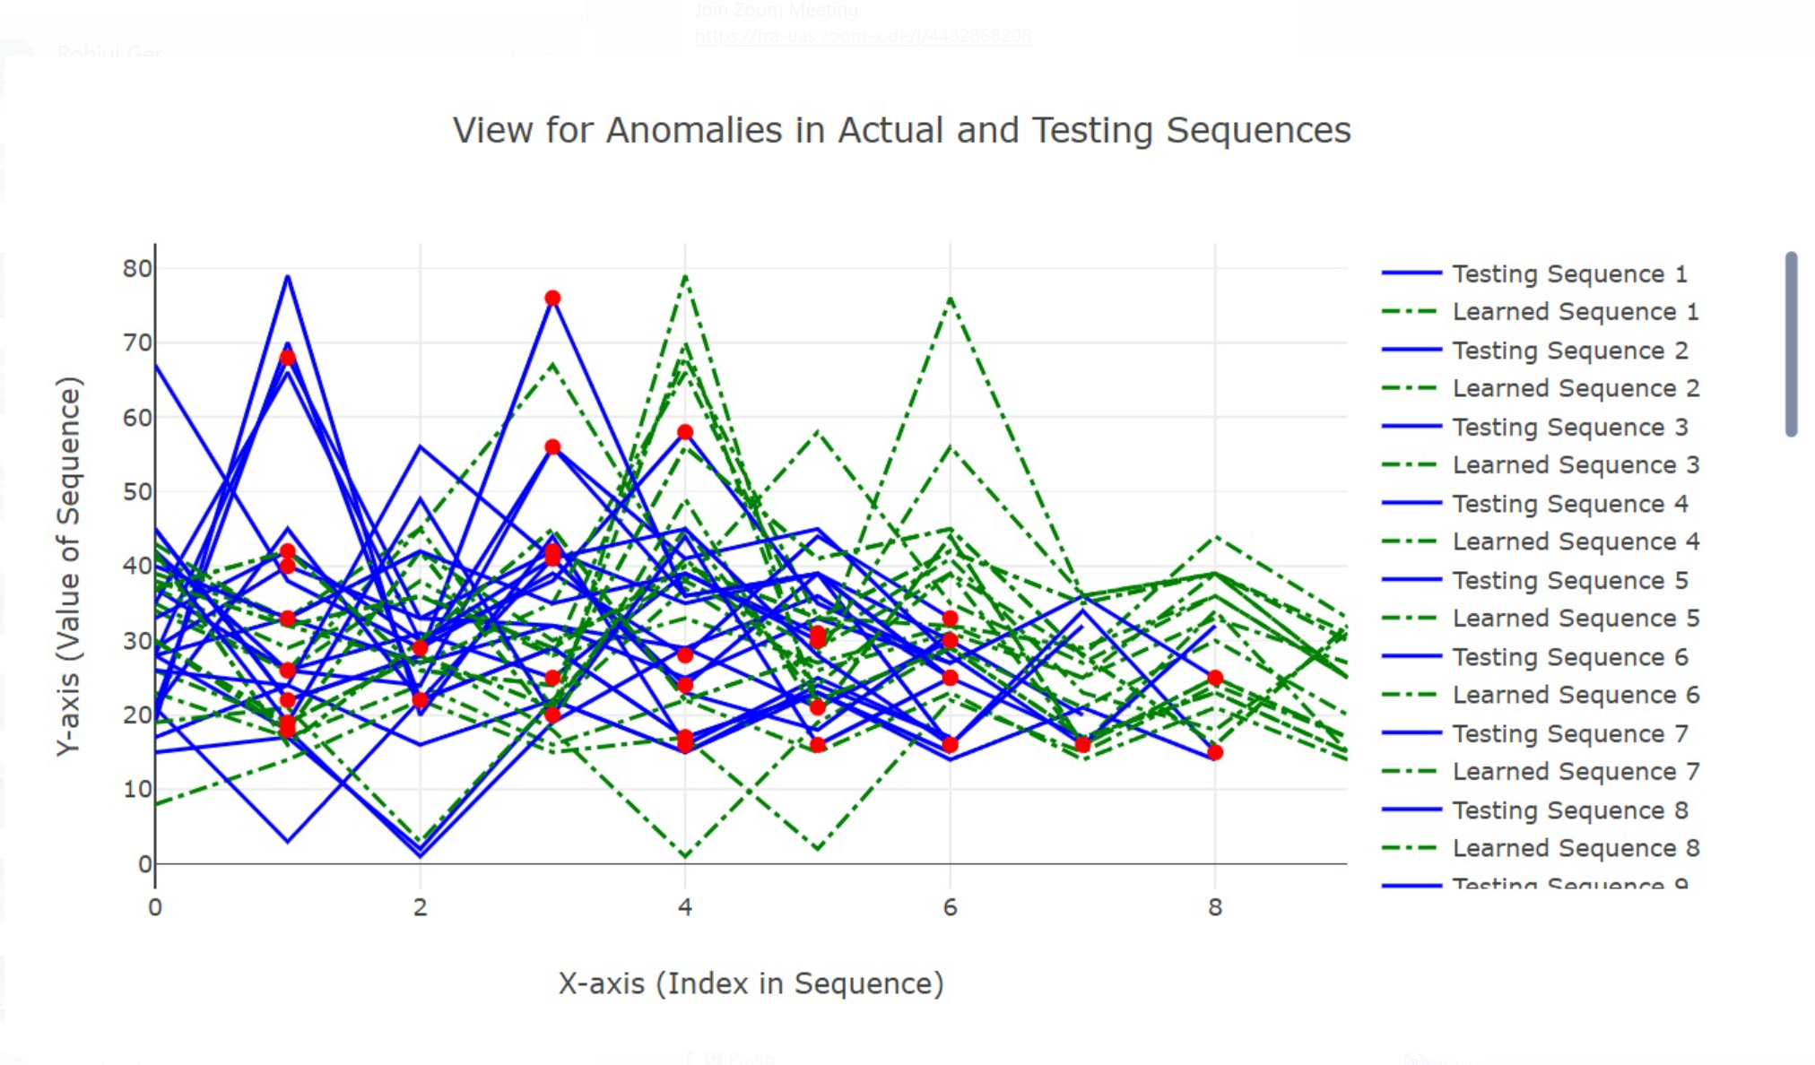
Graphical Results
Training and predicting sequence with anomalies plot

Slide 20
Conclusion
Average FNR of the experiment: 0.22
Average FPR of the experiment: 0.28
We found Anomaly detection results for Testing the sequence: 30, 18, 42, 19, 79, 20, 44, 16, 25, 17
FNR = FN / (FN + TP) = 0/ (0+2) = 0 FPR = FP / (FP + TN) = 2/ (2+5) = 0.29 Where, FN = 0, FP = 2, TN = 5, TP = 2.
After running our sample project, we analyzed the output folder of this experiment and got the following average results:
We can observe that the False Negative Rate(FNR) is in our output (0.22). It is desired that the false negative rate should be as lower as possible in an anomaly detection program. Lower false positive rate is also desirable, but not absolutely essential.

Slide 21
Conclusion
Although, it depends on a number of factors, like quantity (the more, the better) and quality of data, and hyperparameters used to tune and train model; more data should be used for training, and hyperparameters should be further tuned to find the most optimal setting for training to get the best results. We were using less amount of numerical sequences as data to demonstrate our sample project due to time and computational constraints, but that can be improved if we use better resources, like cloud.

Slide 22
References
J. Hawkins and S. Blakeslee, “On Intelligence”, Henry Holt, New York, 2004.
J. Struye and S. Latré, “Hierarchical temporal memory and recurrent neural networks for time series prediction: An empirical validation and reduction to multilayer perceptrons,” Neurocomputing, vol. 396, pp. 291–301, Jul. 2020, doi: https://doi.org/10.1016/j.neucom.2018.09.098.
J. A. Starzyk, and H. He, “Spatio–Temporal Memories for Machine Learning: A Long-Term Memory Organization”, IEEE TRANSACTIONS ON NEURAL NETWORKS, vol. 20, no. 5, pp. 68-780, 2009.
J. Wu, W. Zeng, and F. Yan, “Hierarchical Temporal Memory method for time-series-based anomaly detection,” Neurocomputing, vol. 273, pp. 535–546, Jan. 2018, doi: https://doi.org/10.1016/j.neucom.2017.08.026.
“A Machine Learning Guide to HTM (Hierarchical Temporal Memory),” Numenta. https://www.numenta.com/blog/2019/10/24/machine-learning-guide-to-htm/, (Last Accessed: 22.03,2024).

Slide 23
Thank You

