Slide 1
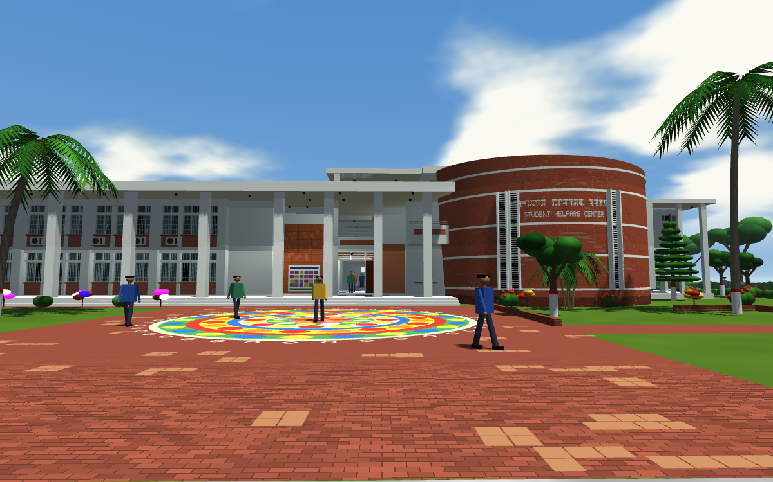
Khulna University of Engineering & Technology
Department of Computer Science and Engineering
An Interactive 3D Model of the KUET Student Welfare Centre
Real-time rendering, animation, walk-through and ray tracing in C++ and OpenGL
Course
CSE-4102: Computer Graphics and Image Processing Laboratory
The main entrance, rendered in real time
Submitted by
Abdullah Al Mahmud
Roll: 2107099
CSE, KUET
Course Teachers
Mr. Md. Mubtashim Abrar Nihal
Mr. Md. Tajmilur Rahman
Notes:
Title slide. The picture is a real-time render from the program.

Slide 2
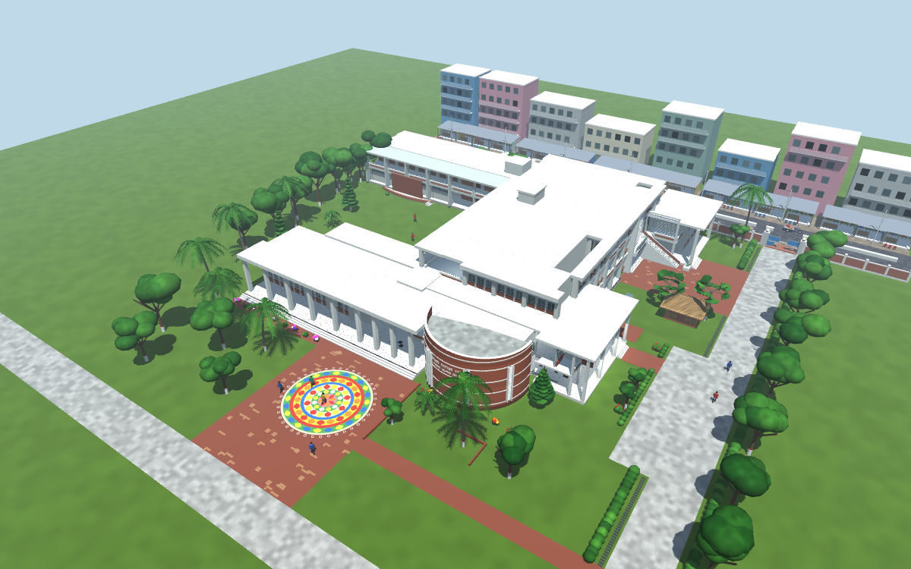
Project Overview
A 3D model of the SWC building, its interior, the site and the street behind it, rebuilt from 93 photographs
Written in C++17 and OpenGL 3.3; only GLFW is used, for the window and input
No model files, no image textures, no math library: geometry, matrices, lighting and animation are all written in the project
Two renderers share one scene: a real-time rasteriser and a CPU ray tracer
Walk through the building with collision, stairs and floor levels
Aerial view of the complete scene
367,000
113
37
63
triangles
point lights
preset views
moving objects
Notes:
Moving objects: 21 ceiling fans, 7 vehicles and 35 pedestrians.

Slide 3
Course Requirements and How They Are Met
# | Requirement | Implementation
1 | Virtual 3D environment | SWC building, interior, site and street
2 | Objects from basic primitives | Nine canonical shapes; everything is assembled from them
3 | Translation, rotation, scaling | Custom 4 x 4 matrices
4 | Composite transformations | T R S products, transform stack, instanced moving objects
5 | Custom vector and matrix operations | Vec3, Mat4, Mat3; dot, cross, product, inverse transpose
6 | Camera and viewing | Custom look-at matrix; orbit and walking cameras
7 | Perspective projection | Custom perspective and orthographic matrices
8 | Interactive manipulation | Mouse and keyboard camera; keys to move, rotate, scale the model
9 | Ambient, diffuse, specular lighting | One sun and 113 point lights
10 | Phong model, per-fragment shading | Evaluated in the fragment shader for every pixel
11 | Exploring from different viewpoints | 37 views, orthographic elevations, walking mode
Notes:
Beyond the requirements: shadow mapping, procedural materials, transparent glass, animation, collision detection and ray tracing.

Slide 4
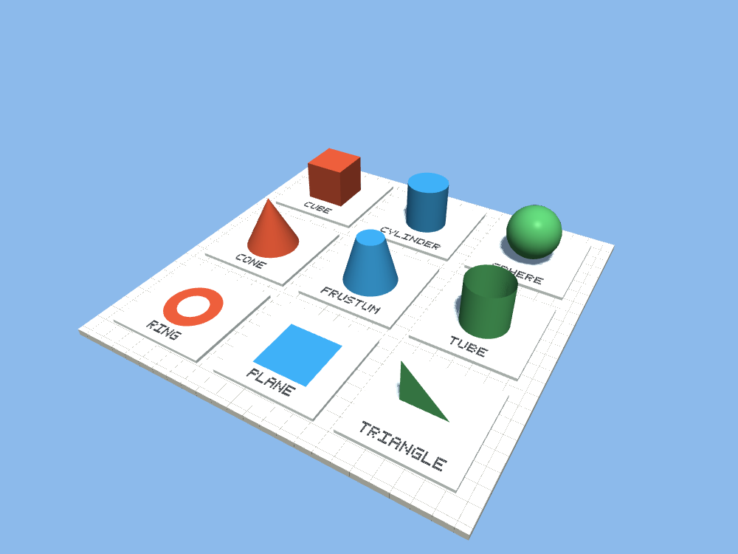
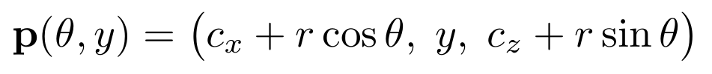
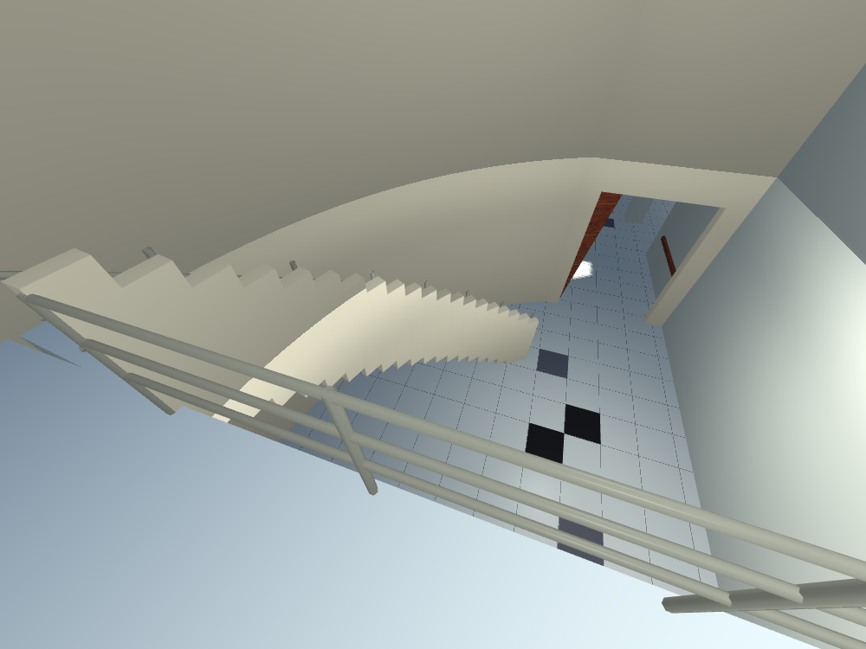
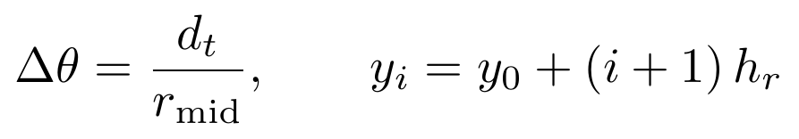
Geometric Modelling from Primitives
Everything is triangles; nine unit shapes are sized and placed to build the scene
Curved surfaces are flat pieces with true normals, so lighting stays smooth
CYLINDER (columns, lamps, wheels)
SPHERE (foliage, lamp globes)
The nine basic shapes
CURVED STAIR: each step is a ring sector
Curved stair of 20 sector steps
Notes:
The curved brick wall is 60 by 14 quads on a cylinder. The stair inside it turns about 51 degrees over 20 steps.

Slide 5
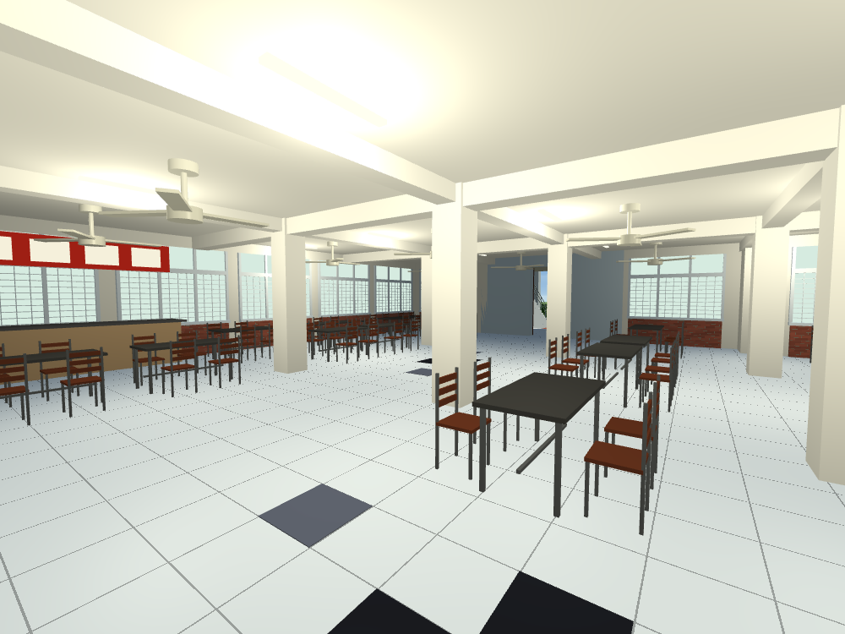
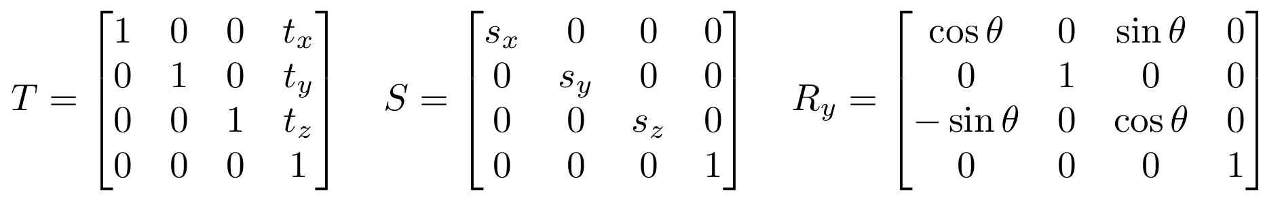
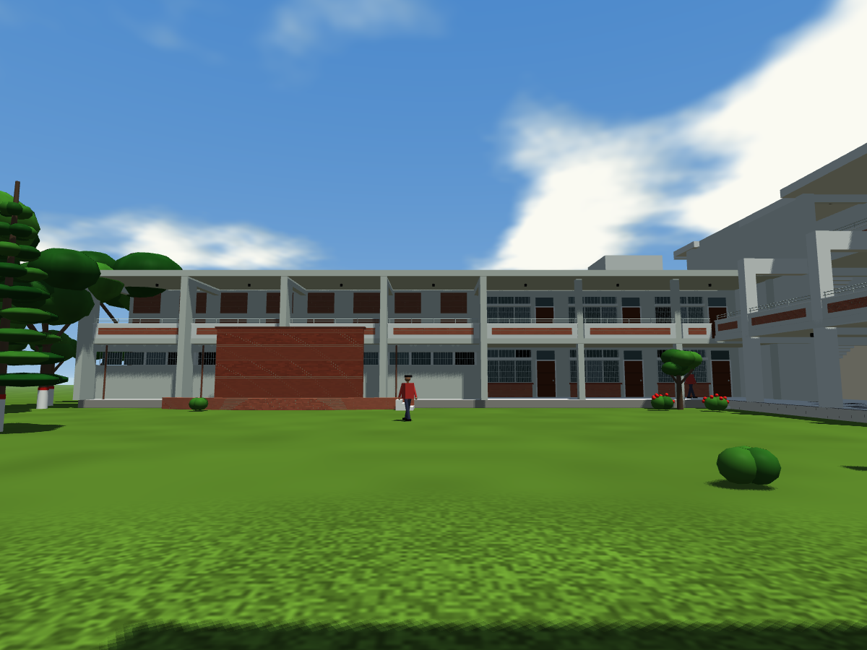
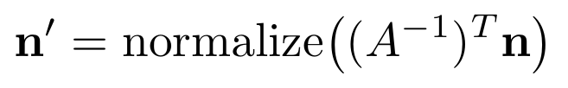

Transformations, Hierarchy and Instancing
TRANSLATION, SCALING, ROTATION (homogeneous 4 x 4)
COMPOSITE (scale, then rotate, then translate) AND PARENT-CHILD STACK
One table set placed 24 times; 14 fan instances
NORMALS UNDER NON-UNIFORM SCALE
INSTANCING: ONE MESH, MANY MATRICES
A window bay is written once and placed along each wing
21 fans, 7 vehicles and 35 people are drawn from 14 small meshes
Repeated window and balcony bays

Slide 6
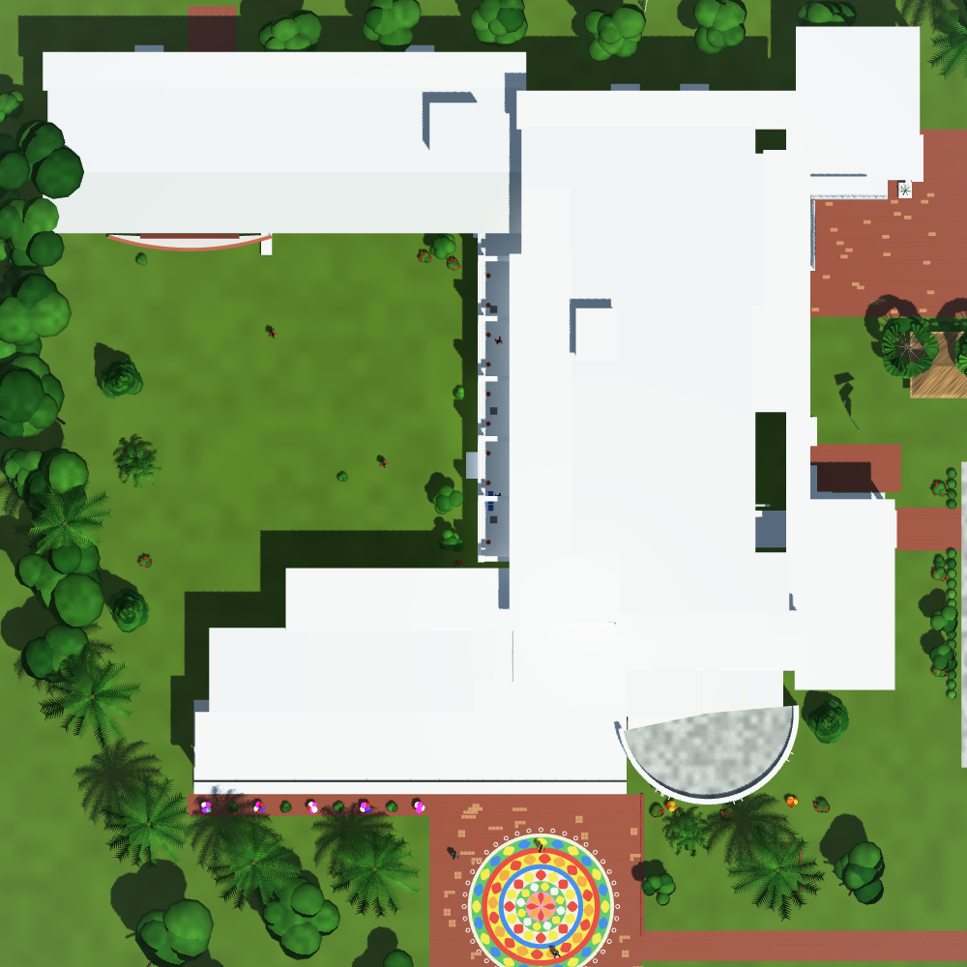
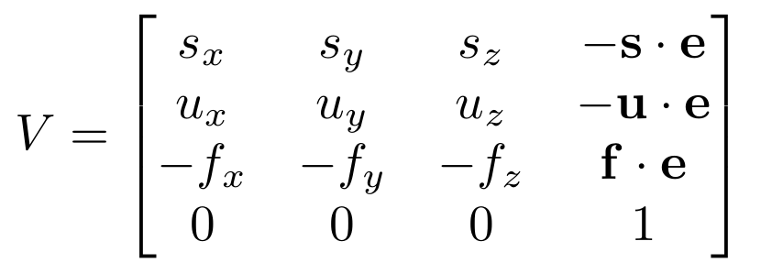
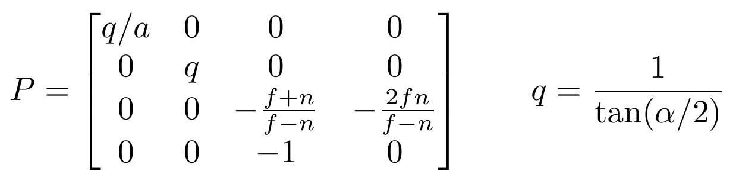

Camera, Viewing and Projection
ORBIT CAMERA: eye on a sphere around the target
VIEW MATRIX (look-at)
PERSPECTIVE PROJECTION
FULL CHAIN FOR A VERTEX
Dividing by w after projection makes distant objects smaller
Orthographic projection (no division) gives the plan and elevations
Orthographic plan: size does not depend on distance

Slide 7
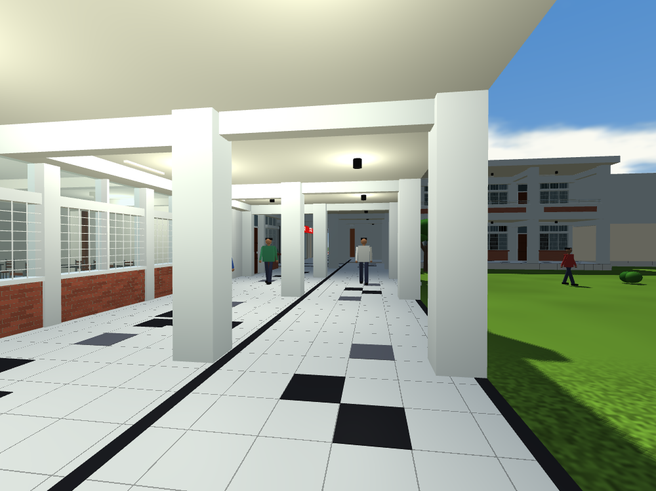
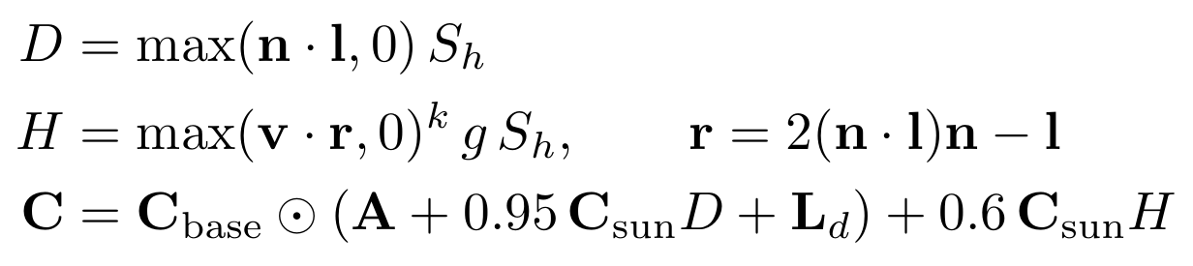
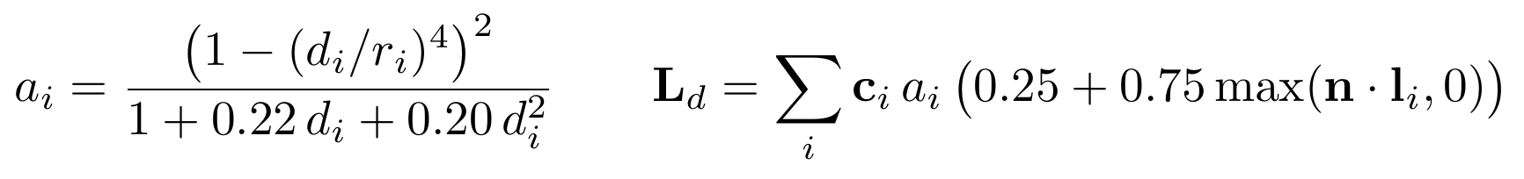
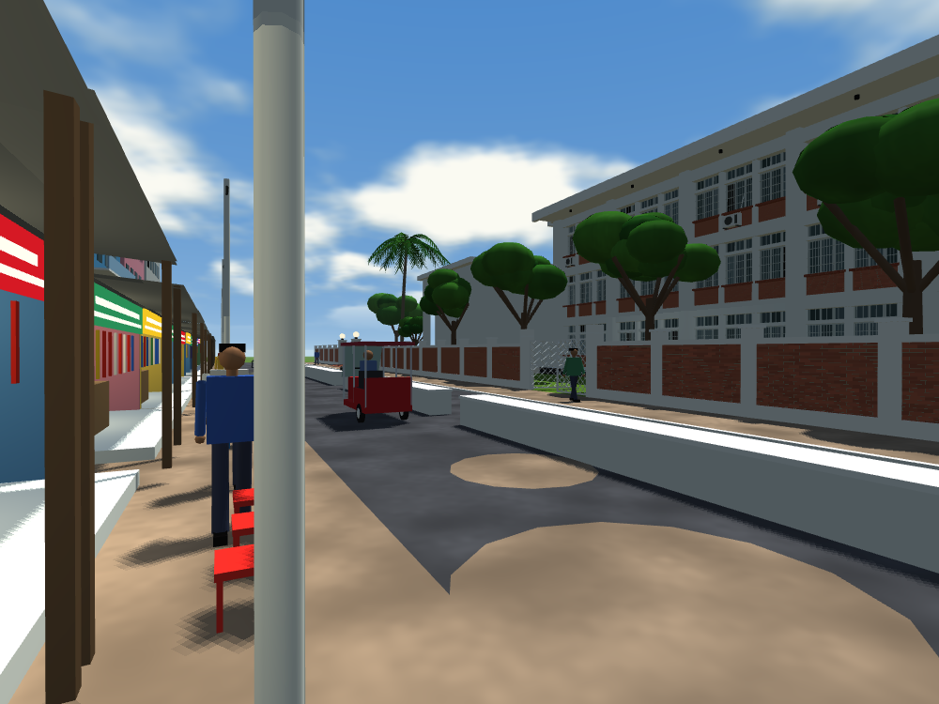
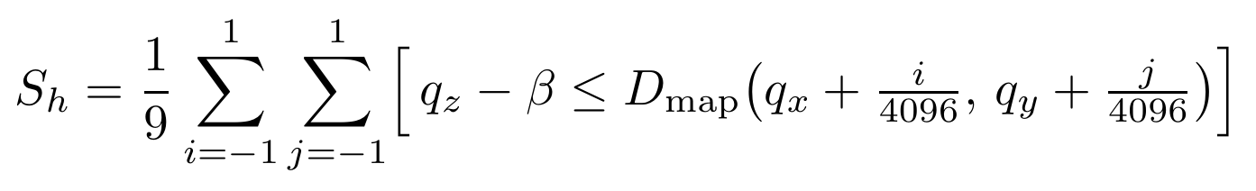
Phong Lighting, Point Lights and Shadows
PHONG MODEL, evaluated per pixel: diffuse, specular, final colour
POINT LIGHTS: attenuation with a smooth cut-off radius
Corridor lit by ceiling point lights
SHADOW MAP 4096 x 4096, softened by 3 x 3 filtering
Sun shadows from the shadow map
Notes:
Ambient blends sky and ground colour by the normal's Y. Gloss g sets the exponent k = 8 + 88 g. Lamps and lit signs are emissive.

Slide 8
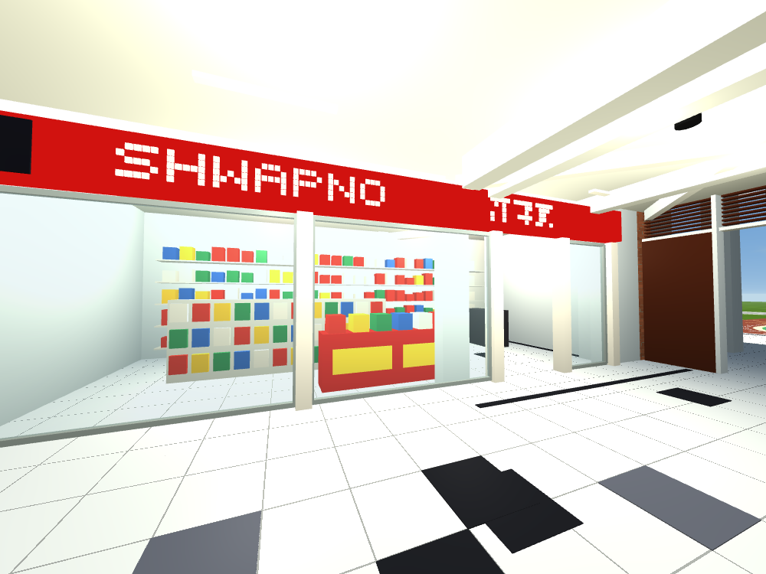
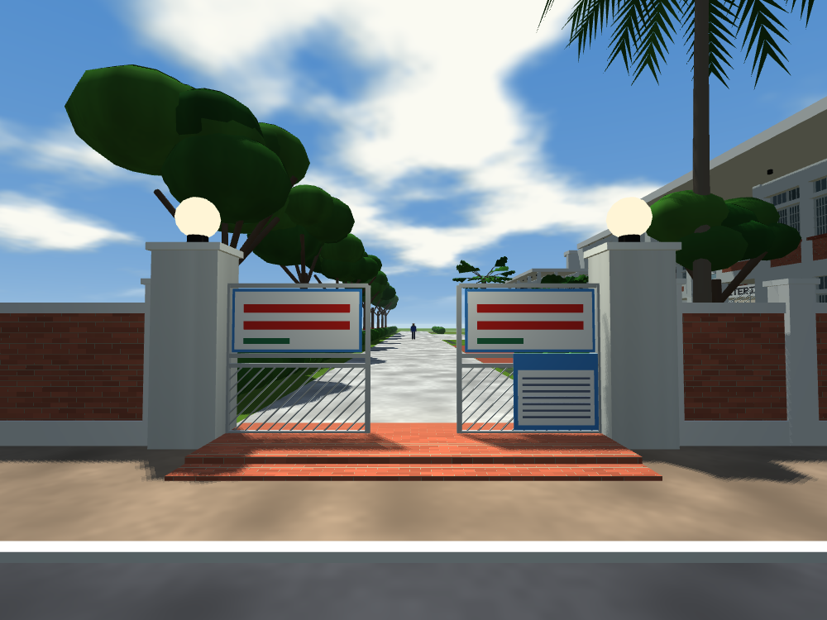
Procedural Materials and Transparent Glass
No image textures: a pattern number on each vertex selects a function of world position
Brick and paving use running bond; floor tiles a straight 0.6 m grid; grass, bark and thatch use value noise
Patterns fade to their average colour when smaller than a pixel, which removes shimmer
Glass panes are drawn last, sorted far to near, and blended
RUNNING BOND: which brick, and where inside it
Glass shop front and tiled floor
ALPHA BLENDING FOR GLASS
Procedural brick and paving

Slide 9
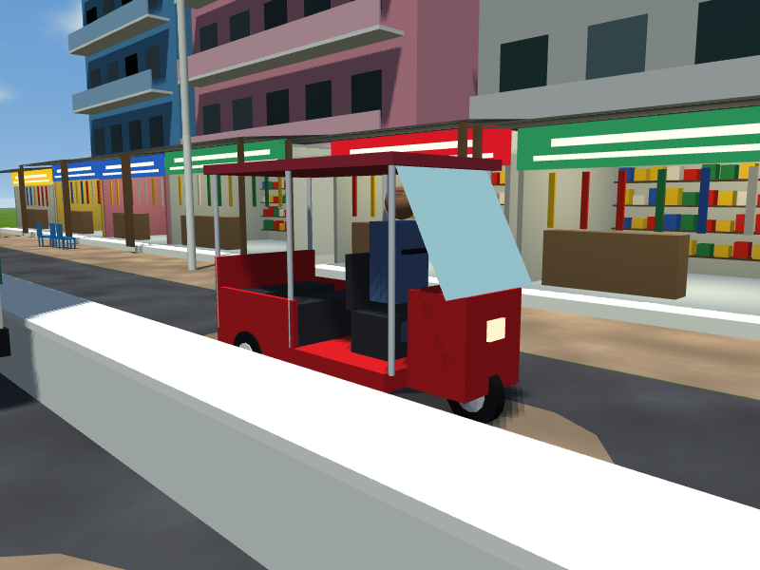
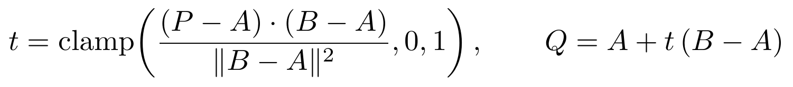
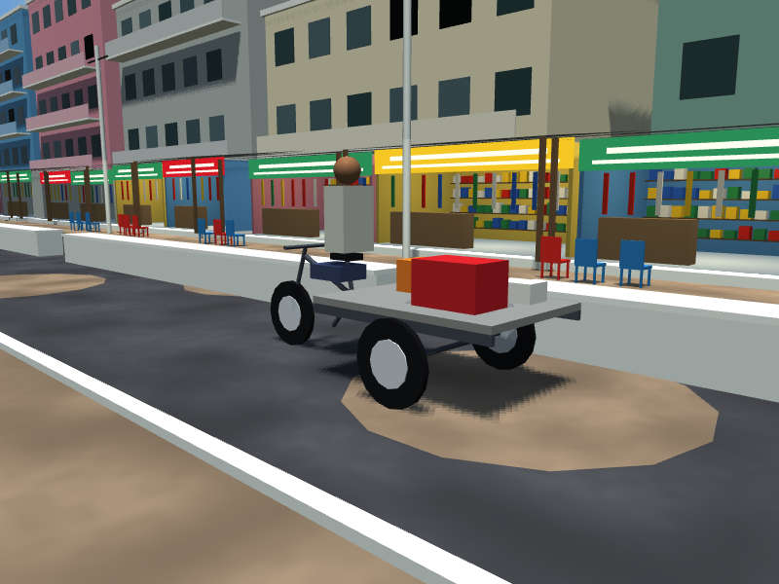
Animation and Walking with Collision
CEILING FANS
TRAFFIC: distance round a loop
PEDESTRIANS: position and heading along a route
COLLISION: closest point on a wall edge to the walker
Easybike on the road behind the SWC
4 easybikes, 2 cycle-vans and a bus that appears about a third of the time
35 people on 14 routes, inside and outside the building
The walker is a cylinder; floors come from barycentric coordinates, so stairs work
Cycle-van with its rider
Notes:
Vehicles in one lane share speed and loop length, so their spacing never changes. Moving objects are not part of collision.

Slide 10
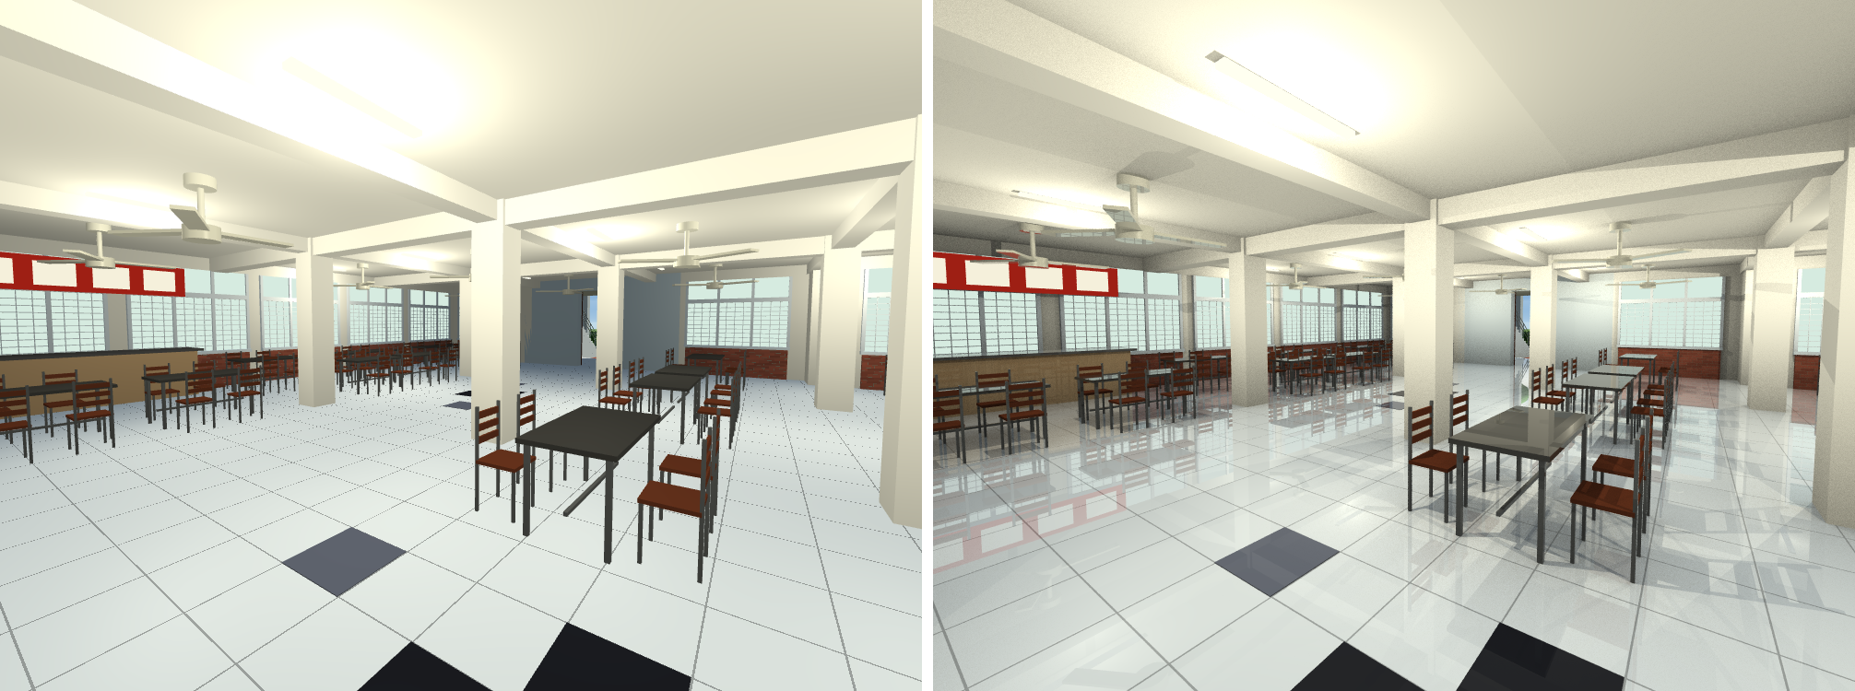
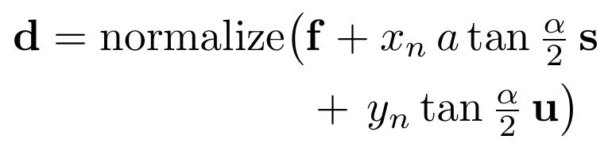
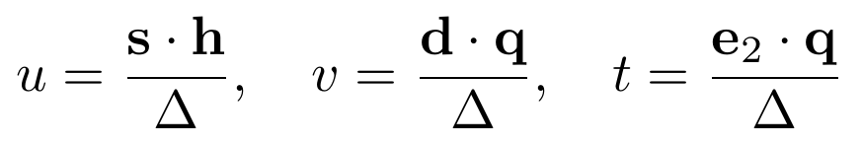
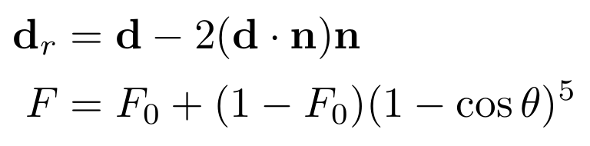
Ray Tracing the Same Scene
Left: real-time OpenGL. Right: ray traced, with floor reflections, lamp shadows and ambient occlusion
RAY THROUGH A PIXEL
RAY-TRIANGLE HIT (Moller-Trumbore)
REFLECTION AND FRESNEL
A bounding-volume hierarchy built with the surface-area heuristic makes 350,000 triangles tractable
Shadow rays to the sun and to every lamp; up to three reflection bounces; one thread per processor
Notes:
The tree split minimises cost = A_L N_L + A_R N_R. Glass continues the ray undeviated and keeps 20 percent of the pane colour.

Slide 11
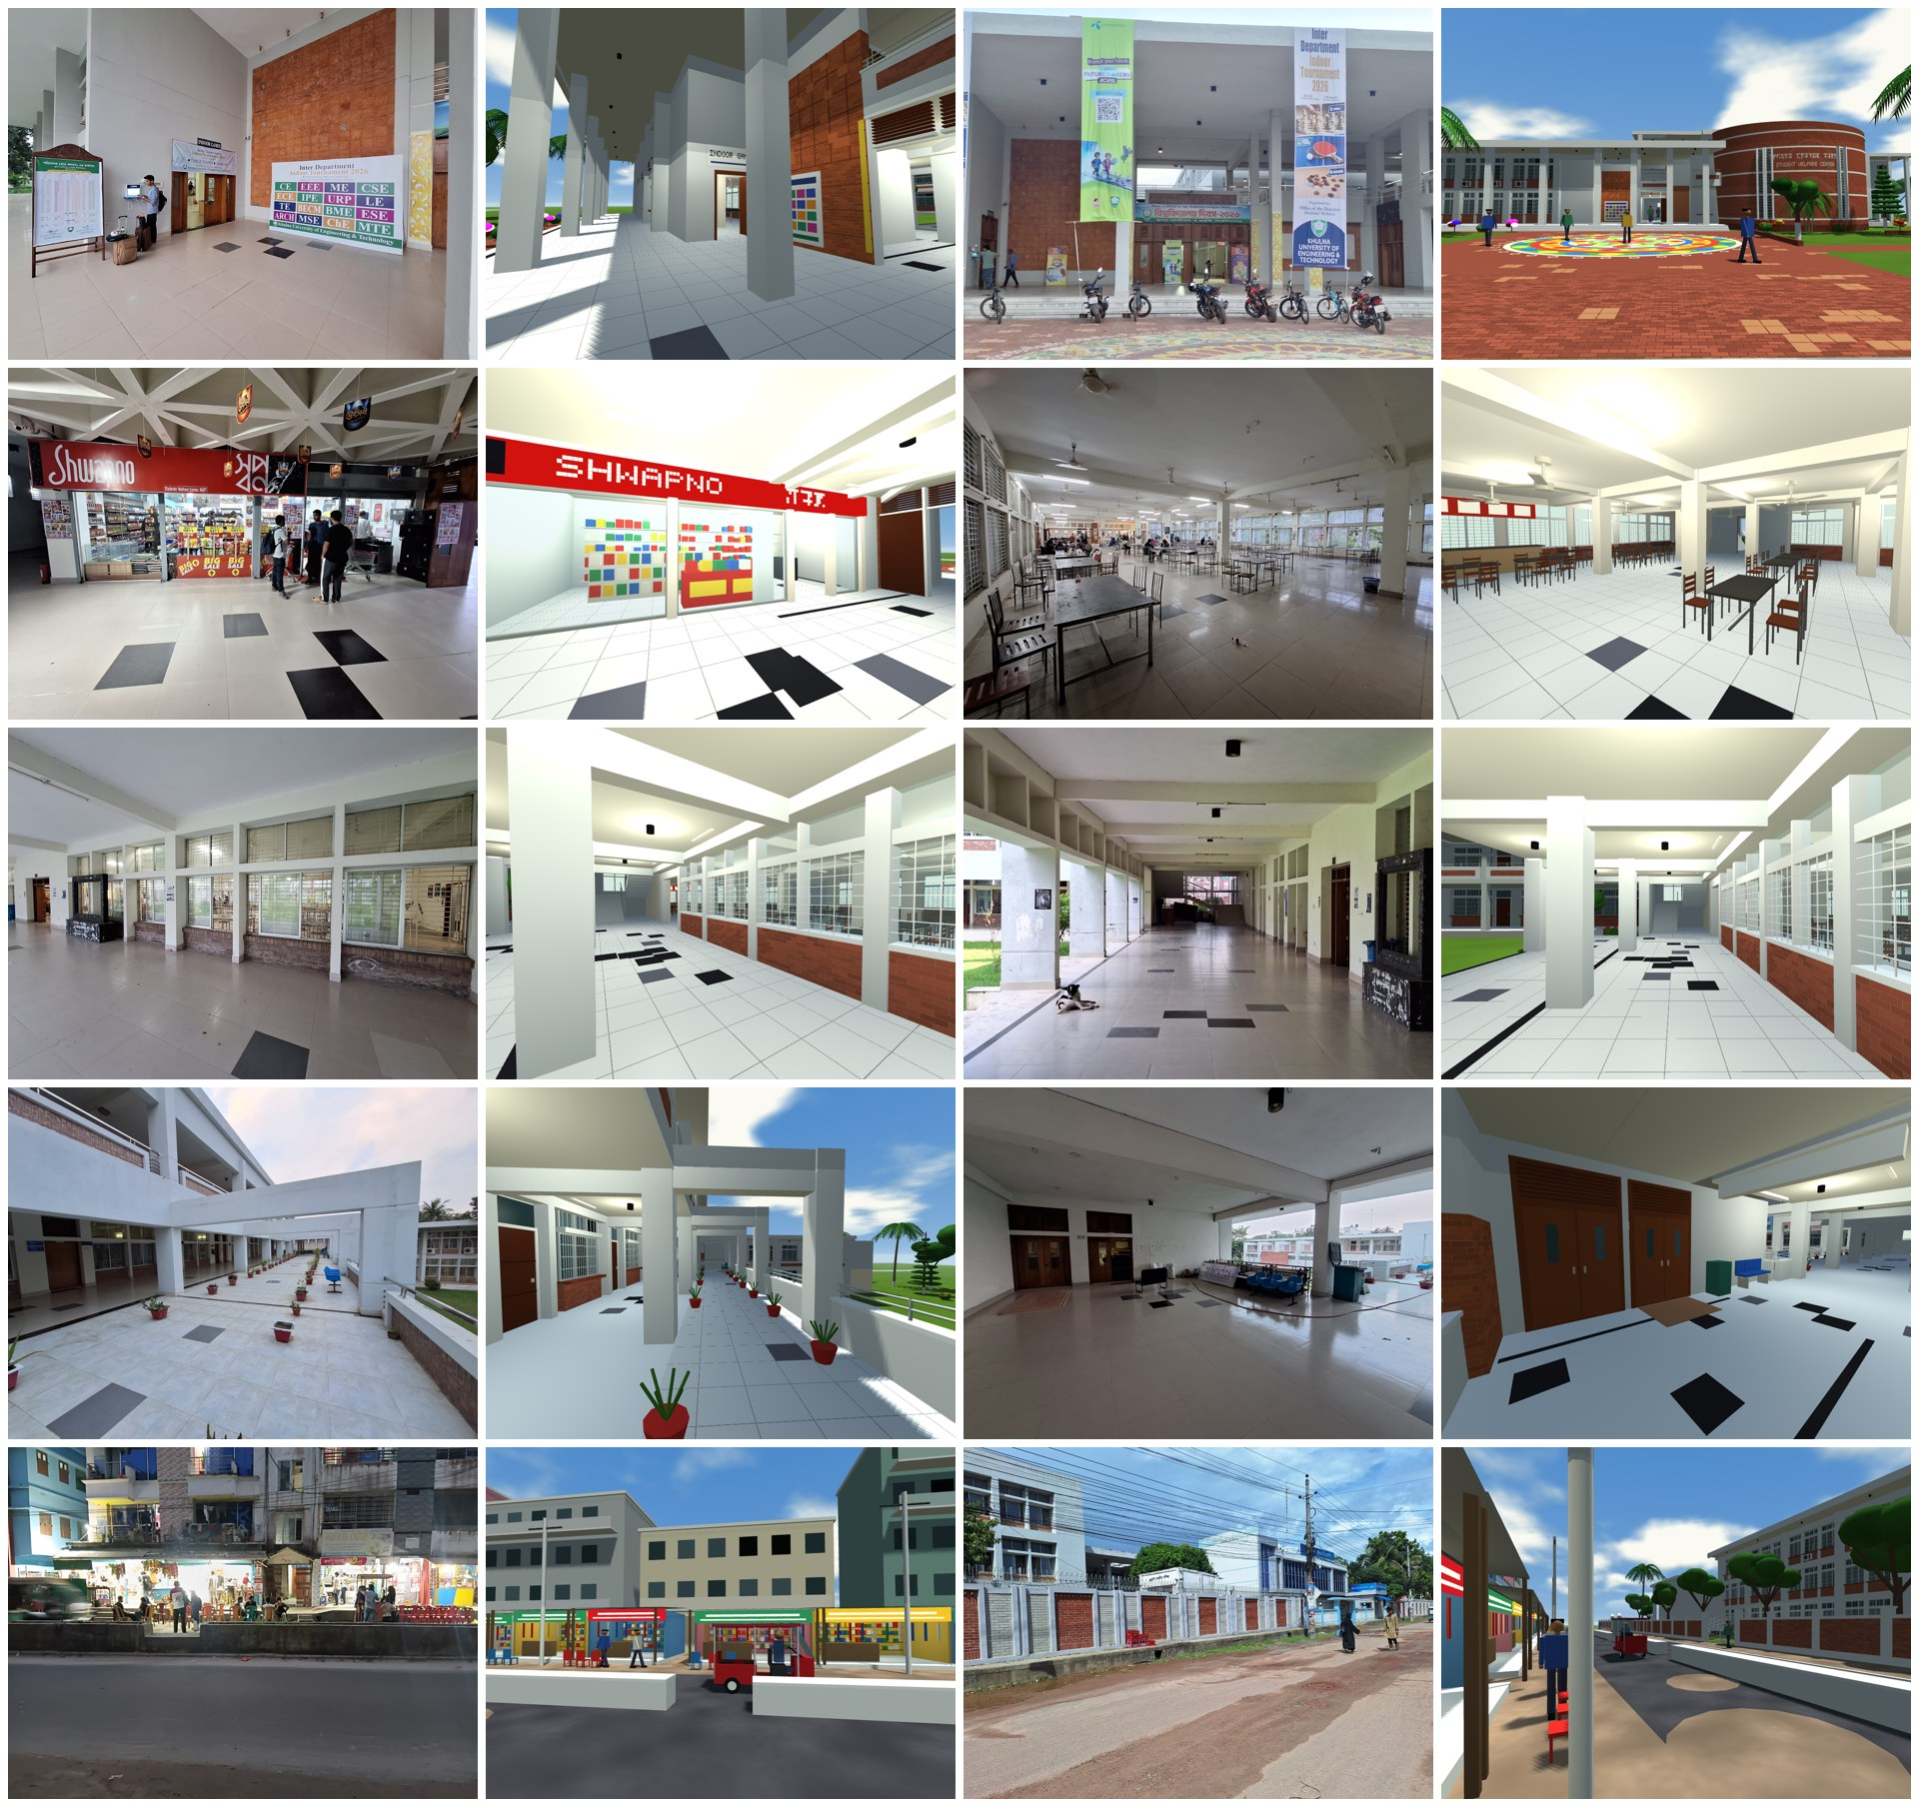
Results and Conclusion
What was achieved
All 11 course requirements met with code written from first principles
A recognisable building, inside and out, that can be explored on foot
Shadows, procedural materials, glass, animation and collision added on top
Three automatic tests pass, including walking every stair and hall
Limits
Dimensions are estimated from photographs, not measured
Point lights cast no shadows in real time; the ray tracer has no soft shadows
Vehicles and people follow fixed paths and are not part of collision
Photographs (left of each pair) beside the model
Notes:
Future work: shadowed point lights, a skeletal walk cycle, path tracing, and a surveyed plan.

