Slide 1
IEMOCAP Emotion Recognition
Data Science Project
Chen Shmila, Alma Hova, Ohad Lavie
May 2025

Slide 2
IEMOCAP - Interactive Emotional Dyadic Motion Capture corpus
  10,039 utterances from 10 speakers (5 female, 5 male) across 5 dyadic sessions
  Each session contains both improvised and scripted scenarios
  Features include emotions score, dimensional emotion ratings (activation, valence, dominance), and acoustic features (pitch, speaking rate, RMS energy)
  10 emotion classes: neutral, frustrated, angry, sad, happy, excited, surprise, fear, disgust, other

Slide 3
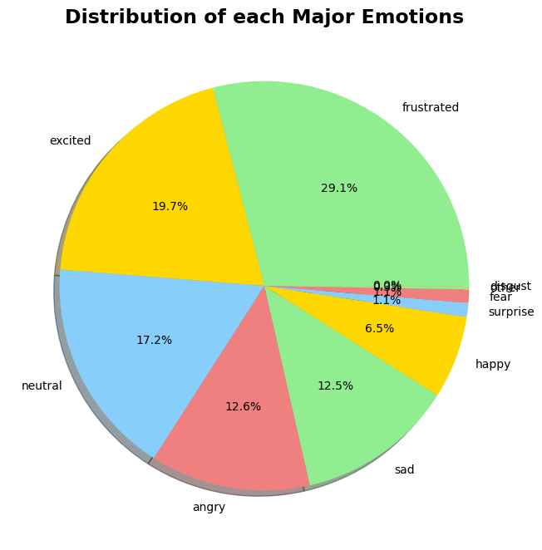
Exploratory Data Analysis of the IEMOCAP Dataset
Dataset overview
The dataset contains no missing values or duplicate values, so no imputation or deduplication is required.
The numerical values in the data are consistent.
The dataset is heavily imbalanced. frustrated and excited are the two most common classes - nearly half the data.
major_emotion | Count | Percentage (%)
frustrated | 2917 | 29.1
excited | 1976 | 19.7
neutral | 1726 | 17.2
angry | 1269 | 12.6
sad | 1250 | 12.5
happy | 656 | 6.5
surprise | 110 | 1.1
fear | 107 | 1.1
other | 26 | 0.3
disgust | 2 | 0.0

Slide 4
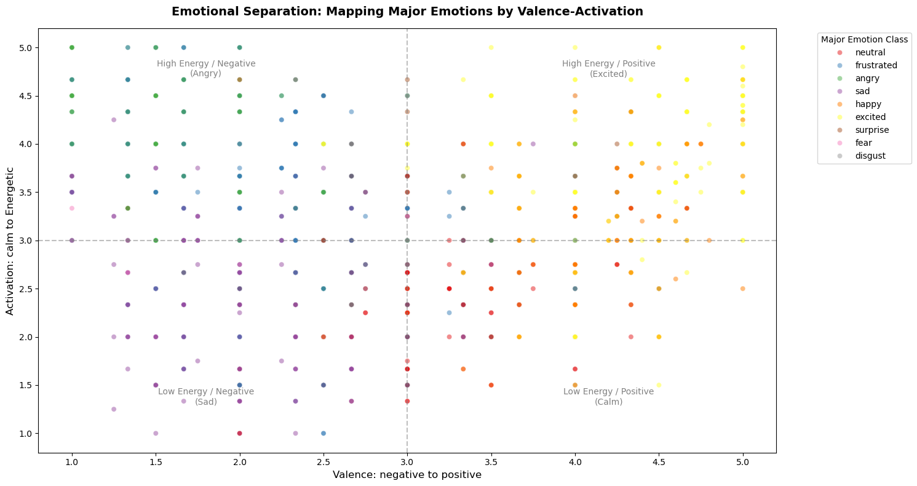
Exploratory Data Analysis of the IEMOCAP Dataset
Notes:
מיפוי רגשות לפי מודל הרגש

Slide 5
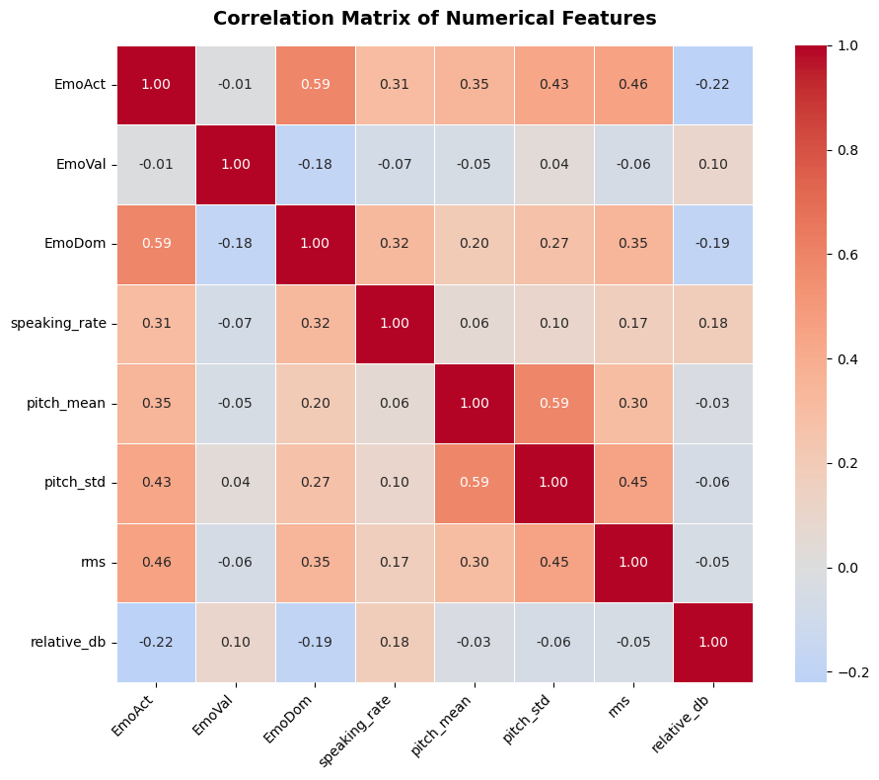
Exploratory Data Analysis of the IEMOCAP Dataset
Conclusions
The strongest correlation in the matrix is between EmoAct and EmoDom. high activation emotions also tend to feel dominant.
EmoAct shows positive correlations with several acoustic features: rms, pitch_std , pitch_mean, and speaking_rate. Energetic emotions being louder, higher pitched, and faster.
pitch_mean and pitch_std are also correlated. Speakers with higher average pitch also vary their pitch more.
EmoVal is largely uncorrelated with all acoustic features. Difficulty of predicting valence from acoustics alone.
rms and relative_db show near zero correlation, indicating they capture different aspects of loudness.

Slide 6
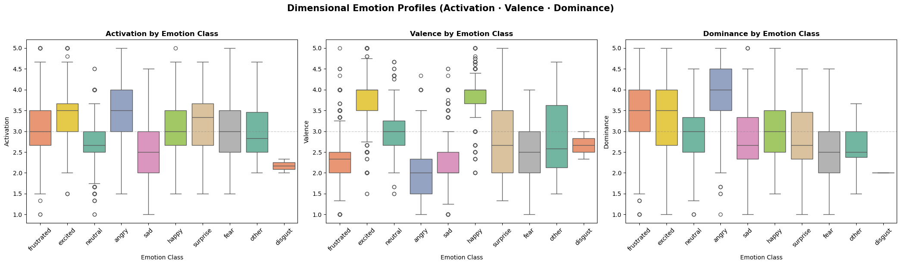
Exploratory Data Analysis of the IEMOCAP Dataset
Conclusions
Angry scores highest on Activation. followed by excited, both are high energy emotions. Sad and neutral score lowest.
On Valence, happy and excited are the most positive, while angry, sad, and frustrated are the most negative.
Angry also scores highest on Dominance, while fear and sad score low.

Slide 7
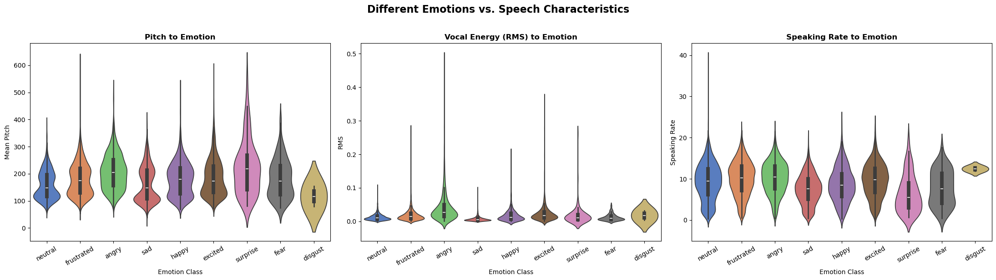
Exploratory Data Analysis of the IEMOCAP Dataset
Acoustic Profile to maps how different emotions physically sound

Slide 8
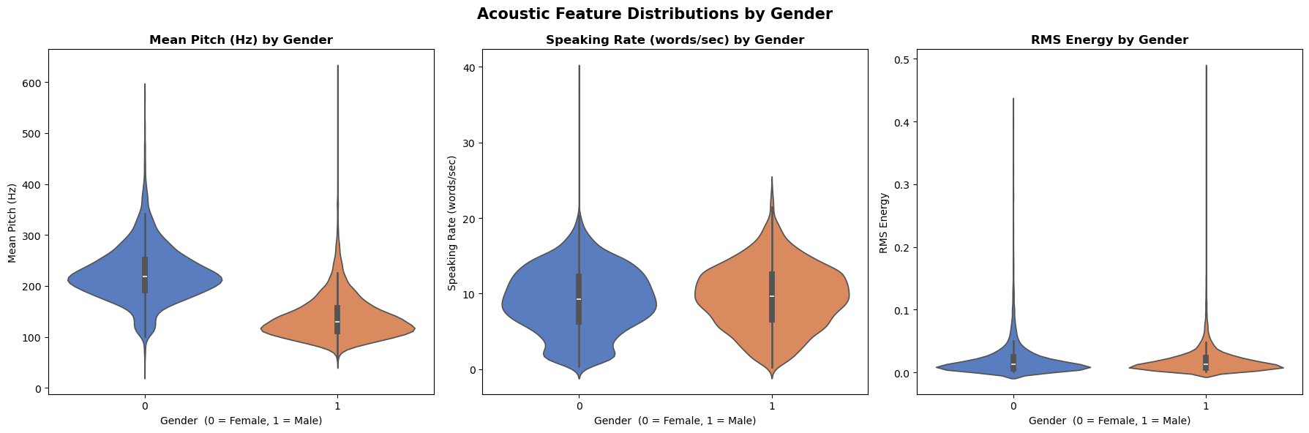
Exploratory Data Analysis of the IEMOCAP Dataset
Conclusions:
Female speakers have a higher mean pitch than male speakers.
Speaking rate and RMS energy distributions are similar across genders.

Slide 9
Research Question
Can we predict the emotion of the speaker based only on his acoustic-speech characteristics?
(Characteristics: speaking_rate, pitch_mean, pitch_std, rms, relative_db)

Slide 10
PI
Sprint # | Explanation | Team Roles
Sprint 1 - EDA | השלמת EDA, מסקנות, איתור בעיות בדאטא, בחירת שאלת מחקר. | PO:Chen Shmila Tech Lead: Ohad Lavie Data scientists: Alma Hova
Sprint 2 – Algorithms | מימוש אלגוריתמים, פתרונות לבעיות שאותרו בספרינט 1. | PO:Alma Hova Tech Lead: Chen Shmila Data scientists: Ohad Lavie
Sprint 3 – Final Version | מסקנות, מצגת סופית, מאמר, תיקונים. | PO:Ohad Lavie Tech Lead: Alma Hova Data scientists: Chen Shmila
General (everyone‘s responsible):
git
Presentations
Sync

Slide 11
Thank you for listening!

