Slide 1
Multimodal Speech Emotion Recognition
"Does combining text and audio improve emotion classification
beyond either modality alone?"
Text
Transcription
Audio
Waveform
Emotion
Label
+
→
Chen Shmila · Alma Hova · Ohad Lavie
Bar-Ilan University · Machine Learning Projects · Spring 2026
Notes:
Introduce the team and the research question.

Slide 2
Emotion is expressed through both words and voice
TEXT ALONE
"I can't believe you did that."
→ Ambiguous: angry? sarcastic? surprised?
AUDIO ALONE
Sharp rising pitch · fast rate · high energy
→ Ambiguous: can't identify the specific emotion
TEXT + AUDIO together → clear, confident emotion signal
Applications: mental health monitoring · voice assistants · call center analytics
A system that ignores either channel is leaving information on the table.
IEMOCAP Emotion Recognition · Bar-Ilan University · Spring 2026
2 / 15
Notes:
Neither words nor tone alone tell the full story. Both signals are needed.

Slide 3
Our dataset: 10,039 labeled utterances from 10 speakers
Dataset at a glance
10,039 utterances
10 speakers (5F + 5M)
5 dyadic sessions
10 original emotion labels
Text transcript AND raw audio for every utterance
Source: Busso et al. (2008) · HuggingFace: AbstractTTS/IEMOCAP
One utterance contains:
Text transcript
"How could you say that to me"
Raw audio file
16 kHz waveform, up to 8.5 seconds
Emotion label
Scored by 4+ human annotators + soft probability scores
Every sample has both modalities — ideal for comparing text-only, audio-only, and combined.
IEMOCAP Emotion Recognition · Bar-Ilan University · Spring 2026
3 / 15
Notes:
IEMOCAP: every utterance has raw audio + text transcript + emotion label.

Slide 4
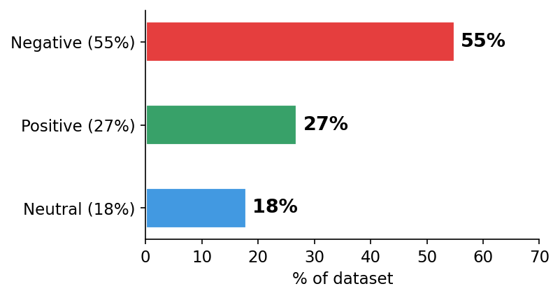
We grouped 10 emotions into 3 classes — and found severe class imbalance
NEGATIVE
angry · frustrated · fear · sad · disgust
POSITIVE
happy · excited
NEUTRAL
neutral · surprise · other
Severe imbalance (55% Negative, 18% Neutral) → Macro F1 as metric + class-weighted loss.
IEMOCAP Emotion Recognition · Bar-Ilan University · Spring 2026
4 / 15
Notes:
Grouped for learnable classes. Imbalance drives metric choice and loss function.

Slide 5
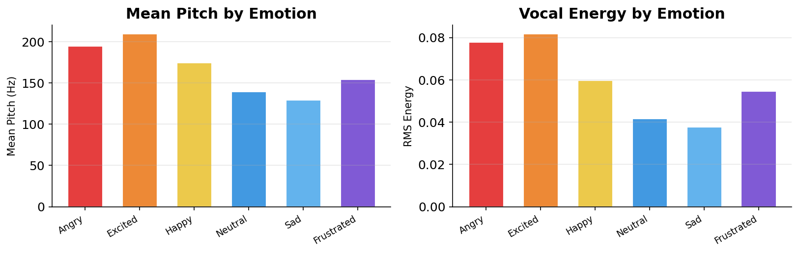
EDA: text and audio capture different emotional dimensions
Audio captures AROUSAL — angry & excited speech has clearly higher pitch and energy
Text captures VALENCE — distinguishing happy vs. angry requires understanding the words
Complementary dimensions: text ≈ valence · audio ≈ arousal. Combining both should help.
IEMOCAP Emotion Recognition · Bar-Ilan University · Spring 2026
5 / 15
Notes:
EDA: audio = arousal signal, text = valence signal. Theoretical basis for fusion.

Slide 6
Preprocessing and evaluation setup
Preprocessing steps
No missing values — no cleaning needed
Label grouping: 10 original classes → 3
(Negative / Positive / Neutral)
Text: RoBERTa tokenizer (max 128 tokens)
Audio: load raw waveform, pad/truncate to 8.5 s at 16 kHz
Class-weighted cross-entropy loss wc = N / (K · Nc)
Train / validation / test split:
TRAIN (Sessions 1–4)
8,014 utterances
VALIDATION (10% of train, stratified)
TEST — Session 5 ✦
2,170 utterances · 4 speakers never seen in training
Primary metric: MACRO F1
Equal weight to each class regardless of frequency
✦ Speaker-independent evaluation — the hardest and most honest test of generalization.
IEMOCAP Emotion Recognition · Bar-Ilan University · Spring 2026
6 / 15
Notes:
LOSO: 4 speakers in Session 5 are completely unseen at training time.

Slide 7
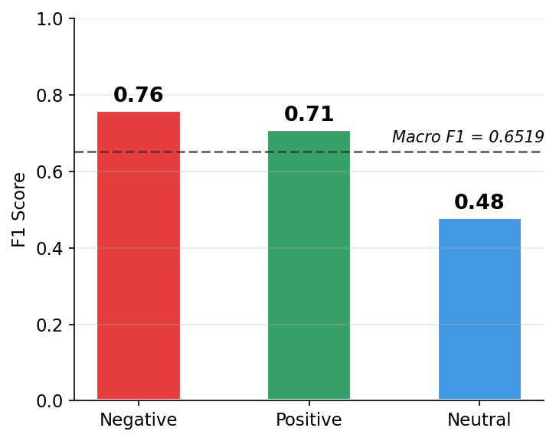
Model 1: RoBERTa reads the words and achieves Macro F1 = 0.6519
How RoBERTa works
Architecture: roberta-base, 12 transformer layers, 125M parameters
Pre-training: MLM on 160 GB text — already understands that 'infuriating' is negative
Fine-tuning: LR = 2×10⁻⁵, batch = 32, class-weighted cross-entropy
Input: text transcript → tokenizer → [CLS] vector → linear head
Best checkpoint: epoch 4 of 7 (early stopping on val Macro F1)
Weakness: Neutral has no distinctive words → text alone struggles
RoBERTa: Accuracy = 0.6793 · Macro F1 = 0.6519 · Neutral F1 = 0.48 (weakest class)
IEMOCAP Emotion Recognition · Bar-Ilan University · Spring 2026
7 / 15
Notes:
RoBERTa: 160GB pre-training. Fine-tuned on transcriptions. Neutral is the weak point.

Slide 8
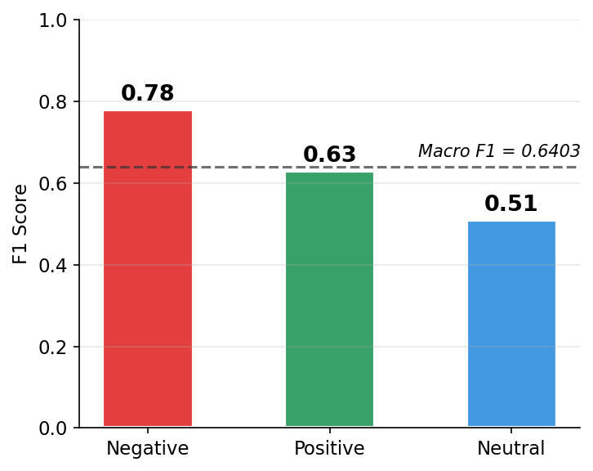
Model 2: Wav2Vec2 listens to the audio and achieves Macro F1 = 0.6403
How Wav2Vec2 works
Architecture: wav2vec2-base, 12 transformer layers, 94M parameters
Pre-training: masked audio prediction on 960h unlabeled speech
Input: raw 16kHz waveform (max 8.5 s = 136,000 samples) → conv encoder (frozen) → transformer → mean pool → linear head
Fine-tuning: LR = 2×10⁻⁵, batch = 8, conv encoder kept frozen
Key finding: Negative F1 = 0.78 (> RoBERTa's 0.76) — audio is stronger at detecting high-arousal angry/frustrated speech
Wav2Vec2: Accuracy = 0.6880 · Macro F1 = 0.6403 · Different per-class strengths than text
IEMOCAP Emotion Recognition · Bar-Ilan University · Spring 2026
8 / 15
Notes:
Wav2Vec2: raw waveform input. Similar Macro F1 to text but different per-class strengths.

Slide 9
The two models make different mistakes — that is why combining them helps
Text ✓ / Audio ✗
"I hate everything about this" — said flatly.
Text reads 'anger'. Audio hears 'calm'.
Audio ✓ / Text ✗
"Fine, whatever." — said with sharp rising anger.
Audio hears anger. Text reads 'neutral'.
Both ✓ — high confidence
Clear emotional words AND distinctive prosody.
Both channels agree → confident prediction.
Both ✗ — genuinely ambiguous
Vague words + flat tone. Human annotators also disagreed.
Not fixable by fusion — an honest failure case.
Non-overlapping errors are the condition for fusion to help — and the data shows they are.
IEMOCAP Emotion Recognition · Bar-Ilan University · Spring 2026
9 / 15
Notes:
Text fails on tone; audio fails on meaning. Non-overlapping errors → fusion helps.

Slide 10
Late Fusion: a weighted sum of output logits — no extra training needed
RoBERTa output → [neg, pos, neu] scores
ŷ_fused = α · ŷ_text + (1−α) · ŷ_audio
↓
Wav2Vec2 output → [neg, pos, neu] scores
No extra training required
Uses already-trained checkpoints as-is
↓
Weighted sum: α × text + (1−α) × audio
One parameter α — found by systematic grid search from 0.0 to 1.0 (step 0.05)
↓
Argmax → Emotion label
α = 0 → pure audio · α = 1 → pure text
Late fusion is training-free: two models + one parameter = stronger combined prediction.
IEMOCAP Emotion Recognition · Bar-Ilan University · Spring 2026
10 / 15
Notes:
Weighted average of score vectors. No new training needed. Grid search finds optimal α.

Slide 11
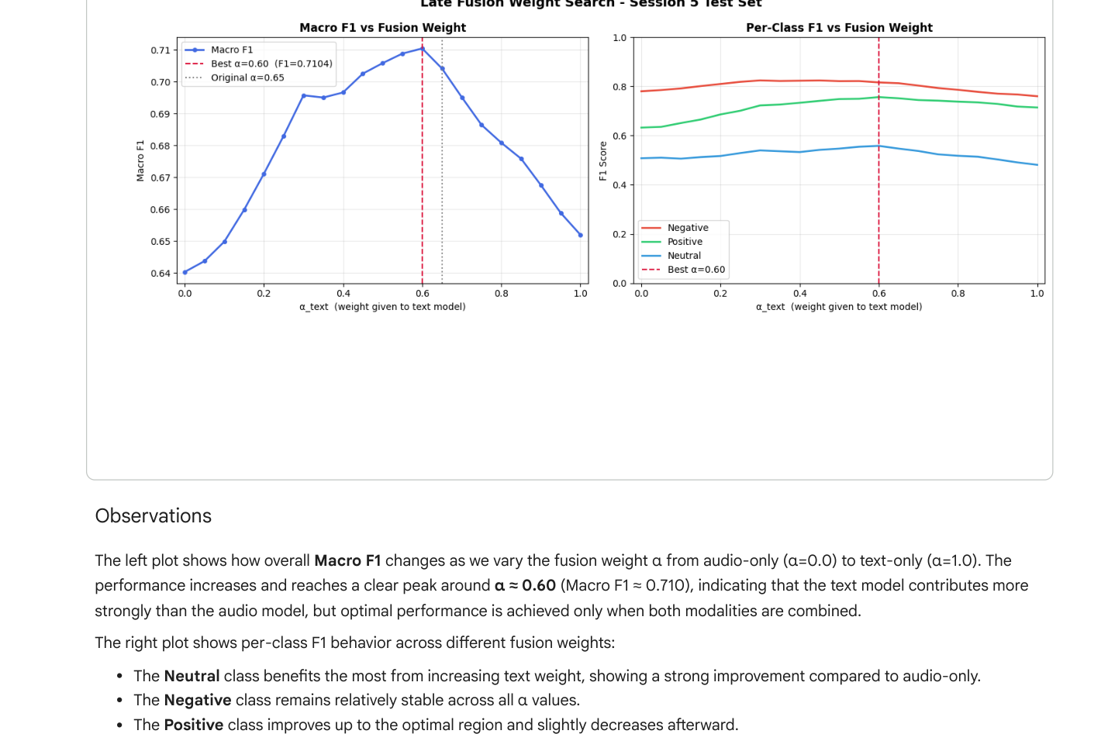
The weight search shows text matters more — but both channels are essential
Best α = 0.60
Text 60% · Audio 40%
Plateau region
Robust for α ∈ [0.5, 0.7]
Sanity check ✓
α=0→0.6403 α=1→0.6519
Best α = 0.60 → Macro F1 = 0.7104 (+0.059 over text-only, +0.070 over audio-only)
IEMOCAP Emotion Recognition · Bar-Ilan University · Spring 2026
11 / 15
Notes:
Grid search peak at α=0.60. Plateau in [0.5,0.7]. Neutral gains most from text weight.

Slide 12
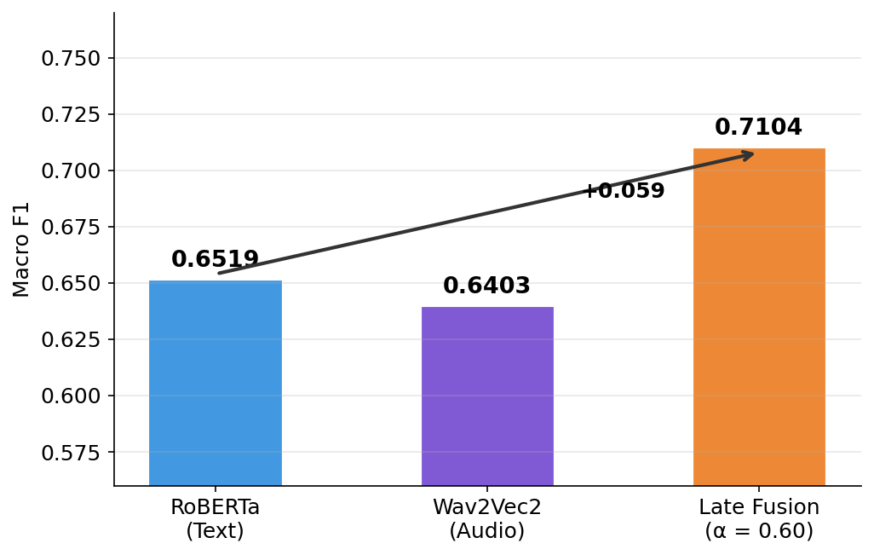
Fusion achieves Macro F1 = 0.71 — a +0.06 improvement over text-only
0.7104
best fusion Macro F1
Model | Acc | Macro F1 | W-F1
RoBERTa | 0.6793 | 0.6519 | 0.6948
Wav2Vec2 | 0.6880 | 0.6403 | 0.6874
Fusion ✦ | — | 0.7104 | —
✦ best α found by grid search (0→1, step 0.05)
+0.059 Macro F1 over text-only · No additional training · Fully speaker-independent
IEMOCAP Emotion Recognition · Bar-Ilan University · Spring 2026
12 / 15
Notes:
Main result: +0.06 Macro F1 gain on 2,170 test utterances. Zero extra training needed.

Slide 13
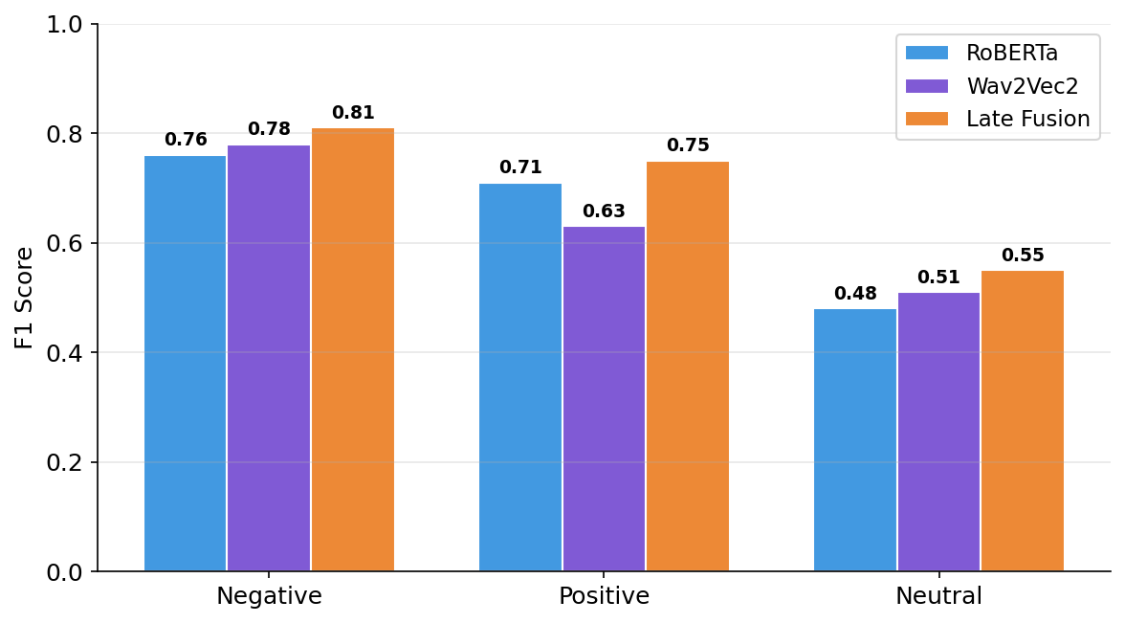
Neutral was the hardest class — fusion helped it most
Negative
0.76 → 0.81
text 0.76 · audio 0.78
Positive
0.71 → 0.75
text 0.71 · audio 0.63
Neutral ★ +0.07
0.48 → 0.55
text 0.48 · audio 0.51
Neutral gains most: both channels show 'no strong signal' → that absence becomes a cue.
IEMOCAP Emotion Recognition · Bar-Ilan University · Spring 2026
13 / 15
Notes:
Neutral improves most because the absence of signal in both channels is itself a cue.

Slide 14
Results hold up under stricter ground-truth validation
Part A — Re-scored against corrected labels (Sum-then-Argmax)
Only 4.24% of test labels changed (92 / 2,170). Δ across all models ≈ −0.004 — essentially zero.
Model | Original Macro F1 | Corrected Macro F1 | Δ
RoBERTa (Text) | 0.6519 | 0.6481 | −0.004
Wav2Vec2 (Audio) | 0.6403 | 0.6356 | −0.005
Late Fusion | 0.7041 | 0.6999 | −0.004
Part B — Performance by human annotator agreement tier
Tier | N | Text F1 | Audio F1 | Fusion F1
Low agreement (<0.50) | 65 | 0.233 | 0.363 | 0.318
Medium (0.50–0.75) | 940 | 0.581 | 0.574 | 0.631
High agreement (>0.75) | 1165 | 0.694 | 0.674 | 0.754
Monotone rise Low → High: models fail where human annotators also disagreed.
IEMOCAP Emotion Recognition · Bar-Ilan University · Spring 2026
14 / 15
Notes:
Sum-then-Argmax: Δ ≈ 0 → results stable. Consensus tier: models fail where humans disagree.

Slide 15
"Yes — combining modalities substantially improves emotion recognition"
Research question: Can combining text and audio improve emotion recognition over either modality alone?
YES.
Macro F1 = 0.7104 · +0.059 over text-only · no additional training required
1. Emotion is multimodal by nature
Text and audio each reach ~0.64–0.65 Macro F1 alone — comparable, but limited.
2. They fail on different examples
Text misses tone; audio misses meaning. Non-overlapping errors are the key.
3. Combining them works
Late fusion: Macro F1 = 0.71 — +0.06 gain, zero training overhead.
4. Neutral benefits most
Hardest class: 0.48/0.51 → 0.55. Absence of signal becomes a signal.
Limitation: single held-out session, no variance estimate · Future: attention-based fusion for per-utterance dynamic weighting
Simple weighted combination of text + audio → Macro F1 = 0.71 · Speaker-independent · No extra training
IEMOCAP Emotion Recognition · Bar-Ilan University · Spring 2026
15 / 15
Notes:
The answer is yes. Text and audio encode different aspects of emotion. When both agree, confidence is high. When they disagree, even that is informative.

Slide 16
Appendix A2 — Full Per-Class Breakdown (show during Q&A)
Model / Class | Precision | Recall | F1 Score | Support
RoBERTa — Negative | 0.80 | 0.73 | 0.76 | 1193
RoBERTa — Positive | 0.75 | 0.68 | 0.71 | 585
RoBERTa — Neutral | 0.39 | 0.66 | 0.48 | 392
Wav2Vec2 — Negative | 0.76 | 0.80 | 0.78 | 1193
Wav2Vec2 — Positive | 0.72 | 0.56 | 0.63 | 585
Wav2Vec2 — Neutral | 0.50 | 0.53 | 0.51 | 392
Fusion — Negative | 0.83 | 0.80 | 0.81 | 1193
Fusion — Positive | 0.79 | 0.71 | 0.75 | 585
Fusion — Neutral | 0.52 | 0.58 | 0.55 | 392
IEMOCAP Emotion Recognition · Bar-Ilan University · Spring 2026
A2
Notes:
Full per-class breakdown for all three models.

Slide 17
Appendix A3 — Hyperparameter Summary (show during Q&A)
Parameter | RoBERTa (Text) | Wav2Vec2 (Audio)
Base model | roberta-base (125M) | wav2vec2-base (94M)
Learning rate | 2×10⁻⁵ | 2×10⁻⁵
Batch size | 32 | 8
Max input | 128 tokens | 8.5 s (136,000 samples)
Max epochs | 7 | 10
Early stop patience | 3 epochs on val Macro F1 | 3 epochs on val Macro F1
Class weights | wc = N / (K · Nc) | wc = N / (K · Nc)
Optimizer | AdamW | AdamW
Output pooling | [CLS] token | Mean pool over time
IEMOCAP Emotion Recognition · Bar-Ilan University · Spring 2026
A3
Notes:
Hyperparameter reference.

