Slide 1
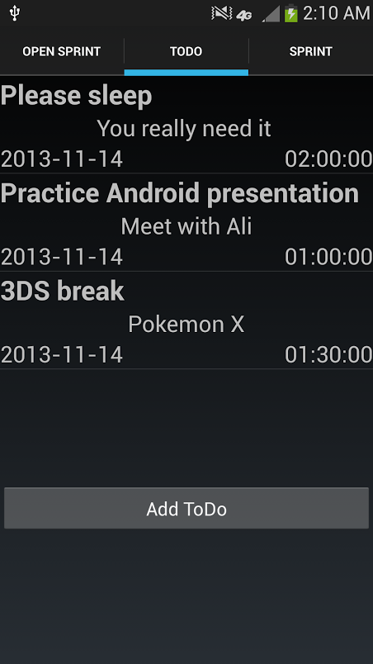
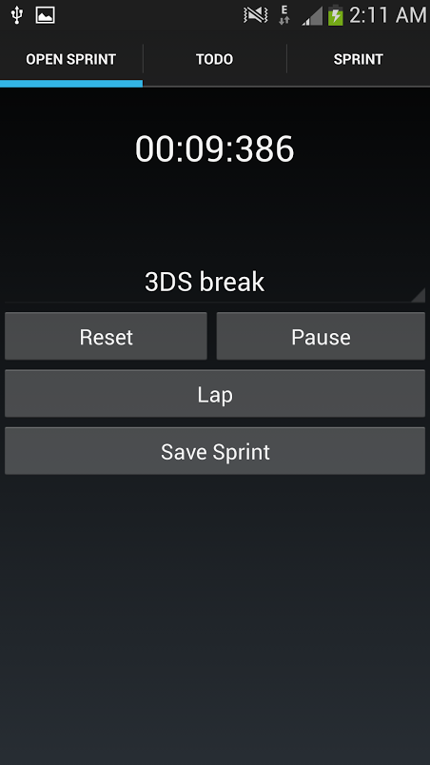
Ali Almajed
Reminda
Omar Abdel-Rahman
https://github.com/almajeas/Reminda

Slide 2
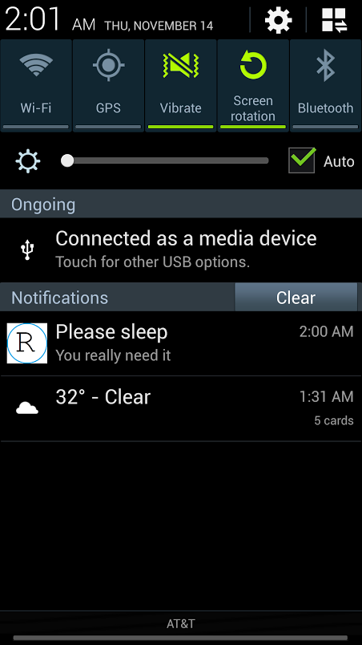
Notifications
Custom Android Notifications for ToDo’s and Sprints(Timer)
Edit/Delete ToDo’s
Cancel Sprints
Notifications bring you to home activity
https://github.com/almajeas/Reminda

Slide 3
Notification.Builder mBuilder = new Notification.Builder(getActivity())
.setSmallIcon(R.drawable.notification)
.setContentTitle("Reminda")
.setContentText("Demo")
.setAutoCancel(true);
Intent resultIntent = new Intent(mContext, RemindaActivity.class);
TaskStackBuilder stackBuilder = TaskStackBuilder.create(mContext);
stackBuilder.addParentStack(RemindaActivity.class);
stackBuilder.addNextIntent(resultIntent);
PendingIntent resultPendingIntent = stackBuilder.getPendingIntent(0, PendingIntent.FLAG_UPDATE_CURRENT);
mBuilder.setContentIntent(resultPendingIntent);
NotificationManager mNotificationManager = (NotificationManager) mContext.getSystemService(Context.NOTIFICATION_SERVICE);
mNotificationManager.notify(mNotificationId, mBuilder.build());
https://github.com/almajeas/Reminda

