Slide 1
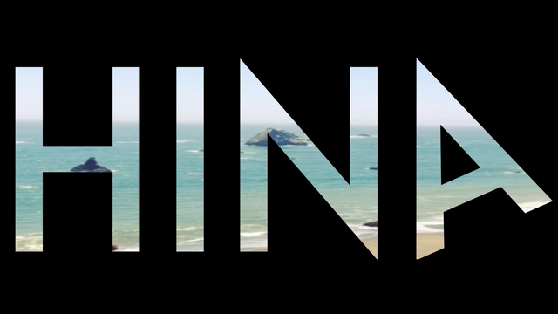
HINA-VIDEO GOES HERE
Woop woop
Notes:
HINA the Hawaiian goddess of Sunrise + Sunset. She is considered to be the mother of all ocean life and the name of our digital agency.
HINA is not only a digital agency but a group of globetrotters who seek funky, underground, and authentic experiences everywhere we go.
It is our MISSION to give travelers the opportunity to plan trips in an easy and organized way with personalized travel solutions. With time-management tools and a sharing network, we make your trip more efficient and fun!
Travelling should be fun and effortless. But, when you factor in all of the research for flights, hotels, rental cars, places to visit, things to eat, and coordinating your schedule, it can be quite exhausting.

Slide 2

CREATE SHARE EXPLORE
Notes:
OUR VISION:
CREATE.SHARE.EXPLORE
OUR MISSION
Hina provides personalized social travel solutions. With recommendations from locals and giving travelers the opportunity to plan
trips in an easy and organized way. Through time-management tools and a sharing network we make your trip more efficient and fun!
OUR company VALUES:
Innovation, simplicity, creating a community through sharing.

Slide 3

Notes:
TROT is the ultimate travel app.
From the very start the user can choose exactly what they would like to see and do while travelling. Providing the most authentic and unique experience for every adventure.
If you just have 8 hours, a day or a weekend, time is precious and with the help of TROT you can squeeze the most out of every moment.
What TROT users have most in common is the need for personalization and getting the very most out of each day!

Slide 4
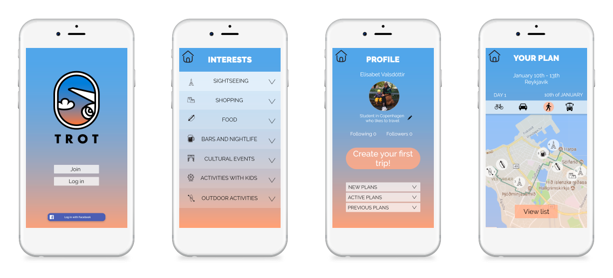
Notes:
Sign up with TROT and create your user profile by selecting your interests. Ranging from craft beer bars to cliff jumping.
Once you have created a profile, the app will generate the perfect plan. You can add and edit if you wish to see something specific based on where you go.
Your profile is linked to your past trips and will store your favorites.
The detailed map offers time-management tools, giving you an estimate of how much time each destination will take.
Finally, Connect with friends and other TROT members to see endless possibilities and share your trip !
Whether you like going to all of the major landmarks or only vintage shops, this app will give you the most personalized experience on every adventure!

Slide 5
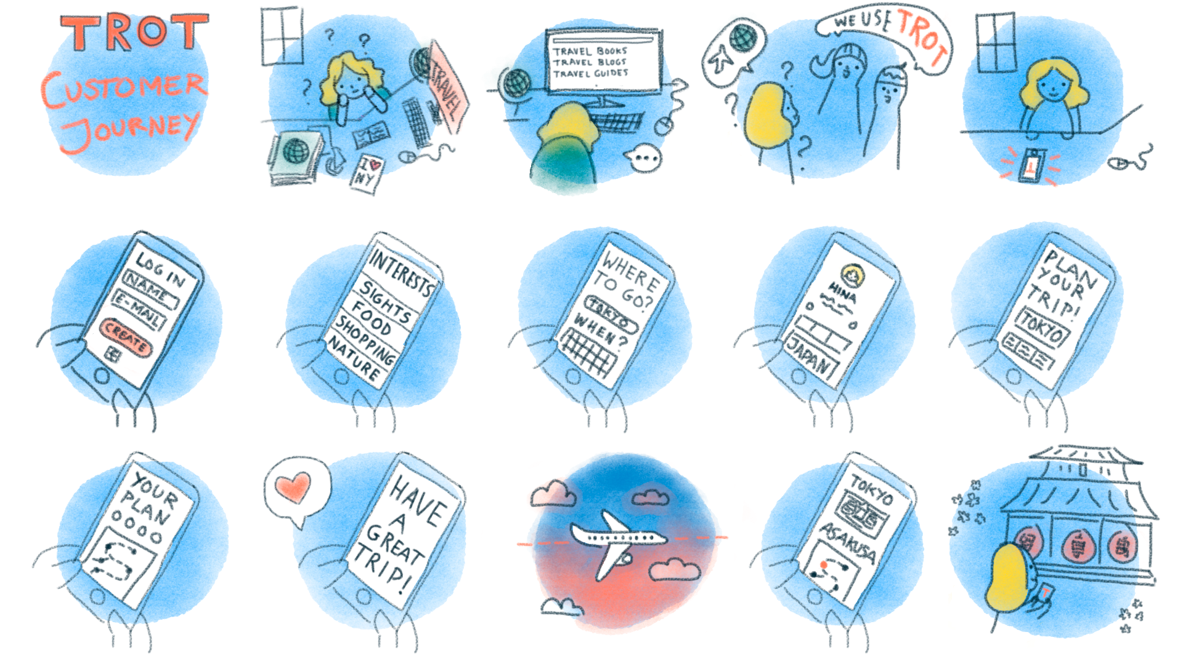
Notes:
Our ideal customer journey: Our globe-TROT-ting girl is wondering how to tackle the crazy task of where to go and what to see on her next trip? Typically she would look at website after website, guidebooks or phone a friend. She learns about TROT after talking to her friends.
She CREATES a profile and select all of her interests. This will be key to making every adventure personalized and unique. There are lots of options to choose from: on a scale of boring to ridiculously specific. (I see you Cat café FANS).
Next step choose where to go and how long the trip will be.
This will determine how to manage her time. Like, she would most likely skip the Louvre if she only had 8 hrs in Paris. Then, TROT creates the perfect plan. Based on her interests and a map with a minute by minute breakdown. No time to waste.
TROT follows and guides her on her trip.
TROT is there from beginning and end of her journey. No matter how short, long, close or far the destination is, TROT is the solution.

Slide 6
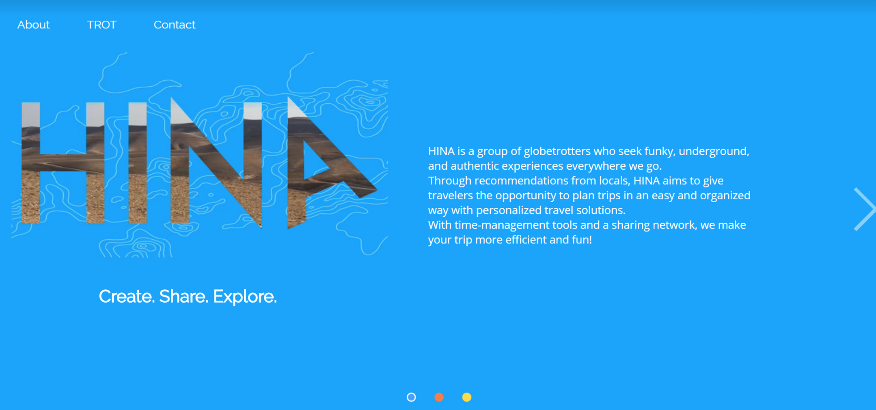
Notes:
Topography maps are part of the visual identity of HINA and TROT.
The term topography originated in ancient Greece and continued in ancient Rome as the detailed description of a place.
The word comes from the Greek topos or place and -graphia, or writing.
In classical literature this refers to writing about a place or places, what is now largely called 'local history'.
The meaning behind the design ties in together with the purpose of HINA and TROT - exploration!
Our colors are inspired by water + sky.
The view out of an airplane window is iconic + timeless. The excited feeling you get from being in the air on the way to your next destination

Slide 7
QUESTIONS

