Slide 1
Knowledge and Practice in the Assessment of Frequent Landscape Disease Risk in Cattle Populations along the Madhumati River, Gopalganj, Bangladesh

Slide 2
Outline
1 Assess the prevalence of FMD and LSD in cattle around the Madhumati River.
2 Identify risk factors contributing to disease occurrence.
3 Analyze the impact of husbandry practices and farmer knowledge on disease prevalence.
4 Investigate seasonal patterns of FMD and LSD.
5 Evaluate current prevention and treatment strategies.
6 Recommend improvements for cattle health management in Gopalganj.

Slide 3

Introduction
This study investigates the prevalence and risk factors associated with various diseases in cattle around the Madhumati River in Gopalganj, Bangladesh. Our findings provide insights into the current landscape of diseases focusing on FMD and LSD, animal health status, farmer knowledge, and existing treatment and prevention strategies in Gopalganj.

Slide 4



Research Methodology
KOBOTOOLBOX
Qgis
R
Data Collection and Preservation
Investigation of Epidemiological prevalence
Programming Language for statistical analysis and
Visual presentation

Slide 5
Season
Rainy
Winter
Summer

Slide 6
Result
Frequency of DISEASE
lsd
FMD
OTHERS
17.39%
13.04%
79.57%

Slide 7
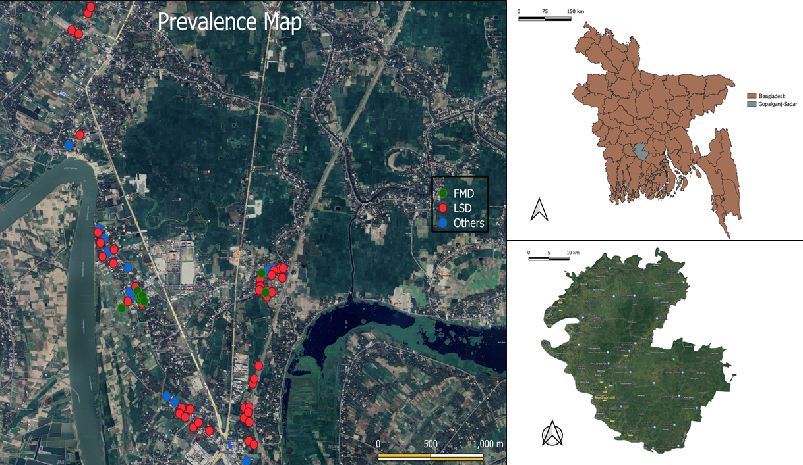

Slide 8
Discussion
In this research, we collected data from multiple areas within Gobra Union in Gopalganj Sadar, Gopalganj. The area included balurmath, charpathalia,north and south area of Ghonapara, nilarmath. According to data we evaluate most prominent diseases are FMD and LSD along with these diseases’ hemorrhagic septicemia, tympany and bloat, dermatitis, mastitis, protozoan diseases and some other frequently occuring disease condition like seasonal diarrhea are noticed in the cattle.
In our study region frequent FMD outbreaks are found in winter season and post monsoon when there is high humidity and low temperature in the environment. Some previous studies also indicated that FMD outbreaks are prominent in the cooler months of the year11.
LSD outbreaks are noticed prominently in summer season,

Slide 9
Conclusion
The study was conducted to investigate the most prevailing diseases FMD and LSD as a major disease risk for the animals of the Gopalganj region. FMD was found to occur mostly during cooler months whereas LSD in hotter months of the year. Besides diseases like mastitis and hemorrhagic septicemia and other health issues were also seen as potential problems in the village. Timely prevention according to different seasons, regular vaccination and de-worming, cleaning, disinfecting the herd area in scheduled time, avoiding river, pond water during the outbreak season might help to reduce the prevalence rate.

Slide 10
thanks!

